Slide 1
COOLSCHRANK
IoT and the internet of Me

Slide 2
Who am I — or — who are we all?
The Internet of ME
Students or recently graduated

Slide 3
Who am I — or — who are we all?
The Internet of ME
Students or recently graduated
Dorms, studios, WGs

Slide 4
Who am I — or — who are we all?
The Internet of ME
Students or recently graduated
Dorms, studios, WGs
Small fridges, small pantry, small wardrobes…

Slide 5
Who am I — or — who are we all?
The Internet of ME
Students or recently graduated
Dorms, studios, WGs
Small fridges, small pantry, small wardrobes…
Buy groceries as needed ¯\_(ツ)_/¯

Slide 6
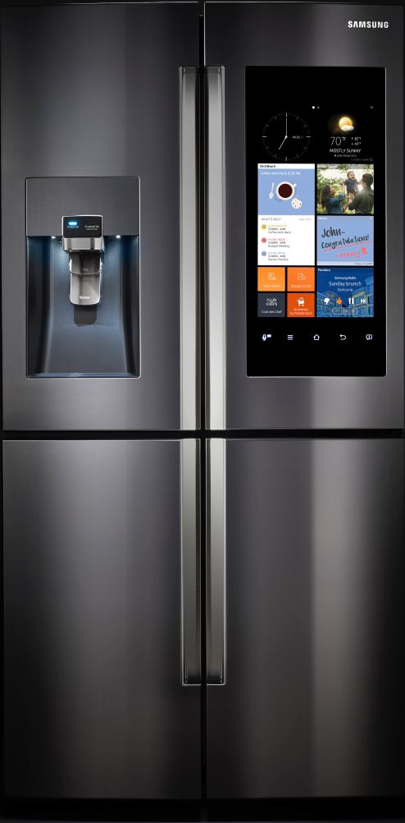
Let’s make smart homes,
the smart way
The Internet of me
Having a smart home means buying smart furniture and devices… and that costs a LOT!

Slide 7
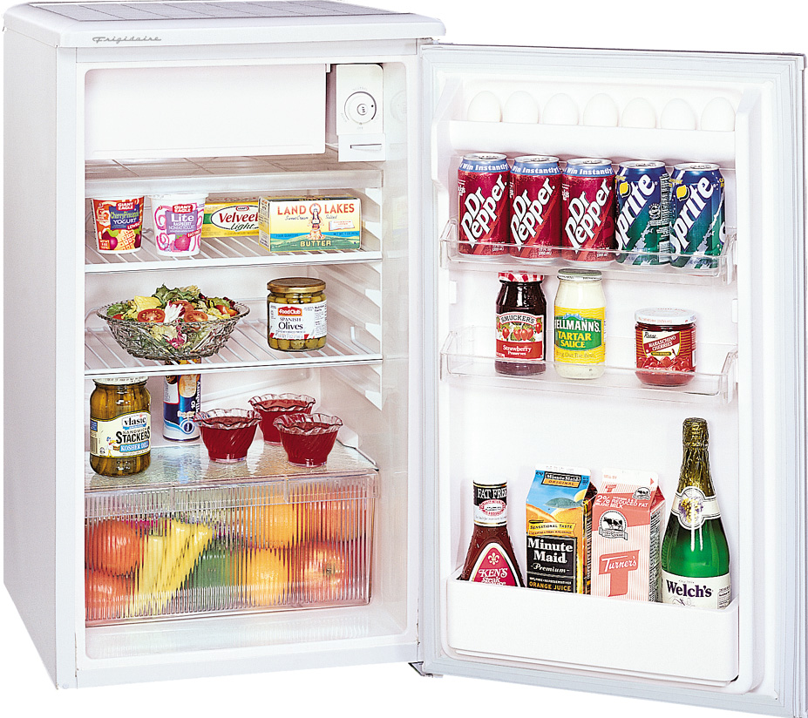
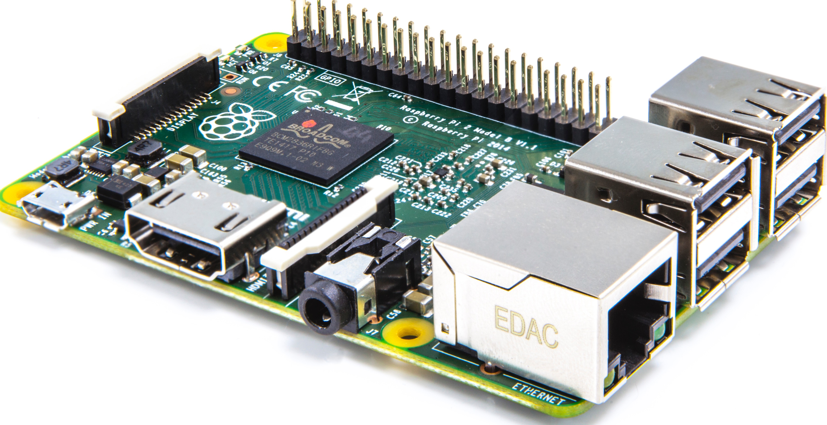
Let’s make smart homes,
the smart way
The Internet of me
Having a smart home means buying smart furniture and devices… and that costs a LOT!
+
Instead, use your good ol’ stuff along with a cheap, small and powerful computer

Slide 8
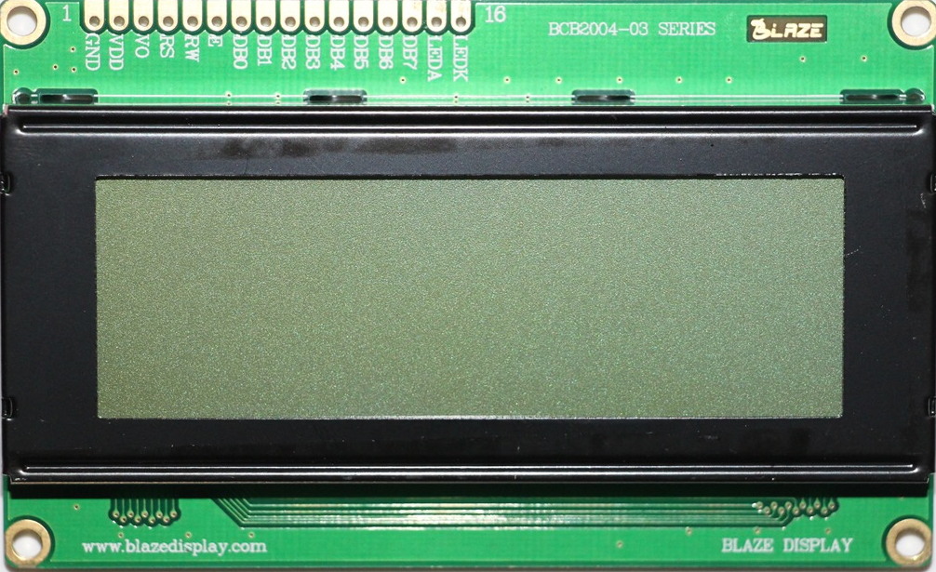
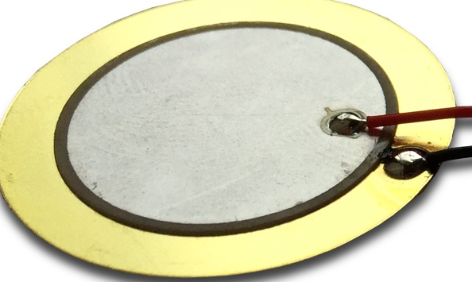

The COOLschrank:
Raspberry Pi
Your fridge and pantry
Displays and LEDs
Some sensors for your supplies
Raspberry Pi — sensors and physical interface

Slide 9


The COOLschrank:
Raspberry Pi + MS Windows 10 + MS Azure IoT
Windows 10 Operating System
MS Azure IoT
Raspberry Pi — sensors and physical interface

Slide 10

The COOLschrank:
MS Azure IoT + Twilio
Your phone
MS Azure IoT
COOLschrank
stock
2/2 Beer 1/3 Milk 0/1 Ketchup(!!!)
Need
You should buy 2 Milk 1 Ketchup
Twillio API

