Slide 1
Assembler Architecture
Assembler is currently split into two major components:
docker-virtue: Builds Docker containers to hold applications
galahad/assembler: Builds VM images to run Docker containers
These are split across two codebases by an accident of history

Slide 2
Unity Image Assembly Workflow
Base Container
XPRA
Application
SSH Keys
xvfb
Startup Script
Virtue Patches
SSH
Crossover
EC2
LSM
Modified Kernel
docker-virtue
Upstream Kernel
Syslog-ng
AWS-based Docker Registry
SSH
Docker
App 1
…
App N
Python
Base VM Image (QCOW)
App 1
Virtuized
Unity Image
(may have multiple apps)
Assembler

Slide 3
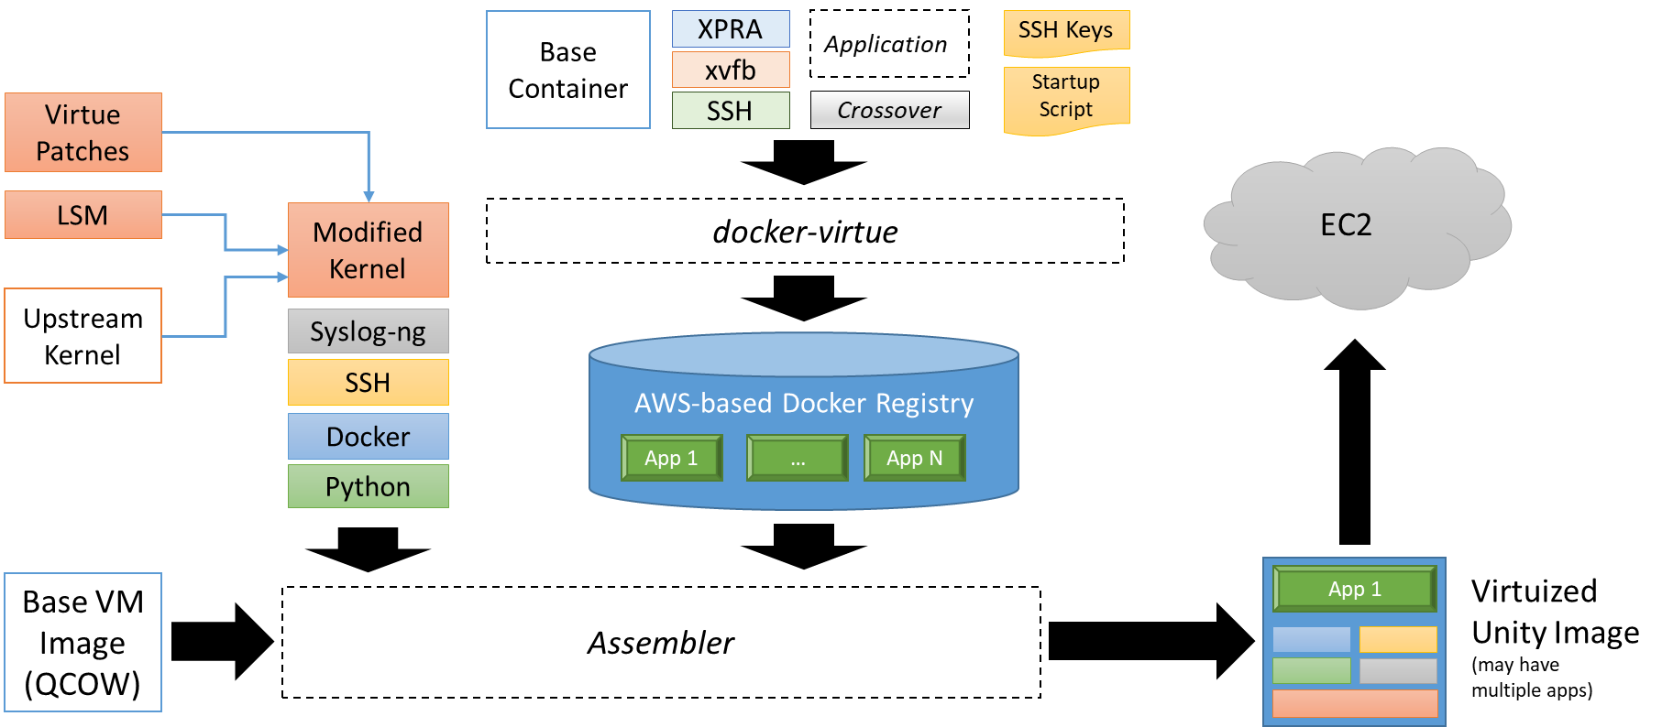
Unity Image Assembly Workflow
github.com/starlab-io/docker-virtue (in virtue/)
github.com/starlab-io/galahad (in unity/)
github.com/starlab-io/galahad (in assembler/)

Slide 4
Assembler Internal Processing
assemble.py
“RSA Key” Stage
- Cloud-init
- Installs public key
“Kernel” Stage
- Cloud-init
- Installs custom kernel
cloud-init’s user-data
+
VM Image
“APT” Stage
- Cloud-init
- Installs docker, python, git
“docker-virtue” Stage
- Cloud-init
- Checks out required virtues
Boot
Virtue Instance
“syslog” Stage
- SSH
- Depends on RSA Key stage
- Installs custom syslog-ng

Slide 5
Docker Container-Maker Internals
build.py: builds all of the containers specified in the VirtueDockerConfig.yml file
run.py: runs an image specified in the VirtueDockerConfig.yml file
Gets copied to the Unity VM
Used to start the container once we’re in The Cloud
AppArmor and seccomp policies are specified per-container
virtue-base Container
App-Specific Dockerfile
AppArmor Policy
SecComp Policy
App Image
Running Container
Application Files
build.py
run.py

