Slide 1
Galahad Design Diagrams

Slide 2
Architecture Overview (Current)
Virtue/Unity
Virtue Service “Excalibur”
Windows Compatibility Layer
Security Controls
Authentication
Data Controls
Windows Sensing and Logging
Secure Kernel
AWS Controls
Object Schema
Virtue Orchestration
Sensor Controls
Virtue Admin API
Sensing and Logging
Virtue Import / Export
User API
Sensing and Logging
Admin Services
Event Aggregator
Policy Management
Valor
Canvas
Event Storage
Virtue Management
XenBlanket
Frontend GUI
Event Analysis
Admin Service Interface
Sensing and Logging
Virtue Service Control
Sensor Data API
Virtue Assembler
Xen Orchestration
XPRA Controls
Sensor Management
Engineering Interface
AWS
Test and Evaluation
Setup Virtue Isolation
Engineering Configuration
Docker Image Repository
File Store Linkage
Active Directory Linkage
T&E Infrastructure
KEY
Program Management
Not Started
In Progress
Complete
Design Documentation
Midterm Software
Final Software
Notes:
Virtue-WCL
Compatibility and Run environment for Windows/Legacy Apps
Virtue-WCL-Sensing&Logging
Instrumentation for events of interest within WCL (File operations, network socket, etc)
Virtue-Sensing&Logging
Instrumentation for events of interest
Virtue-SecurityControls
All dynamic security functionality including, and docker lockdown.
Virtue-SecureBase
The kernel kconfig options, and other static security mechanisms that are in place: SElinux policies, seccomp,
Virtue-OrchestrationAgent
AutoConfiguration of dynamic elements: connection of ports between docker containers etc, Credential syncing and bootstrapping (ssh keys etc)
Sensing&Logging-EventAggregator
The Local collection and shipping facility on each Unity, including searchguard configuration, filtering, and parsing.
Sensing&Logging-EventStorage
Construction and configuration of aws based event storage infrastructure
Sensing&Logging-EventAnalysis
Design and implementation of the event analysis capabilities of Galahad
Sensing&Logging-SensorDataAPI
Galahad Sensor Data interface based on APL API document
Sensing&Logging-SensorManagement
Level of control of sensors as they relate to the APL API document
VirtueService-Authentication
Prove Root of Authority for Authentication
VirtueService-AWSControls
All API tooling that is used by Excalibur to talk to AWS
VirtueService-SensingControls
Tooling to manipulate sensor instrumentation
VirtueService-DataControls-Database
Galahad’s general-purpose metadata repository
VirtueService-DataControls-AdministratorAPI
Galahad admin interface based on APL API document
VirtueService-DataControls-UserAPI
Galahad user interface based on APL API document
Valor-XenBlanket
Tasks to test and integrate Xen Blanket into Galahad on AWS
Valor-S&L
Instrumentation and controls for general logging
Valor-Orchestration
Controls for all the dynamic tasking (e.g. migration, network bridges, etc.)
Canvas-FrontendGUI
UI for Galahad end users
Canvas-VirtueServiceControls
Tooling to interact with and control VirtUEs from end user devices
Canvas-XpraControls
Tooling to interact with and control Xpra connections from end user devices
AdminService-PolicyManagement
Tools for manipulating and constructing policies for Galahad artifacts (e.g. Virtues, apps, resources, etc.)
AdminService-VirtueManagement
Virtue control tasks initiated by a user and passed to the Galahad system.
AdminService-AdminServiceInterface
Perform auxiliary tasks on virtues and the Galahad system.
AdminService-VirtueAssembler
Construct Virtues from basic artifacts (Base File systems, Docker Containers, and other resources)
AdminService-EngineeringUserInterface
Basic dashboard for administration
T&E-FileStoreLinkage
The configuration and setup to integrate T&E filestores
T&E-ActiveDirectoryLinkage
The configuration and setup to integrate T&E ActiveDirectory
T&E-LinkUpT&EInfrastructure
Auxilliary configuration and efforts required integrate the remaining T&E infrastructure
Account sharing permissions, IAM policy etc
PM-DesignDocument
PM-MidTermSoftware
Software Deliverables in order to perform T&E
PM-FinalSoftware
Software Deliverables at end of program
AWS-SetupVirtueIsolation
Design and configure a reproducible Virtue Isolation mechanism
AWS-DockerImageRepository
Setup and configuration of an S3 backed docker image repository
AWS-Engineeringconfiguration
Setup and configuration of static Galahad aws infrastructure (Admin VPC,User Virtue VPC,Loggin VPC and all accompanying policies, assets, etc)

Slide 3
How You Actually See an Application
CanvasInstance
VNC Client
XFCE Environment
Canvas
virtue-<app>
XFCE Environment
Docker
App
6768
sshd
Canvas
2022
XPRA
2023
App
xvfb
VNC Server
App

Slide 4


System Architecture
App VM
App VM
App VM
Nested HV
Nested HV
Admin Interface
Centralized Logging
App VM
Nested HV
App UI
App UI
Nested HV
App UI
Administrator
User

Slide 5


Windows Compatibility Layer and Sensing
Based on CodeWeavers Crossover product
Commercial fork of WINE project
Windows apps use fake DLLs that call out to WINE .so files
WINE .so files call back to the WINE server, which translates to Linux system calls
Sensing points added in fake DLLs and in the WINE server
Unmodified Windows Application
Fake DLL
Fake DLL
Fake DLL
Fake DLL
Fake DLL
Fake DLL
CodeWeavers Crossover
WINE Server
syslog-ng
Sensing Points

Slide 6
Secure Kernel
Apply a set of security-related configuration options
https://kernsec.org/wiki/index.php/Kernel_Self_Protection_Project/Recommended_Settings
Examples:
CONFIG_DEBUG_WX=y # report memory pages marked write + exec
CONFIG_PROC_KCORE=n # disable virtual kernel core dumps
CONFIG_STRICT_DEVMEM=y # enforce strict access to /dev/mem
CONFIG_KGDB=n # disable kernel debugger
CONFIG_HIBERNATION=n # disable hibernation
CONFIG_BPF_JIT=n # disable BPF JIT, used in Spectre attacks
Future:

Slide 7
Sensing Concept
Monitor execution at three layers:
CrossOver WinAPI emulation layer (CX): monitor by hooking WineServer component
Linux Security Module (LSM): monitor at LSM sensor/audit points
Nested Hypervisor: monitor fundamental activities (storage, network, Unity starts/stops)
Currently logging to syslog and relaying them via syslog-ng to ElasticSearch
Allows for mutual authentication via certificates created at provisioning time
Easy-mode visualization of results via Kibana
Multiple co-located Unity instances send to a local aggregation point, running as a separate domU
Integration into other systems is straight forward
Backend design is still to be finalized, but trying to stick to well-known tooling to aid in adoption. Easy to replace current stuff with more performant versions if necessary.
Currently developing CX and LSM monitoring
Can intercept file operations at both CX and LSM layer
Working on networking next
Wide variety of "badge-check" kinds of events that we can implement

Slide 8
Current Sensing Points
Sensor | Location | Monitored Events
Crossover ws2_32.dll | Application | WS_accept, WS_bind, WS_listen, WS_connect, WS2_ConnectEx
Crossover kernel32.dll | Application | CreateProcessA, CreateProcessW
WINE Server | Application | open_fd, process_died, create_process
Host SSH sensor | Unity Host | SSH authentication events
LSM | Unity Kernel | task_create, path_mkdir, socket_bind, socket_connect, inode_create, bprm_set_creds
Initial focus for T&E is to build the infrastructure and critical sensing points
As program matures and threat picture clarifies, we will expand the number of things we sense

Slide 9
Sensing and Logging Architecture
EC2 Instance
Unity
Unity
Unity
syslog-ng
client
syslog-ng
client
Windows App(s)
Wine
Wine Server
syslog-ng
client
EC2 Instance
Local Storage
ElasticSearch
Wine Instr.
Unity
Unity
syslog-ng
client
syslog-ng
client
Syslog
Local Storage
Linux Kernel
LSM
Valor
Storage
Net
VirtUE Control

Slide 10
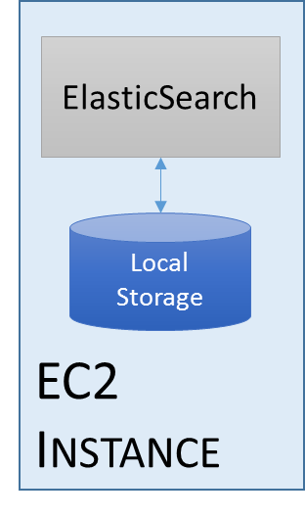
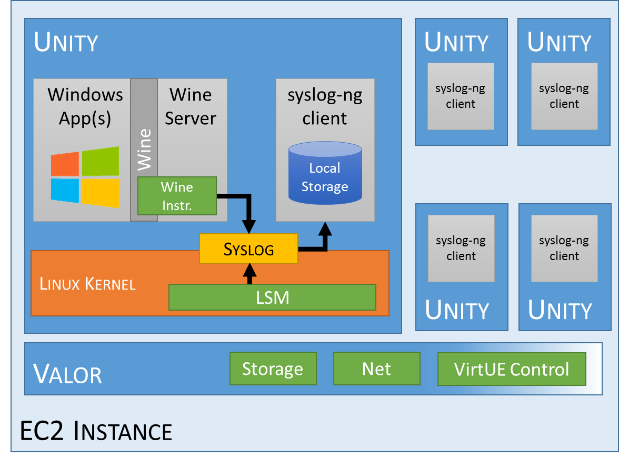
Log Aggregation
Excalibur
ES Cluster
Sensor Data API

Slide 11




Transducer Control Architecture – Midterm T&E
Secured via TLS
Static certs for T&E
Per-instance certs later
Unity
WINE
Excalibur API
UNIX Domain Socket
LSM
RethinkDB
syslog
Local State:
Running virtue instances
Default sensor config
Role to virtues to instances map
Desired config x instance
Last reported config x instance
syslog-ng
Comms Endpoint
Filter logic
Secured via
SearchGuard with TLS
ElasticSearch
Commands
Virtue ID | Transducer ID | Enabled | Timestamp | Signature
1 | msword_openfile | True | 1521486930 | <binary>
1 | msword_sockets | False | 1521487135 | <binary>
2 | firefox_sockets | True | 1521486953 | <binary>
All of the previous
fields signed with
Excalibur’s key
Excalibur: -w
Virtues: r-
ACKs
Virtue ID | Transducer ID | Enabled | Timestamp | Signature
1 | msword_openfile | True | 1521486930 | <binary>
1 | msword_sockets | False | 1521487135 | <binary>
2 | firefox_sockets | True | 1521486953 | <binary>
Excalibur: r-
Virtues: -w
All of the previous
fields signed with
the Virtue’s key

Slide 12
Unity Image Assembly Workflow
Base Container
XPRA
Application
SSH Keys
xvfb
Startup Script
Virtue Patches
SSH
Crossover
EC2
LSM
Modified Kernel
docker-virtue
build.py
Upstream Kernel
Syslog-ng
AWS-based Docker Registry
SSH
Docker
App 1
…
App N
Python
Base VM Image (QCOW)
App 1
Virtuized
Unity Image
(may have multiple apps)
Assembler
assemble.py
run.py

Slide 13
Docker Container-Maker Internals
build.py: builds all of the containers specified in the VirtueDockerConfig.yml file
run.py: runs an image specified in the VirtueDockerConfig.yml file
Gets copied to the Unity VM
Used to start the container once we’re in The Cloud
AppArmor and seccomp policies are specified per-container
virtue-base Container
App-Specific Dockerfile
AppArmor Policy
SecComp Policy
App Image
Running Container
Application Files
build.py
run.py

Slide 14
Assembler Internal Processing
assemble.py
“RSA Key” Stage
- Cloud-init
- Installs public key
“Kernel” Stage
- Cloud-init
- Installs custom kernel
cloud-init User Data
“APT” Stage
- Cloud-init
- Installs docker, python, git
+
VM Image
“docker-virtue” Stage
- Cloud-init
- Checks out required virtues
“syslog” Stage
- SSH
- Depends on RSA Key stage
- Installs custom syslog-ng
Boot
“Cleanup” Stage
- SSH
- Remove unneeded packages, etc.
Virtue Instance

Slide 15
Virtue Import/Export Workflow
A Role is a set of Applications
Containers are incorporated by reference to a central registry
Roles can be distributed in a variety of ways, stored centrally, etc.
Importing registers the applications, role, and policies with the Galahad OpenLDAP DB
Currently do not have an implementation of the import or export workflow
Notional File format (JSON):
{
“Role” : “Router Admin”,
“Version” : “1.93”,
“Created-by” : “Vi R. Tue”,
“role-signature” : “...”,
“Applications”: [
{
“application” : “PowerShell”,
“description” : “PowerShell Core v6.0”,
“container-ref” : “virtue-ecr.aws.com/pwsh:1.2”,
“apparmor-policy”: “...”,
“seccomp-policy” : “...”,
“dockerfile” : “...”,
“container-signature” : “...”
},
{
“application” : “bash-with-network-tools”,
“description” : “Includes nc, ssh, telnet, etc.”,
“container-ref” : “virtue-ecr.aws.com/bash:2.13”,
“apparmor-policy”: “...”,
“seccomp-policy” : “...”,
“dockerfile” : “...”
“container-signature” : “...”
}
]
}

Slide 16
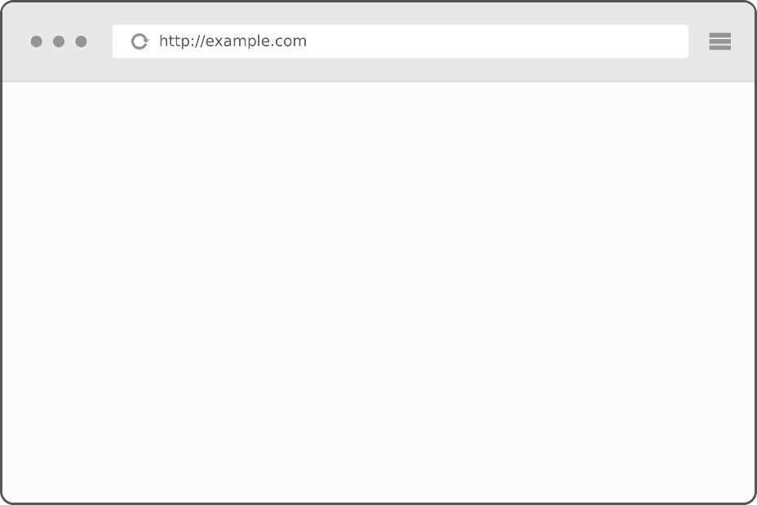

Virtue Import Storyboard
I need a router admin role…
Virtue Role Explorer
Android Developer
MS Office Document Author
Router Administration
Security Engineer
Financial Analyst
Router Admin:
PowerShell
bash-with-net-tools
firefox
Virtue Container Registry
OpenLDAP
Local Container Store
PowerShell
bash
Firefox
Office
Virtue Importer
chrome
IMINT Tools

