Slide 1
Assembly, Provisioning, and Administrative Workflows
DRAFT
26 JUNE 2018

Slide 2
Definition of Terms
Construct: convert a clean Ubuntu PVM into a Unity
Assemble: create a Virtue by installing Docker containers on a Unity
Provision: install keys and user-specific data onto a Virtue
1. Ubuntu PVM +
Galahad Source Code
Unity Image
Virtue Image
5. Running Virtue
2. Construct
3. Assemble
4. Provision

Slide 3
Walkthrough of Full Assembly Process
1. At the start of the assembly pipeline, the Constructor needs access to an Ubuntu PVM image and source code required to create a Unity. In CI, the Ubuntu PVM is created by an augmented AWS instance with additional Xen tools, including the command xen-create-image.
2. During Construction, all required source code is compiled into .deb files and the Ubuntu image is mounted to a directory. Tools such as chroot are used to set up virtue users and install required packages and .deb files, including the Galahad Kernel patches, Merlin, the LSM, Transducers, and the Docker daemon. The resulting Unity will seldom need to be re-constructed and only lacks Docker-containerized applications, key files, and any user-specific data.
3. The Assembly step installs role-specific Docker containers onto a copied Unity to produce a non-provisioned Virtue. This process cannot be done to a mounted image. It requires a Unity to be running on a Valor in order to interact with the Docker daemon. Assembly is run every time the API call role create is made.
4. Provisioning mounts a copy of the non-provisioned Virtue and installs key files and user data. The API call virtue create triggers provisioning.
5. The end-result is a fully operational Virtue, ready to be launched by the User call virtue launch.

Slide 4
Construct the Galahad Components
Building the Unity Base Image
Building the Docker Containers
Galahad Sources
WINE Patches
Upstream WINE Src
Instrumented WINE
Merlin src
merlin.deb
Result is a Xen VM
Virtue Patches
Per-application Dockerfile
Unity Kernel DEB file
Base Container
XPRA
Application
LSM
xvfb
Unity Base Image
External Dependencies
SSH
Crossover
Upstream Kernel Src
Ubuntu APT Repos
Docker
AWS Elastic Container Registry
Python
SSHD
App 1
…
App N
Latest Ubuntu 16.04 PVM
Per-application Dockerfile
Per-application Dockerfile
Per-application Dockerfile
Notes:
Orange = Galahad src
Blue = external dependency
Green = constructed product
These two steps can be done by CI, by a release pipeline, or whatever other mechanism is appropriate, but the key point is that the things in green are

Slide 5
Construct the Galahad Components, Continued
Alex’s best guess at the current process
Building Valor
Building Excalibur
Upstream Kernel Src
XenBlanket Kernel Patches
Upstream Xen Src
Galahad XenBlanket Patches
?
Kernel .DEB with XenBlanket Support
Xen HV with XenBlanket Support
Compute Config
Router Config
EFS
Open vSwitch
Open vSwitch AMI
XenBlanket AMI
Notes:
The Valor steps are based on my best guess understanding after reading through https://github.com/starlab-io/galahad-XenBlanket/tree/master/deploy
It doesn’t look like Excalibur is actually “built” by anything. The CI process seems to spin up a CloudFormation stack and then run the tests on the Excalibur instance that comes up with the stack. It appears to pull new Galahad code down on top of the Excalibur EC2 instance. This approach works for testing, but for building the final product, is not complete as it doesn’t build a new AMI, we’d have to make the source repo available to the deployed users, etc.

Slide 6
Assembling a new Role
Unity Base Image
AWS-based Docker Registry
Local Site Administrator
App 1
…
App N
Role: Document Editor
- Microsoft Word
- Microsoft Excel
- Database Explorer
Fetch Available Applications List
Static Configuration Data
Available Applications List
Word
Excel
Virtue Role Image
(Unity + app containers)
Not yet running anywhere
DB Explorer
Excalibur
Virtue Image Store
Notes:
Farhan: The “available application list” should be a Excalibur API command that the admin issues to get the list of applications. The point being that the only entity the admin interacts with is Excalibur and Excalibur in turn communicates the the docker registry and gets the application list. I have updated the picture to depict this change in flow.

Slide 7
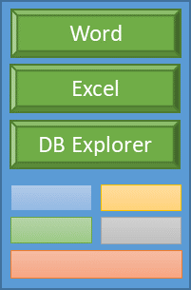
Provisioning the Galahad System
Note that this integration point is where we should be able to version components, define the set of AMIs to use, etc.
Galahad
(Excalibur, Infrastructure parts, multiple Valor instances, and EFS mount holding Unity images)
Valor AMI
Open vSwitch AMI
CloudFormation Script
AWS CloudFormation
Excalibur AMI
Aggregator AMI
RethinkDB AMI
Note that we currently do not have a mechanism to build AMIs from source code repositories other than the assembler…
EFS

Slide 8
Provisioning a new Virtue instance within Galahad
Virtue Role Image
(Unity + app containers)
Not yet running anywhere
Valor
Word
Valor
Excel
Valor
DB Explorer
3
“Create a DocEditor for Joe with keys ...”
3a
Load Dynamic Configuration Data
Valor
Virtue Image Store
Excalibur
LDAP
4
Canvas does its thing
“Joe is a DocEditor”
1
2
Local Site Administrator
“I am Joe and I want to edit documents”
Joe User

Slide 9
Process
Build Components
[Done by Continuous Integration or a formal release process]
Base Unity Image
Per-application Docker containers
Valor hypervisor base image w/ dom0
Create a Role
Administrator selects applications to include in the role, submits to Excalibur
Excalibur triggers Role Creation process
Provision a Virtue Instance
Excalibur decides which Valor to use (somehow)
Spins up appropriate virtue
Inject credentials into containers

Slide 10
Modifications Proposed
Assembler needs to be overhauled
Split into two parts:
Construction
Build base Unity image and push to EFS (?)
Build Docker containers and push to CI or stable registry
Assembly
Build Virtue VM from base Unity image + Docker containers
Store Virtue VM somewhere convenient (EFS?)
Need two different set of artifacts (Unity, Docker containers, Virtues)
“stable” – this is the last tagged release that we expect to work
“dev” – this is the bleeding edge, built by CI
Need to be able to mix stable and dev components during development
Need two different EFS stores – one for construction/assembly, and one for provisioning to Valors
Excalibur team is responsible for the provisioning workflow

Slide 11
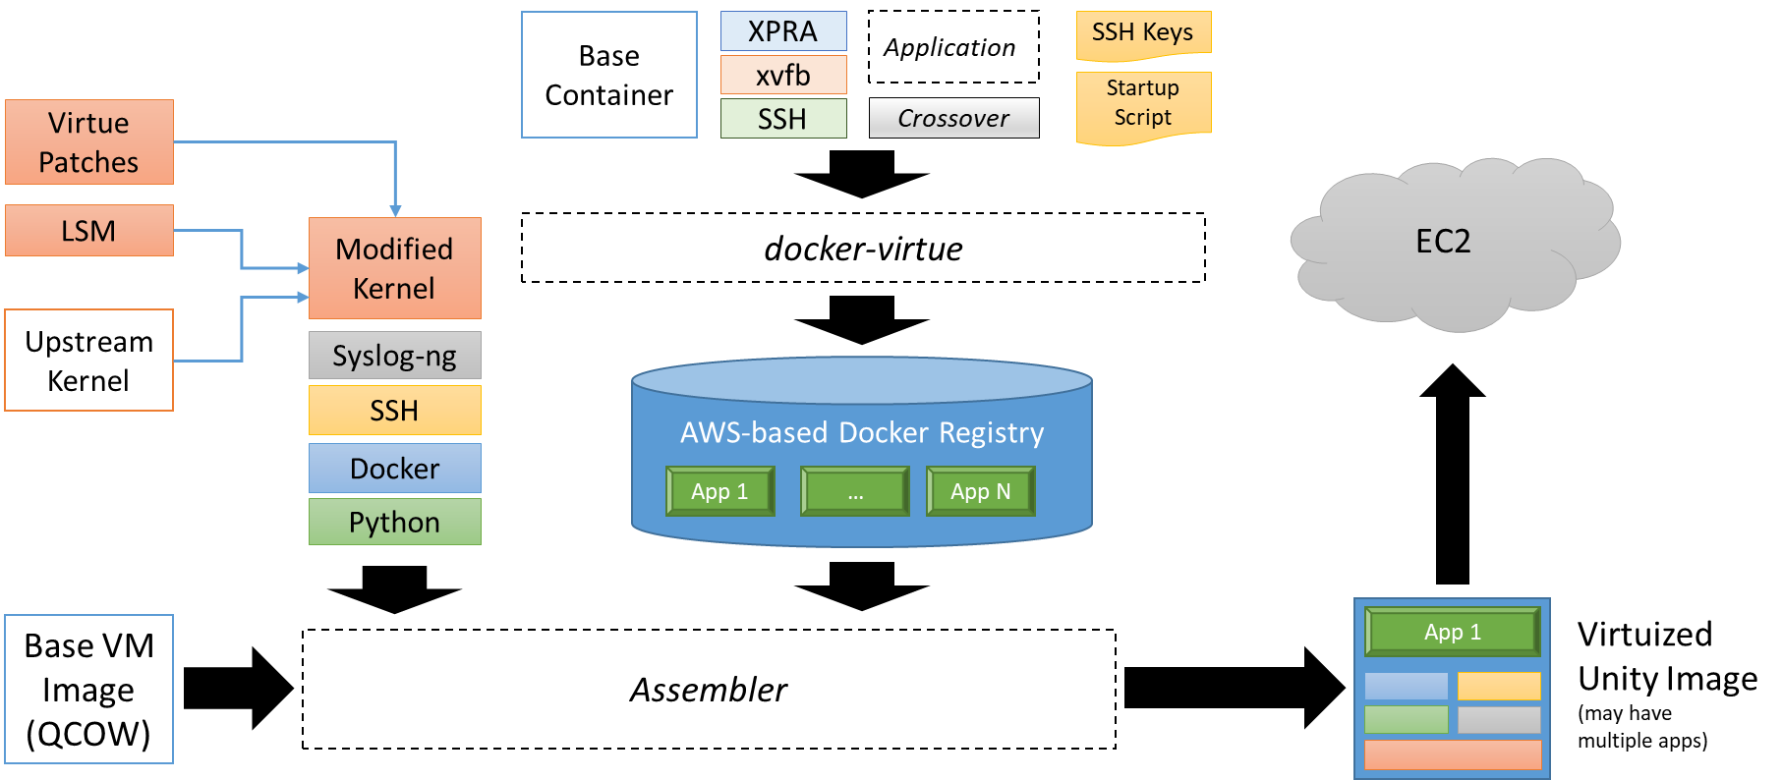
EXISTING Unity Image Assembly Workflow
Obsolete
github.com/starlab-io/docker-virtue (in virtue/)
github.com/starlab-io/galahad (in unity/)
github.com/starlab-io/galahad (in assembler/)
Notes:
Note that this is what the current system does, and it’s wrong in a bunch of different ways. It is recorded here for posterity.

