Slide 1
18.06
Zack Remscrim

Slide 2
What is the goal of 18.06?
Roughly: To understand matrices
A matrix is much more than just a table of values
A matrix encodes a function
input: a vector
output: a vector
Real goal: To understand these functions
Understanding a function means more than just being able to evaluate it

Slide 3
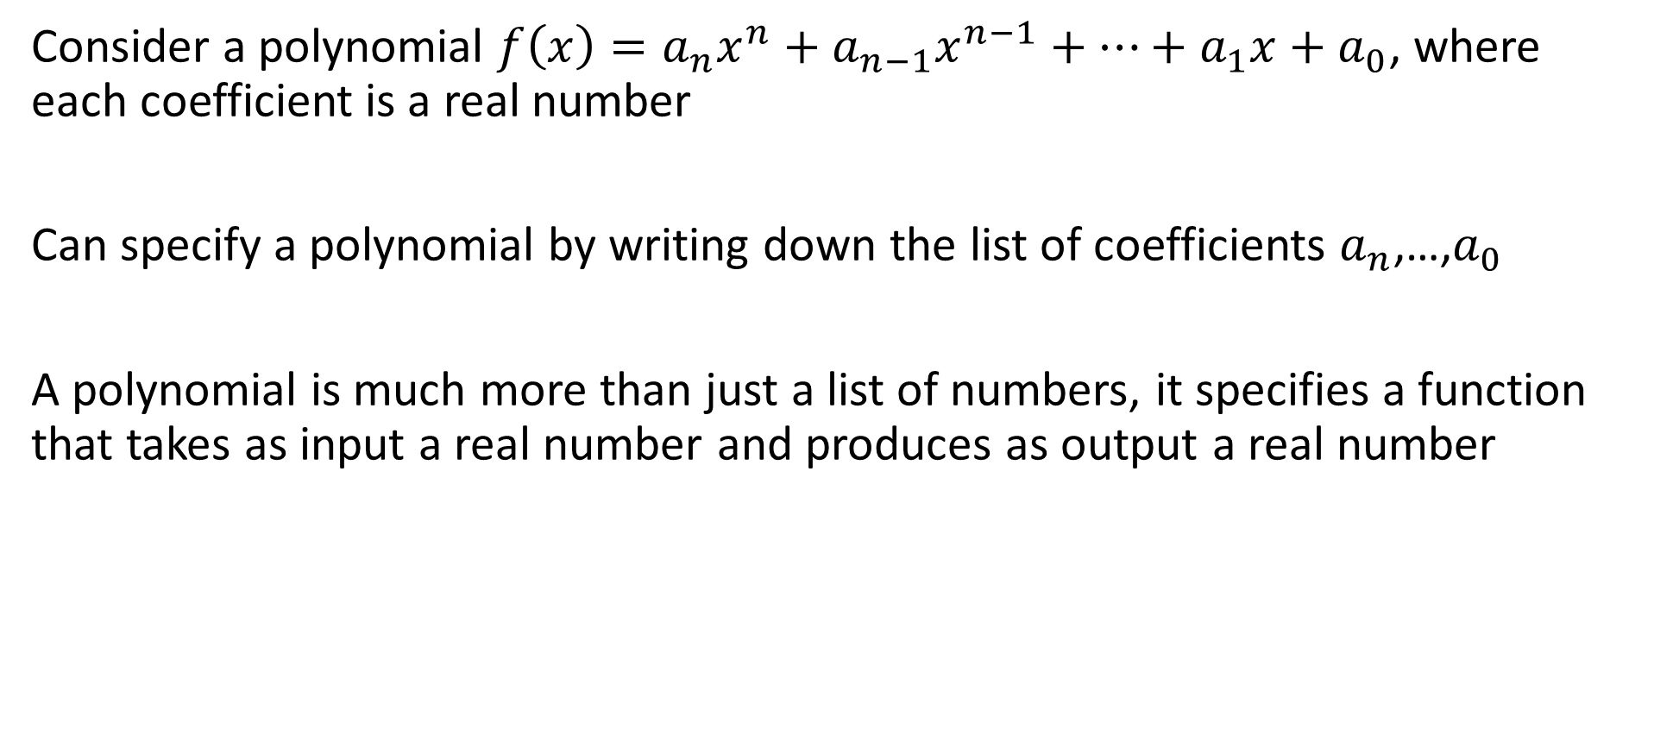
What was (one of the) goals of 18.01?
Consider a polynomial $f\left(x\right)=a_{n}x^{n}+a_{n−1}x^{n−1}+⋯+a_{1}x+a_{0}$, where each coefficient is a real number
Can specify a polynomial by writing down the list of coefficients $a_{n}$,…,$a_{0}$
A polynomial is much more than just a list of numbers, it specifies a function that takes as input a real number and produces as output a real number

Slide 4
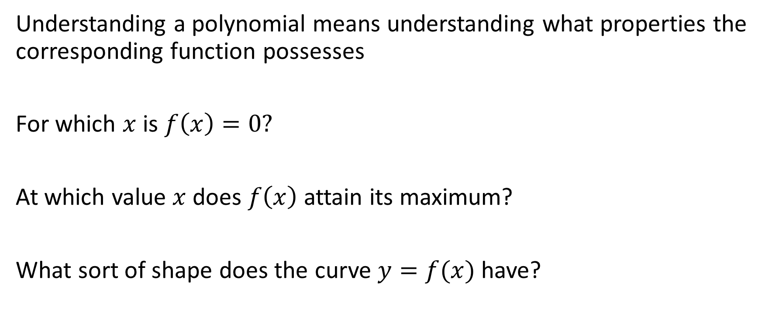
What was (one of the) goals of 18.01?
Understanding a polynomial means understanding what properties the corresponding function possesses
For which $x$ is $f\left(x\right)=0?$
At which value $x$ does $f\left(x\right)$ attain its maximum?
What sort of shape does the curve $y=f(x)$ have?

Slide 5
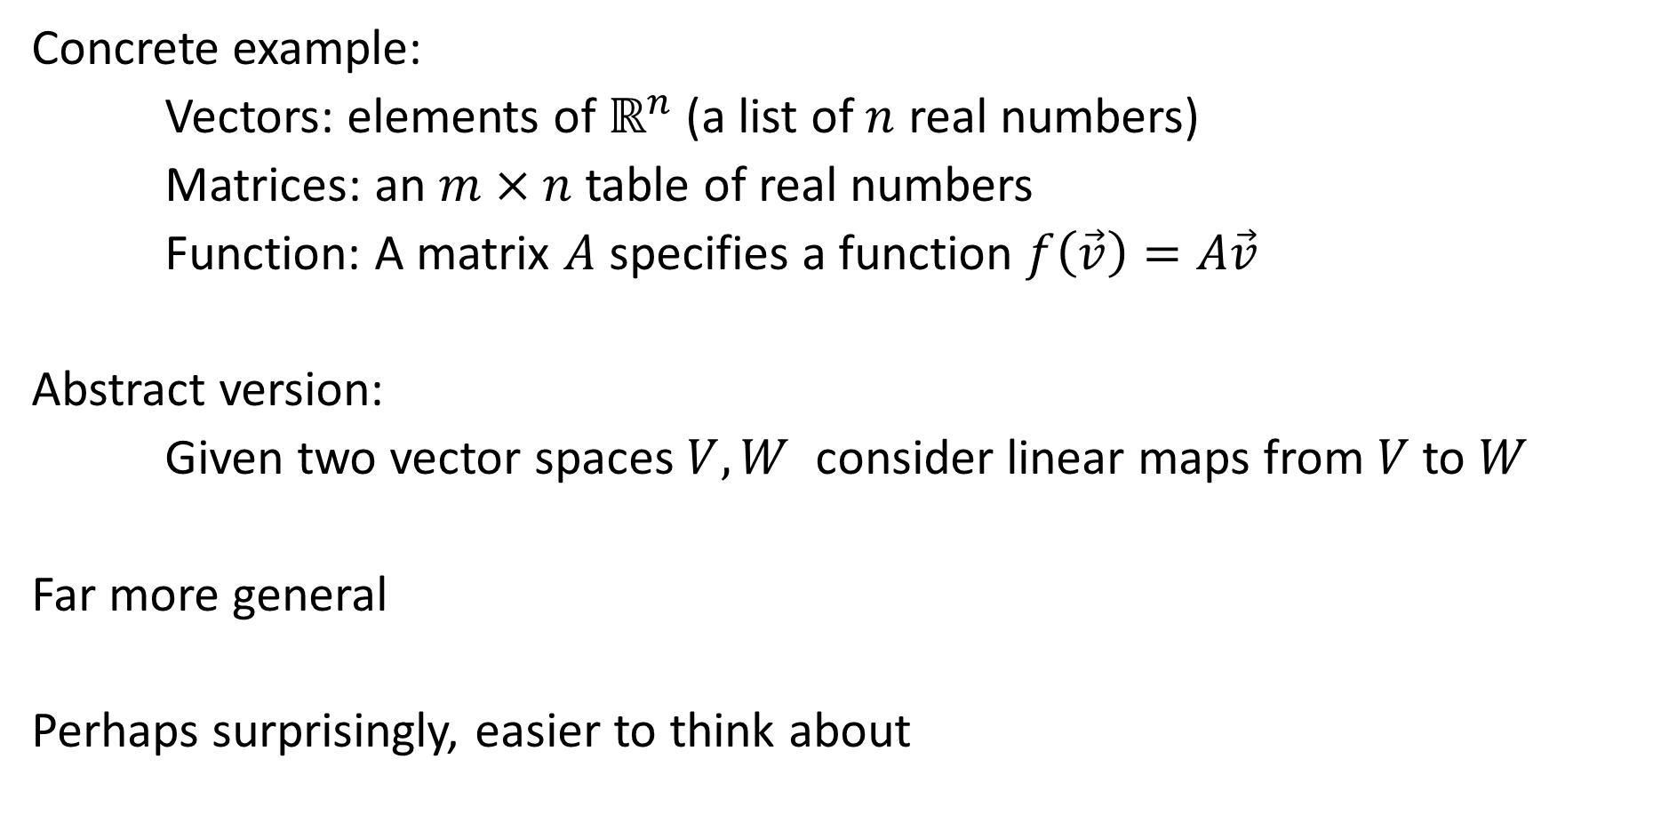
The Value of Abstraction
Concrete example:
Vectors: elements of ${\text{ℝ}}^{n}$ (a list of $n$ real numbers)
Matrices: an $m×n$ table of real numbers
Function: A matrix $A$ specifies a function $f\left(\vec{v}\right)=A\vec{v}$
Abstract version:
Given two vector spaces $V,W$ consider linear maps from $V$ to $W$
Far more general
Perhaps surprisingly, easier to think about

Slide 6
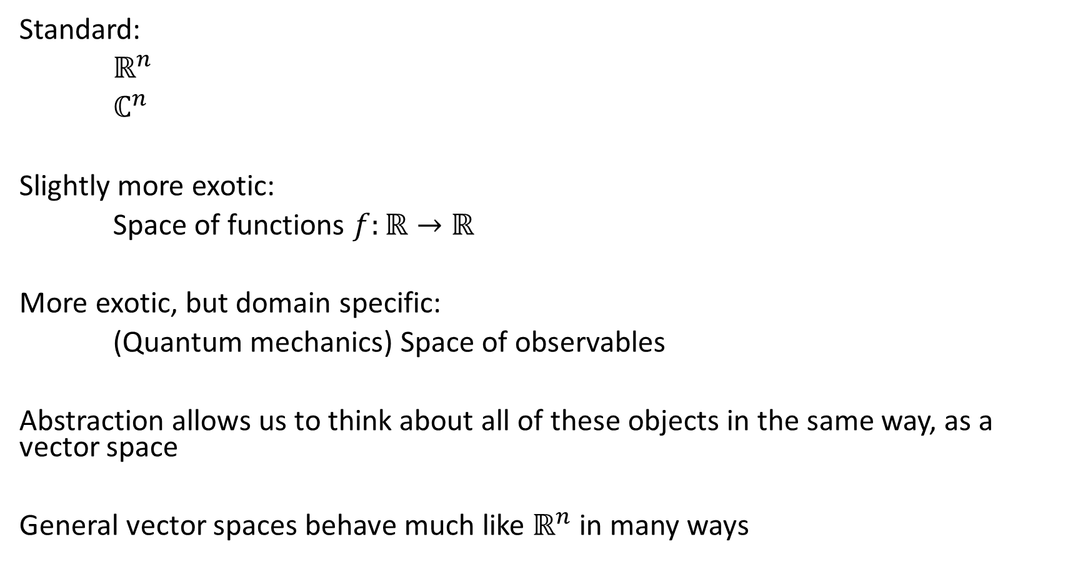
Examples of Vector Spaces
Standard:
${\text{ℝ}}^{n}$
$ℂ^{n}$
Slightly more exotic:
Space of functions $f:\text{ℝ}→\text{ℝ}$
More exotic, but domain specific:
(Quantum mechanics) Space of observables
Abstraction allows us to think about all of these objects in the same way, as a vector space
General vector spaces behave much like ${\text{ℝ}}^{n}$ in many ways

Slide 7
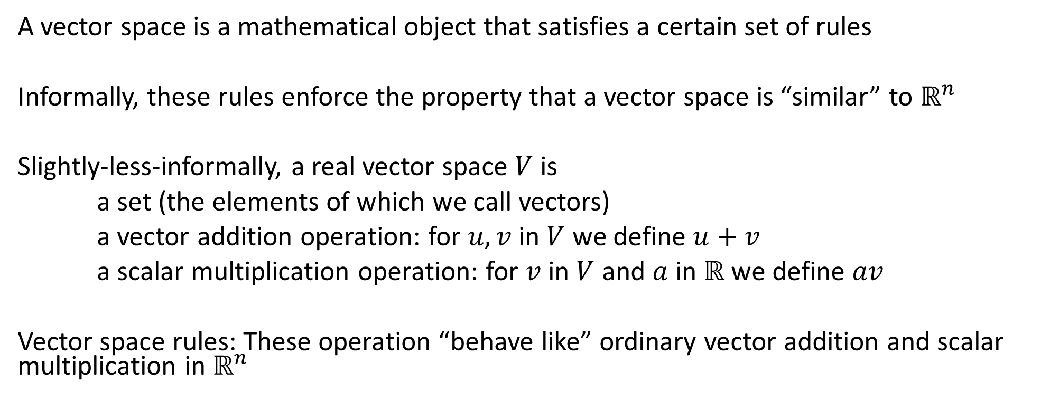
What is a Vector Space?
A vector space is a mathematical object that satisfies a certain set of rules
Informally, these rules enforce the property that a vector space is “similar” to ${\text{ℝ}}^{n}$
Slightly-less-informally, a real vector space $V$ is
a set (the elements of which we call vectors)
a vector addition operation: for $u,v$ in $V$ we define $u+v$
a scalar multiplication operation: for $v$ in $V$ and $a$ in $\text{ℝ}$ we define $av$
Vector space rules: These operation “behave like” ordinary vector addition and scalar multiplication in ${\text{ℝ}}^{n}$

Slide 8

What is a Linear Map?
For vector spaces $V,W$ a linear map is a function $f:V→W$ such that
for any $u,v$ in $V$ and $a,b$ in $\text{ℝ}$
$f\left(au+bv\right)=af\left(u\right)+bf(v)$

Slide 9


Example: Projection in${\text{ℝ}}^{2}$
Define $X:{\text{ℝ}}^{2}→{\text{ℝ}}^{2}$ such that, for $\left[\begin{matrix}x \\ y\end{matrix}\right]$ in ${\text{ℝ}}^{2}$, $X\left(\left[\begin{matrix}x \\ y\end{matrix}\right]\right)=\left[\begin{matrix}x \\ 0\end{matrix}\right]$
Projection onto $x$-axis

Slide 10
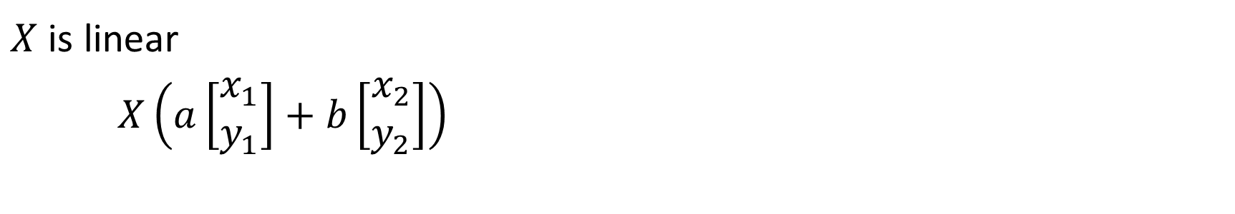

Example: Projection in${\text{ℝ}}^{2}$
$X$ is linear
$X\left(a\left[\begin{matrix}x_{1} \\ y_{1}\end{matrix}\right]+b\left[\begin{matrix}x_{2} \\ y_{2}\end{matrix}\right]\right)$
$= X\left(\left[\begin{matrix}ax_{1}+bx_{2} \\ {ay}_{1}+by_{2}\end{matrix}\right]\right)$
$$=\left[\begin{matrix}ax_{1}+bx_{2} \\ 0\end{matrix}\right]$$
$=a\left[\begin{matrix}x_{1} \\ 0\end{matrix}\right]+b\left[\begin{matrix}x_{2} \\ 0\end{matrix}\right]$
$=aX\left(\left[\begin{matrix}x_{1} \\ y_{1}\end{matrix}\right]\right)+bX\left(\left[\begin{matrix}x_{2} \\ y_{2}\end{matrix}\right]\right)$

Slide 11
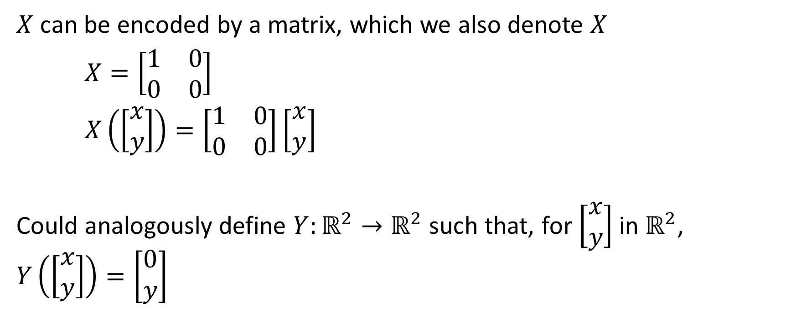
Example: Projection in${\text{ℝ}}^{2}$
$X$ can be encoded by a matrix, which we also denote $X$
$X=\left[\begin{matrix}1 & 0 \\ 0 & 0\end{matrix}\right]$
$X\left(\left[\begin{matrix}x \\ y\end{matrix}\right]\right)=\left[\begin{matrix}1 & 0 \\ 0 & 0\end{matrix}\right]\left[\begin{matrix}x \\ y\end{matrix}\right]$
Could analogously define $Y:{\text{ℝ}}^{2}→{\text{ℝ}}^{2}$ such that, for $\left[\begin{matrix}x \\ y\end{matrix}\right]$ in ${\text{ℝ}}^{2}$, $Y\left(\left[\begin{matrix}x \\ y\end{matrix}\right]\right)=\left[\begin{matrix}0 \\ y\end{matrix}\right]$

Slide 12
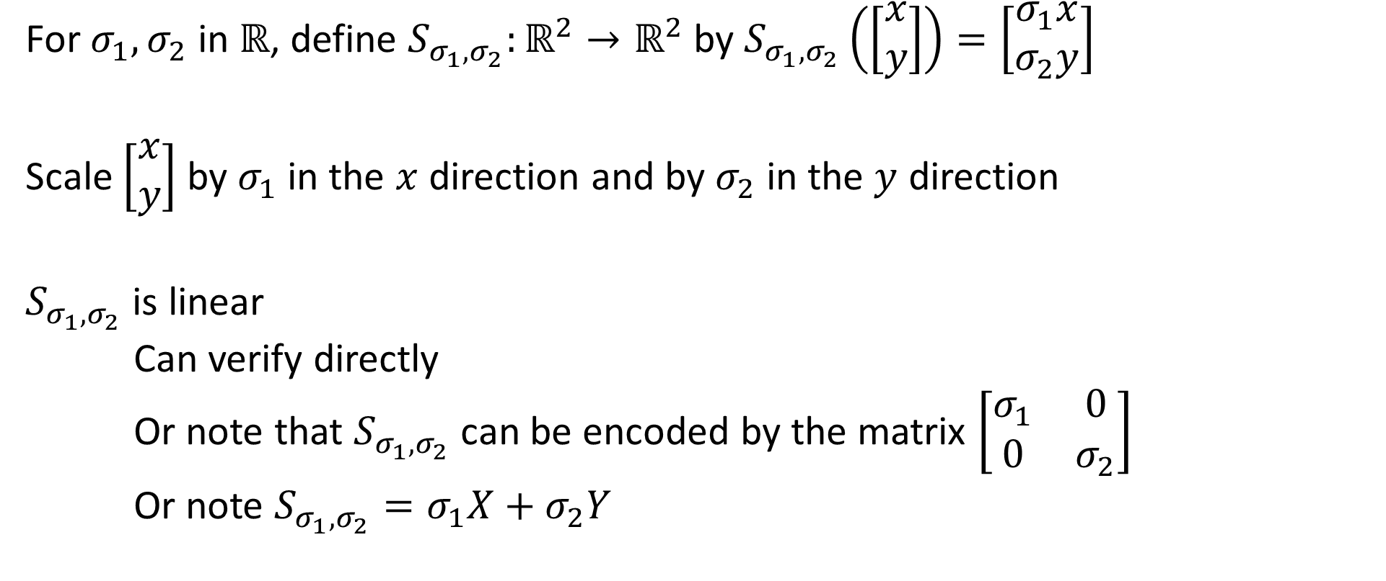

Example: Orthogonal Scaling in${\text{ℝ}}^{2}$
For $σ_{1},σ_{2}$ in $\text{ℝ}$, define $S_{σ_{1},σ_{2}}:{\text{ℝ}}^{2}→{\text{ℝ}}^{2}$ by $S_{σ_{1},σ_{2}}\left(\left[\begin{matrix}x \\ y\end{matrix}\right]\right)=\left[\begin{matrix}σ_{1}x \\ σ_{2}y\end{matrix}\right]$
Scale $\left[\begin{matrix}x \\ y\end{matrix}\right]$ by $σ_{1}$ in the $x$ direction and by $σ_{2}$ in the $y$ direction
$S_{σ_{1},σ_{2}}$ is linear
Can verify directly
Or note that $S_{σ_{1},σ_{2}}$ can be encoded by the matrix $\left[\begin{matrix}σ_{1} & 0 \\ 0 & σ_{2}\end{matrix}\right]$
Or note $S_{σ_{1},σ_{2}}=σ_{1}X+σ_{2}Y$

Slide 13
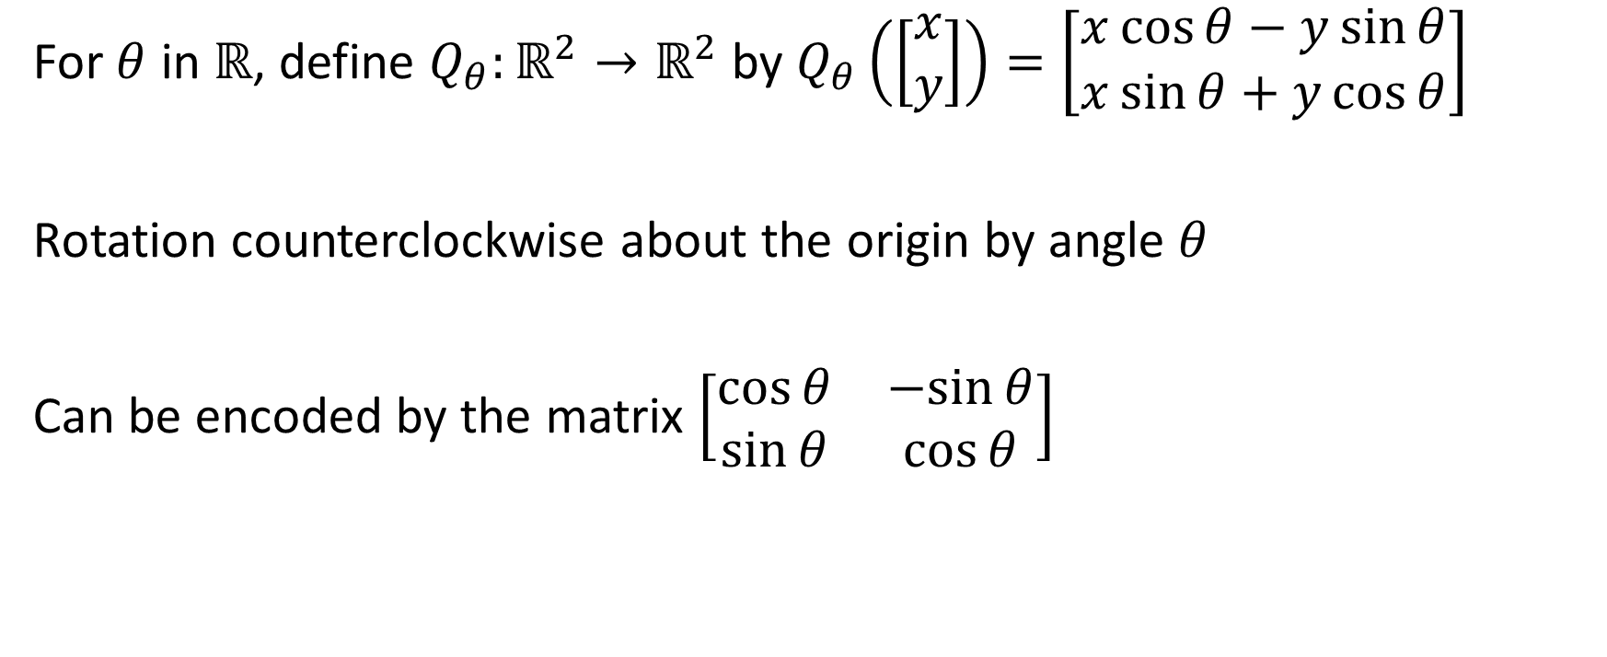

Example: Rotation in${\text{ℝ}}^{2}$
For $θ$ in $\text{ℝ}$, define $Q_{θ}:{\text{ℝ}}^{2}→{\text{ℝ}}^{2}$ by $Q_{θ}\left(\left[\begin{matrix}x \\ y\end{matrix}\right]\right)=\left[\begin{matrix}x\cos{θ}−y\sin{θ} \\ x\sin{θ}+y\cos{θ}\end{matrix}\right]$
Rotation counterclockwise about the origin by angle $θ$
Can be encoded by the matrix $\left[\begin{matrix}\cos{θ} & −sin{θ} \\ \sin{θ} & \cos{θ}\end{matrix}\right]$

Slide 14
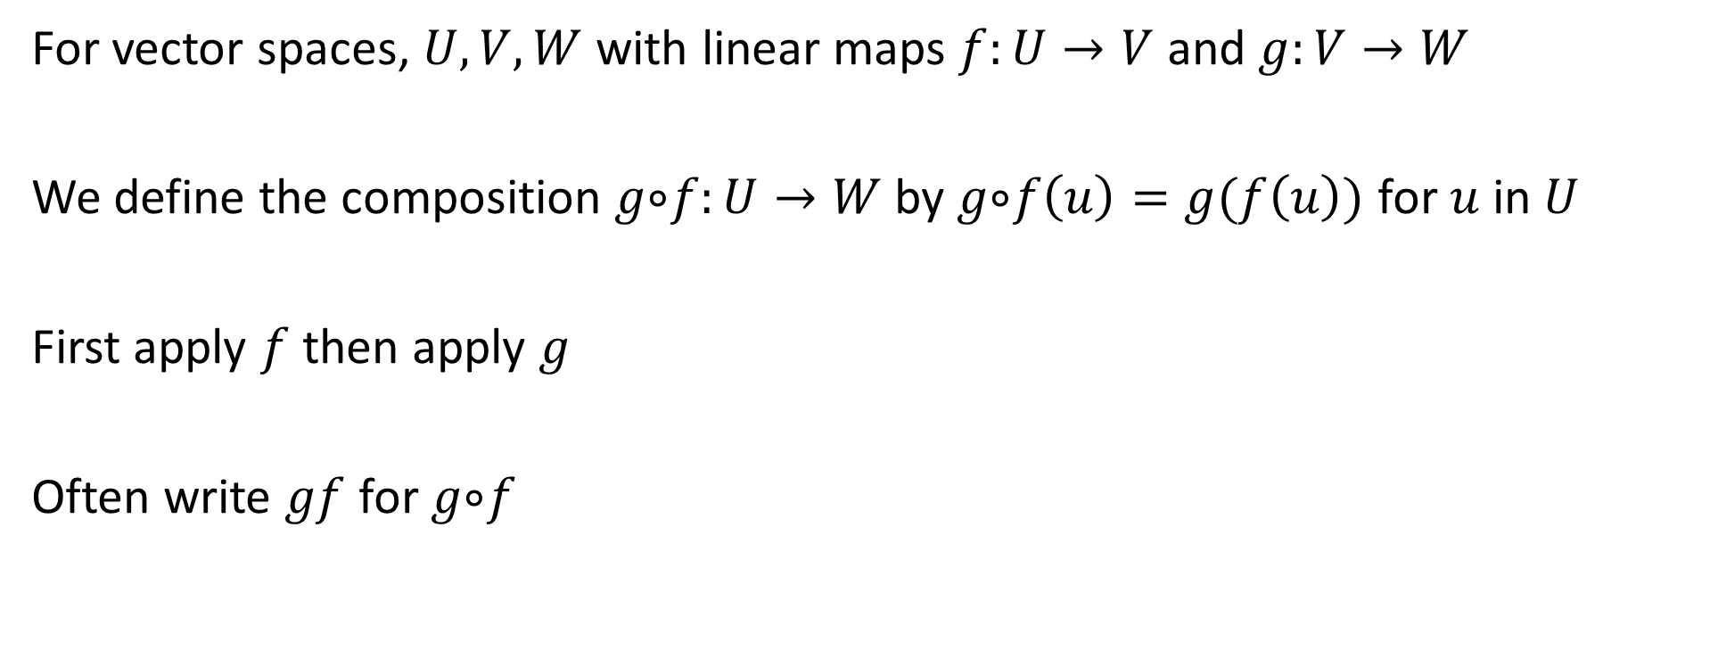
Composition of Linear Maps
For vector spaces, $U,V,W$ with linear maps $f:U→V$ and $g:V→W$
We define the composition $g ⃘f:U→W$ by $g ⃘f\left(u\right)=g(f\left(u\right))$ for $u$ in $U$
First apply $f$ then apply $g$
Often write $gf$ for $g ⃘f$

Slide 15

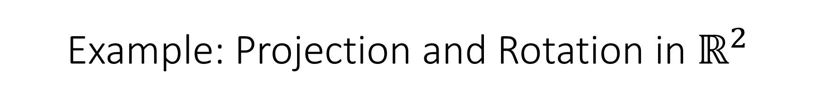
Example: Projection and Rotation in ${\text{ℝ}}^{2}$
Do we have $Q_{\frac{π}{2}}X=XQ_{\frac{π}{2}}$ ?
No, $Q_{\frac{π}{2}}X\left(\left[\begin{matrix}1 \\ 0\end{matrix}\right]\right)$=$\left[\begin{matrix}0 \\ 1\end{matrix}\right]$
but $XQ_{\frac{π}{2}}\left(\left[\begin{matrix}1 \\ 0\end{matrix}\right]\right)$=$\left[\begin{matrix}0 \\ 0\end{matrix}\right]$
Order matters
Matrix multiplication is not commutative

