Slide 1



SafeShelf
Personalized Recipe Recommendations
Developed by:
Nikolai Kuzmin
Andrey Alexeev
Emil Davlityarov
Arsenii Belugin
Alyona Sinyagina

Slide 2


The Problems
1
Food Waste
Globally, a significant portion of food is wasted due to improper storage and forgotten ingredients.
2
Recipe Inspiration
Finding new and exciting recipes can be challenging, leading to repetitive meals and culinary boredom.
3
Food Budgeting
Overspending on groceries due to impulsive purchases and lack of awareness of available ingredients.
4
Unhealthy Eating
Lack of knowledge about healthy dietary options and proper portion control.

Slide 3

Key Features of the SafeShelf Platform
Receipt Scanning
Expiration Date Tracking
Effortlessly capture your grocery list by scanning receipts with the SafeShelf website
Automatically monitor the expiration dates of your ingredients, ensuring freshness and reducing waste
Personalized Recipe Recommendations
Dietary Customization
Receive tailored recipe suggestions based on the ingredients you have available
Adjust your recipe recommendations to fit your dietary preferences, allergies, and restrictions

Slide 4








Technological stack
Backend
Database
Frontend
PostgreSQL
React
Java 21
Spring Boot
Spring Secure
Chroma
HTML
CSS
Python 3.8

Slide 5


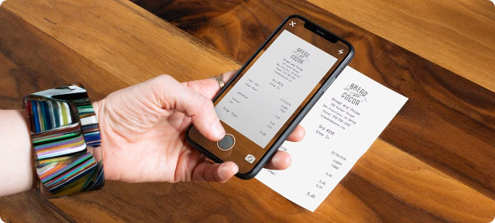


Scanning Receipts to Get Product Lists
Receipt Scanning
Users scan their receipts with the SafeShelf app.
Product Database
The extracted product names are compared against a comprehensive database.
Product List Generation
A complete list of products purchased is generated and displayed in the website.

Slide 6

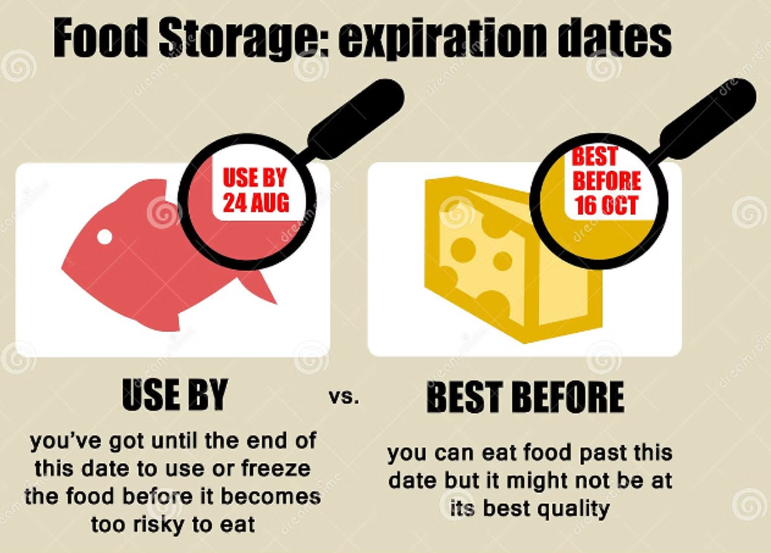
Accurate Expiration Date Determination
Product Type
Expiration Date Determination Method
«Honest Sign» system products (milk, water, etc.)
User input (manual or automated based on product type)
Other products
User input (manual or automated based on product type)

Slide 7






Personalized Recipe Recommendations
Ingredient Matching
The ML analyzes the user's available ingredients.
Recipe Database
It matches the ingredients with a vast database of recipes.
Dietary Preferences
The app considers dietary preferences, allergies, and restrictions.
Personalized Recommendations
The system recommends relevant and enticing recipes based on the user's unique dietary needs and available ingredients.

Slide 8
DEMO

Slide 9
Next Steps
- expanding the recipe database
- integrating with meal planning services
- exploring machine learning algorithms to optimize recipe recommendations

Slide 10
Thank you for your attention
Any questions?

