Slide 1




Store Sales - Time Series Forecasting
(DEPI)
Round (1) 2024

Slide 2
Hello,
1
2
Team Members: - 1. Emad Mostafa Srag Eldein
2. Omar Hussein Mohamed Sahwan
3.Ebrahem Osama Hassan Mohamed Omran
4. Abdelrahman Mohamed Youssef Zahran
3
4
5
6
7
8
9

Slide 3
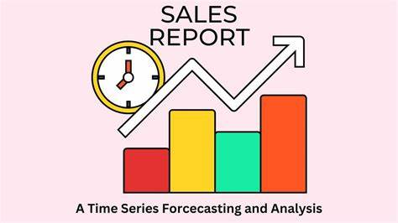
Introduction
1
What is a Store Sales – Time Series Forecasting ?
is a data science challenge focused on predicting future retail sales using historical data and external factors.
This involves modeling sales trends over time to generate accurate forecasts based on past performance and relevant influences.
2
3
4
5
6
7
8
9

Slide 4

Problem Statement
What is the primary challenge in predicting future sales for retail stores?
The primary challenge is to accurately predict future sales for these retail stores
.This involves analyzing historical sales trends and integrating external variables that can impact sales performance
By leveraging advanced time series forecasting techniques, the goal is to generate reliable sales forecasts that can aid in strategic decision-making and enhance operational efficiency.
1
2
3
4
5
6
7
8
9

Slide 5
Techniques Used in Sales Prediction
Dataset Description
.This section outlines the different datasets utilized, including training and testing data along with additional relevant information like holidays and oil prices.
2. Exploratory Data Analysis (EDA)
. Provides insights into the data through visualizations and statistical analyses, helping to understand relationships between variables and key trends
3. Feature Engineering
. Involves the creation of new features that enhance the predictive power of the models, derived from existing data and external sources.
4. Data Preprocessing
. Focuses on the steps taken to clean and prepare the data, addressing missing values, merging datasets, and encoding categorical variables for modeling.
5. Modeling . Describes the implementation of machine learning models, detailing the methodologies, architectures, training processes, and evaluation metrics for performance comparison
1
2
3
4
5
6
7
8
9

Slide 6
Dataset Description
Train Dataset:
Historical daily sales data, including store numbers, product families, promotions, and sales amounts, essential for training models to identify sales patterns.
Test Dataset: Similar structure to the train dataset but without sales figures, used for evaluating model performance and predicting future sales.
Additional Datasets:
Holidays: Public holiday information in Ecuador to capture seasonal sales effects.
Oil Prices: Daily oil prices impacting consumer spending and sales.
Store Details: Information about store locations and sizes for improved model accuracy.
Transaction Volumes: Data on transaction counts per store for insights into customer traffic
1
2
3
4
5
6
7
8
9

Slide 7
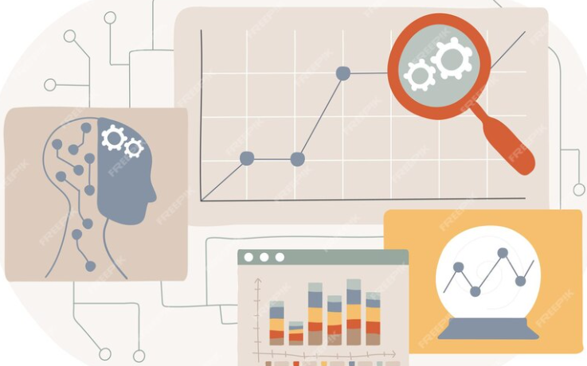
Exploratory Data Analysis (EDA)
1-Displaying the first 5 records.
2-Showing info about data types, non-null values,
and memory usage.
3-Providing a statistical summary of numerical columns.
4-Listing the column names.
5-Showing missing values in each column.
6-Displaying the shape of the dataset (number of rows and columns).
7-checking for duplicate rows in the dataset.
1
2
3
4
5
6
7
8
9

Slide 8
Data Preprocessing
1. Reading the Datasets: Loaded the train, test, and additional datasets into a manageable format for analysis.
2. Handling Missing Values:
- Filled missing values for oil prices and transactions using interpolation.
- Categorical features, such as holidays, were handled by filling with mode values.
3. Merging Datasets: Combined datasets using common keys like store numbers and dates to create a comprehensive dataset for analysis.
4. Data Types and Feature Encoding:
- Converted date columns to datetime format.
- Used Label Encoding for categorical variables such as family, holiday type, and city.
5. Outlier Detection and Treatment: Identified and treated outliers through visualization techniques and applied winsorization to mitigate their on the dataset.
1
2
3
4
5
6
7
8
9

Slide 9
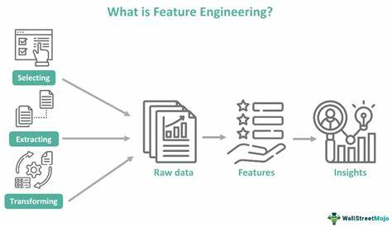
Feature Engineering
Calendar-based Features: - Generated features such as day of the week, week of the year, month, year, and weekend indicators to capture seasonal patterns in sales. Additional Features: - Integrated external data like daily oil prices and transaction volumes.Encoded categorical variables such as product family, city, and holiday type to include relevant information in the model
1
2
3
4
5
6
7
8
9

Slide 10
Modeling
In the modeling phase, we developed predictive models to forecast future sales using historical data and external factors. Here are the details of the two primary approaches utilized: 1.K-Means Model
Purpose: Cluster customers based on sales and promotions, enabling tailored marketing strategies.
Implementation: The K-Means algorithm was applied to identify distinct customer segments for targeted promotions.
2.ARIMA Model
Purpose: Used for analyzing and forecasting time series data that exhibits trends, cycles, or seasonality.
Implementation: The ARIMA model identified patterns in historical sales data, providing insights for future sales predictions
1
2
3
4
5
6
7
8
9

Slide 11
3. XGBoost Model
Purpose: Chosen for its robustness in handling complex feature interactions and scalability for large datasets.
Data Transformation: Applied PolynomialFeatures to create interaction terms, capturing nonlinear relationships.Scaled the data to ensure equal contribution from all features.
Pipeline Creation: Established a machine learning pipeline to automate data preprocessing and modeling steps
. Training and Testing: Trained on the transformed dataset, with performance evaluated using RMSE, MAE (Mean Absolute Error), and R² score metrics.
1
2
3
4
5
6
7
8
9

Slide 12
Conclusion
1
The project successfully implemented advanced time series forecasting techniques to predict sales for Corporación Favorita in Ecuador. The results indicate that both LSTM and XGBoost models are capable of providing valuable insights for strategic decision-making in retail operations. Future improvements may include refining feature engineering, exploring additional models, and incorporating more external variables to enhance predictive accuracy.
2
3
4
5
6
7
8
9

Slide 13
Thank you
Questions?

