Slide 1

Syrian Private University faculty of Artificial Intelligence Engineering Telecommunication Engineering
Project Title:
A Simulation-Based Model Design for High-Performance 5G Networks
Supervisors:
Dr. Rawad Melhem
Prepared By:
MHD.Nour Najeeb
LaithAbdAlrazek

Slide 2
OUTLINE:
Project objective .
Problem statement .
Theoretical Fundamentals .
- Literature Review.
-Project Flowchart .
-References

Slide 3
Project objective :
To design and implement a 5G network simulation model with Network Slicing, and develop an intelligent dynamic resource allocation algorithm to optimize performance across eMBB, uRLLC, and mMTC slices.

Slide 4
The problem that the project addresses :
The inability of traditional resource management mechanisms to simultaneously meet the conflicting performance requirements of different 5G applications (eMBB, uRLLC, mMTC).

Slide 5
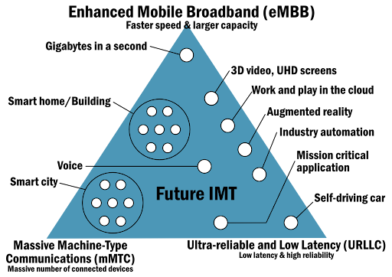
Theoretical Fundamentals (1/3)

Slide 6
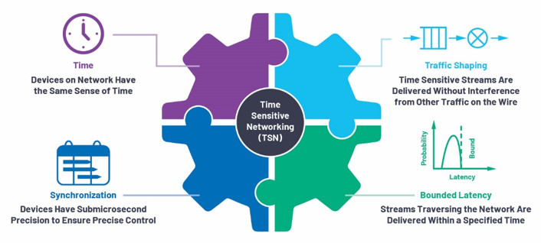
Theoretical Fundamentals (2/3)

Slide 7
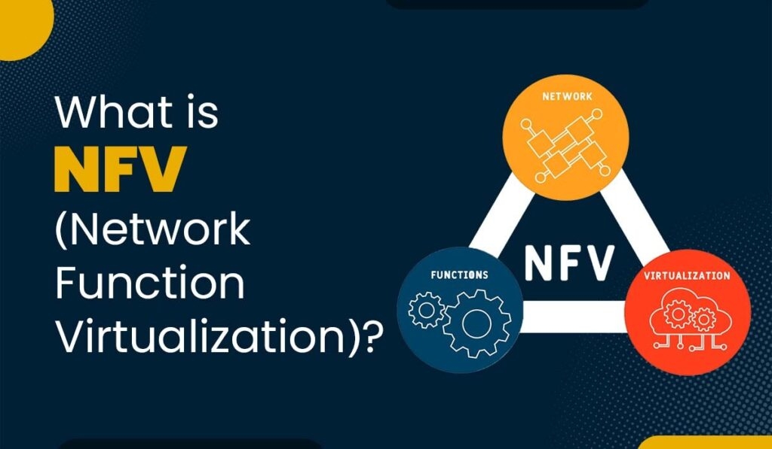
Theoretical Fundamentals (3/3)

Slide 8
Literature Review (1/3)
Paper 1:
[1] Slice-aware resource allocation and admission control for smart factory wireless networks
Content: A framework for allocating 5G resources to three network slices (CL, URLLC, TS) in a smart factory. Core Principle:
Convex optimization to allocate power and sub-channels across three slices (CL, URLLC, TS) based on QoS.
The framework ensures slice isolation by using a feedback control loop for CL slice rate adjustments and closed-form rate expressions for URLLC and TS users.
When base station power limits are exceeded, an admission control mechanism proportionally reduces
target rates for CL users using Lagrange multipliers, while preserving critical URLLC and TS services
Simulation Tools: Custom MATLAB-based simulator.

Slide 9
Literature Review (2/3)
Paper 2:
[2] Scalability Analysis of 5G-TSN Applications in Indoor Factory Settings.
Content: This paper establishes a performance baseline for integrated 5G-TSN in wireless industrial applications. It evaluates scalability by assessing whether 5G-TSN can maintain low latency and high reliability as the number of connected devices (AGVs) increases across different indoor factory environments.
Principle:
The study integrates 5G (URLLC) with TSN's deterministic Ethernet standards to create a unified wireless network.
It models realistic factory clutter and interference using 3GPP specifications to test time-critical traffic (control, video, best-effort) under strict priority queuing.
The principle is to evaluate if this hybrid network can guarantee bounded delays for sensitive applications as device density scales.
Simulation Tools: OMNeT++ simulation framework.

Slide 10
Literature Review (3/3)
Paper 3:
[3] “A survey on beyond 5G network slicing for smart cities applications.”
Content: This paper reviews how Beyond 5G networks can use network slicing to create separate virtual networks for different smart city applications like emergency response, smart transportation, and video surveillance, each with its own performance requirements.
Principle:
The paper discusses network slicing through practical use cases including:
The first 5G smart patrol car in Taiwan.
Telecom's connected ambulances for emergency healthcare services in Taiwan
Smart building with IoT with over 28,000 sensors for managing meeting rooms, and working spaces.
Smart traffic management to optimize traffic flow and reduce congestion in Miami
Simulation Tools: Mosaic5G, OpenAirInterface, and 5G Test Network (5GTN)

Slide 11
Project Execution Stages:
Phase 1: Study & Planning
- Literature review of 5G architecture and network slicing
- Study OMNeT++ and Simu5G capabilities
Phase 2: Design
- Define simulation scenarios (eMBB, URLLC, mMTC) - Design network topology and components
- Define performance metrics (throughput, latency)
Phase 3: Implementation
- Install OMNeT++ with Simu5G/INET frameworks
- Build network model in NED files
- Configure traffic patterns and applications
- Implement network slicing

Slide 12
Phase 4: Simulation
- Run baseline simulations
- Perform parameter variations
- Collect and export results
Phase 5: Analysis
- Generate graphs and compare results
- Validate against theoretical requirements
Phase 6: Documentation
- Write project report
- Prepare final presentation

Slide 13
References
[1] Ochonu, Regina, and Josep Vidal. "Slice-aware resource allocation and admission control for smart factory wireless networks." 2024 IEEE 100th Vehicular Technology Conference (VTC2024-Fall). IEEE, 2024.
[2] Zanbouri, Kouros, Md Noor-A-Rahim, and Dirk Pesch. "Scalability Analysis of 5G-TSN Applications in Indoor Factory Settings." 2025 IEEE Wireless Communications and Networking Conference (WCNC). IEEE, 2025.
[3] Rafique, Wajid, et al. "A survey on beyond 5g network slicing for smart cities applications." IEEE Communications Surveys & Tutorials 27.1 (2024): 595-628.

