Slide 1
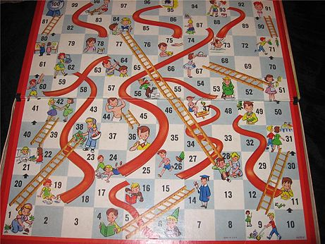
Markov model
Relevant to many domains:
Weather
Finance
Music
Language
Games
Biological sequences
Wikipedia
Notes:
Will discuss biological sequences later

Slide 2
Terminology
transition
0.9
0.1
0.8
transition probability
rain
sun
0.2
transition matrix
state
Transition probabilities are independent of time t

Slide 3
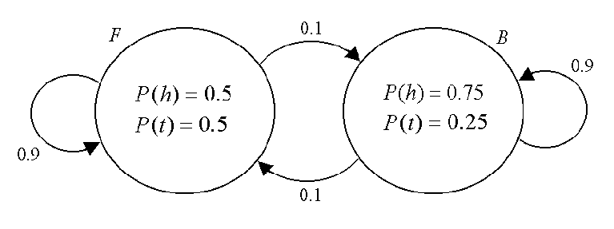
Hidden Markov Model States with emission distributions
transition
transition probability
state
emission
distribution
Notes:
Fair and Biased coin

Slide 4
Hidden Markov Model States with emission distributions
Model for temporal or sequential data
Stochastic (probabilities)
Probability of being in one state (now) depends on the state(s) you were in previously
Probability of a particular observation depends on what state you’re in (and maybe have been in previously)
Can emit (generate) observations … or be used to label a given sequence.

Slide 5
Hidden Markov Model States with emission distributions
Consider the observed flips: HTH
What is the probability of observing that string from each possible combination of states
(suppose initialization is 75% fair, 25% unfair)
FFF:
FFU:
.
.
.
UUU:

Slide 6
Hidden Markov Model States with emission distributions
Consider the observed flips: HTH
What is the probability of observing that string from each possible combination of states
(suppose initialization is 75% fair, 25% unfair)
FFF: (.75*.5) (.9*.5) (.9*.5) = 0.076
FFU:
.
.
.
UUU:

Slide 7
Hidden Markov Model States with emission distributions
Consider the observed flips: HTH
What is the probability of observing that string from each possible combination of states
(suppose initialization is 75% fair, 25% unfair)
FFF: (.75*.5) (.9*.5) (.9*.5) = 0.076
FFU: (.75*.5) (.9*.5) (.1*.75) = 0.013
.
.
.
UUU:

Slide 8
Hidden Markov Model States with emission distributions
Consider the observed flips: HTH
What is the probability of observing that string from each possible combination of states
(suppose initialization is 75% fair, 25% unfair)
FFF: (.75*.5) (.9*.5) (.9*.5) = 0.076
FFU: (.75*.5) (.9*.5) (.1*.75) = 0.013
.
.
.
UUU: (.25*.75) (.9*.25) (.9*.75) = 0.028

Slide 9
HMMs in action
Dice
Gene annotation
Protein-coding DNA

Slide 10
HMMs in action
Dice
Gene annotation
Protein-coding DNA

Slide 11
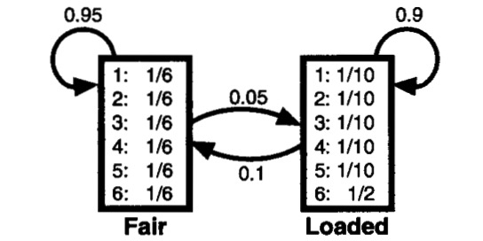

Slide 12
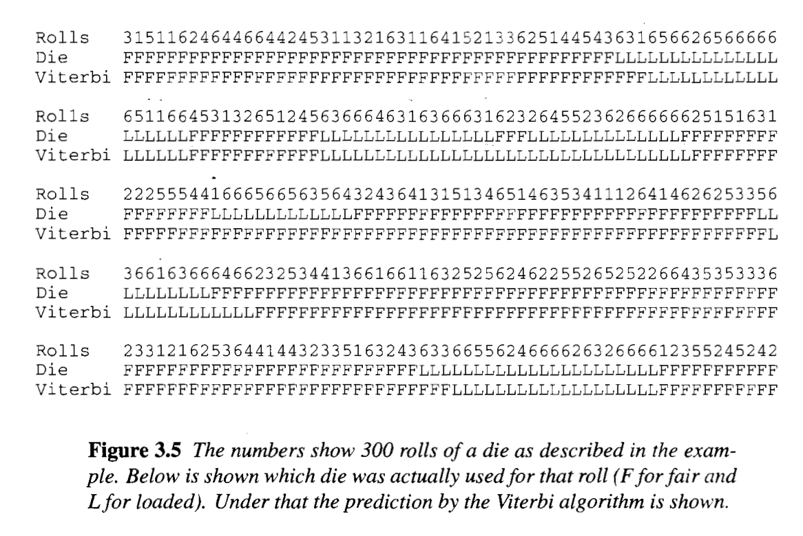

Slide 13
HMMs in action
Dice
Gene annotation
Protein-coding DNA

Slide 14
ACGTTGCTAGCTCAGATTATCGCGTCCAAGCCCAGGAGTTTGAGACCAGCCTGAACCACAGTGAGACCCCGTCTC
GAGAGGTGAGGAGTTCCAGACCAGCTGAACTGGGCCATAGTGAGACCCTGGGAATTCACCGACCATACTTTG
AGCCCAGGAGTTTGAGACCAGC----CTGAACCACAGTGAGACCC
|| ||||||||| |||||||| ||| ||| ||||||||||
AGGCCAGGAGTTCCAGACCAGCtgaaCTGGGCCATAGTGAGACCC
query
target
Notes:
Frequently, the best alignment involves only subsequences of one or both of the sequences you’re looking at. This is called a “local” alignment
Like if you’re looking at a protein domain within a protein, or a fragment of a TE

Slide 15
Local alignment - subsequences
query
target
query
CCAAGGCAGGAGGATCAAACTCCAAGCCCAGGAGTTTGAGACCAGC....CTGAACCACAGTGAGACCCCGTCTC
||||| |||||||| | || ||||||||| |||||||| ||| ||| ||||||||||||||||
CCAAGATAGGAGGAT-----TGTGAGGCCAGGAGTTCCAGACCAGCtgaaCTGGGCCATAGTGAGACCCCGTCTC
target
Notes:
Essentially, by some method or other, you have a high-scoring core of the alignment, and you extend it a bit this way

Slide 16
Local alignment - subsequences
query
target
query
CCAAGGCAGGAGGATCAAACTCCAAGCCCAGGAGTTTGAGACCAGC....CTGAACCACAGTGAGACCCCGTCTC
||||| |||||||| | || ||||||||| |||||||| ||| ||| ||||||||||||||||
CCAAGATAGGAGGAT-----TGTGAGGCCAGGAGTTCCAGACCAGCtgaaCTGGGCCATAGTGAGACCCCGTCTC
target
Notes:
… and that way,

Slide 17
Local alignment - subsequences
query
target
query
CCAAGGCAGGAGGATCAAACTCCAAGCCCAGGAGTTTGAGACCAGC....CTGAACCACAGTGAGACCCCGTCTC
||||| |||||||| | || ||||||||| |||||||| ||| ||| ||||||||||||||||
CCAAGATAGGAGGAT-----TGTGAGGCCAGGAGTTCCAGACCAGCtgaaCTGGGCCATAGTGAGACCCCGTCTC
target
Notes:
until you reach a maximum score – any further extension causes the score to get lower … and that’s your alignment
How far do you go?

Slide 18
Overextension
Notes:
Consider, for example, this alignment, which came from a real search using my tool nhmmer.
The thing I searched with (represented by the top sequence) was a couple thousand letters long, and the thing I was searching against was a simulated chromosome … so this is just a local alignment.
Did I get it right? Sure seems like a trustworthy alignment

Slide 19

Overextension
Notes:
Consider, for example, this alignment, which came from a real search using my tool nhmmer.
The thing I searched with (represented by the top sequence) was a couple thousand letters long, and the thing I was searching against was a simulated chromosome … so this is just a local alignment.
Did I get it right? Yes and no

Slide 21
% Identity | < 60% n = 461 |  | 60% - 70% n = 3774 |  | 70% - 80% n = 2904 |  | 80% - 90% n = 1217 |  | > 90% n = 141 |  | Overall n = 8947
Trimming approach | Over | Under | Over | Under | Over | Under | Over | Under | Over | Under | Over | Under
None | 66.3 | - | 32.1 | - | 21.6 | - | 22.4 | - | 21.3 | - | 28.8 | -
HMM | 61.2 | 0.6 | 17.1 | 3.2 | 7.4 | 2.1 | 8.2 | 1.1 | 12.4 | 0.5 | 14.9 | 2.3

Slide 22
HMMs in action
Dice
Gene annotation
Protein-coding DNA (with calculations)

Slide 23
http://www.cs.ubbcluj.ro/~csatol/mach_learn/bemutato/Mate_Korosi_HMMpres.pdf
Notes:
Want to model something a bit more complicated, a gene with introns and exons.

Slide 24
Insanely oversimplified model of a gene
start
0.01
1
A: 0.25
C: 0.25
G: 0.25
T: 0.25
A: 0.4
C: 0.1
G: 0.1
T: 0.4
0.98
0.96
0.01
“Exon”
“Intron”
0.04
end

Slide 25
This is a hidden Markov model (HMM)
Completely specified by three things:
Initialization probabilities : π(i)
Transition probabilities : t(i|j)
Emission probabilities : e(x|i)
Notes:
Transition: probability of moving to state i from state j
Emission: probability of observing x, given that you’re in state i

Slide 26
Probability of a path through the model
E E E I I I E E E
Notes:
Ignore the “hidden” part for now:
Given the model, the probability of a path through the model is just the product of transition probabilities

Slide 27
Probability of a path through the model
E E E I I I E E E
1 * .98 * .98 * .01 * .96 * .96 * .04 * .98 * .98 * .01 = 3.4e-6

Slide 28
Fixed path: probability of observed sequence
E E E I I I E E E
c g a a a t a g t
Notes:
If we know the model and path, the probability of a given sequence is just the product of the emission probabilities

Slide 29
Fixed path: probability of observed sequence
E E E I I I E E E
c g a a a t a g t
.25 * .25 * .25 * .4 * .4 * .4 * .25 * .25 * .25 = 0.000015625
Notes:
If we know the model and path, the probability of a given sequence is just the product of the emission probabilities
“computing the observation probability is straightforward when we know the underlying state sequence.”

Slide 30
Joint probability of path and sequence
E E E I I I E E E
c g a a a t a g t
1 * .98 * .98 * .01 * .96 * .96 * .04 * .98 * .98 * .01 *
.25 * .25 * .25 * .4 * .4 * .4 * .25 * .25 * .25 = 5.3e-11
Notes:
“Joint probability” is the probability of following a sequence of states, and given that sequence, the probability of seeing the observed seqeunce

Slide 31
But what if the states are hidden?
? ? ? ? ? ? ? ? ?
c g a a a t a g t
Given a sequence :
Which state path is most probable?
Where are the exons and introns
How confident are we that the best path is the true path?
What is the probability of the observed sequence?
Is this even a gene?

Slide 32
But what if the states are hidden?
? ? ? ? ? ? ? ? ?
c g a a a t a g t
Given a sequence :
Which state path is most probable?
Where are the exons and introns
How confident are we that the best path is the true path?
What is the probability of the observed sequence?
Is this even a gene?

Slide 33
Which state path is most probable?
? ? ? ? ? ? ? ? ?
c g a a a t a g t
One way: compute joint probability for each state path, pick the best.

Slide 34
Which state path is most probable?
? ? ? ? ? ? ? ? ?
c g a a a t a g t
One way: compute joint probability for each state path, pick the best.
 | c | g | a | a | a | t | a | g | t
E
I
Notes:
A sequence of states and letters can be thought of as a path through a table like this

Slide 35
Which state path is most probable?
? ? ? ? ? ? ? ? ?
c g a a a t a g t
One way: compute joint probability for each state path, pick the best.
 | E | E | E | I | I | I | E | E | E
 | c | g | a | a | a | t | a | g | t
E
I
1 * .98 * .98 * .01 * .96 * .96 * .04 * .98 * .98 * .01 *
.25 * .25 * .25 * .4 * .4 * .4 * .25 * .25 * .25

Slide 36
Which state path is most probable?
? ? ? ? ? ? ? ? ?
c g a a a t a g t
One way: compute joint probability for each state path, pick the best.
(how many paths?)
 | E | E | E | I | I | I | E | E | E
 | c | g | a | a | a | t | a | g | t
E
I
1 * .98 * .98 * .01 * .96 * .96 * .04 * .98 * .98 * .01 *
.25 * .25 * .25 * .4 * .4 * .4 * .25 * .25 * .25
Notes:
2^(L-2) for length-L string (needs to start and end in the E state)

Slide 37
Which state path is most probable?
One way: compute joint probability for each state path, pick the best.
A better way?
 | c | g | a | a | a | t | a | g | t
E
I
Notes:
Well … the most probable path needs to end somehow.
How?
In the E state.

Slide 38
Which state path is most probable?
One way: compute joint probability for each state path, pick the best.
A better way: compute the best state path (Dynamic Programming).
 | c | g | a | a | a | t | a | g | t
E
I
Notes:
Ends in the E state.
But how did it get there?

Slide 39
Which state path is most probable?
One way: compute joint probability for each state path, pick the best.
A better way?
 | c | g | a | a | a | t | a | g | t
E
I
Notes:
Ends in the E state.
Must have come from one of these. If we knew the most probable way to end up in each of those states, then we could compute the probability of extending either one, and pick the best.

Slide 40
Which state path is most probable?
One way: compute joint probability for each state path, pick the best.
A better way?
Dynamic programming: V(i,j) = max
 | c | g | a | a | a | t | a | g | t
E
I
j ∈ { I, E }
i
V(i-1,E) * t(j|E) * e(x|j)
V(i-1,I) * t(j|I) * e(x|j)

Slide 41
But what if the states are hidden?
? ? ? ? ? ? ? ? ?
c g a a a t a g t
Given a sequence :
Which state path is most probable?
Where are the exons and introns
How confident are we that the best path is the true path?
What is the probability of the observed sequence?
Is this even a gene?

Slide 42
How confident are we that this best path is the true path?
Confidence_{π} =
P( p_{π} )
Σ_{i} P( p_{i} )
Notes:
In other words: maybe there’s only a .0001% chance that we’d see this sequence … but the identified path accounts for almost all of that probability.

Slide 43
But what if the states are hidden?
? ? ? ? ? ? ? ? ?
c g a a a t a g t
Given a sequence :
Which state path is most probable?
Where are the exons and introns
How confident are we that the best path is the true path?
What is the probability of the observed sequence (being emitted by the model somehow)?
Is this even a gene?

Slide 44
What is the probability of the observed sequence?
? ? ? ? ? ? ? ? ?
c g a a a t a g t
One way: for each possible state path, compute the probability of the observed string, and … ?

Slide 45
What is the probability of the observed sequence?
? ? ? ? ? ? ? ? ?
c g a a a t a g t
One way: for each possible state path, compute the probability of the observed string, and … add up those probabilities
Notes:
Board work: show probabilities of “cga” for all state paths, and “cgaa” for all state paths ending in E.
EEE = 1*.25*.98*.25*.98*.25 = .01501 * .98 * .25 = 0.00368
EIE = 1*.25*.01*.1*.04*.25 = .0000025 * .98 * .25 = 0.0000006125
---→ then add on a in E state
EII = 1*.25*.01*.1*.96*.4 = .000096 * .04 * .25 = 0.00000096
EEI = 1*.25*.98*.25*.01*.4 = .00025 * .04 * .25 = 0.0000025

Slide 46
What is the probability of the observed sequence?
One way: for each possible state path, compute the probability of the observed string, and … add up those probabilities
A better way?
 | c | g | a | a | a | t | a | g | t
E
I

Slide 47
What is the probability of the observed sequence?
One way: for each possible state path, compute the probability of the observed string, and … add up those probabilities
A better way?
 | c | g | a | a | a | t | a | g | t
E
I
Notes:
and EIEE. Both end in the same state, and everything after that just starts at E (memoryless)
Can
EEE = 1*.25*.98*.25*.98*.25 = .01501
EIE = 1*.25*.01*.1*.04*.25 = .0000025
sum = .01501
EII = 1*.25*.01*.1*.96*.4 = .000096
EEI = 1*.25*.98*.25*.01*.4 = .00025
sum = 0.000346
and “cgaa” for all state paths ending in E: .01501 * .98 * .25 + 0.000346 * .04 * .25 = 0.00368

Slide 48
What is the probability of the observed sequence?
One way: for each possible state path, compute the probability of the observed string, and … add up those probabilities
A better way?
Dynamic programming : F(i,j) = sum
 | c | g | a | a | a | t | a | g | t
E
I
j ∈ { I, E }
i
F(i-1,E) * t(j|E) * e(x|j)
F(i-1,I) * t(j|I) * e(x|j)

Slide 49
But what if the states are hidden?
? ? ? ? ? ? ? ? ?
c g a a a t a g t
Given a sequence :
Which state path is most probable?
Where are the exons and introns
How confident are we that the best path is the true path?
What is the probability of the observed sequence (being emitted by the model somehow)?
Is this even a gene?

Slide 50
Is this a gene?
Odds ratio:
P( string | Model )
P(string | random )
Notes:
In other words: maybe there’s only a .0001% chance that we’d see this sequence … but the identified path accounts for almost all of that probability.

Slide 51
Is this a gene?
Odds ratio: log
P( Model )
P( random )

Slide 52
Hidden Markov models (HMMs)
Eddy 2004
Notes:
Which state path is most probable?
Viterbi
What is the probability of the observed sequence?
Forward
How confident are we that the best path is the true path?

Slide 53
Synopsis
Viterbi: V(i,j) = max
Forward: F(i,j) = sum
V(i-1,E) * t(j|E) * e(x|j)
V(i-1,I) * t(j|I) * e(x|j)
F(i-1,E) * t(j|E) * e(x|j)
F(i-1,I) * t(j|I) * e(x|j)
 | c | g | a | a | a | t | a | g | t
E
I
Notes:
But that’s a trivial difference, right?

Slide 54
Numerical Stability
Viterbi: B(i,j) = max
Forward: S(i,j) = sum
B(i-1,E) * t(j|E) * e(x|j)
B(i-1,I) * t(j|I) * e(x|j)
S(i-1,E) * t(j|E) * e(x|j)
S(i-1,I) * t(j|I) * e(x|j)
 | c | g | a | a | a | t | a | g | t
E
I
Notes:
Can do the first in log space. Second is harder.

