Slide 1
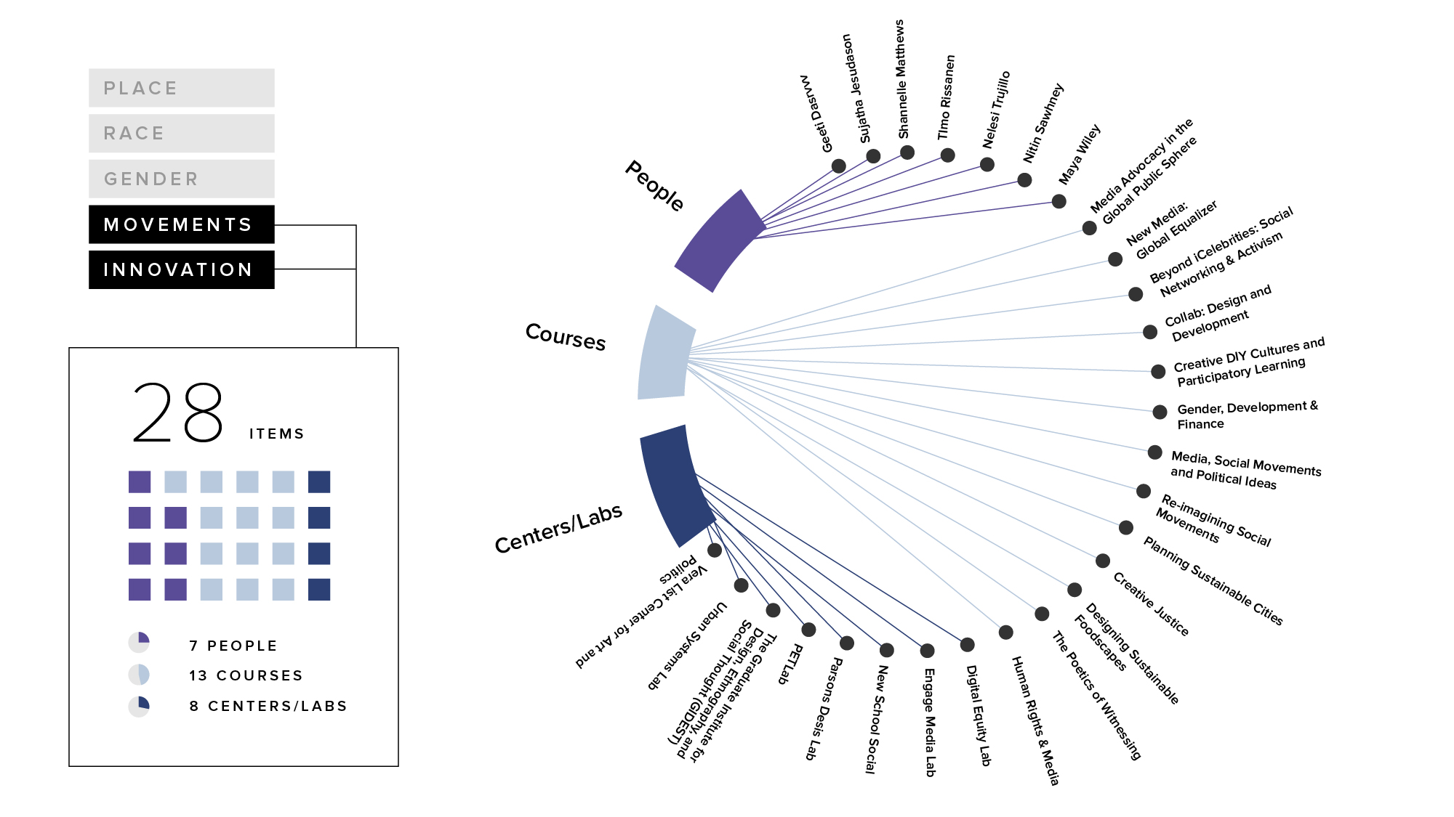
Notes:
Alternative 1

Slide 2
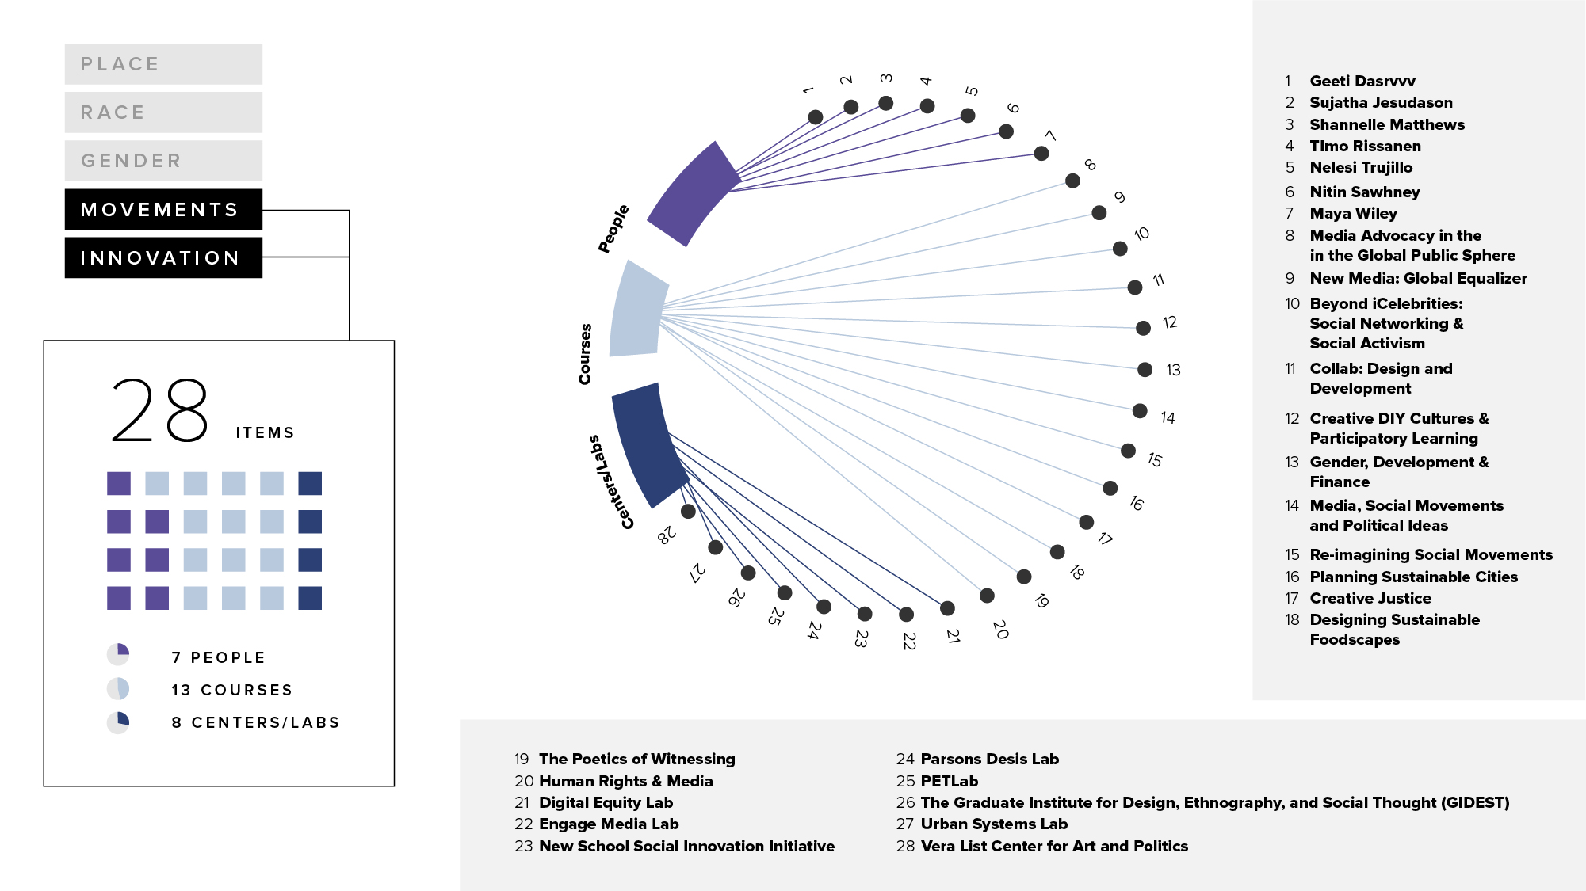
Notes:
Alternative 2

Slide 3
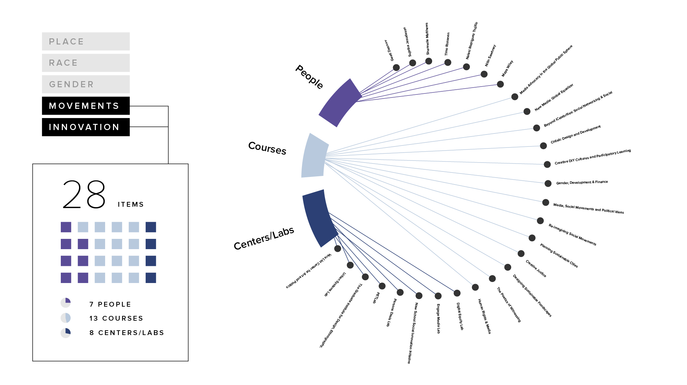

Notes:
Original

