Slide 1
Attic Vision Anlytics UI Draft
애틱 주식회사

Slide 2
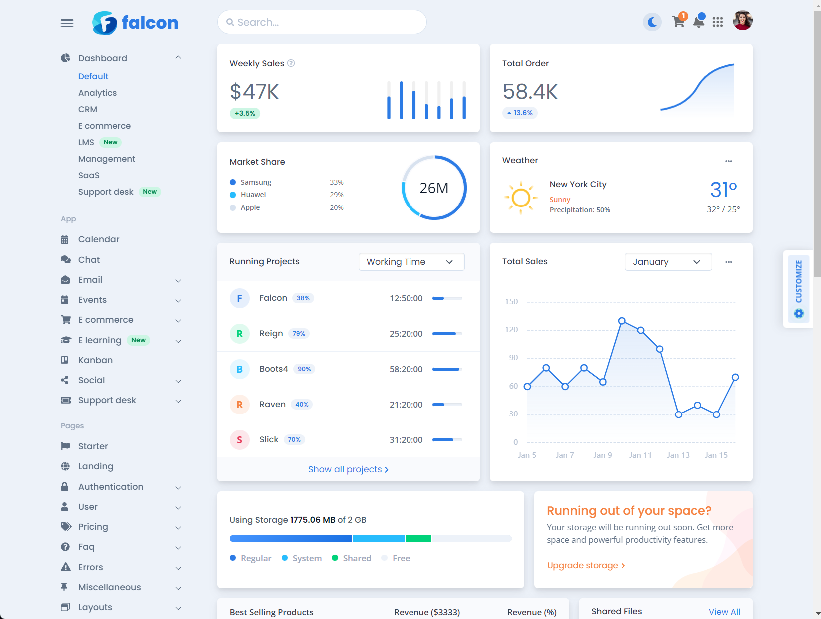
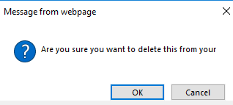
Log in
ATTIC Vision Analytics
Image Viewer
Modelling
Measurement
Report
Settings
Log on
ID :
Password :

Slide 3
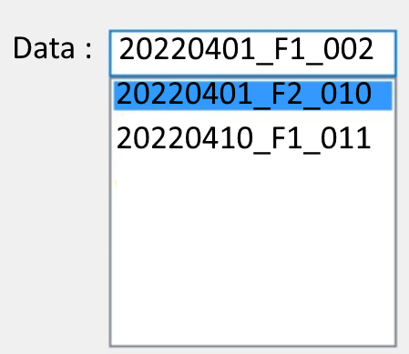
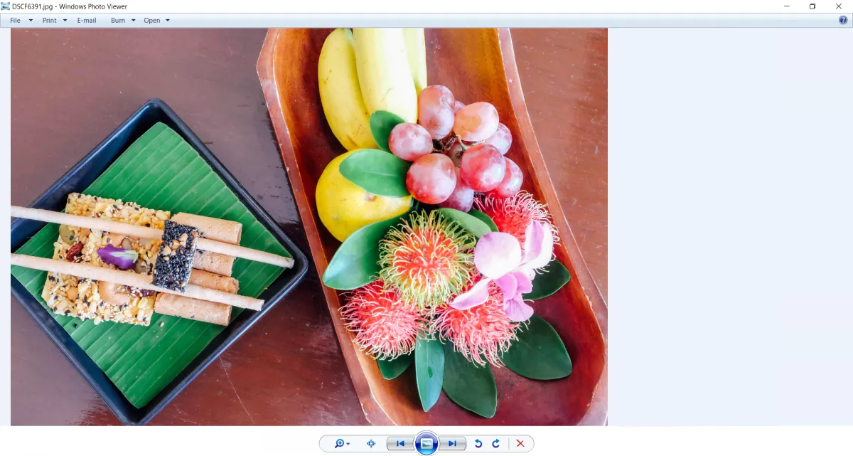
Image Viewer
./img/IMG_6207.png
./img/IMG_6210.png
./img/IMG_6213.png
./img/IMG_6314.png
./img/IMG_6338.png
Input : List of images(PNG or JPG)
ATTIC Vision Analytics
Image Viewer
Modelling
Measurement
Report
Settings
IMG ID : 001
파일명 : 201_001.PNG
촬영일 : 2023. 04.01
촬영장소 : F2, LAB01
포맷 : PNG
크기 : 720 x 860
해상도 : 16M
카메라 : CAM003
관리자 : P00451

Slide 4
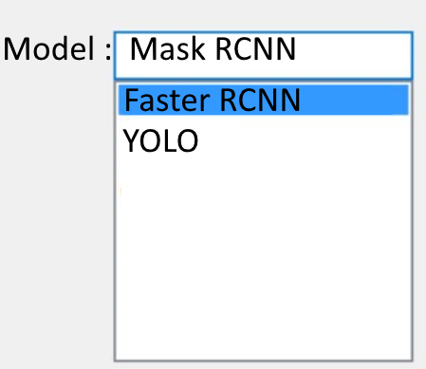
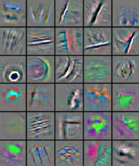


Modelling
Modelling Page는 아직 구현하지 마십시요
Input : a Set of Matrix(numpy)
ATTIC Vision Analytics
Image Viewer
Modelling
Measurement
Report
Settings

Slide 5
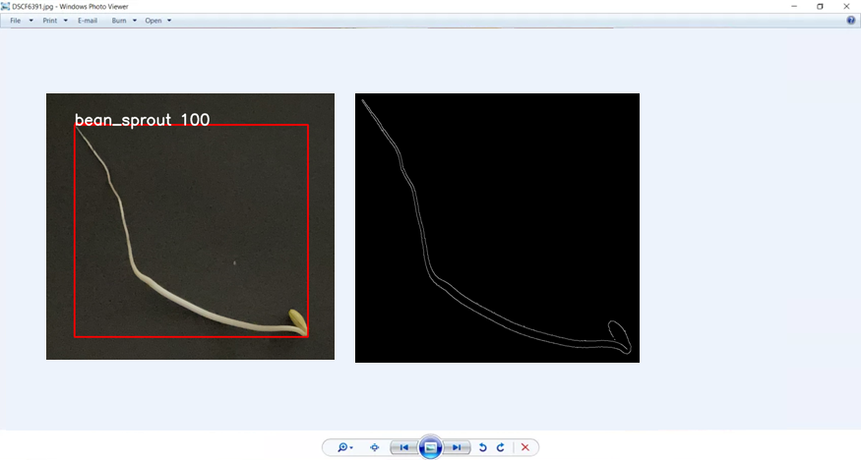
Measurements
Input
List of Images(PNG or JPG) : Detection 결과
List of Images(PNG or JPG) : Edge Detection 결과
Dataframe : 측정 결과(Image ID, 길이, 두께)
ATTIC Vision Analytics
Detection 결과
Edge Detection 결과
Image Viewer
Modelling
Measurement
Report
Settings
./detected/IMG_6207.png
./edge/6207_01.png
./edge/6207_02.png
./edge/6207_03.png
./detected/IMG_6210.png
./edge/6210_01.png
./edge/6210_02.png
./edge/6210_03.png
IMG ID : 001
길이 : 10.1cm
두께 : 31 mm
./detected/IMG_6213.png
./edge/6213_01.png
./edge/6213_02.png
./edge/6213_03.png
./detected/IMG_6314.png
./edge/6314_01.png
./edge/6314_02.png
./edge/6314_03.png
./edge/6314_04.png
./detected/IMG_6338.png
./edge/6338_01.png
./edge/6338_02.png
./edge/6338_03.png
./edge/6338_04.png

Slide 6
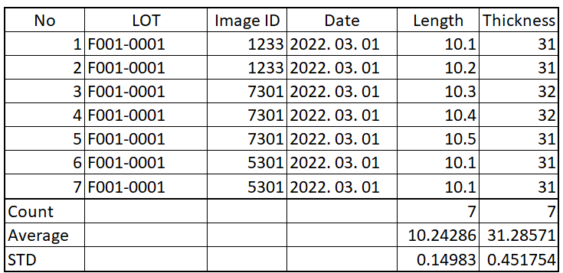
Report
Input
Dataframe : No, LOT, Image ID, Date, Length, Thickness 등
ATTIC Vision Analytics
Image Viewer
Modelling
Measurement
Report
Settings
Download
File_name.csv

