Slide 1
Attic Vision Anlytics UI Draft
애틱 주식회사

Slide 2
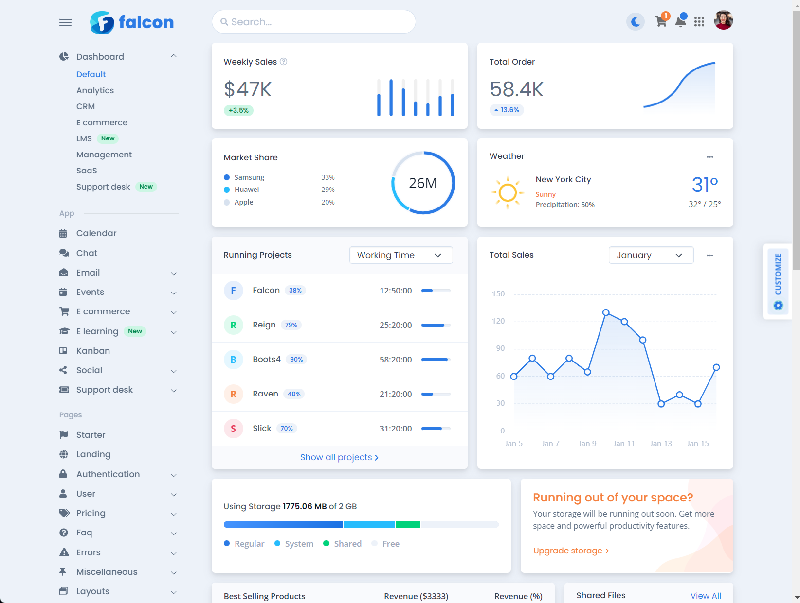
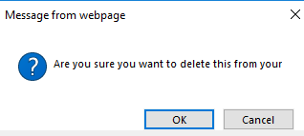
Log in
ATTIC Vision Analytics
Image Viewer
Modelling
Measurement
Report
Settings
Log on
ID :
Password :

Slide 3
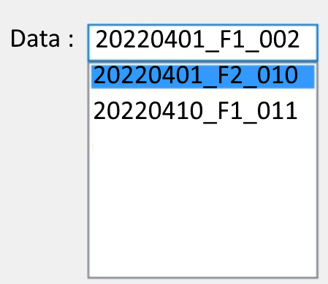
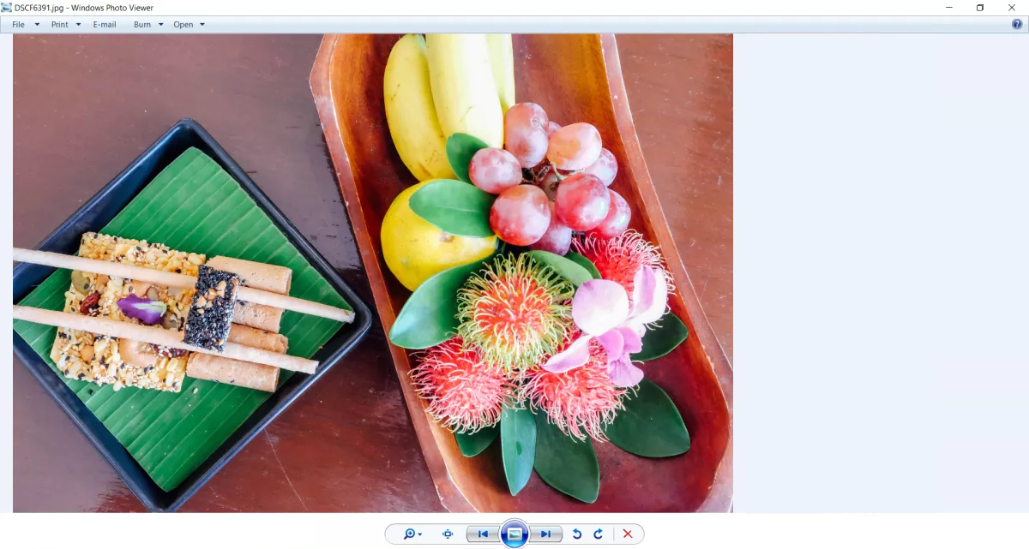
Image Viewer
Input : List of images in a flolder(PNG or JPG)
ATTIC Vision Analytics
Image Viewer
Modelling
Measurement
Report
Settings
IMG ID : 001
파일명 : 201_001.PNG
촬영일 : 2023. 04.01
촬영장소 : F2, LAB01
포맷 : PNG
크기 : 720 x 860
해상도 : 16M
카메라 : CAM003
관리자 : P00451

Slide 4
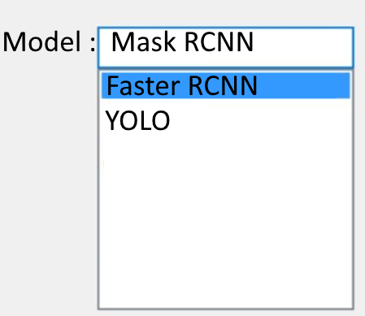
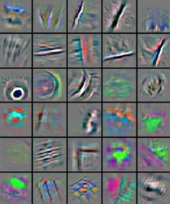


Modelling
Modelling Page는 아직 구현하지 마십시요
Model ; Mask RCNN, Faster RCNN, YOLO v5, YOLO v8(List Box)
Input : a Set of Matrix(numpy)
ATTIC Vision Analytics
Image Viewer
Modelling
Measurement
Report
Settings

Slide 5
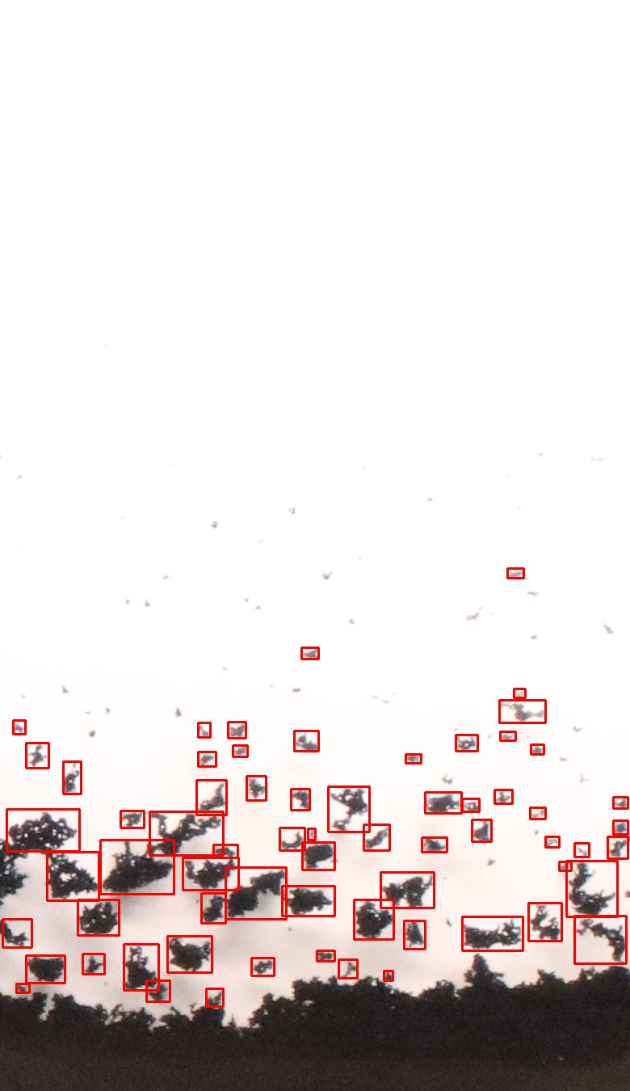
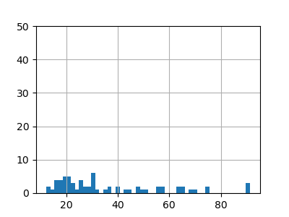

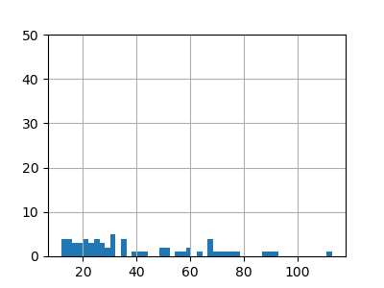
Floc Measurements
Output
List of Images(PNG or JPG) : GT이미지 원본
List of Images(PNG or JPG) : detection 결과
List of Images or 크기 분포 : floc 크기 분포
ATTIC Vision Analytics
Image Viewer
Modelling
Measurement
Report
Settings
GT
Predited

Slide 6
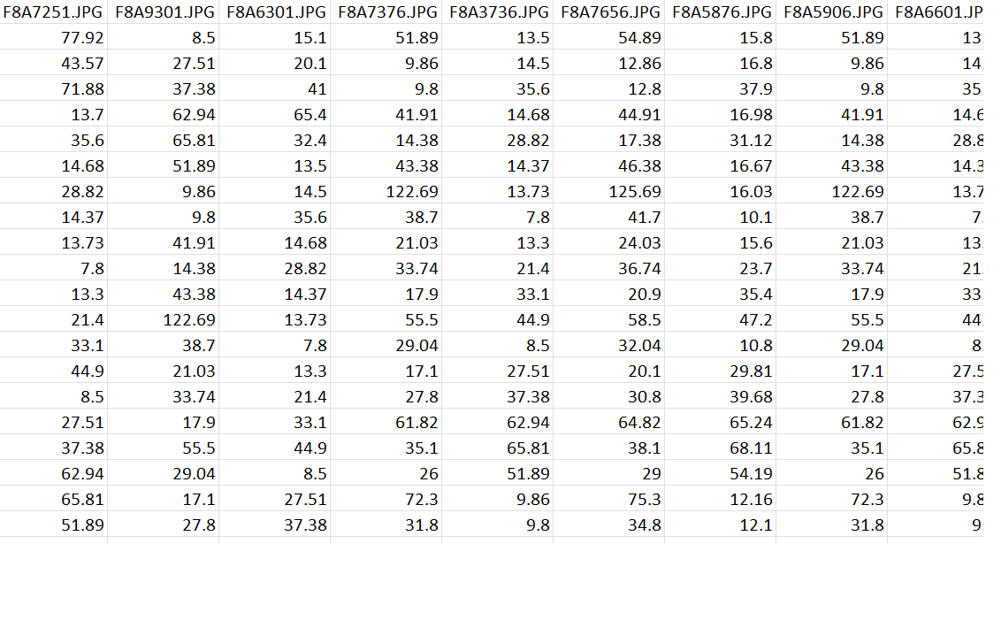
Floc Report
Input
Dataframe : Image File Names
ATTIC Vision Analytics
Image Viewer
Modelling
Measurement
Report
Settings
Download
File_name.csv

Slide 7
침강속도 분석
Input : List of Images(배치 폴더, ../input/[배치이름] )
ATTIC Vision Analytics
Image Viewer
Modelling
Measurement
Report
Settings
배치이름(폴더명)
IMG ID : 001
파일명 : 201_001.PNG
촬영일 : 2023. 04.01
촬영장소 : F2, LAB01
포맷 : PNG
크기 : 720 x 860
해상도 : 16M
카메라 : CAM003
관리자 : P00451
Attic Sentimentation Speed Analyzer

Slide 8

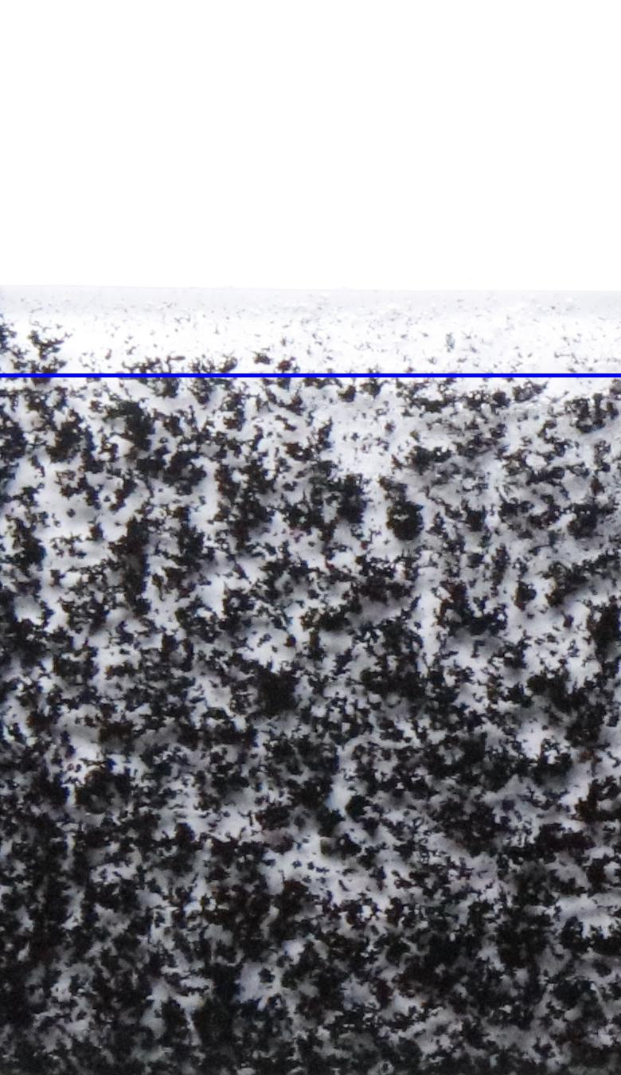
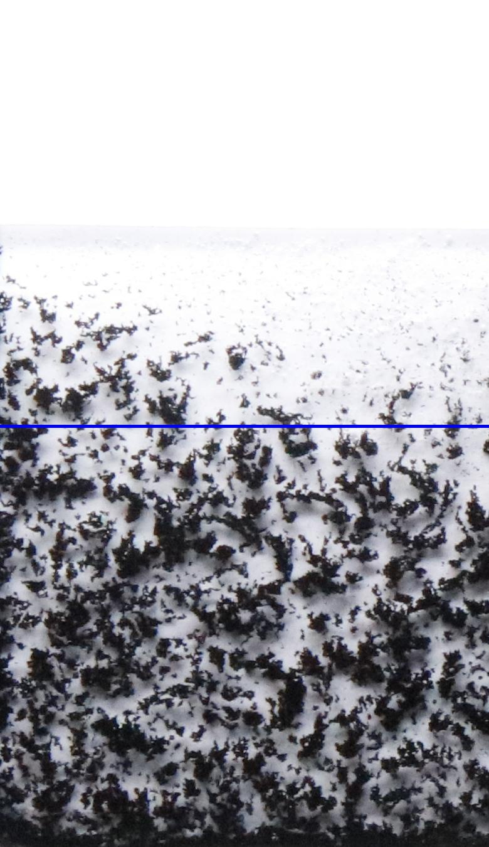
침강속도 분석 결과
Input : List of Images (../output/sentimentation/images/ [배치이름] )
ATTIC Vision Analytics
Image Viewer
Modelling
Measurement
Report
Settings
배치 ID
batch_0901_303
침강속도
24.8(Pixel/Secs)

Slide 9
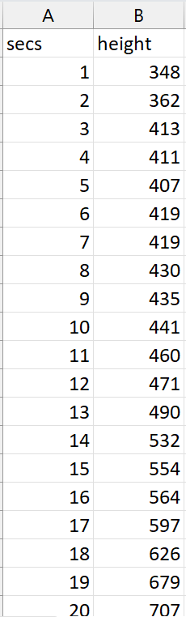
침강속도 분석 리포트
Input :
CSV 파일(../output/sentimentation/csv/[배치이름])
침강속도
ATTIC Vision Analytics
Image Viewer
Modelling
Measurement
Report
Settings
배치 ID
batch_0901_303
침강속도
24.8(Pixel/Secs)
Download
File_name.csv

