Slide 1



민관협력 오픈이노베이션
풀무원 분석 결과
2023-06-22
애틱 주식회사

Slide 2


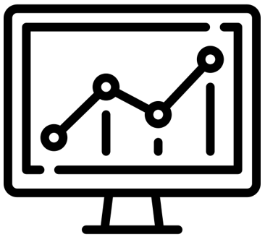
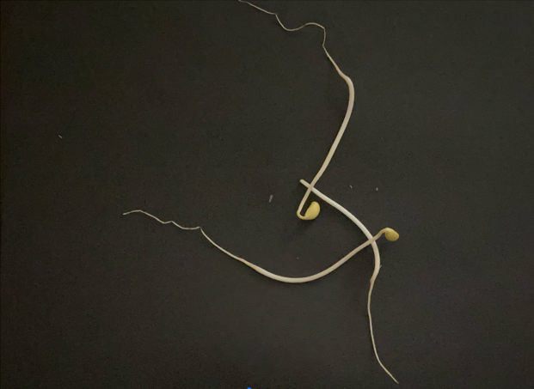


2 분석 프로젝트
나물 성상 자동 측정 Solution
Quantitative Analysis System of Images
Image Upload 201_001.png
Raw Image
Image Modeling
Report
Train Settings
Objectives Object Detection
Model YOLO 3.0
Start
Objects Detected 25 (ea.)
Accuracy 85 (%)
 Results
No. | Length | Height | Thickness | Weight | Weight(Act.) | MAPE
1
2
3
4
5
6
7
8
9
10
11
12
13
14
15
16
17
18
19
20
Detected Image
Notes:
If Your Data Is Bad, Your Machine Learning Tools Are Useless,
Harvard Business Review
https://hbr.org/2018/04/if-your-data-is-bad-your-machine-learning-tools-are-useless
IBM pitched its Watson supercomputer as a revolution in cancer care. It’s nowhere close.
STATNEWS, 2017. 9. 5
https://www.statnews.com/2017/09/05/watson-ibm-cancer/
Facial Recognition Is Accurate, if You’re a White Guy
https://www.nytimes.com/2018/02/09/technology/facial-recognition-race-artificial-intelligence.html
백인 남자의 성별 인식 정확도 99%
백인 여자의 성별 인식 정확도 93%
유색 남자의 성별 인식 정확도 88%
유색 여자의 성별 인식 정확도 65%

