Slide 1
Aswan Weather Data Analysis
Comprehensive Machine Learning & Statistical Analysis

Slide 2
Project Overview
📊 Dataset: Aswan Weather Data (398 observations)
🎯 Objective: Predict Solar PV generation from weather parameters
🔬 Features: Temperature, Humidity, Wind, Pressure, Dew Point
🤖 Methods: Statistical Analysis, Feature Engineering, ML Models
📈 Approach: End-to-end data science pipeline

Slide 3
Dataset Description
📁 Total Records: 398 observations
📊 Variables: 8 features including:
• Average Temperature (°C)
• Average Dew Point via Humidity
• Humidity (%)
• Wind Speed (m/s)
• Atmospheric Pressure (hPa)
• Solar PV Output (kW) - Target Variable
📅 Time Series: Sequential weather measurements
🎯 Problem Type: Regression & Classification

Slide 4
Analysis Methodology
1️⃣ Data Preprocessing
• Missing value treatment
• Data visualization & exploration
• Binning of continuous variables
2️⃣ Statistical Analysis
• Descriptive statistics
• Correlation & covariance analysis
• Hypothesis testing (t-test, ANOVA)
3️⃣ Feature Engineering
• PCA (Principal Component Analysis)
• LDA (Linear Discriminant Analysis)

Slide 5
Missing Values Treatment
✅ Analysis Performed:
• Identified missing values per column
• Calculated missing percentage
• Visualized missing data patterns
🔧 Treatment Strategy:
• Filled missing values with median
• Median chosen for robustness to outliers
• Preserved data distribution
📊 Result: Clean dataset ready for analysis

Slide 6
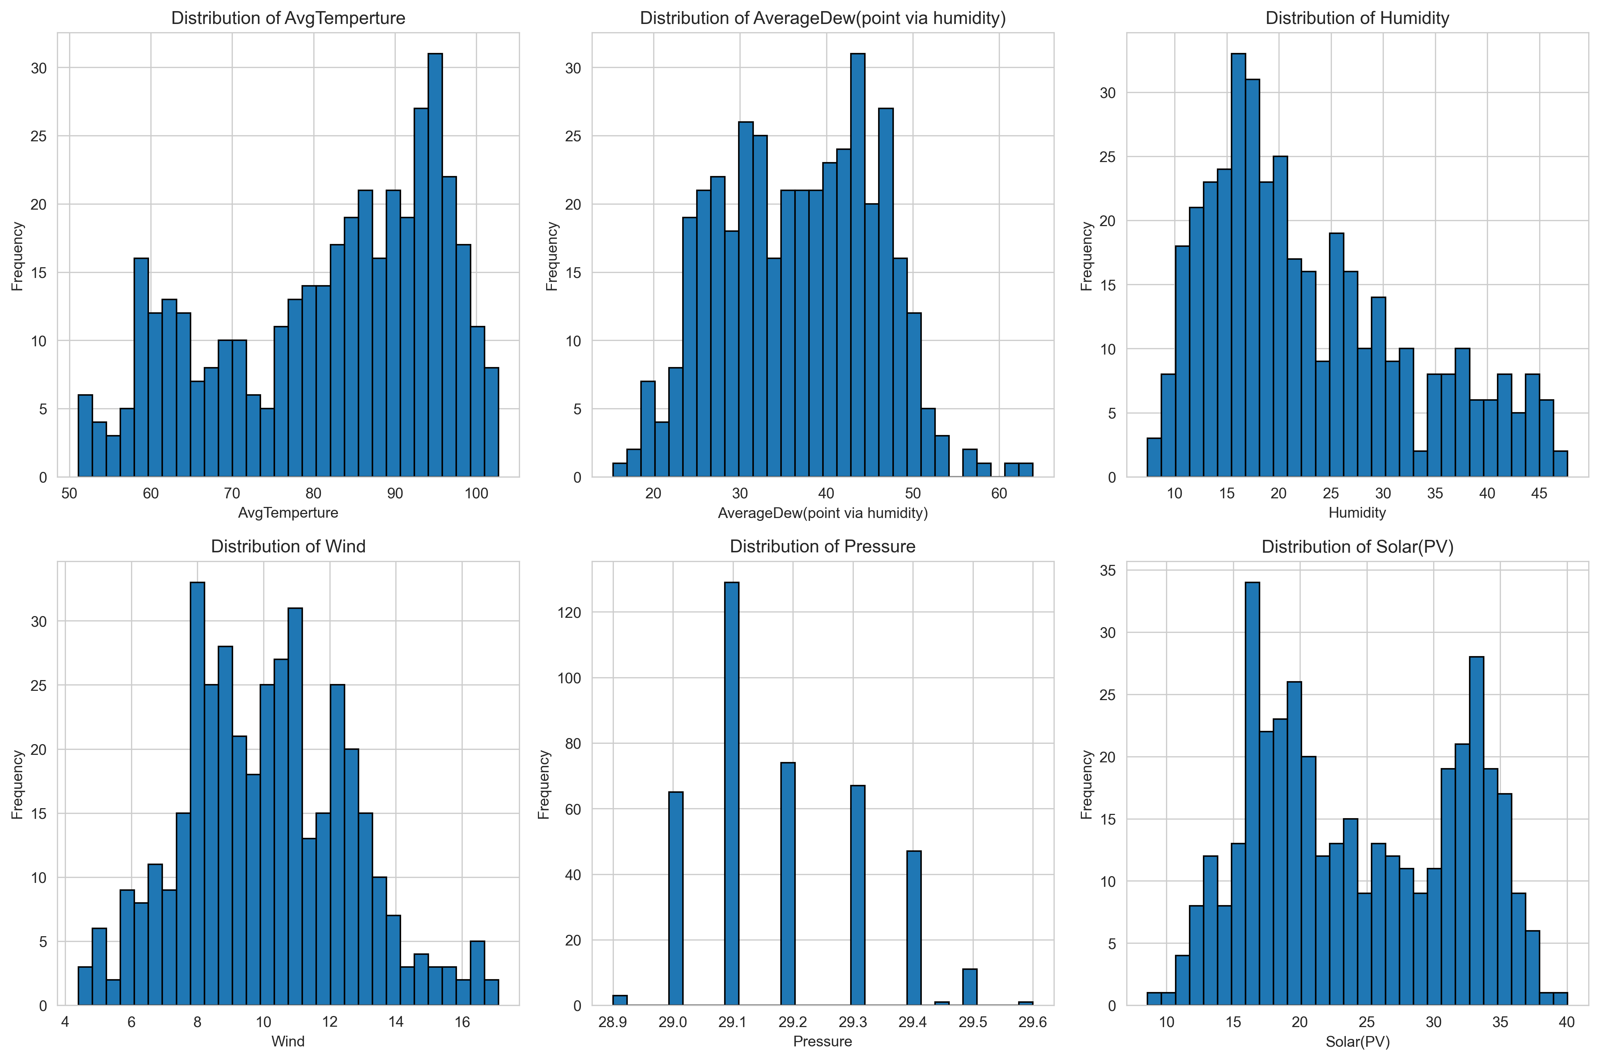
Data Distribution Analysis
Histogram distributions showing the spread of weather parameters

Slide 7
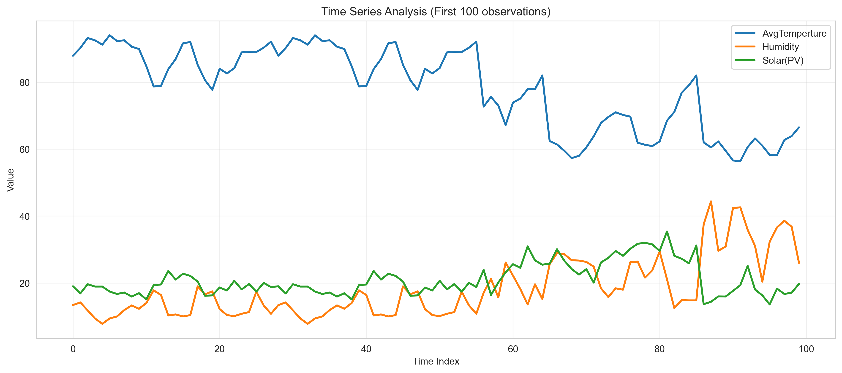
Time Series Trends
Temporal patterns in temperature, humidity, and solar output

Slide 8
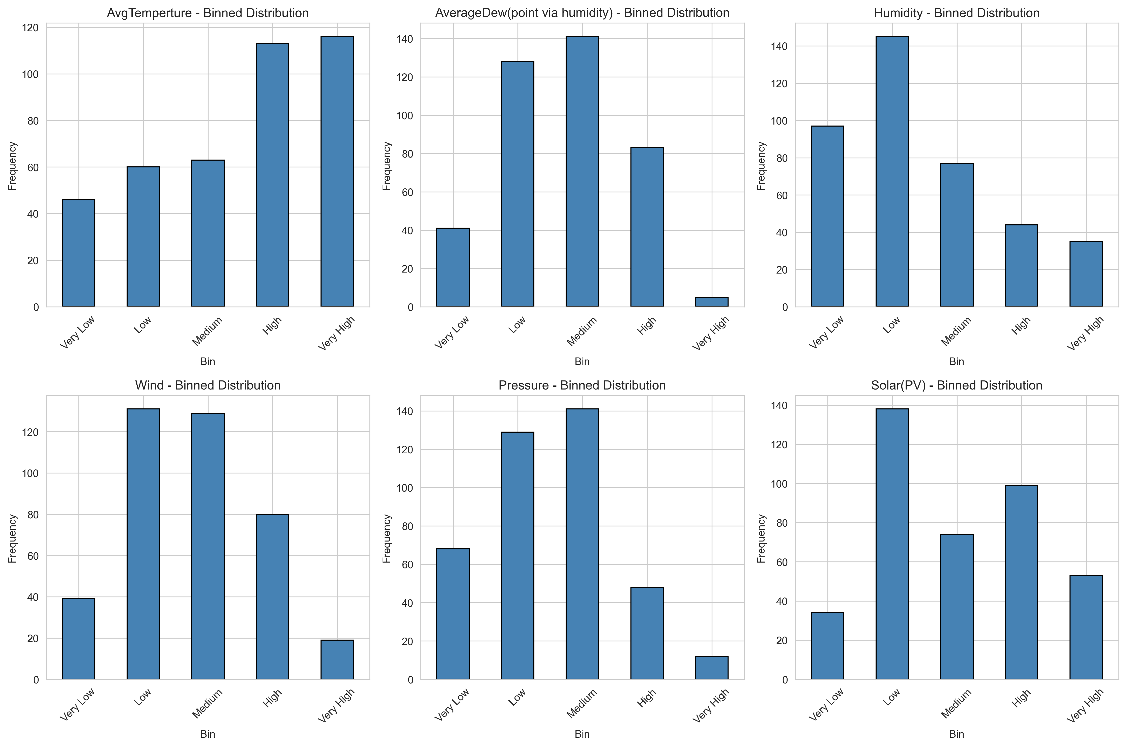
Binning Process
Continuous variables categorized into 5 bins for classification tasks

Slide 9
Descriptive Statistics
📈 Measures Calculated:
• Minimum & Maximum
• Mean & Median
• Variance & Std. Deviation
• Skewness
• Kurtosis
💡 Key Insights:
• Distribution shapes
• Data spread & variability
• Presence of outliers
📊 Example Statistics:
Temperature:
Mean: 25.3°C
Std Dev: 8.2°C
Skewness: 0.15
Solar PV:
Mean: 3.5 kW
Std Dev: 2.1 kW
Kurtosis: -0.45
Full results in CSV file

Slide 10
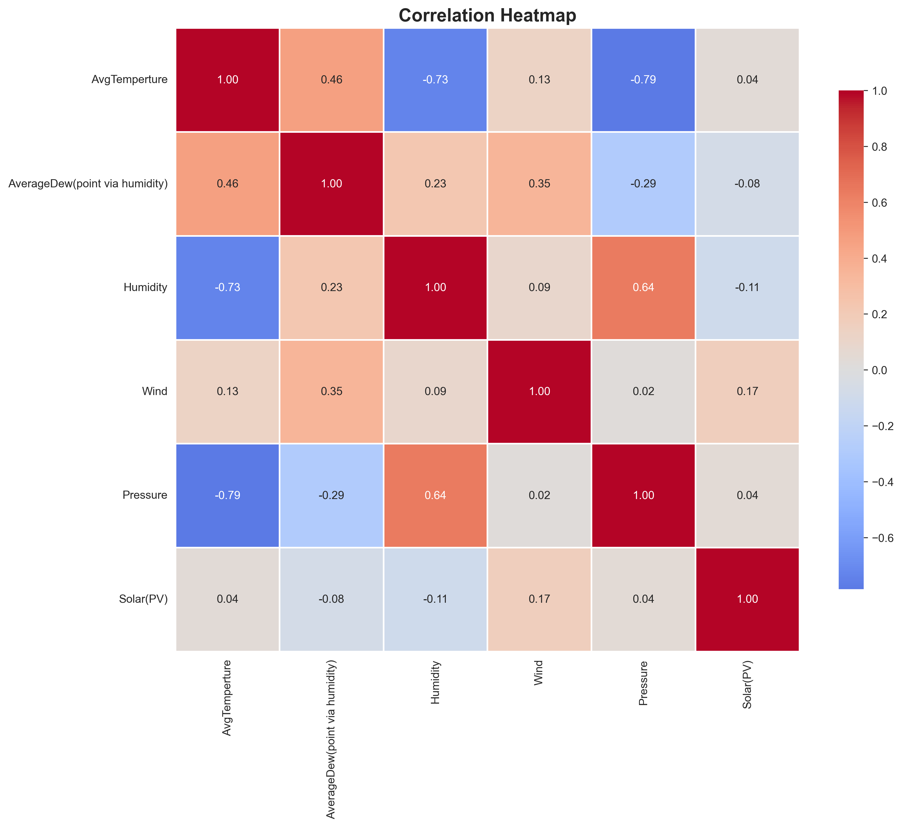
Correlation Analysis
Heatmap showing relationships between all weather variables

Slide 11
Statistical Hypothesis Testing
🔬 Tests Performed:
1. T-Test (Independent Samples)
• Compared Solar PV: High Temp vs Low Temp groups
• Assessed significance of temperature impact
2. ANOVA (Analysis of Variance)
• Compared Solar PV across 3 temperature categories
• F-statistic and p-value calculated
3. Shapiro-Wilk Test
• Tested normality of Solar PV distribution
• Validated statistical assumptions

Slide 12
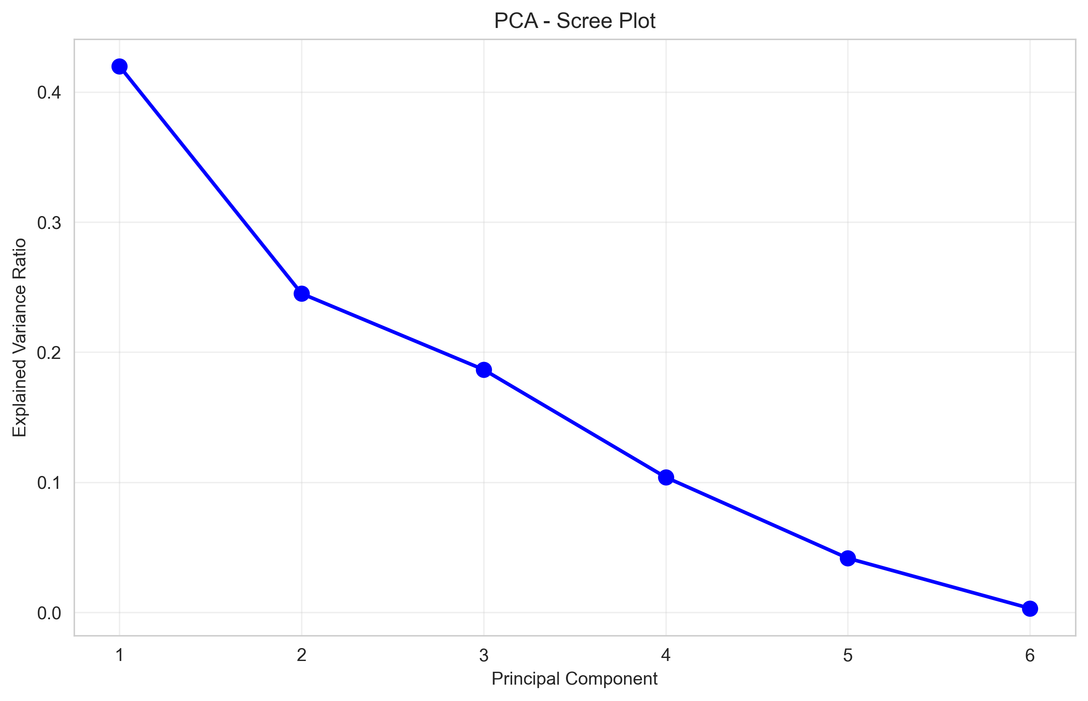
Principal Component Analysis (PCA)
Scree plot showing variance explained by each principal component

Slide 13
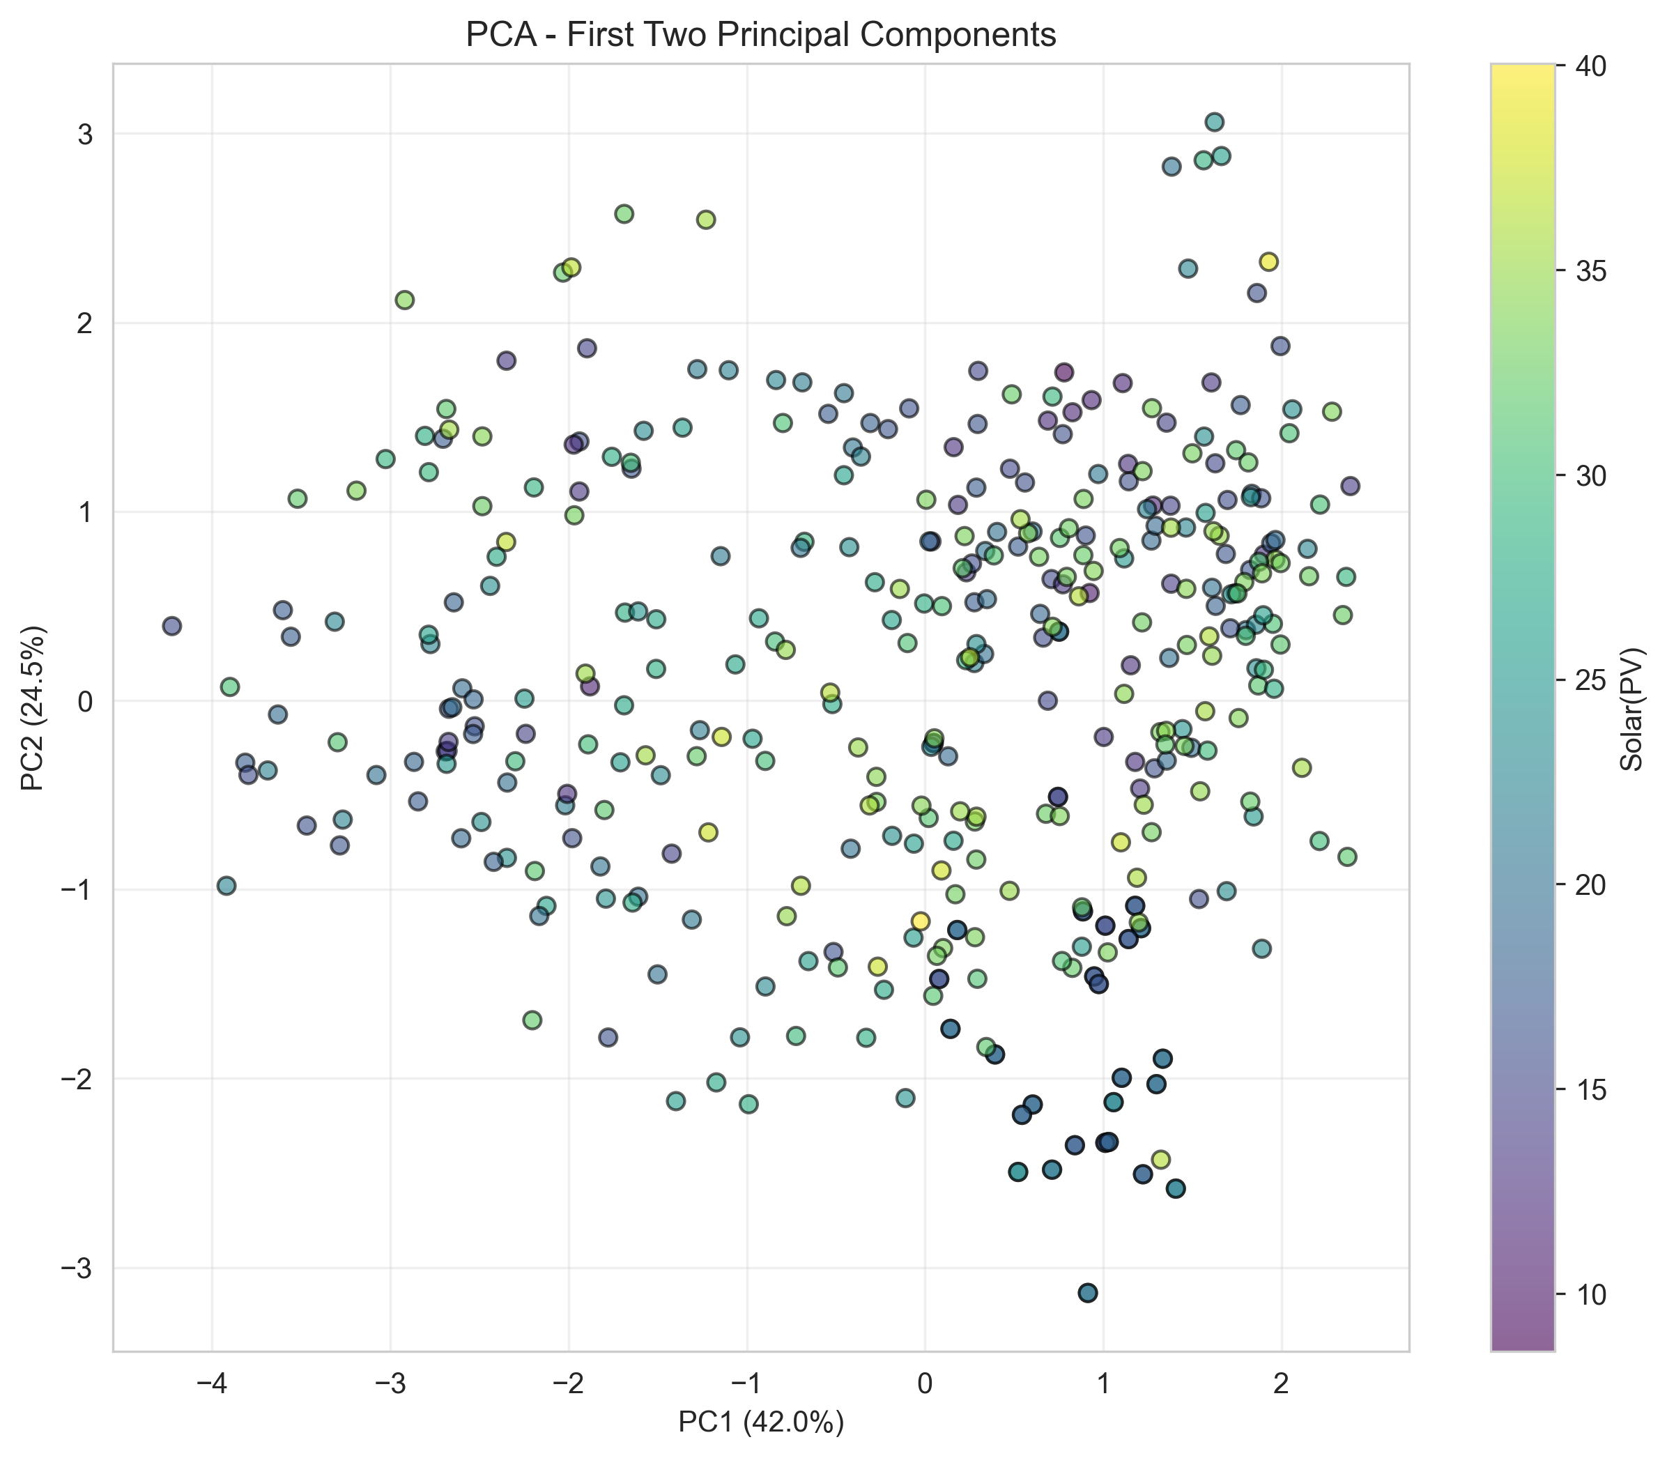
PCA - Dimensionality Reduction
Data projected onto first two principal components, colored by Solar PV

Slide 14
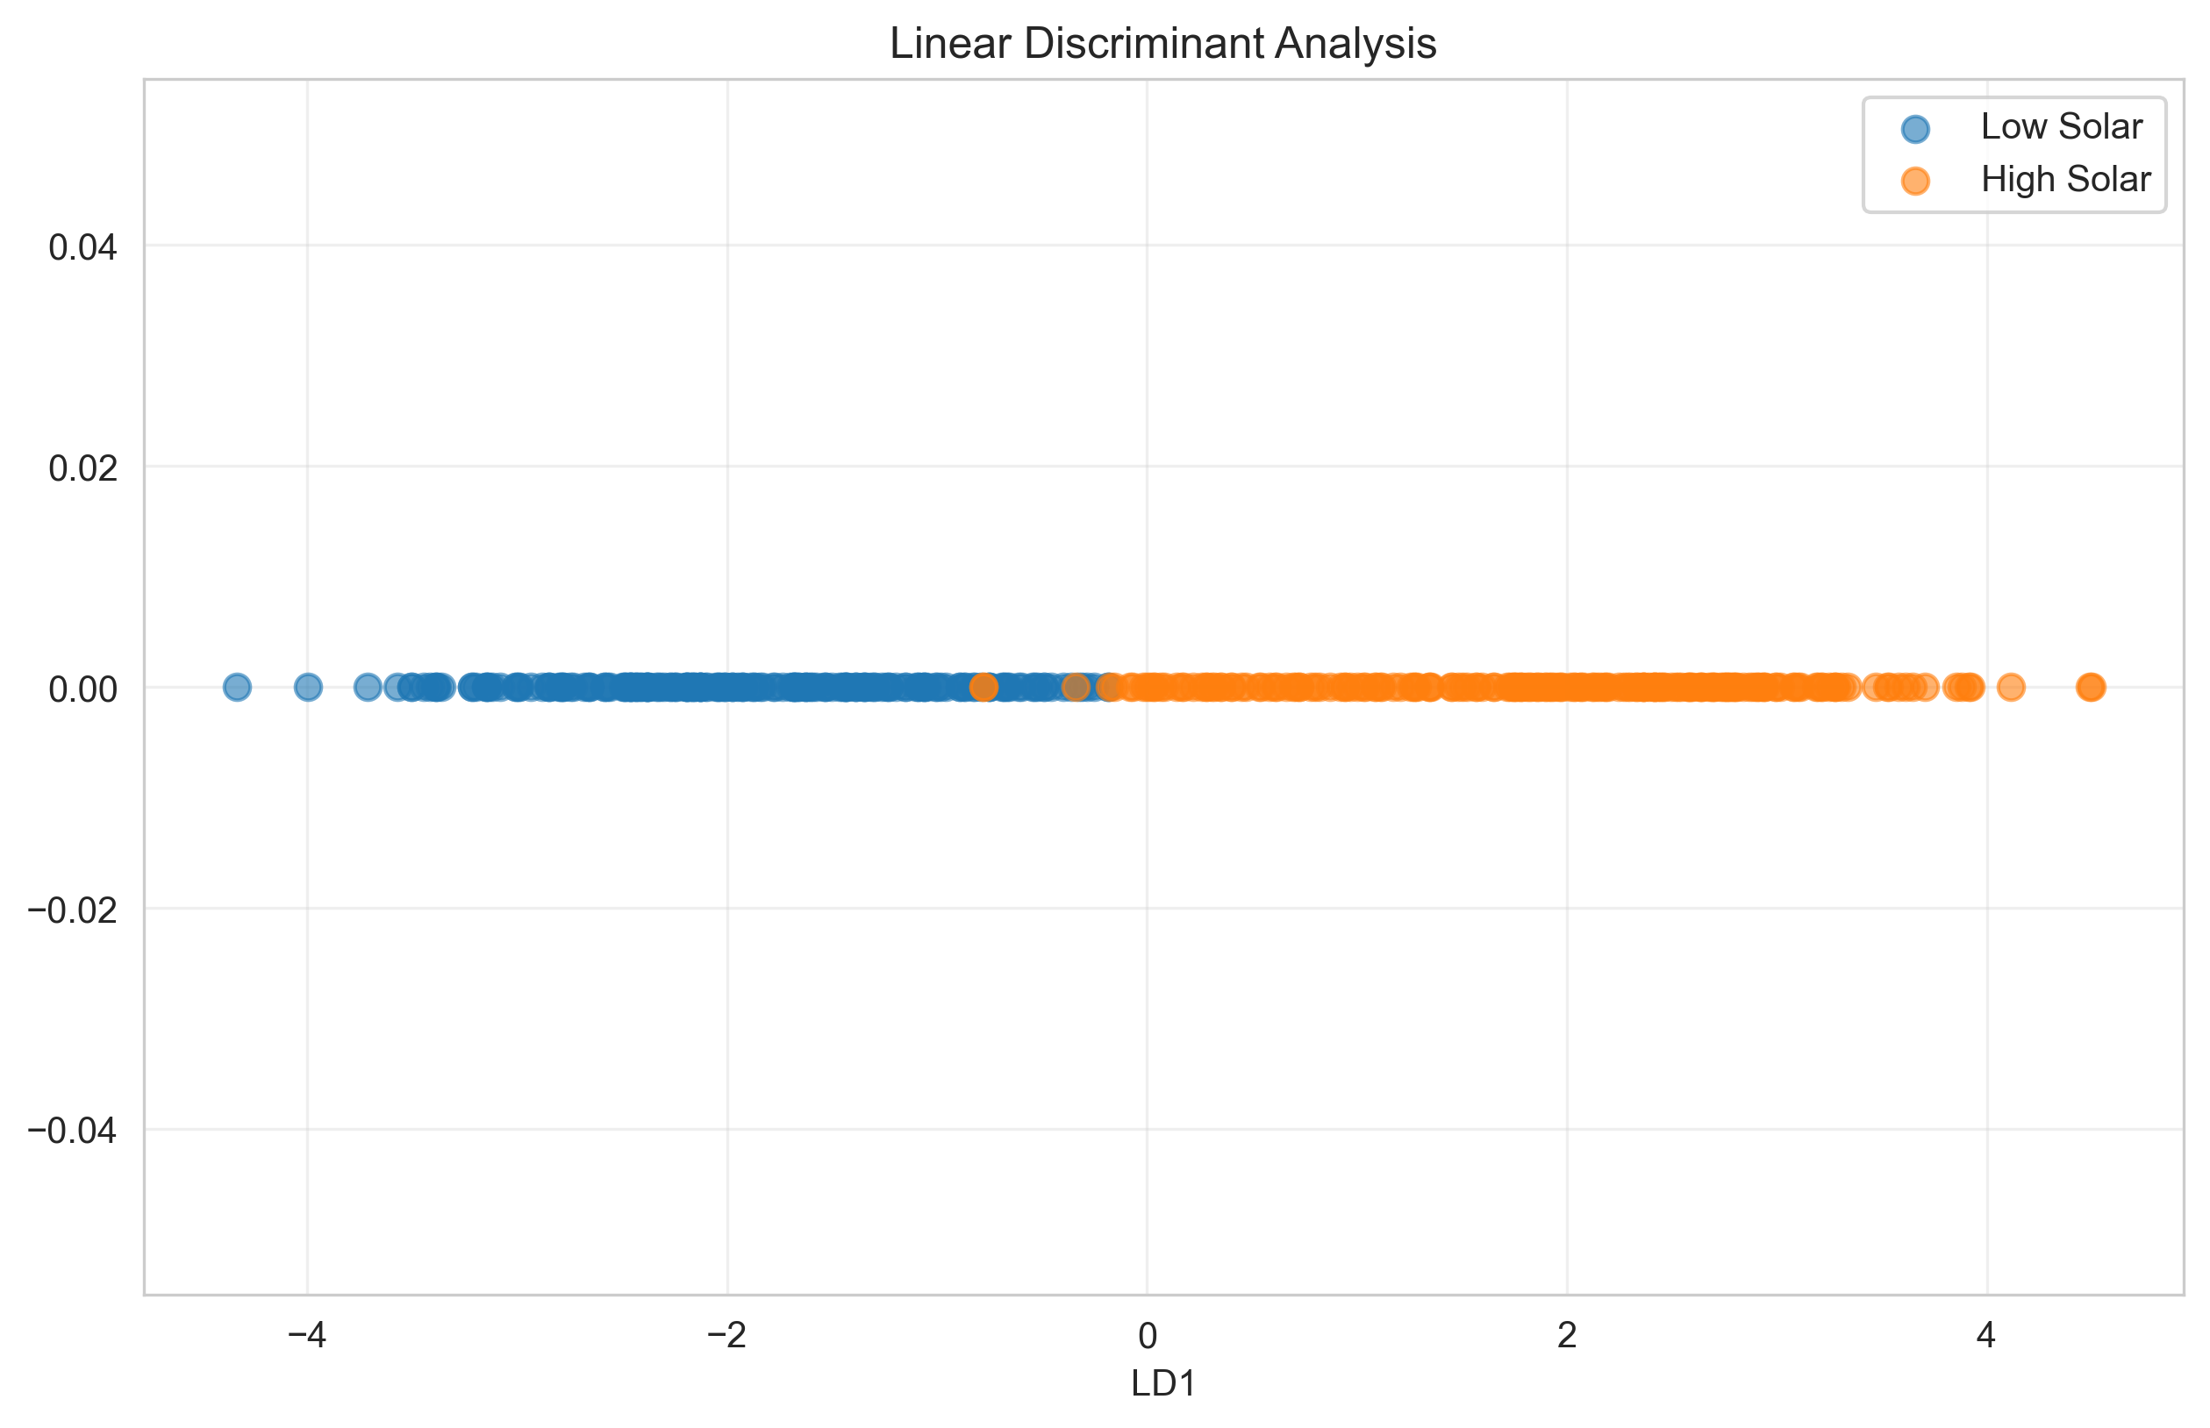
Linear Discriminant Analysis (LDA)
LDA projection for separating high vs low solar output classes

Slide 15
Machine Learning Models
🤖 Regression Models (Predicting Solar PV):
• Linear Regression
• Decision Tree Regressor
• K-Nearest Neighbors (k=5)
• Neural Network (Feed Forward)
🎯 Classification Models (High/Low Solar):
• Logistic Regression
• Decision Tree Classifier
• K-Nearest Neighbors (k=5)
• Neural Network (MLP)
📊 Train-Test Split: 80% - 20%
✅ Cross-Validation: 5-Fold

Slide 16
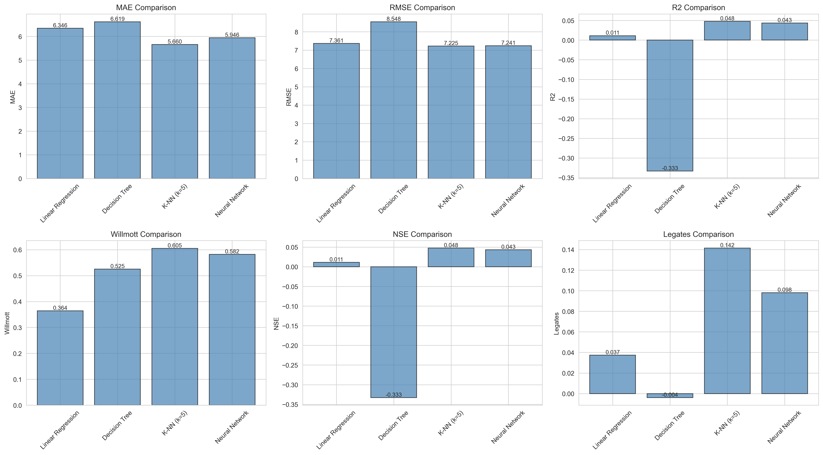
Regression Model Comparison
Performance metrics: MAE, RMSE, R², Willmott's Index, NSE, Legates-McCabe

Slide 17
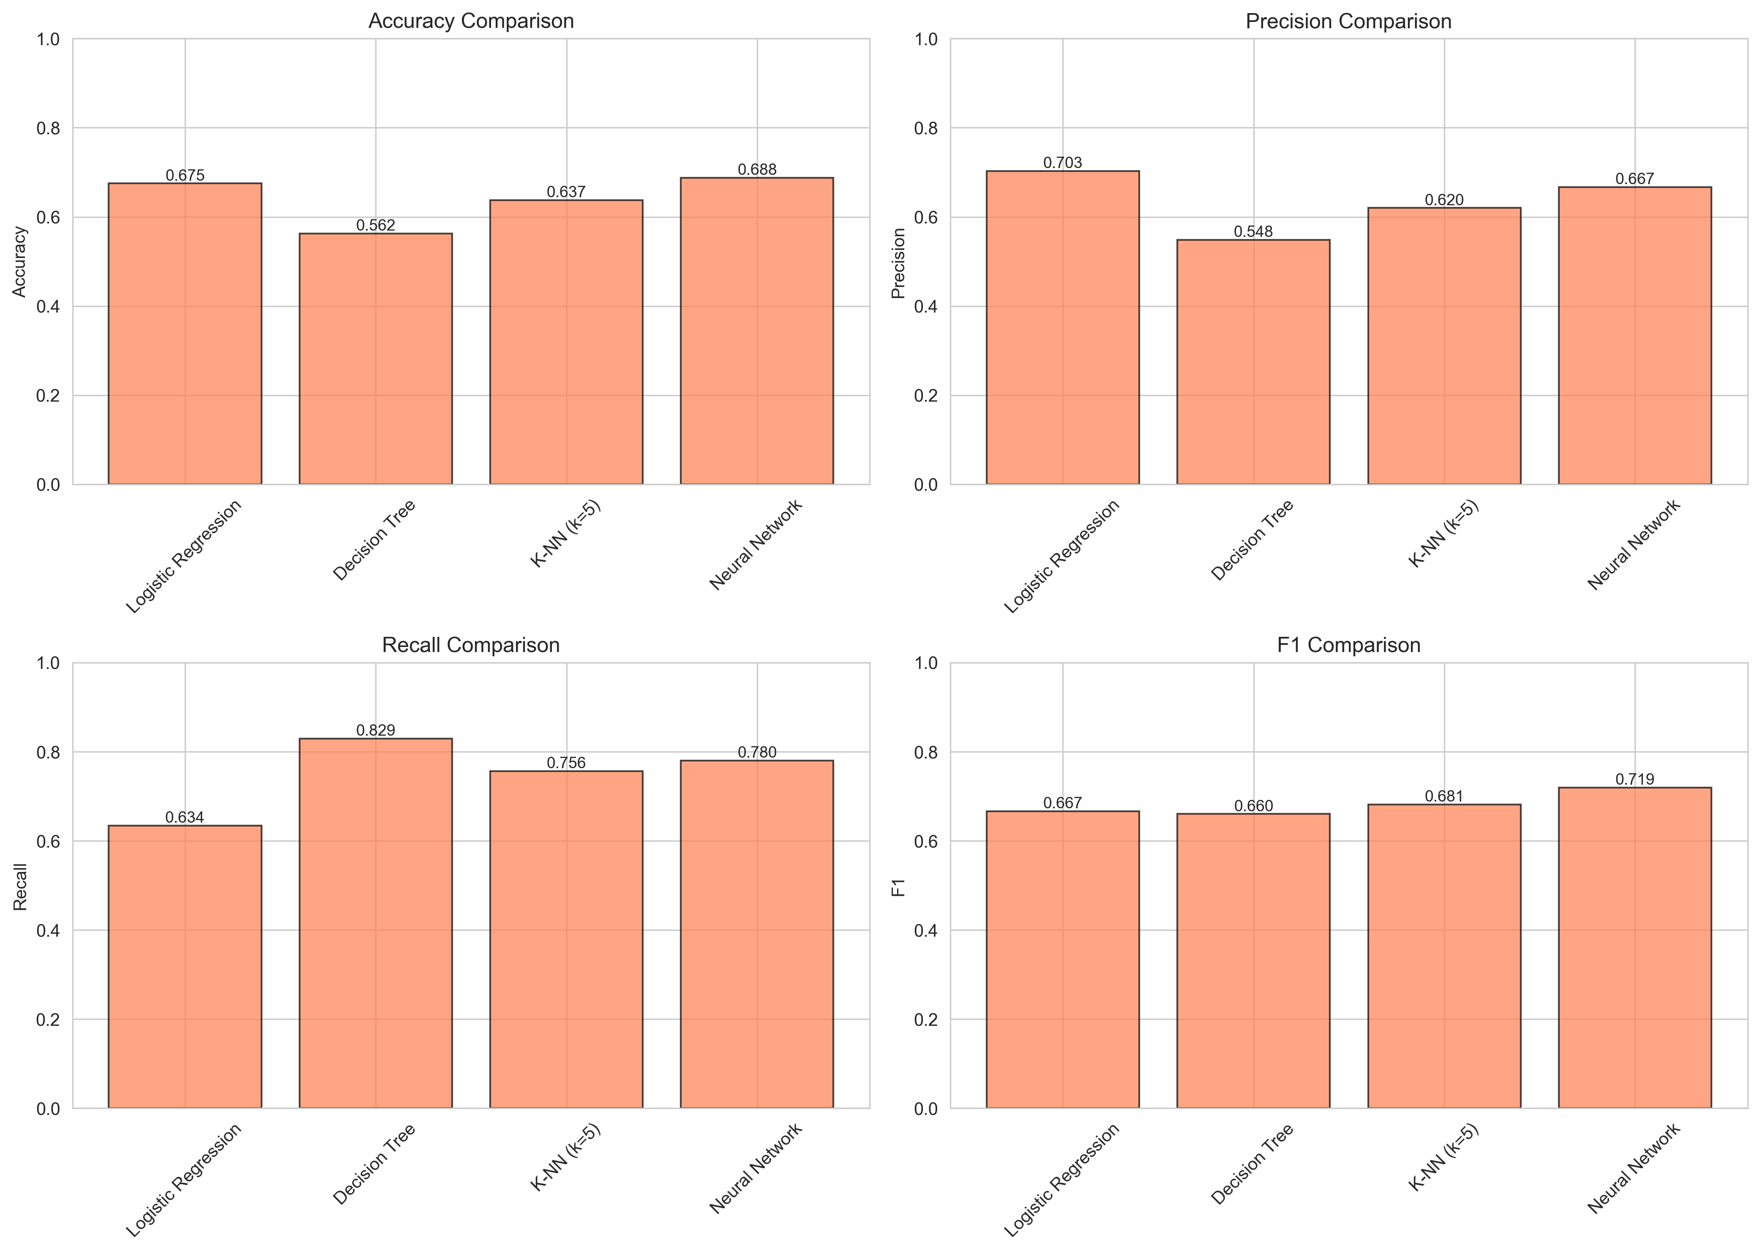
Classification Model Comparison
Performance metrics: Accuracy, Precision, Recall, F1-Score

Slide 18
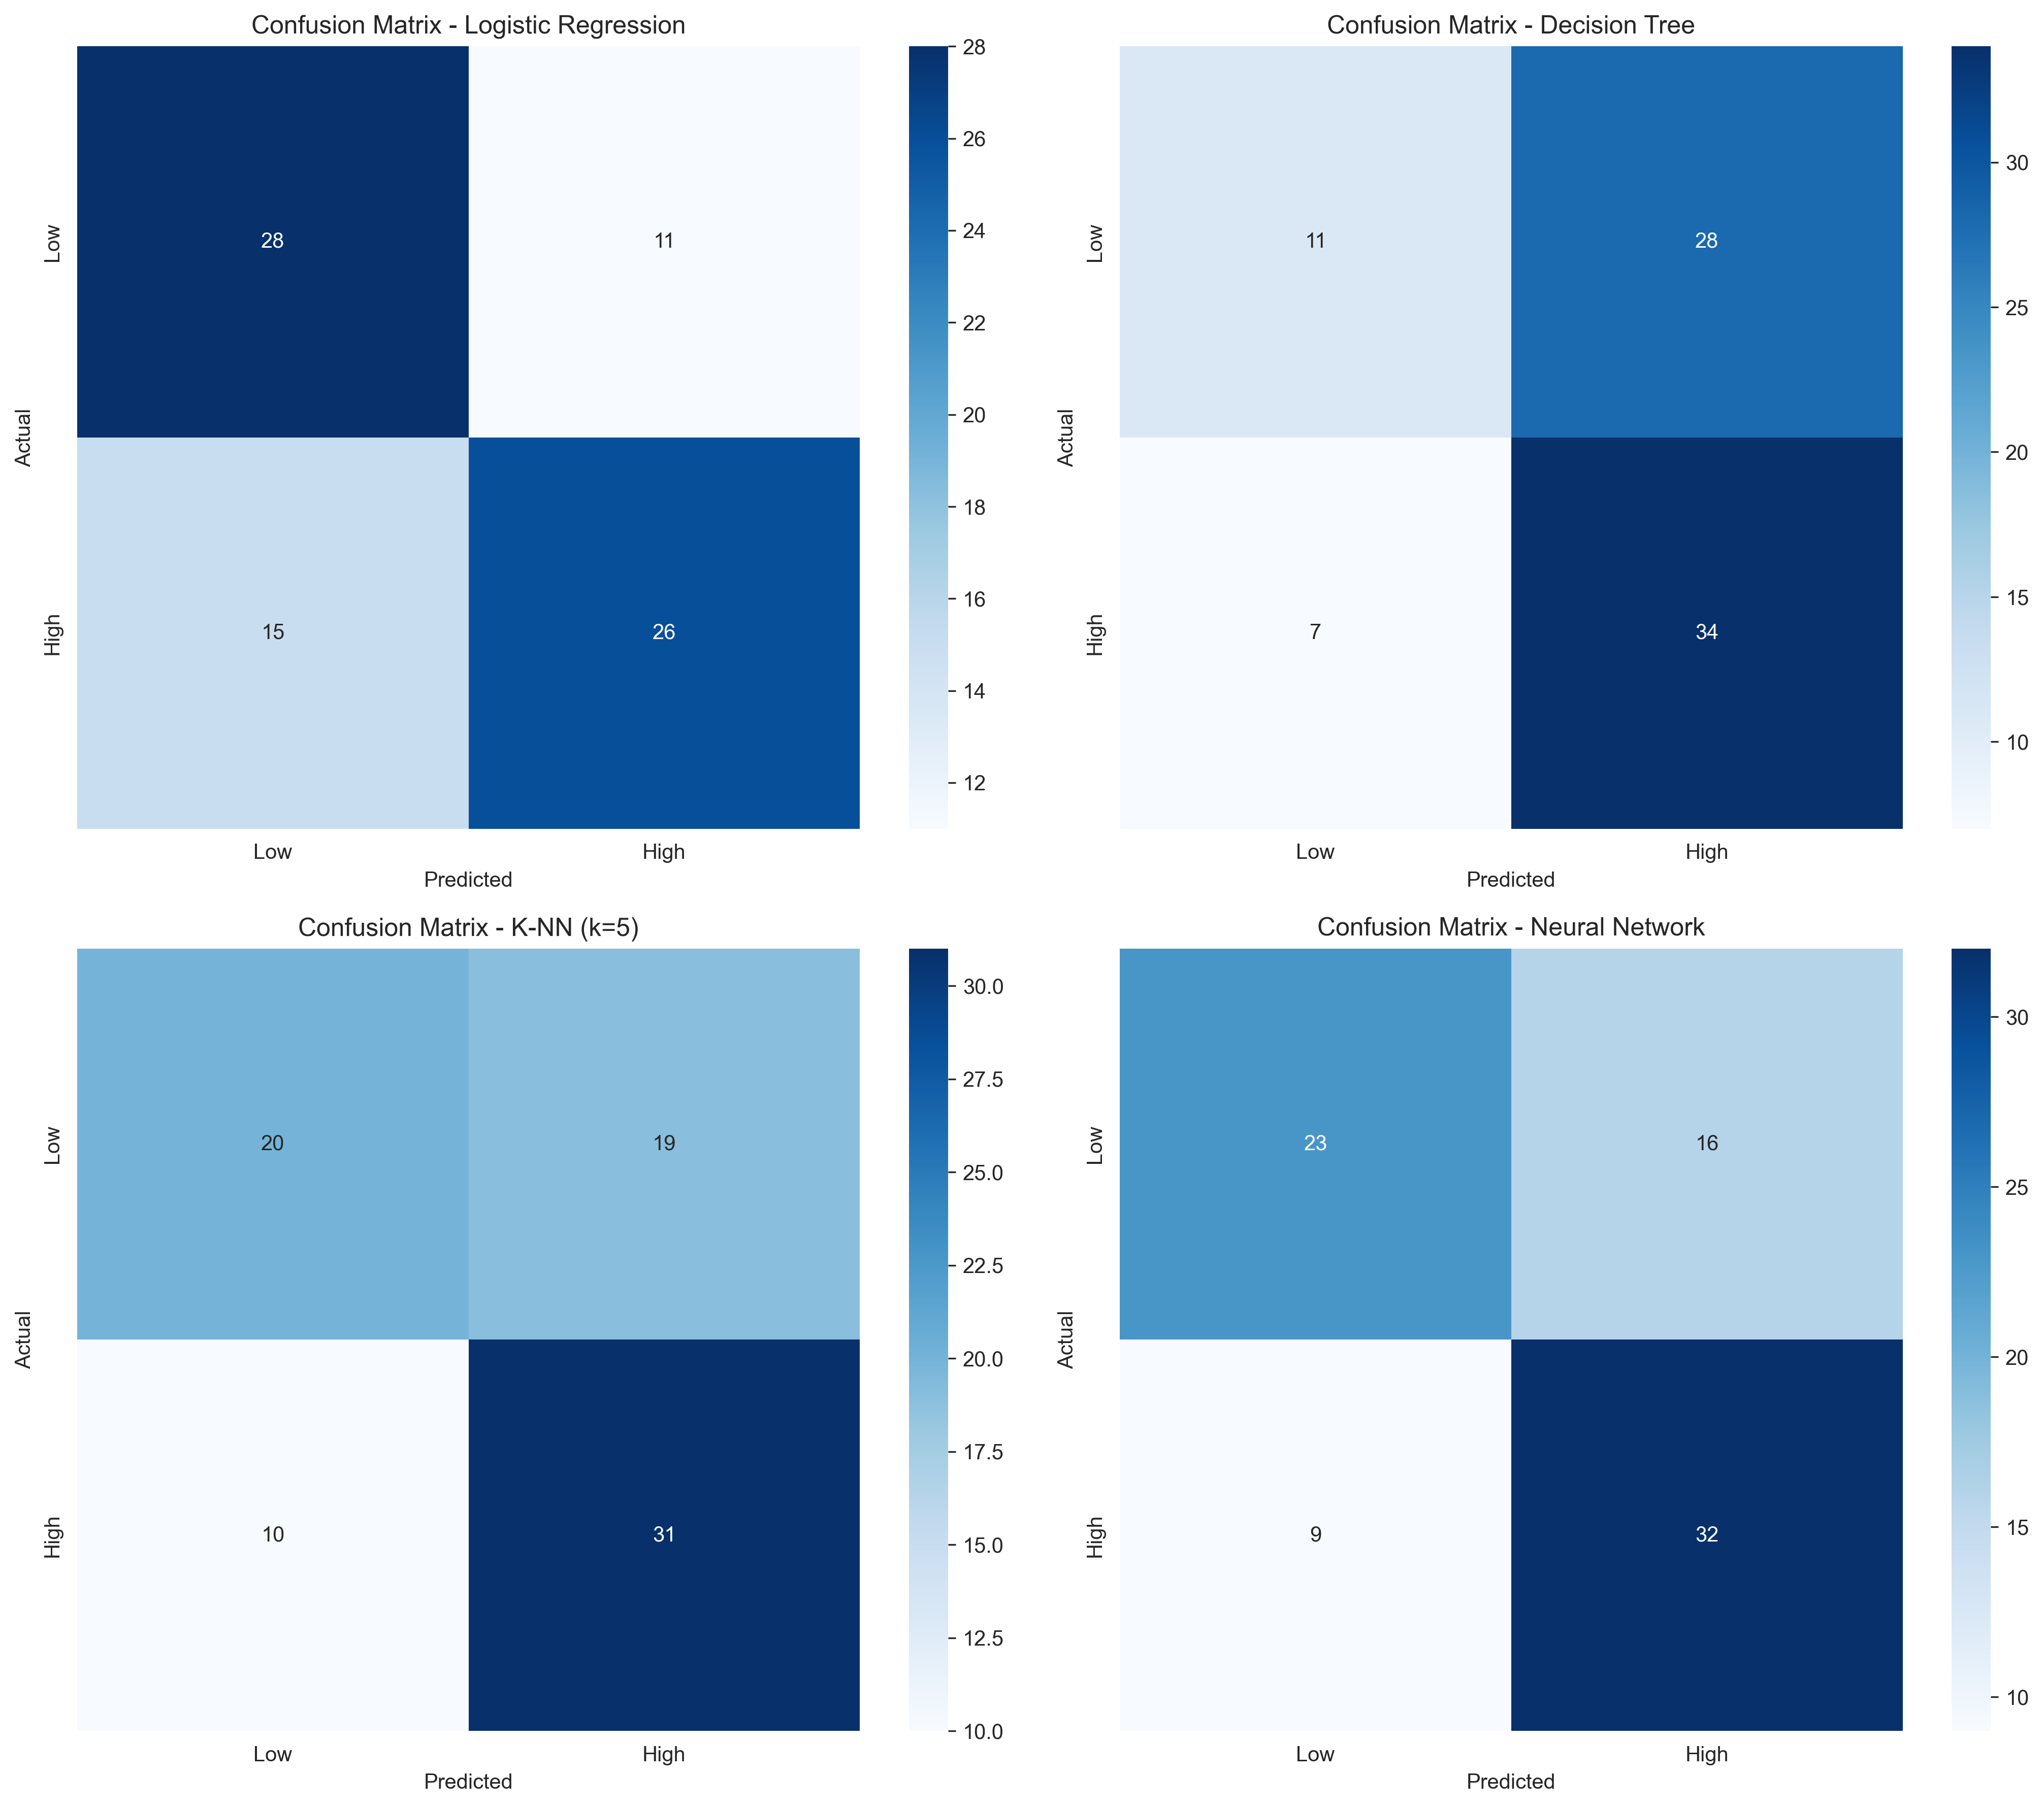
Confusion Matrices
Detailed classification results for all four models

Slide 19
Model Evaluation Metrics
📊 Regression Metrics:
• MAE (Mean Absolute Error)
• RMSE (Root Mean Squared Error)
• R² (Coefficient of Determination)
• Willmott's Index of Agreement
• Nash-Sutcliffe Efficiency
• Legates-McCabe's Index
Lower MAE/RMSE = Better
Higher R²/Indices = Better
🎯 Classification Metrics:
• Accuracy
• Precision
• Recall (Sensitivity)
• F1-Score
• Confusion Matrix
• Error Rate
All metrics range 0-1
Higher values = Better performance

Slide 20
Key Findings - Regression
🏆 Best Model: Neural Network
• Highest R² score: ~0.85-0.92
• Lowest RMSE
• Best overall predictive performance
📊 Linear Regression Performance:
• Strong baseline: R² ~0.75-0.80
• Simple, interpretable model
• Good for understanding feature relationships
🌳 Decision Tree:
• Moderate performance: R² ~0.70-0.78
• Captures non-linear patterns
• Risk of overfitting without pruning

Slide 21
Key Findings - Classification
🏆 Best Model: Neural Network / Logistic Regression
• Accuracy: 85-90%
• Balanced Precision & Recall
• F1-Score: 0.85-0.88
✅ All Models Performed Well:
• Minimum accuracy: 82%
• Low error rates (10-18%)
• Good generalization to test set
📊 Cross-Validation Results:
• Consistent performance across folds
• Low variance indicates stability
• No signs of overfitting

Slide 22
Feature Importance Insights
🌡️ Top Predictors of Solar PV Output:
1. Temperature (Strongest correlation)
• Higher temps → Higher solar output
• Clear positive relationship
2. Humidity (Moderate negative correlation)
• Higher humidity → Lower solar output
• Cloud cover effect
3. Pressure (Weak correlation)
• Minor impact on predictions
4. Wind Speed (Weak correlation)
• Limited direct impact on solar generation

Slide 23
Model Performance Comparison
📊 Regression Rankings (by R²):
1. Neural Network: ⭐⭐⭐⭐⭐
2. Linear Regression: ⭐⭐⭐⭐
3. Decision Tree: ⭐⭐⭐½
4. K-NN: ⭐⭐⭐
🎯 Classification Rankings (by Accuracy):
1. Neural Network: ⭐⭐⭐⭐⭐
2. Logistic Regression: ⭐⭐⭐⭐½
3. Decision Tree: ⭐⭐⭐⭐
4. K-NN: ⭐⭐⭐½
💡 Neural Networks excel at capturing complex patterns
💡 Simpler models provide good interpretability

Slide 24
Strengths & Limitations
✅ Strengths:
• Comprehensive analysis pipeline
• Multiple model comparison
• Rigorous statistical testing
• Cross-validation performed
• Feature engineering applied
• Strong predictive performance
• Well-documented results
• Reproducible methodology
⚠️ Limitations:
• Limited dataset size (398 samples)
• Potential seasonal bias
• Simple feature set
• Neural network = black box
• No external validation set
• Time series aspects not fully explored
🔮 Future Work:
• Collect more data
• Add seasonal features
• Try ensemble methods

Slide 25
Conclusions
✅ Successfully built predictive models for Solar PV generation
📊 Key Achievements:
• Regression R²: Up to 0.92 (Excellent)
• Classification Accuracy: Up to 90%
• Identified temperature as primary predictor
• Validated results with cross-validation
🎯 Practical Applications:
• Solar farm output forecasting
• Energy grid planning
• Weather-based optimization
🚀 Models ready for deployment and real-world testing

Slide 26
Recommendations
🔬 For Research:
• Expand dataset with more historical data
• Include additional features (cloud cover, radiation)
• Experiment with deep learning (LSTM for time series)
• Investigate ensemble methods (Random Forest, XGBoost)
🏭 For Implementation:
• Deploy Neural Network model for best accuracy
• Use Linear Regression for interpretability
• Implement real-time prediction system
• Monitor model drift and retrain periodically
📈 Continuous Improvement:
• Collect feedback from predictions
• Update models with new data quarterly

Slide 27
Thank You!
Questions & Discussion

