Slide 1
Run down of our 3 months

Slide 2
Overview
Where we started
Added documentation
Upgraded configs
Added new dataset
Updated file names
Created Meta Feature scripts
What we learnt

Slide 3
Overview of end of honours project
Codon pairs and single codon, what was the goal. What state was it in. structural overview.
Reads on transcript code, working but very specific to my working environment.

Slide 4
Upgraded configs for riboviz 2.1 release
Updated configuration yamls in example-datasets by running riboviz.tools.upgrade_config_file

Slide 5
Added documentation
Add-new-dataset.md in riboviz/example-datasets
Documentation of steps involved in adding new species and new datasets to the riboviz/example-datasets repository
A template with checklist for adding a new dataset
Checklist template you can select when creating an issue ticket for the addition of a new species and/or a new dataset

Slide 6
Added new dataset
Why Histoplasma capsulatum: fungal pathogen, commonly observed in immunocompromised patients
Followed documentation in Add-new-dataset.md to test its usability
Added the new species H. capsulatum to example-datasets
Assembled and tested annotation and contamination files for the species
Added a new dataset for H. capsulatum from Anita Sil’s lab
Why creating annotations is difficult
It is running

Slide 7
Outputs of new dataset, things to look out for in the future
Potentially due to poor annotation, a noncoding sequence is slipping into the final results. Overall there is good periodicity, so potential to analyse in the future

Slide 8
Updated file names
To meet reviewers feedback, some of the confusing names had to be addressed. Pretty tedious work, as numerous files but I got my way through it.

Slide 9
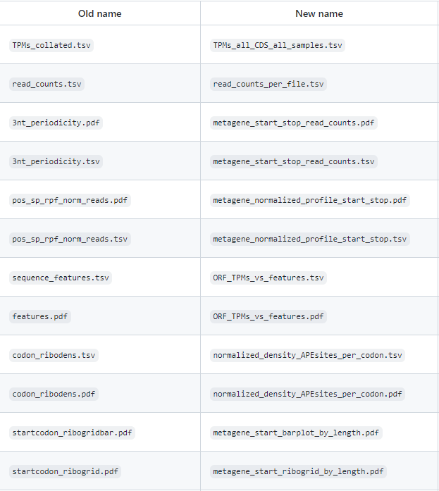
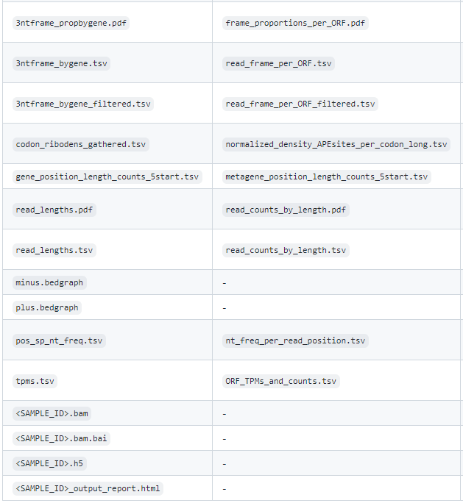

Slide 10
Article writing
Open science as an undergraduate.
look over and evaluate our time with the lab, gain a publication
Practice writing

Slide 11
Created Meta Feature scripts
The goal of Sophie’s undergrad project was to investigate inhibitory codon pairs. This would be done by
There are currently 3 scripts, which are running but need some refactoring:
A script for codon pairs
A script for single codons
A script that works by nucleotide position

Slide 12
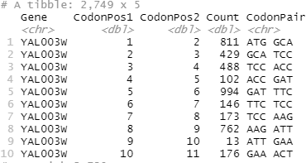
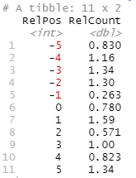
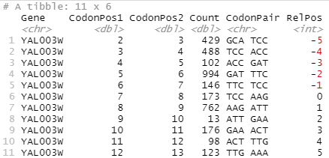
Codon pairs – How does it work
Generate a table of Genes, positions, counts and codon pairs
H5
GFF3
Codon positions table
A site displacement
Slice a window of positions around the codon of interest
Codon Pair
Expand width
Calculate the Relative count for all occurrences of the codon of interest

Slide 13
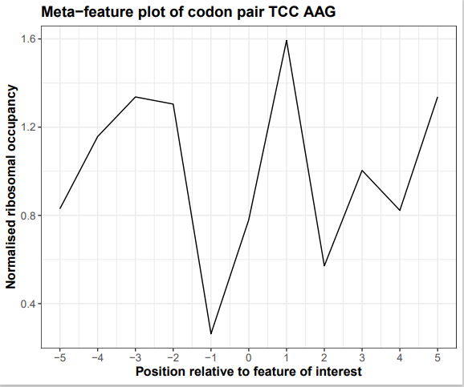
Testing with YAL5 simulated dataset

Slide 14
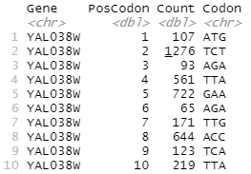
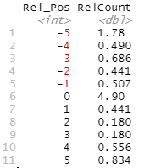
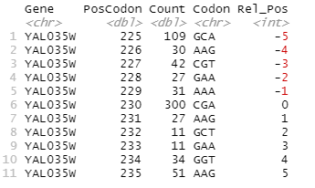
Single codons – how does it work, outputs
Generate a table of Genes, positions, counts and codon pairs
H5
GFF3
Codon positions table
A site displacement
Slice a window of positions around the codon of interest
Codon Pair
Expand width
Calculate the Relative count for all occurrences of the codon of interest

Slide 15
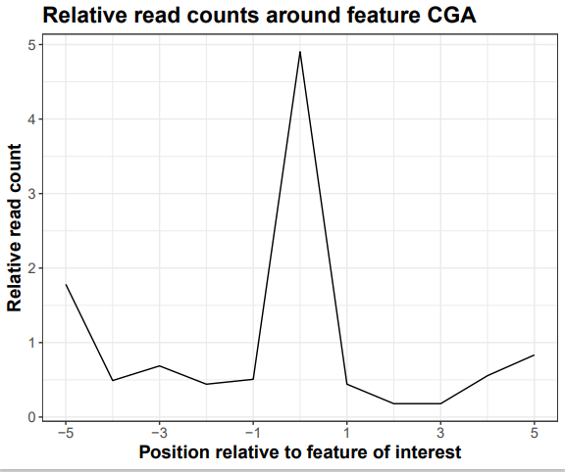
Testing with YAL5 simulated dataset

Slide 16
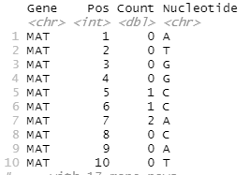

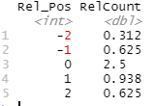
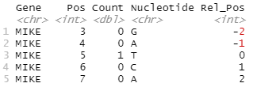
Nucleotides – why, how does it work
Generate a table of Genes, positions, counts and codon pairs
H5
GFF3
FASTA file
A site displacement
Slice a window of positions around the given positions of interest
List of Gene and Positions
Expand width
Calculate the average Relative count for all positions of interest

Slide 17
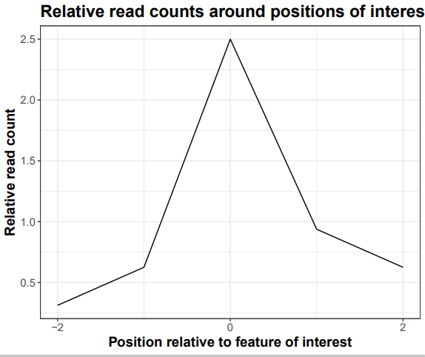
Testing with tinysim dataset

Slide 18
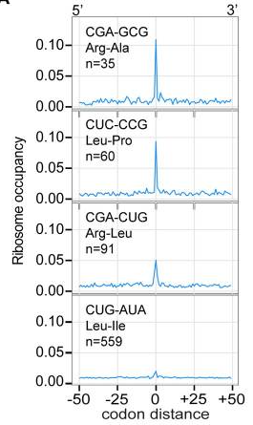
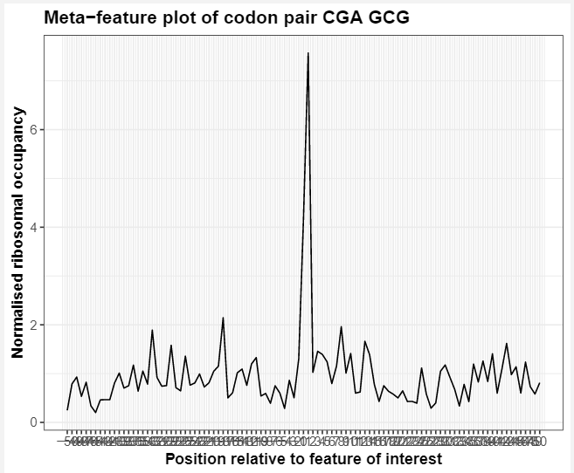
Recreating data from Gamble et al, 2016

Slide 19
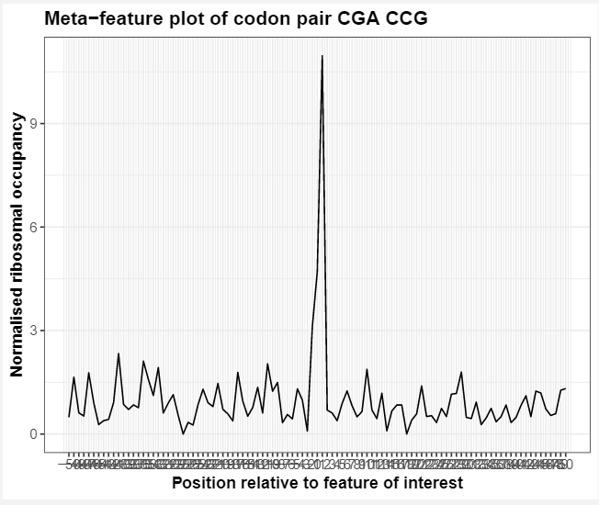
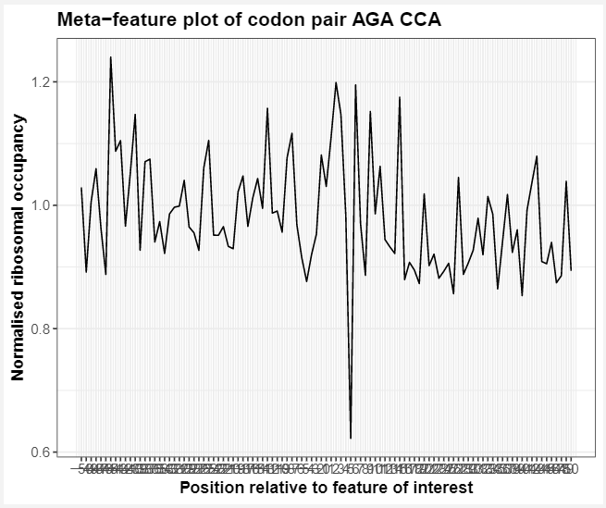
Comparing inhibitory and optimised codon pairs

Slide 20
Next steps
Add functionality to identify feature locations for nt metafeature script
Codons and Codon pairs would likely be easy
Is there a tool or protein database that can identify positions of secondary structural features? Can this data be downloaded for each gene? Will the names be compatible? Ligand binding positions?
Restructure to have one script containing function definitions and another calling the functions.

Slide 21
What we learnt
Collaboration - prioritise tasks that aid the team
Communication – better updates on Github and clearer comments in code
Insights into the process of writing papers
Insights into software development and maintenance
Greatly improved the quality of code we write

Slide 22
Thanks to everyone in the lab

