Slide 1
Run down of our 3 months

Slide 2
Overview
Where we started
Added documentation
Upgraded configs
Added new dataset
Updated file names
Created Meta Feature scripts
What we learnt

Slide 3
Overview of end of honours project
Codon pairs and single codon, what was the goal. What state was it in. structural overview.
Reads on transcript code, working but very specific to my working environment.

Slide 4
Upgraded configs
Older configs did not contain

Slide 5
Added documentation
How to add new datasets and species
Added checklist for issue tickets

Slide 6
Added new dataset
Follow documentation on adding new species
Why Histoplasma?
Why creating annotations is difficult
It is running

Slide 7
Outputs of new dataset, things to look out for in the future
Potentially due to poor annotation, a noncoding sequence is slipping into the final results. Overall there is good periodicity, so potential to analyse in the future

Slide 8
Updated file names
To meet reviewers feedback, some of the confusing names had to be addressed. Pretty tedious work, as numerous files but I got my way through it.

Slide 9
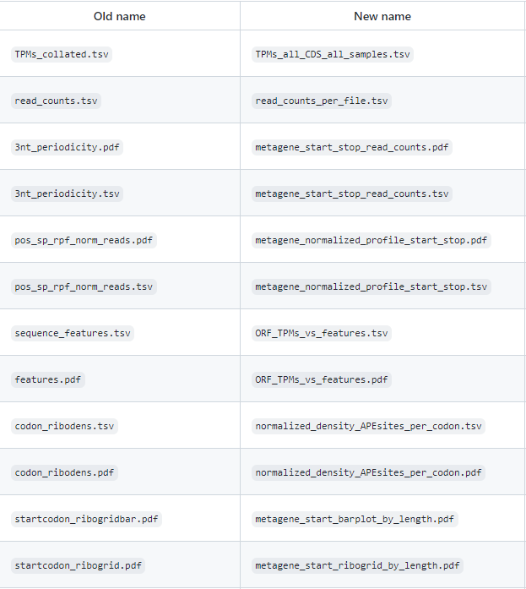
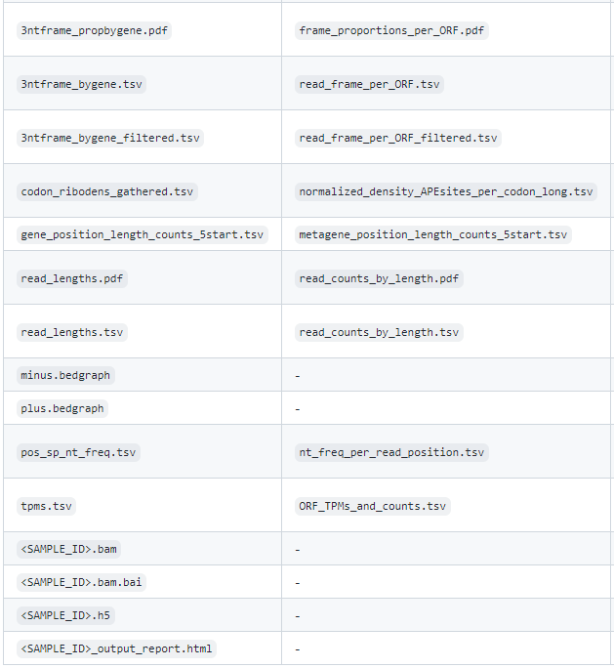

Slide 10
Article writing
Open science as an undergraduate.
look over and evaluate our time with the lab, gain a publication
Practice writing

Slide 11
Created Meta Feature scripts
Codon pairs
Single codons
Nucleotides

Slide 12
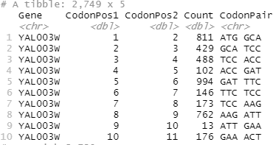
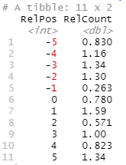
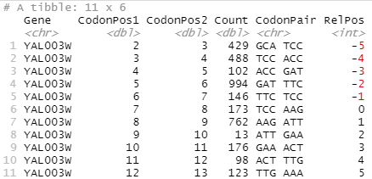
Codon pairs – How does it work
Generate a table of Genes, positions, counts and codon pairs
H5
GFF3
Codon positions table
A site displacement
Slice a window of positions around the codon of interest
Codon Pair
Expand width
Calculate the Relative count for all occurrences of the codon of interest

Slide 13
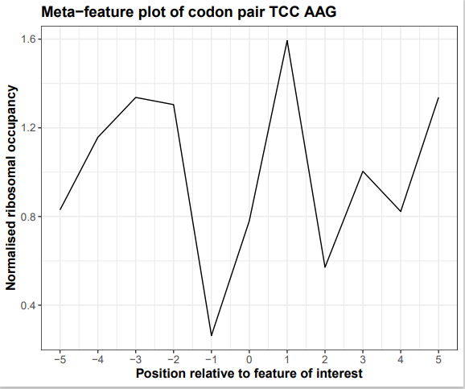

Slide 14
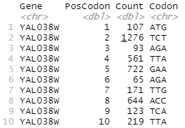
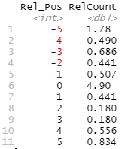
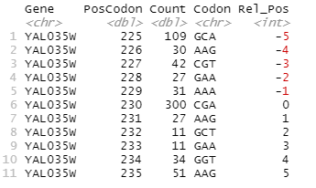
Single codons – why, how does it work, outputs
Generate a table of Genes, positions, counts and codon pairs
H5
GFF3
Codon positions table
A site displacement
Slice a window of positions around the codon of interest
Codon Pair
Expand width
Calculate the Relative count for all occurrences of the codon of interest

Slide 15
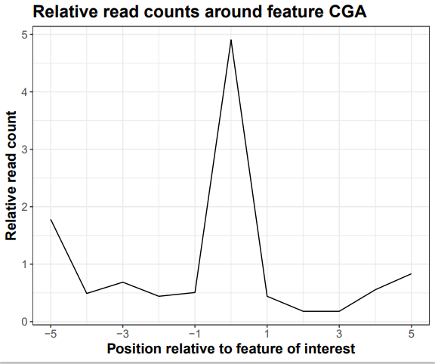
Testing with YAL5 simulated dataset

Slide 16
Nucleotides – why, how does it work

Slide 17
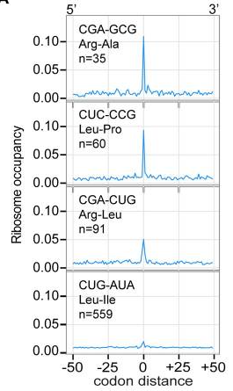
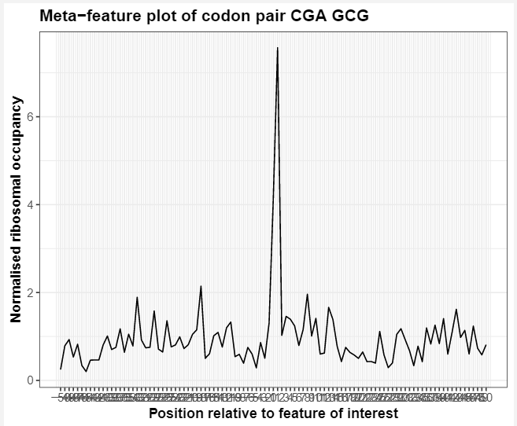
Recreating data from Gamble et al, 2016

Slide 18
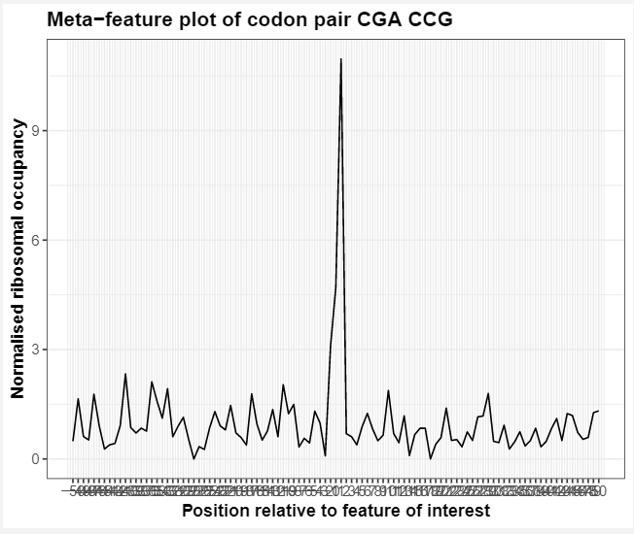
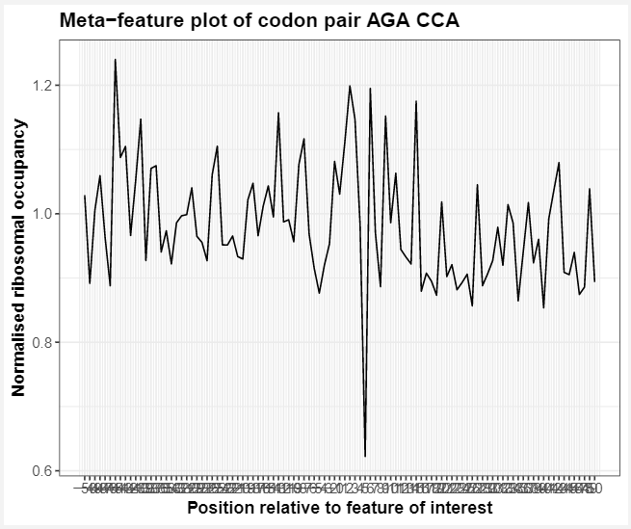
Comparing inhibitory and optimised codon pairs

Slide 19
Next steps
Add functionality to identify feature locations for nt metafeature script
Codons and Codon pairs would likely be easy
Is there a tool or protein database that can identify positions of secondary structural features? Can this data be downloaded for each gene? Will the names be compatible? Ligand binding positions?
Restructure to have one script containing function definitions and another calling the functions.

Slide 20
What we learnt
Collaboration - prioritise tasks that aid the team
Communication – better updates on Github and clearer comments in code
Insights into the process of writing papers
Insights into software development and maintenance
Greatly improved the quality of code we write

Slide 21
Thanks to everyone in the lab

