Slide 1
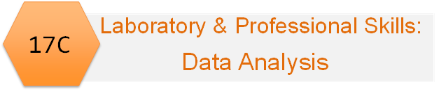
Emma Rand Data Analysis in R
Week 2: Introduction to module and to R and RStudio
Notes:
Hello and welcome to Data Analysis in R!
This is the second term of teaching for 17C.
There are a few optional chemistry workshops and some employability sessions but most of the second term teaching for 17C is about statistics, data analysis and data presentation.

Slide 2

Notes:
Cartoon by Allison Horst “welcome to rstats”
#rstats is the twitter tag
This is a module I really enjoy teaching!
It is going to change your life….for the better!

Slide 3
Data Analysis in R Aims
To explain what matters in choosing methods of data analysis and give you practice in making those decisions.
To train you in analysing data in R specifically and help you develop an understanding of some core and highly transferable concepts in data analysis.

Slide 4
Module Learning Outcomes (MLO)
The successful student will be able to:
Explain the purpose of data analysis
Choose classical univariate statistical tests (and some non-parametric equivalents) appropriate to a given scenario and recognise when these are not suitable
Use R to perform these analyses on data in a variety of formats
Interpret, report and graphically present the results of covered tests
Notes:
Classical means “frequentist” regression, t-tests and ANOVA
Univariate means you only have one out come variable or response.

Slide 5
Meeting the learning outcomes will enable you to:
Write-up your laboratory report
Design and analyse experiments including those for projects in stages 2, 3, and 4 and year-away
Evaluate and interpret the data analysis in papers
Perform well in assessments
Improve your employability!

Slide 6
What advice or encouragement would you give to a stage 1 student?
You might not like it, but try to like it because you're not going to every get away from it throughout your degree
Practise practise practise!! Just mess around in R as much as possible
GO. TO. THE. WORKSHOPS
R is widely used in top institutions, that is a good resource that will allow people to stand out, and that it is way more powerful than it appears to be.
Try and work with others when learning R. You learn a lot by trying to help those around you - answer each other's questions
Don't panic if you don't understand everything. Most people (even professionals) have no idea how R really works.
Approach with an open mind. It will be hard if you’ve never used code before.
Google!
Just give it a go!
Rstudio can be daunting, however Emma is an expert in Rstudio and very few other biology degrees can offer the same level of training as you have available through her teaching. Taking the time to learn Rstudio will be really useful if you intend to do a year in industry or finding grad jobs requiring any kind of data analysis skills. Don't skip the workshops during your first year!
Just get stuck in because it will really help you down the line! Once you gain confidence then it starts to become really enjoyable too!
Recognise the importance of it! Statistics/ data science, including R, aren't just useful in your degree but are essential for research in both industry and academia!
At the beginning it will seem impossible, but don't give up because the more you practice the better you will be able to solve any problems that arise. I would recommend attending all the workshops, as R isn't something you can just read about and understand. It is a lot easier to learn if you can watch someone do it and practice doing it yourself. If you think you are only one that doesn't get it, then you are wrong, because most people will feel the same. I hadn't done any coding before I came to uni and I really didn't like R to begin with, but now I can see how much easier and faster it is to analyse data with R.

Slide 7
All the advice and encouragement
https://docs.google.com/spreadsheets/d/1kN26o_qhIvkLVl3u-1ROawLsWOWkt7U2CGD3fpS2818/edit?usp=sharing
Don't be hungover for your first session because it'll make everything a lot more difficult than it is

Slide 8
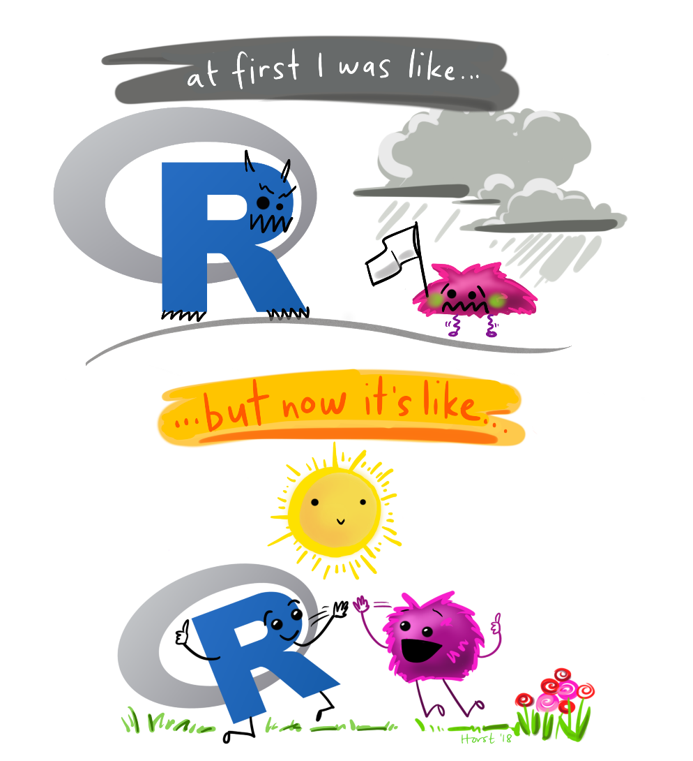
Notes:
Allison Horst cartoon.
At first R was scary but now we are friends.
It is hard. But it is very achievable. There is no gene for coding ability!
You do not need to be good at maths.

Slide 9
Organisation: Interlinked
Weekly Workshop
Preparatory independent study
Introduction to statistical concepts
Demos: How to do in R
Workshop – guided practice applying
Follow up Independent study – problems to consolidate understanding
Warnings!
These do not standalone – weekly L.O.
All are needed
Progressive

Slide 10
Overview of topics
Week | Topic
2 | Introduction to module, data analysis and RStudio including first figure
3 | Hypothesis testing, data types, reading data in to R and saving figures in reports
4 | The normal distribution, summary statistics and confidence intervals; user-defined functions, RStudio
5 | One- sample t-tests and their non-parametric equivalents
6 | Two-sample t-tests and their non-parametric equivalents
7 | One-way ANOVA and Kruskal-Wallis
8 | Two-way ANOVA incl understanding the interaction
9 | Correlation and regression
10 | Chi-squared tests

Slide 11
Summary of this week
We explain why we do statistical tests
Using RStudio we learn how to use the command line, some functions and arguments; navigate the panes; and what the workspace, scripts and history are

Slide 12
Learning objectives for the week
By actively following the material and carrying out the independent study the successful student will be able to:
explain why we need data analysis (MLO 1)
use the R command line as a calculator and to assign variables (MLO 3)
Create and use the basic data types in R (MLO 3)
find their way around the RStudio windows (MLO 3)
create, use and save a script file to run R commands (MLO 3)
search and understand manual pages (MLO 3)

Slide 13
Why do we need data analysis?

Slide 14
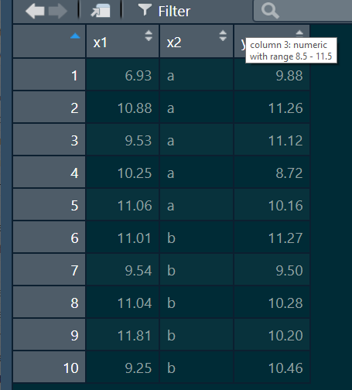
Foundations of statistical testing: Science overview
‘Experiments’
Some things we control, choose or set
Something
we measure
Independent variables
Explanatory variables
The ‘x’ s
Dependent variables
Response variables
The ‘y’ s
inferences made

Slide 15
Why do we need statistics?
If a drug reduces everybody’s blood pressure by exactly the same amount we don’t need statistics! The drug is effective!
If every beetle in population A is exactly 400mg and every beetle in population B is exactly 398mg we don’t need statistics! Beetles in population A are heavier!

Slide 16
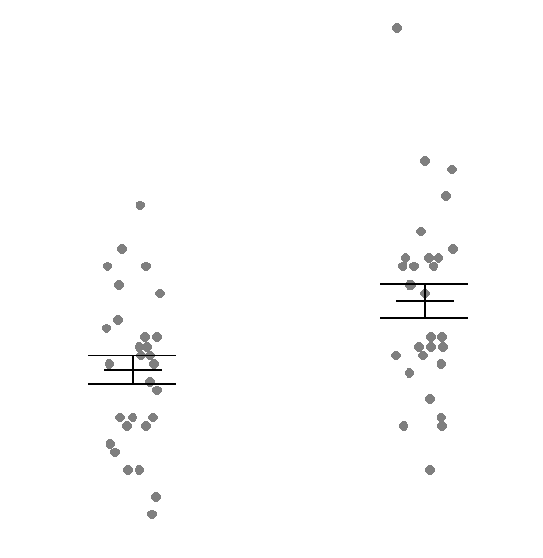
Why do we need statistics?
But Responses vary!
Is the difference between two means real?
Or just random variation?

Slide 17
Why do we need statistics?
Responses vary
humans see patterns
‘coincidence’ can be common
We need statistics to tell us if there are real and consistent patterns

Slide 18
The logic of ‘hypothesis’ testing
Have a ‘null’ hypothesis’: no difference
Calculates probability of getting your data if that null hypothesis is true
If the probability is less than 0.05 reject the null hypothesis
Frequentist/classical statistics
N.b. 0.05 is an agreed but arbitrary level

Slide 19
See you next week!

