Slide 1

Emma Rand Data Analysis in R
Week 6 Two sample tests

Slide 2
Last week
We will cover
General intro to one- and two- sample tests
one sample-tests
The one-sample t-test
The paired sample t-test
The one sample Wilcoxon
R practice
No workshop
Activities to consolidate previous skills: Workflow basics and projects

Slide 3
Summary of this week
Independent and non-independent samples
Two-sample-tests
The two-sample t-test
The two sample Wilcoxon, also known as the Mann-Whitney
In RStudio
t-tests and their non-parametric equivalents
Summarising, plotting and reporting

Slide 4
Learning objectives
By actively following the material and carrying out the independent study the successful student will be able to:
Recognise when two samples are not independent (MLO 2)
Select, appropriately, t-tests and their non-parametric equivalents (MLO 2)
Know what functions are used in R to run these tests and how to interpret them(MLO 3 and 4)
Know how to state the results of these tests scientifically (MLO 3 and 4)
Create figures for these tests which are suitable for including in a scientific report (MLO 3 and 4)

Slide 5
Introduction to one- and two-sample tests
Reminder

Slide 6
Types of t-test
One-sample
Compares the mean of sample to a particular value (compares the response to a reference)
Includes paired-sample test – compares the mean difference to zero (i.e., compares dependent means)
Two-sample
Compares two (independent) means to each other

Slide 7
t-tests in general Assumptions
All t-tests assume the “residuals” are normally distributed and have homogeneity of variance
A residual is the difference between the predicted and observed value
Predicted value is the mean / group mean

Slide 8
t-tests Paired-sample t-tests
Two samples but values are not independent (could not reorder)
Actually a one-sample test

Slide 9
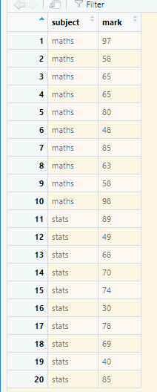
Is there a difference between the maths and stats marks of 10 students? The one sample is the difference between the pairs of values n.b. tidy data
t-tests Paired-sample t-tests example
Same student

Slide 10
t-tests Paired-sample t-tests
Two samples but values are not independent.
They could be
Same individual
Same time or location
Key: do pairs of observations have something in common that make them more similar to each other than to other observations.

Slide 11
Two-sample t-tests
Is there a difference between two independent means
Independent – values in one group not related to values in the other group
Example: is there a difference between the masses of different subspecies of chaffinches?

Slide 12
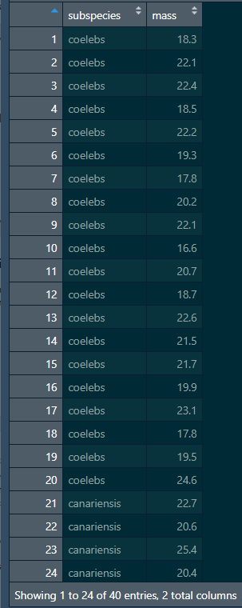
Is there a difference between the masses of different subspecies of chaffinches? n.b. tidy data
t-tests two-sample t-test
No link
Could reorder

Slide 13
The two-sample t-test
A parametric test

Slide 14
two-sample t-test example
A number of subspecies of the common chaffinch have been described, based principally on the differences in the pattern and colour of the adult male plumage. Two of these subspecies are:
"coelebs group" that occurs in Europe and Asia
"canariensis group" on the Canary Islands

Slide 15
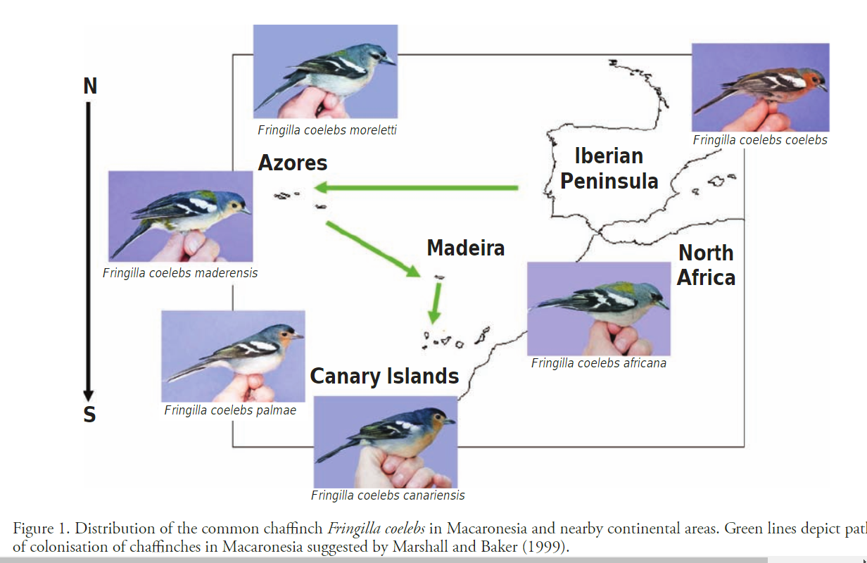
Notes:
https://onlinelibrary.wiley.com/doi/abs/10.1111/jav.01885
Acoustic, genetic, and morphological analyses of the Canarian common chaffinch complex Fringilla coelebs ssp. reveals cryptic diversification
Juan Carlos Illera
Juan Carlos Rando
Eduardo Rodriguez‐Exposito
Mariano Hernández
Santiago Claramunt
Aurelio Martín

Slide 16
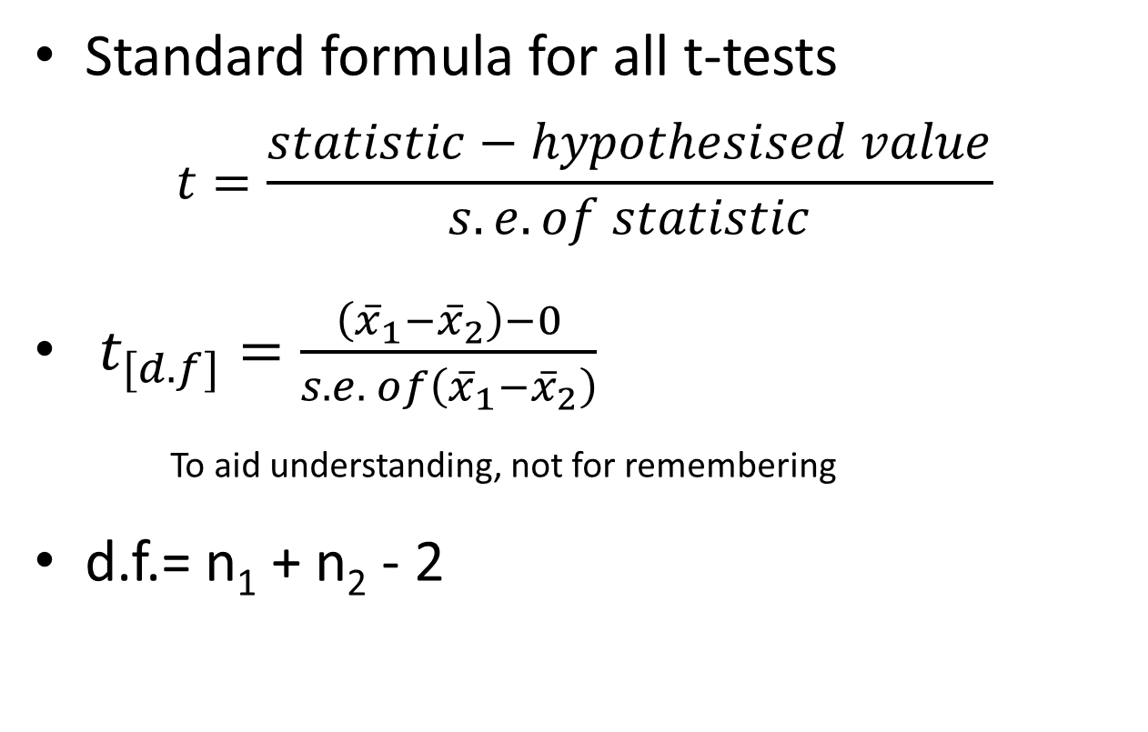
t-tests
Standard formula for all t-tests
$$t=\frac{statistic−hypothesised value}{s.e. of statistic}$$
$t_{[d.f]}=\frac{\left({\overline{x}}_{1}−{\overline{x}}_{2}\right)−0}{s.e. of\left({\overline{x}}_{1}−{\overline{x}}_{2}\right)}$
To aid understanding, not for remembering
d.f.= n₁ + n₂ - 2
Notes:
i.e., the number in the sample of differences

Slide 17
t-tests Two-sample t-test example
chaff <- read_table("data/chaff.txt")
Note: these data are ‘tidy’
All the responses in one column with other variables indicating the group
Organise your
data this way

Slide 18
Tidy data
Each variable should be in one column.
Each different observation of that variable should be in a different row.
There should be one table for each "kind" of data.
If you have multiple tables, they should include a column in the table that allows them to be linked.
Independent study: Wickham, H (2013). Tidy Data. Journal of Statistical Software.
https://www.jstatsoft.org/article/view/v059i10

Slide 19
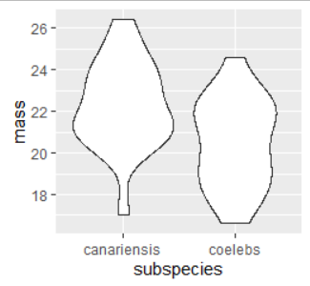
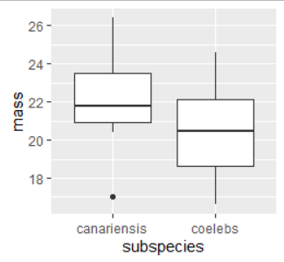
t-tests Two-sample t-test example
Plot your data: roughly – perhaps one of these…
ggplot(data = chaff,
aes(x = subspecies, y = mass)) +
geom_violin()
ggplot(data = chaff,
aes(x = subspecies, y = mass)) +
geom_boxplot()
Notes:
don’t overthink. Just gives you idea of what to expect and helps identify issues (missing data, outliers etc).
So canariensis seem a little bigger

Slide 20
t-tests Two-sample t-test example
Summarise the data:
chaffsum <- chaff %>%
group_by(subspecies) %>%
summarise(mean = mean(mass),
std = sd(mass),
n = length(mass),
se = std/sqrt(n))
chaffsum
# A tibble: 2 x 5
subspecies mean std n se
<chr> <dbl> <dbl> <int> <dbl>
1 canariensis 22.3 2.15 20 0.481
2 coelebs 20.5 2.14 20 0.478

Slide 21
t-tests Two-sample t-test example
Run the t-test
Name of the dataframe
t.test(data = chaff,
mass ~ subspecies,
var.equal = T)
The ‘model’ explain mass by subspecies
Paired = FALSE is the default.
No need to include
We are assuming homogeneity of variance

Slide 22
t-tests Two-sample t-test example
Run the t-test
Paired = FALSE is the default.
Two-sample test done by default
t.test(data = chaff,
mass ~ subspecies,
var.equal = T)
Two Sample t-test
data: mass by subspecies
t = 2.6471, df = 38, p-value = 0.01175
alternative hypothesis: true difference in means is not equal to 0
95 percent confidence interval:
0.422266 3.167734
sample estimates:
mean in group canariensis mean in group coelebs
22.275 20.480
The model

Slide 23
t-tests Two-sample t-test example
Run the t-test
The two group means
t.test(data = chaff,
mass ~ subspecies,
var.equal = T)
Two Sample t-test
data: mass by subspecies
t = 2.6471, df = 38, p-value = 0.01175
alternative hypothesis: true difference in means is not equal to 0
95 percent confidence interval:
0.422266 3.167734
sample estimates:
mean in group canariensis mean in group coelebs
22.275 20.480

Slide 24
t-tests Two-sample t-test example
Run the t-test
95% CI on the difference between the two means
22.275 - 20.480 = 1.795
t.test(data = chaff,
mass ~ subspecies,
var.equal = T)
Two Sample t-test
data: mass by subspecies
t = 2.6471, df = 38, p-value = 0.01175
alternative hypothesis: true difference in means is not equal to 0
95 percent confidence interval:
0.422266 3.167734
sample estimates:
mean in group canariensis mean in group coelebs
22.275 20.480

Slide 25
t-tests Two-sample t-test example
Run the t-test
The bit that says whether it is significant p value
t.test(data = chaff,
mass ~ subspecies,
var.equal = T)
Two Sample t-test
data: mass by subspecies
t = 2.6471, df = 38, p-value = 0.01175
alternative hypothesis: true difference in means is not equal to 0
95 percent confidence interval:
0.422266 3.167734
sample estimates:
mean in group canariensis mean in group coelebs
22.275 20.480

Slide 26
t-tests Two-sample t-test example
Run the t-test
p < 0.05
Conclusion: there is a significant difference between the subspecies in mass
t.test(data = chaff,
mass ~ subspecies,
var.equal = T)
Two Sample t-test
data: mass by subspecies
t = 2.6471, df = 38, p-value = 0.01175
alternative hypothesis: true difference in means is not equal to 0
95 percent confidence interval:
0.422266 3.167734
sample estimates:
mean in group canariensis mean in group coelebs
22.275 20.480

Slide 27
t-tests Two-sample t-test example
Run the t-test
The values we will quote in results
t.test(data = chaff,
mass ~ subspecies,
var.equal = T)
Two Sample t-test
data: mass by subspecies
t = 2.6471, df = 38, p-value = 0.01175
alternative hypothesis: true difference in means is not equal to 0
95 percent confidence interval:
0.422266 3.167734
sample estimates:
mean in group canariensis mean in group coelebs
22.275 20.480

Slide 28
t-tests Two-sample t-test example
Check the assumptions
All t-tests assume the “residuals” are normally distributed and have homogeneity of variance
First use common sense: mass is a continuous and we would expect it to be normally distributed thus we would expect the residuals to be normally distributed

Slide 29
t-tests Two-sample t-test example
Second by plotting residuals:
calculate the residuals – the difference between predicted and observed (i.e., group mean and value)
# add the group means to the data
chaff <- merge(chaff, chaffsum[,1:2], by = "subspecies")
# add the residuals
chaff <- chaff %>%
mutate(residual = mass - mean)

Slide 30
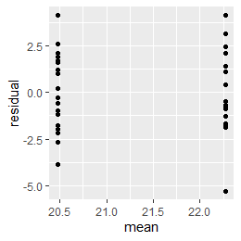
t-tests Two-sample t-test example
Checking the assumptions: normally and homogenously distributed residuals
ggplot(data = chaff,
aes(x = mean, y = residual)) +
geom_point()
Variance is about the same for all values of x

Slide 31
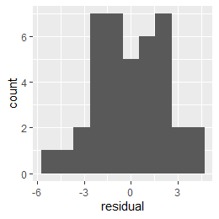
t-tests Two-sample t-test example
Checking the assumptions: normally and homogenously distributed residuals
ggplot(data = chaff,
aes(x = residual)) +
geom_histogram(bins = 10)
Looks roughly normal
symmetrical

Slide 32
t-tests Two-sample t-test example
Checking the assumptions: normally and homogenously distributed residuals
shapiro.test(chaff$residual)
Shapiro-Wilk normality test
data: chaff$residual
W = 0.98046, p-value = 0.7067
Not significantly different from a normal distribution

Slide 33
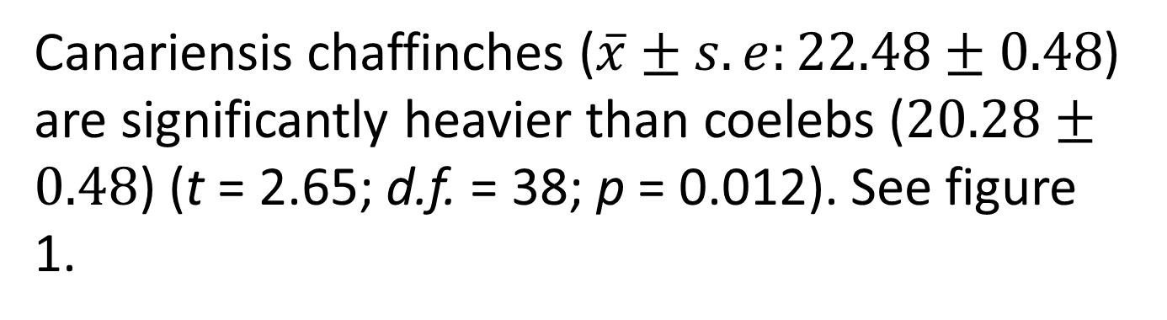
t-tests Two-sample t-test example
Reporting the result: “significance of effect, direction of effect, magnitude of effect”
Canariensis chaffinches ($\overline{x}±s.e:22.48±0.48$) are significantly heavier than coelebs ($20.28±0.48$) (t = 2.65; d.f. = 38; p = 0.012). See figure 1.

Slide 34
t-tests Two-sample t-test: figures
Supports your claim:
Show the data (all if possible)
Show the ‘model’ (the predicted values i.e., means and error bars)
Say what kind of error bars
Full but concise figure legends

Slide 35
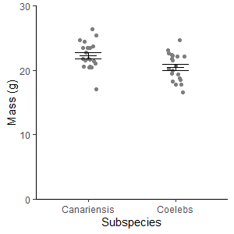
t-tests Two-sample t-test: figures
Figure 1. Mean two subspecies of chaffinch. Error bars are means +/- one standard error.

Slide 36
t-tests Two-sample t-tests - summary
Parametric
To test for a difference between two independent means
t is size of difference relative to the s.e.
Function in R:
t.test(data = df, response ~ explanatory,
var.equal = TRUE)
If p < 0.05 the test is significant
assumptions: normally and homogenously distributed residuals
Significance, direction, magnitude
Figure: data and ‘model’

Slide 37
The two sample Wilcoxon also known as the Mann-Whitney
Non-parametric equivalent of the two-sample t-test

Slide 38
When the t-test assumptions are not met: non- parametric tests
Non-parametric tests make fewer assumptions
Based on the ranks rather than the actual data
Null hypotheses are about the mean rank (not the mean)

Slide 39
Non-parametric tests t-test equivalents
i,.e., the type of question is the same but the response variable is not normally distributed or it is impossible to tell (small samples)
one – sample t-test and paired-sample t-test: the one-sample Wilcoxon
Two-sample t-test (next week): two-sample Wilcoxon aka Mann-Whitney

Slide 40
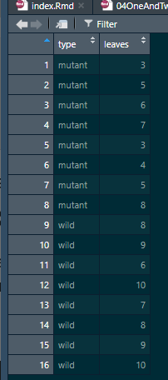

Non-parametric tests two-sample Wilcoxon (Mann-Whitney)
Example: comparing the number of leaves on 8 mutant and wild type plants (small samples, counts)

Slide 41
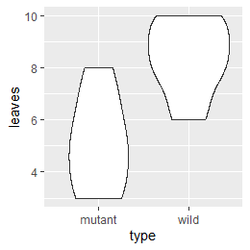
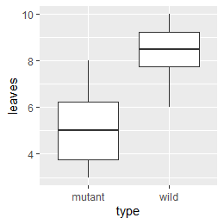
Non-parametric tests two-sample Wilcoxon (Mann-Whitney)
Plot your data: roughly – perhaps one of these…
ggplot(data = arabidopsis,
aes(x = type, y = leaves)) +
geom_violin()
ggplot(data = arabidopsis,
aes(x = type, y = leaves)) +
geom_boxplot()

Slide 42
Non-parametric tests two-sample Wilcoxon (Mann-Whitney)
Summarise the data:
arabidopsissum <- arabidopsis %>%
group_by(type) %>%
summarise(median = median(leaves),
n = length(leaves))
arabidopsissum
# A tibble: 2 x 3
type median n
<chr> <dbl> <int>
1 mutant 5 8
2 wild 8.5 8

Slide 43
Non-parametric tests two-sample Wilcoxon (M-W): example
Carrying out the test two-sample Wilcoxon
wilcox.test(data = arabidopsis, leaves ~ type)
Wilcoxon rank sum test with continuity correction
data: leaves by type
W = 5, p-value = 0.005051
alternative hypothesis: true location shift is not equal to 0
Warning message:
In wilcox.test.default(x = c(3, 5, 6, 7, 3, 4, 5, 8), y = c(8, 9, :
cannot compute exact p-value with ties
No need to worry!

Slide 44
Non-parametric tests two-sample Wilcoxon (M-W): example
Reporting the result: “significance of effect, direction of effect, magnitude of effect”
There are significantly more leaves on wild-type (median = 8.5) than mutant (median = 5) plants (Mann-Whitney: W=5, n₁=8, n₂=8, p = 0.005051)
44

Slide 45
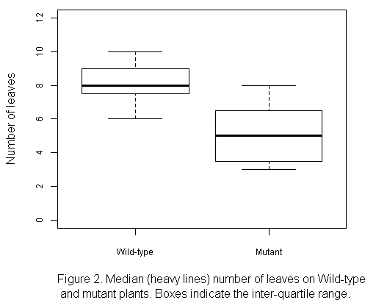
Non-parametric tests two-sample Wilcoxon (M-W): example
Label with units
Non-parametric tests: use median+IQR
Measure of dispersion - IQR
What is the figure?
Always refer to figure in the text

Slide 46
t-tests Wilcoxon- summary
Non-parametric
when assumptions for t-test not met
To test whether the mean rank in one group differs from another
Function in R:
wilcox.test(data = df, response ~ explanatory)
If p < 0.05 the test is significant
Few assumptions
Figure: boxplot

