Slide 1
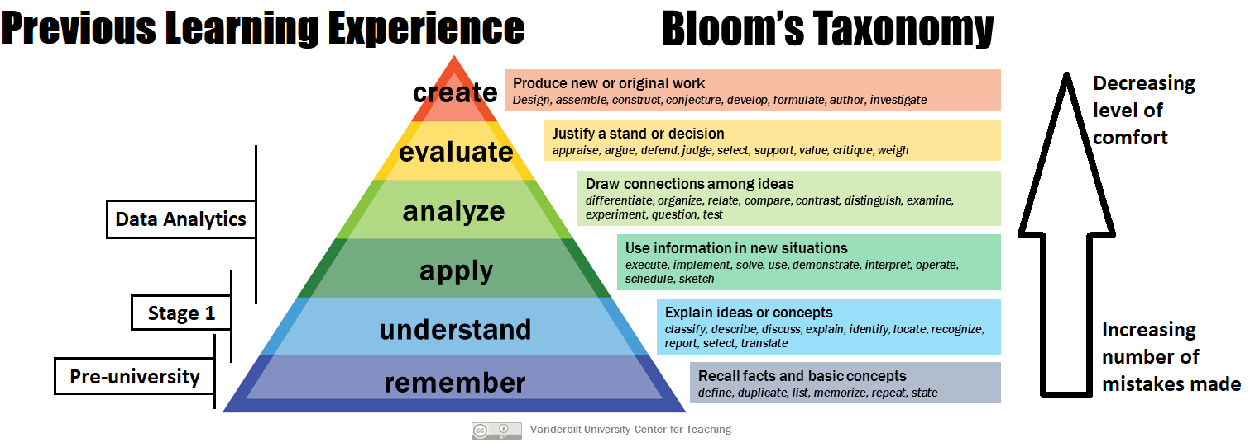
“It’s hard………”

Slide 2

Emma Rand Data Analysis in R
Week 5 Introduction to one- and two-sample tests. One sample tests

Slide 3
Last week
The normal distribution - because it is the basis of many tests (parametric tests such as t-test, regression and ANOVA)
Properties of normal distributions
Sampling distribution of the mean and the standard error
Confidence intervals
In RStudio
Calculate probabilities and quantiles from normal distributions
Calculate confidence intervals

Slide 4
Summary of this week
We will cover
General intro to one- and two- sample tests
one sample-tests
The one-sample t-test
The paired sample t-test
The one sample Wilcoxon
R practice
No workshop
Activities to consolidate previous skills: Workflow basics and projects

Slide 5
Summary of this week
We will cover one sample-tests
The one-sample t-test
The paired sample t-test
The one sample Wilcoxon
R practice
No workshop
Activities to consolidate previous skills : Workflow basics and projects
‘Parametric’ tests –
Based on the normal distribution

Slide 6
Summary of this week
We will cover one sample-tests
The one-sample t-test
The paired sample t-test
The one sample Wilcoxon
R practice
No workshop
Activities to consolidate previous skills : Workflow basics and projects
Non-parametric

Slide 7
Learning objectives
By actively following the material and carrying out the independent study the successful student will be able to :
Appreciate that t-tests are based on the normal distribution and have assumptions relating to it
Understand the principles of t-tests
Select, appropriately, one-sample t-tests and their non-parametric equivalent (MLO 2)
Recognise when two samples are not independent (MLO 2)
Know what functions are used in R to run these tests and how to interpret them(MLO 3 and 4)
Know how to state the results of these tests scientifically (MLO 3 and 4)

Slide 8
Introduction to one- and two-sample tests
T-tests and their non-parametric equivalents

Slide 9
Reminder: The choice of test depends on ….
Type of data
The type of values a variable can take: Discrete or continuous?
Their role in the analysis
Which is the response and which is/are explanatory?
(week 3 Hypothesis testing, data types, reading data in to R and saving figures

Slide 10
Choosing tests: 3 steps
What is a one sentence description of what you want to know?
What are your explanatory variables?
Categories: t-tests, ANOVA, Wilcoxon, Mann-Whitney
Continuous: Regression, correlation
What is your response variable?
Normally distributed: t-tests, ANOVA, regression
Counts: Chi-squared or stage 2 ☺

Slide 11
Choosing tests: 3 steps
What is a one sentence description of what you want to know?
What are your explanatory variables?
Categories: t-tests, ANOVA, Wilcoxon, Mann-Whitney
Continuous: Regression, correlation
What is your response variable?
Normally distributed: t-tests, ANOVA, regression
Counts: Chi-squared or stage 2 ☺

Slide 12
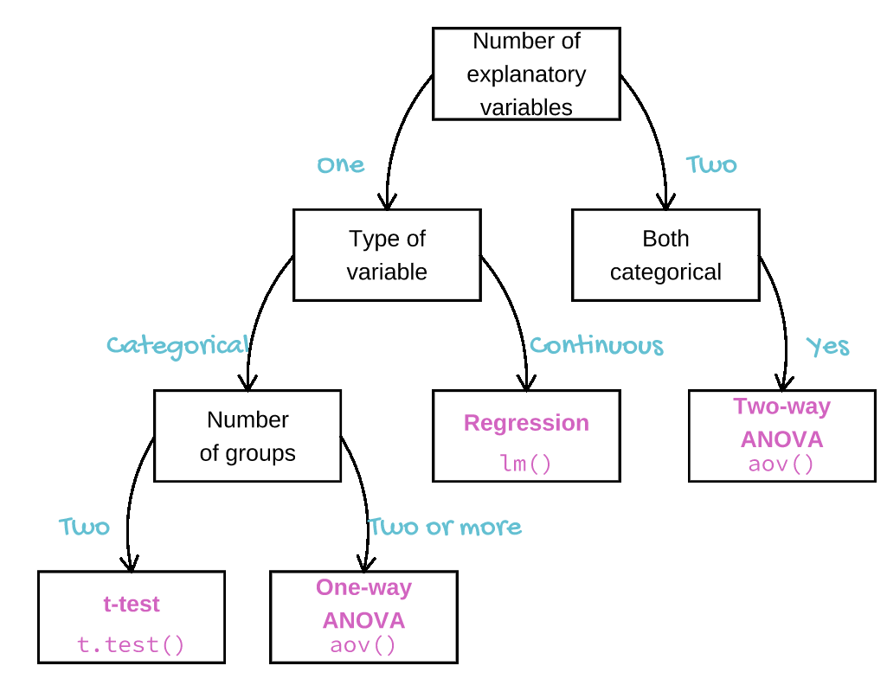

Slide 13
Types of t-test
One-sample
Compares the mean of sample to a particular value (compares the response to a reference)
Includes paired-sample test – compares the mean difference to zero (i.e., compares dependent means)
Two-sample
Compares two (independent) means to each other

Slide 14
t-tests in general Assumptions
All t-tests assume the “residuals” are normally distributed and have homogeneity of variance
A residual is the difference between the predicted and observed value
Predicted value is the mean / group mean

Slide 15
t-tests in general: assumptions Checking Assumptions
- Common sense
Data should be continuous
No/few repeats
- Plot the residuals
- Using a test in R

Slide 16
t-tests in general: assumptions When residuals are not normally distributed
Transform (not really covered)
E.g. Log to remove skew
Use a non-parametric test (covered)
Fewer assumptions
Generally less powerful

Slide 17
The one-sample t-test
A parametric test

Slide 18
t-tests One-sample t-tests
Tests whether the mean of a single sample differs from an expected value (i.e., H₀)
Example: Fields are sprayed if crop plants have a disease score* of 76.
20 plants in a field are measured
Is their mean significantly different from the reference of 76?
*Arbitrary scale

Slide 19
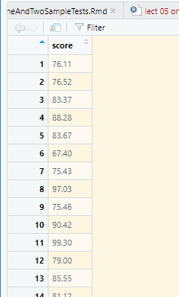
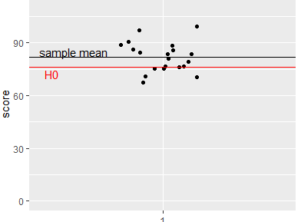
t-tests One-sample t-tests - example
plants %>%
summarise(mean = mean(score),
sd = sd(score),
n = length(score))
mean sd length
1 81.803 8.533749 20
Notes:
Null hypothesis has been covered in first lecture

Slide 20
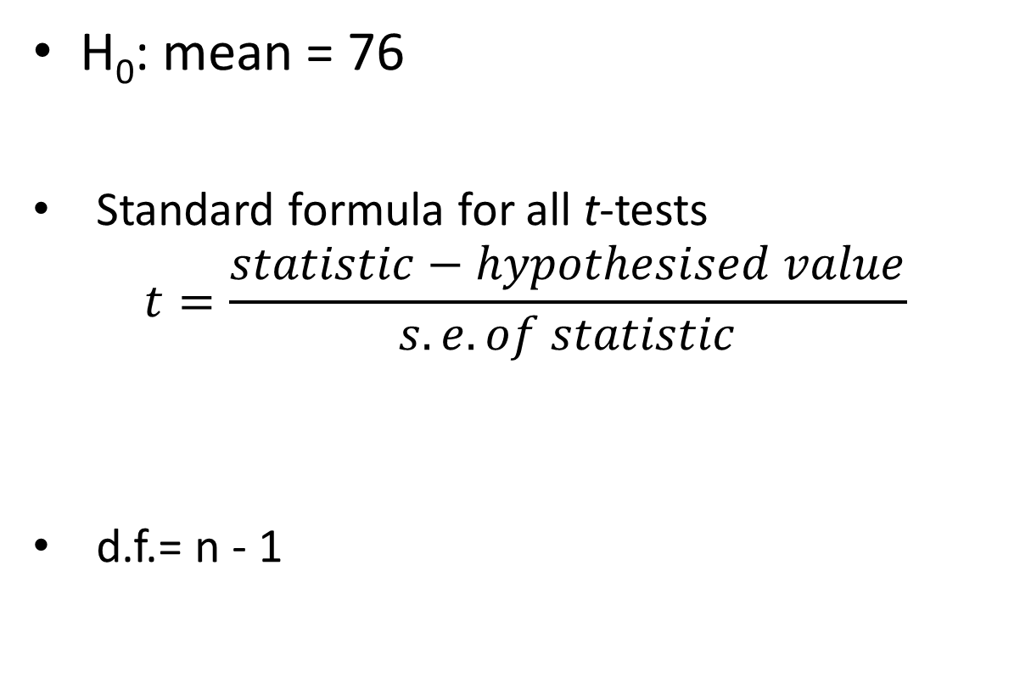
t-tests One-sample t-tests - example
H₀: mean = 76
Standard formula for all t-tests
$$t=\frac{statistic−hypothesised value}{s.e. of statistic}$$
d.f.= n - 1
Notes:
The size of t depends both on the amount of difference and the variation

Slide 21
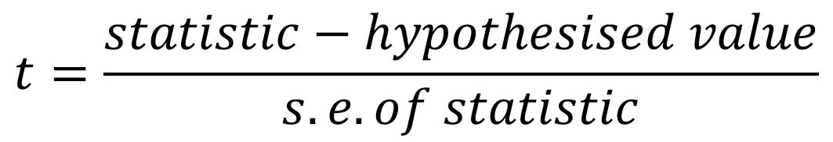
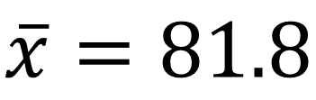
t-tests One-sample t-tests - example
$$t=\frac{statistic−hypothesised value}{s.e. of statistic}$$
$$\overline{x}=81.8$$
Is the difference between the obtained value and the expected value big relative to the variability?

Slide 22
t-tests One-sample t-tests - example
t.test(plants$score, mu = 76)
One Sample t-test
data: plants$score
t = 3.0411, df = 19, p-value = 0.006721
alternative hypothesis: true mean is not equal to 76
95 percent confidence interval:
77.80908 85.79692
sample estimates:
mean of x
81.803
Note: you can also use
t.test(data = plants, score ~ 1, mu = 76)

Slide 23
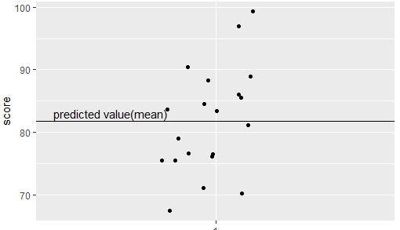
t-tests One-sample t-tests - example
Checking the assumptions: normally and homogenously distributed residuals
Residual

Slide 24
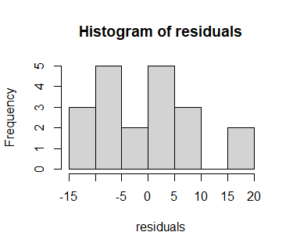
t-tests One-sample t-tests - example
Checking the assumptions: normally and homogenously distributed residuals
residuals <- plants$score - mean(plants$score)
hist(residuals)
shapiro.test(residuals)
Shapiro-Wilk normality test
data: residuals
W = 0.9725, p-value = 0.8065

Slide 25
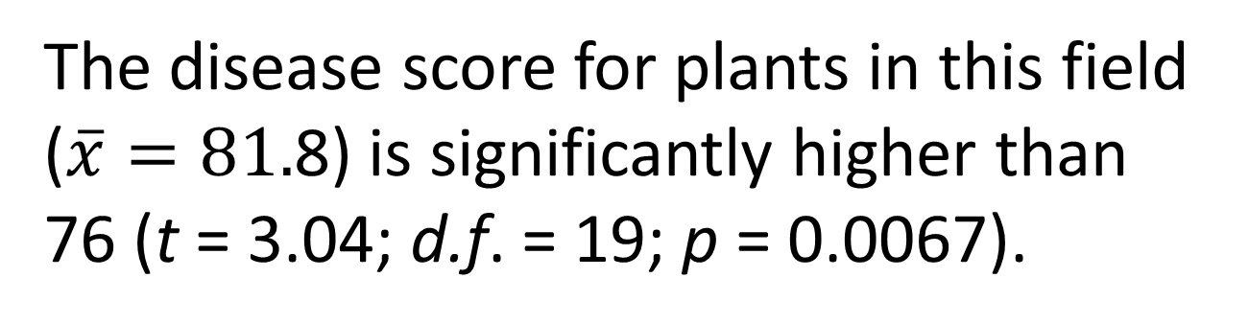
t-tests One-sample t-tests - example
Reporting the result: “significance of effect, direction of effect, magnitude of effect”
The disease score for plants in this field ($\overline{x}=81.$8) is significantly higher than 76 (t = 3.04; d.f. = 19; p = 0.0067).

Slide 26
t-tests One-sample t-tests - summary
Parametric
To test whether the mean of a single sample differs from an expected value
t is size of difference relative to the s.e.
Function in R:
t.test(df$response, mu = Exp)
If p < 0.05 the test is significant
assumptions: normally and homogenously distributed residuals
Significance, direction, magnitude
Figure: probably not needed

Slide 27
The paired sample t-test
A parametric test

Slide 28
t-tests Paired-sample t-tests
Two samples but values are not independent (could not reorder)
Actually a one-sample test

Slide 29
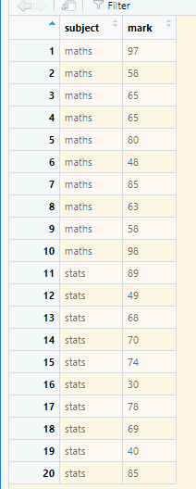
Is there a difference between the maths and stats marks of 10 students? The one sample is the difference between the pairs of values n.b. tidy data
t-tests Paired-sample t-tests example
Same student

Slide 30
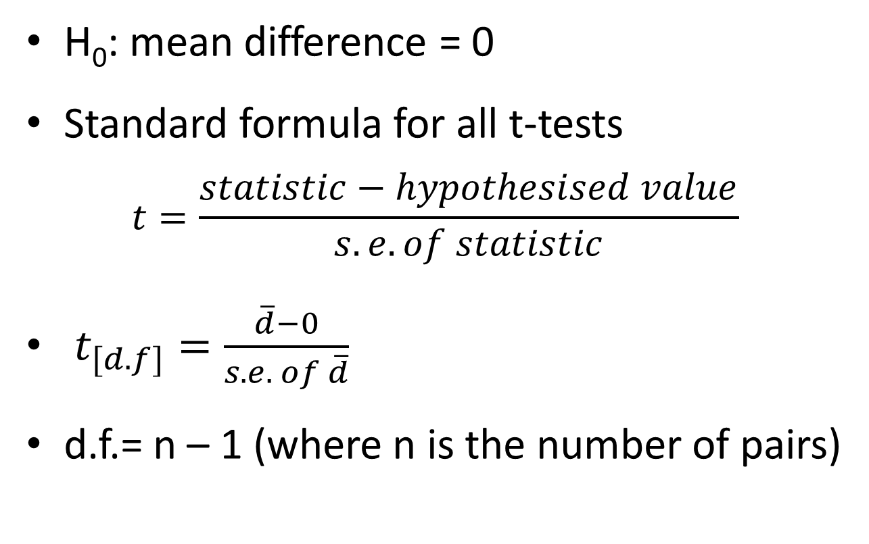
t-tests Paired-sample t-tests - example
H₀: mean difference = 0
Standard formula for all t-tests
$$t=\frac{statistic−hypothesised value}{s.e. of statistic}$$
$t_{[d.f]}=\frac{\overline{d}−0}{s.e. of \overline{d}}$
d.f.= n – 1 (where n is the number of pairs)
Notes:
i.e., the number in the sample of differences

Slide 31
t-tests Paired-sample t-tests
Run paired sample t-test
t.test(data = marks, mark ~ subject, paired = TRUE)
Paired t-test
data: mark by subject
t = 2.3399, df = 9, p-value = 0.04403
alternative hypothesis: true difference in means is not equal to 0
95 percent confidence interval:
0.2159788 12.7840212
sample estimates:
mean of the differences
6.5

Slide 32
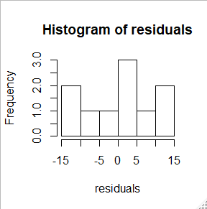
t-tests Paired-sample t-tests - example
Checking the assumptions: normally and homogenously distributed residuals
diffs <- marks$mark[marks$subject == "maths"] - marks$mark[marks$subject == "stats"]
residuals <- diffs - mean(diffs)
hist(residuals)
shapiro.test(residuals)
Shapiro-Wilk normality test
data: residuals
W = 0.91246, p-value = 0.2983

Slide 33
t-tests Paired-sample t-tests
Reporting the result: “significance of effect, direction of effect, magnitude of effect”
Individual students score significantly higher in maths than in statistics (t = 2.34; d.f. = 9; p = 0.044) with an average difference of 6.5%.

Slide 34
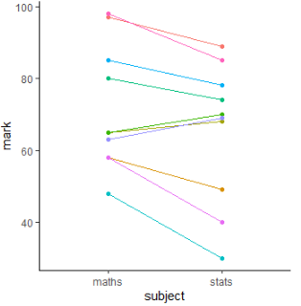
t-tests Paired-sample t-tests: figure

Slide 35
t-tests Paired-sample t-tests - summary
Parametric
To test whether the mean difference between pairs of values is zero
t is size of mean difference relative to the s.e.
Function in R:
t.test(data = df, response ~ explanatory, paired = TRUE)
If p < 0.05 the test is significant
assumptions: normally and homogenously distributed residuals
Significance, direction, magnitude
Figure: none or spaghetti plot

Slide 36
The one sample Wilcoxon
Non-parametric equivalent of the paired-sample t-test

Slide 37
When the t-test assumptions are not met: non- parametric tests
Non-parametric tests make fewer assumptions
Based on the ranks rather than the actual data
Null hypotheses are about the mean rank (not the mean)

Slide 38
Non-parametric tests t-test equivalents
i,.e., the type of question is the same but the response variable is not normally distributed or it is impossible to tell (small samples)
one – sample t-test and paired-sample t-test: the one-sample Wilcoxon
Two-sample t-test (next week): two-sample Wilcoxon aka Mann-Whitney

Slide 39
Non-parametric tests one/paired-sample Wilcoxon
Marks – small sample.
Wilcoxon might be more appropriate
wilcox.test(data = marks, mark ~ subject, paired = TRUE)
Wilcoxon signed rank test with continuity correction
data: mark by subject
V = 48.5, p-value = 0.03641
alternative hypothesis: true location shift is not equal to 0
Warning message:
In wilcox.test.default(x = c(97L, 58L, 65L, 65L, 80L, 48L, 85L, :
cannot compute exact p-value with ties

Slide 40
Non-parametric tests one/paired-sample Wilcoxon
Reporting the result: “significance of effect, direction of effect, magnitude of effect”
Individual students score significantly higher in maths than in statistics (Wilcoxon: V = 48.5; n = 10; p = 0.036) with a median difference of 7.5%.

Slide 41
t-tests Wilcoxon- summary
Non-parametric
when assumptions for t-test not met
To test whether the mean rank difference between pairs of values is zero
Function in R:
wilcox.test(data = df, response ~ explanatory, paired = TRUE)
If p < 0.05 the test is significant
Few assumptions
Figure: none or spaghetti plot

