Slide 1

Emma Rand Data Analysis in R
Correlation and Regression

Slide 2
Previous weeks
We have considered data with categorical explanatory variables

Slide 3
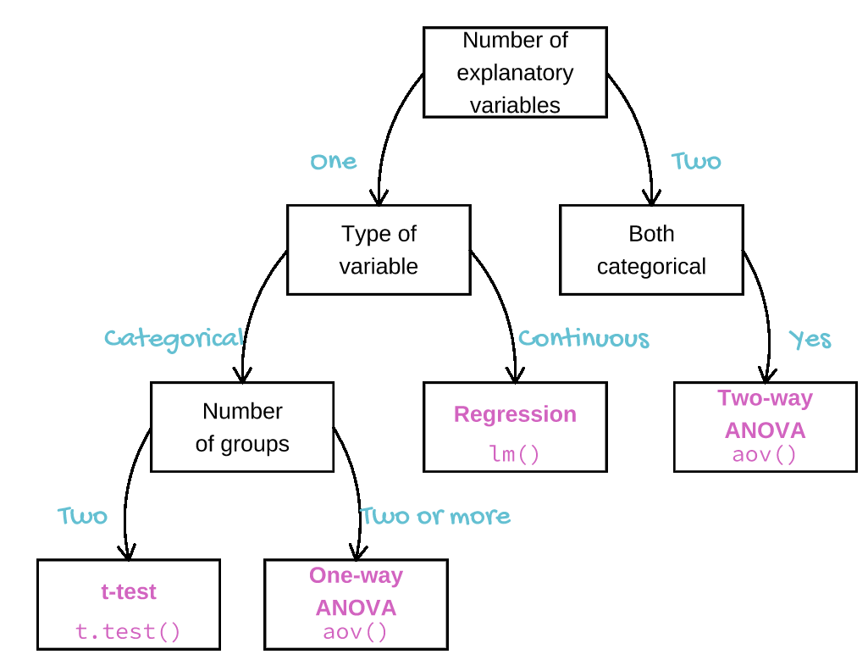

Slide 4
Summary of this week
Situations where our explanatory variable is ‘continuous’ rather than categorical.
Parametric and non-parametric correlation
Meaning
Assumptions
Carrying out, interpreting and Reporting
Tests of correlation coefficients
Regression
Meaning and terminology
Carrying out, interpreting and Reporting
Assumptions
Assessment of fit (explanatory power)
Notes:
Continuous or ordered discrete

Slide 5
Learning objectives for the week
By the end of this week the successful student should be able to :
Explain the principles of correlation and of regression and know when each can be applied (MLO 1)
Select, appropriately correlation and regression (MLO 2)
Apply and interpret a correlation in R (MLO 3 and 4)
Appreciate the difference between statistical significance and biological significance (MLO 1 and 4)
Apply and interpret a simple linear regression in R (MLO 3 and 4)
Evaluate whether the assumptions of regression are met (MLO 2)
Summarise and illustrate with appropriate R figures test results scientifically (MLO 3 and 4)

Slide 6
Introduction

Slide 7
Correlation and Regression Similar but different
Correlation
Linear
Association
Axes can be switched
two randomly sampled continuous or ordered discrete variables
Scatter plot, no line
Regression
Linear
Prediction
Axes cannot be switched
X is “sampled without error”; y randomly sampled for each x
Scatter plot, must have the regression line

Slide 8
Correlation and Regression Similar but different
Correlation
Regression

Slide 9
Correlation

Slide 10
Correlation Basics
Sample correlation: r
Reflects degree of linear association between two sampled variables: -1 to +1
Several types but same principles
Here: Pearson’s (Pearson’s Product Moment Correlation Coefficient)
Parametric

Slide 11
Correlation Example of correlations
r ≈ 1
r ≈ -1
Positive: Highest scores on one axis associated with highest scores on other
Negative: Highest scores on one axis associated with lowest scores on other

Slide 12
Correlation Example of positive correlations
r ≈ 1
Highest scores on one axis associated with highest scores on other

Slide 13
Correlation Correlation but not linear
r ≈ 0
Cannot use Pearson’s PMMC

Slide 14
Correlation Example
Wheat seeds: High quality visualization of the internal kernel structure by a soft X-ray technique and 7 measurements taken:
Area
Perimeter
Compactness
Kernel length
Kernel width
Asymmetry coefficient
Length of kernel groove
We will examine the correlation between compactness and kernel width

Slide 15
Two-way ANOVA example Reading in and examining the structure of the data
file <- "data-raw/seeds_dataset.xlsx"
seeds <- read_excel(file, sheet = "seeds_dataset")
glimpse(seeds)
Observations: 70
Variables: 7
$ area <dbl> 15.26, 14.88, 14.29, 13.84, 16.14, 14.38, 14.69, 14.11, 1...
$ perimeter <dbl> 14.84, 14.57, 14.09, 13.94, 14.99, 14.21, 14.49, 14.10, 1...
$ compactness <dbl> 0.8710, 0.8811, 0.9050, 0.8955, 0.9034, 0.8951, 0.8799, 0...
$ kernal_length <dbl> 5.763, 5.554, 5.291, 5.324, 5.658, 5.386, 5.563, 5.420, 6...
$ kernel_width <dbl> 3.312, 3.333, 3.337, 3.379, 3.562, 3.312, 3.259, 3.302, 3...
$ asymmetry_coef <dbl> 2.2210, 1.0180, 2.6990, 2.2590, 1.3550, 2.4620, 3.5860, 2...
$ groove_length <dbl> 5.220, 4.956, 4.825, 4.805, 5.175, 4.956, 5.219, 5.000, 5...

Slide 16
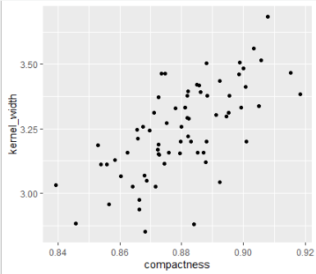
Correlation Plot your data
Plot your data: roughly
ggplot(data = seeds, aes(x = compactness, y = kernel_width)) +
geom_point()
Check roughly linear
This looks ok

Slide 17
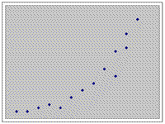
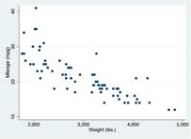
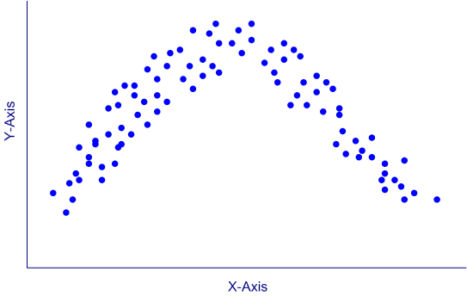
Correlation Plot your data
Not suitable for linear correlation

Slide 18
Correlation Running the test
cor.test(data = seeds, ~ compactness + kernel_width)
Pearson's product-moment correlation
data: compactness and kernel_width
t = 7.3738, df = 68, p-value = 2.998e-10
alternative hypothesis: true correlation is not equal to 0
95 percent confidence interval:
0.5117537 0.7794620
sample estimates:
cor
0.6665731
A variable is not being explained:
~ compactness + kernel_width

Slide 19
Correlation Running the test
cor.test(data = seeds, ~ compactness + kernel_width)
Pearson's product-moment correlation
data: compactness and kernel_width
t = 7.3738, df = 68, p-value = 2.998e-10
alternative hypothesis: true correlation is not equal to 0
95 percent confidence interval:
0.5117537 0.7794620
sample estimates:
cor
0.6665731
Gives type of correlation done. Pearson’s in the default

Slide 20
Correlation Running the test
cor.test(data = seeds, ~ compactness + kernel_width)
Pearson's product-moment correlation
data: compactness and kernel_width
t = 7.3738, df = 68, p-value = 2.998e-10
alternative hypothesis: true correlation is not equal to 0
95 percent confidence interval:
0.5117537 0.7794620
sample estimates:
cor
0.6665731
Gives type of correlation done. Pearson’s in the default

Slide 21
Correlation Running the test
cor.test(data = seeds, ~ compactness + kernel_width)
Pearson's product-moment correlation
data: compactness and kernel_width
t = 7.3738, df = 68, p-value = 2.998e-10
alternative hypothesis: true correlation is not equal to 0
95 percent confidence interval:
0.5117537 0.7794620
sample estimates:
cor
0.6665731
The correlation coefficient, r

Slide 22
Correlation Running the test
cor.test(data = seeds, ~ compactness + kernel_width)
Pearson's product-moment correlation
data: compactness and kernel_width
t = 7.3738, df = 68, p-value = 2.998e-10
alternative hypothesis: true correlation is not equal to 0
95 percent confidence interval:
0.5117537 0.7794620
sample estimates:
cor
0.6665731
Confidence interval on, r

Slide 23
Correlation Running the test
cor.test(data = seeds, ~ compactness + kernel_width)
Pearson's product-moment correlation
data: compactness and kernel_width
t = 7.3738, df = 68, p-value = 2.998e-10
alternative hypothesis: true correlation is not equal to 0
95 percent confidence interval:
0.5117537 0.7794620
sample estimates:
cor
0.6665731
Test of whether r is significantly from zero

Slide 24
Correlation Reporting the result
data: compactness and kernel_width
t = 7.3738, df = 68, p-value = 2.998e-10
alternative hypothesis: true correlation is not equal to 0
95 percent confidence interval:
0.5117537 0.7794620
sample estimates:
cor
0.6665731
There is a significant positive correlation (r = 0.67) between compactness and kernel width (t = 7.37; d.f. = 68, p < 0.001).

Slide 25
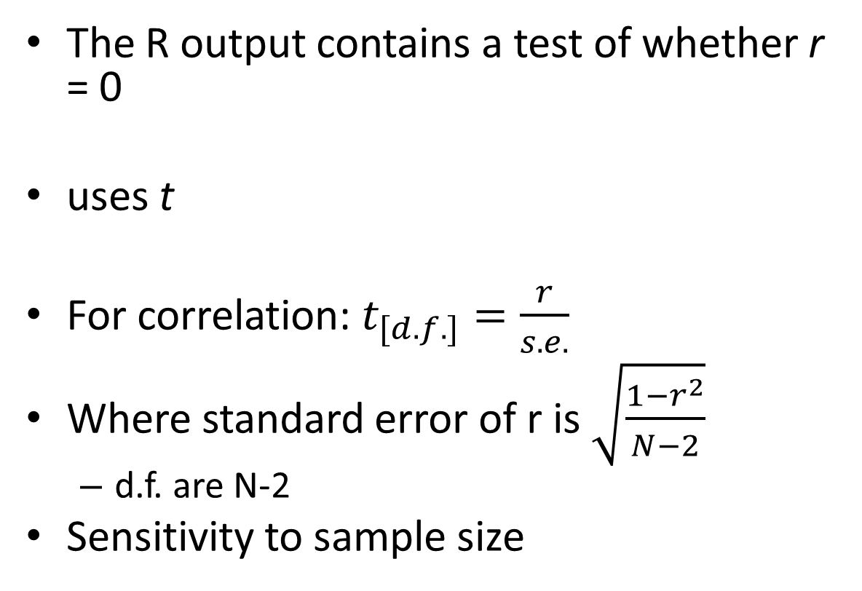
Correlation Understanding the test of significance
The R output contains a test of whether r = 0
uses t
For correlation: $t_{[d.f.]}=\frac{r}{s.e.}$
Where standard error of r is $\sqrt{\frac{1−r^{2}}{N−2}}$
d.f. are N-2
Sensitivity to sample size

Slide 26
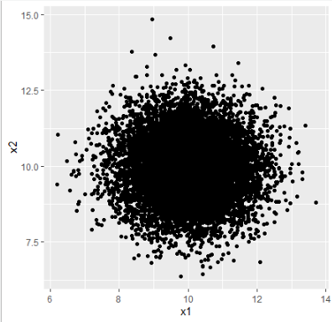
Statistical significance ≠Biological significance
data: x1 and x2
t = -2.2154, df = 9998, p-value = 0.02675
alternative hypothesis: true correlation is not equal to 0
95 percent confidence interval:
-0.041733016 -0.002552103
sample estimates:
cor
-0.02215107
Large samples mean small probability
But r is tiny!
Our knowledge determines biological significance

Slide 27
Correlation summary
Association
Pearson’s is Parametric; Spearman’s is non-parametric
Two randomly sampled continuous/ordered variables
Function in R:
cor.test(data = df, ~ x1 + x2)
quote r, its significance and n
if scatterplot included do NOT show a fitted line

Slide 28
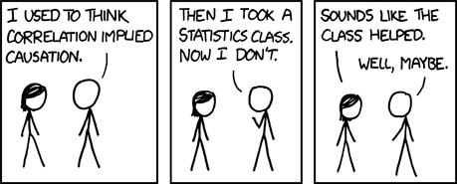

Slide 29
Regression

Slide 30
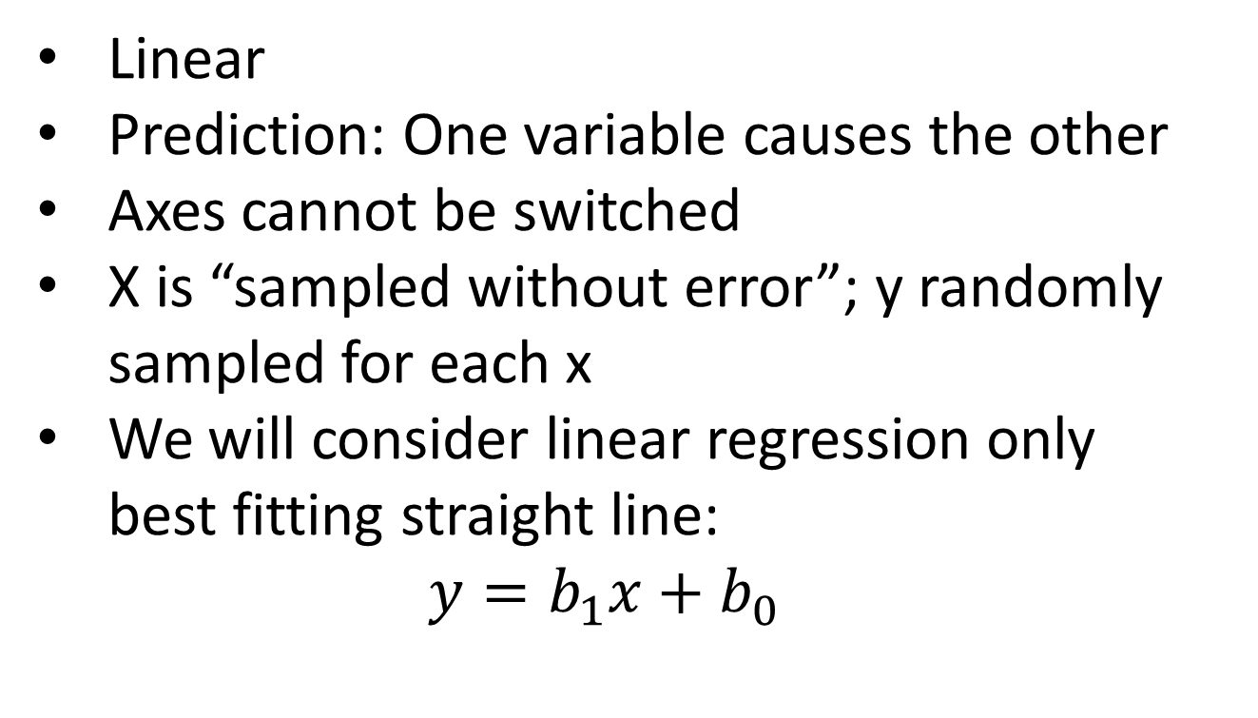
Regression
Linear
Prediction: One variable causes the other
Axes cannot be switched
X is “sampled without error”; y randomly sampled for each x
We will consider linear regression only
best fitting straight line:
$$y=b_{1}x+b_{0}$$

Slide 31
Regression Null hypothesis
Can be expressed as:
b₁ = 0
x cannot predict y
Regression line doesn’t explain variance in y
Assumptions
Normality and homoscedascity of residuals
X is “sampled without error”;
y randomly sampled for each x and normally distributed

Slide 32
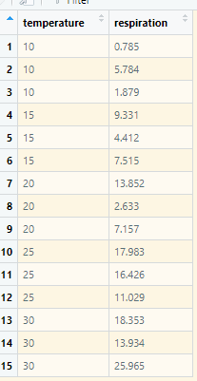
Regression Example
Brine Shrimp (Artemia salina) were put in water baths at 10C, 15C, 20C, 25C, 30C and their respiration rate measured (units)

Slide 33
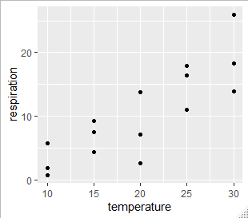
Correlation Plot your data
Plot your data: roughly
ggplot(data = shrimp, aes(x = temperature, y = respiration)) +
geom_point()
Check roughly linear
This looks ok

Slide 34
Regression Running the test
mod <- lm(data = shrimp,
respiration ~ temperature)
summary(mod)

Slide 35
Regression Understanding the output
Core statistical ideas – very extendable. You will see again next year
Call:
lm(formula = respiration ~ temperature, data = shrimp)
Residuals:
Min 1Q Median 3Q Max
-7.8362 -2.6216 -0.3377 3.1854 7.2433
Coefficients:
Estimate Std. Error t value Pr(>|t|)
(Intercept) -6.0359 3.1560 -1.912 0.0781 .
temperature 0.8253 0.1488 5.547 9.43e-05 ***
---
Signif. codes: 0 ‘***’ 0.001 ‘**’ 0.01 ‘*’ 0.05 ‘.’ 0.1 ‘ ’ 1
Residual standard error: 4.074 on 13 degrees of freedom
Multiple R-squared: 0.703, Adjusted R-squared: 0.6801
F-statistic: 30.77 on 1 and 13 DF, p-value: 9.433e-05

Slide 36
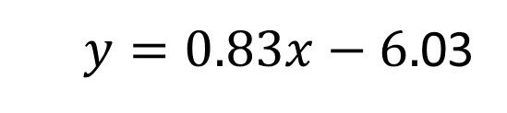
Regression Understanding the output
Core statistical ideas – very extendable. You will see again next year
Call:
lm(formula = respiration ~ temperature, data = shrimp)
Residuals:
Min 1Q Median 3Q Max
-7.8362 -2.6216 -0.3377 3.1854 7.2433
Coefficients:
Estimate Std. Error t value Pr(>|t|)
(Intercept) -6.0359 3.1560 -1.912 0.0781 .
temperature 0.8253 0.1488 5.547 9.43e-05 ***
---
Signif. codes: 0 ‘***’ 0.001 ‘**’ 0.01 ‘*’ 0.05 ‘.’ 0.1 ‘ ’ 1
Residual standard error: 4.074 on 13 degrees of freedom
Multiple R-squared: 0.703, Adjusted R-squared: 0.6801
F-statistic: 30.77 on 1 and 13 DF, p-value: 9.433e-05
b₀ and b₁
$y=0.83x−6.$03

Slide 37
Regression Understanding the output
Call:
lm(formula = respiration ~ temperature, data = shrimp)
Residuals:
Min 1Q Median 3Q Max
-7.8362 -2.6216 -0.3377 3.1854 7.2433
Coefficients:
Estimate Std. Error t value Pr(>|t|)
(Intercept) -6.0359 3.1560 -1.912 0.0781 .
temperature 0.8253 0.1488 5.547 9.43e-05 ***
---
Signif. codes: 0 ‘***’ 0.001 ‘**’ 0.01 ‘*’ 0.05 ‘.’ 0.1 ‘ ’ 1
Residual standard error: 4.074 on 13 degrees of freedom
Multiple R-squared: 0.703, Adjusted R-squared: 0.6801
F-statistic: 30.77 on 1 and 13 DF, p-value: 9.433e-05
Test: b₀ = 0
Often not impt
Test: b₁ = 0
Always of interest

Slide 38
Regression Understanding the output
Call:
lm(formula = respiration ~ temperature, data = shrimp)
Residuals:
Min 1Q Median 3Q Max
-7.8362 -2.6216 -0.3377 3.1854 7.2433
Coefficients:
Estimate Std. Error t value Pr(>|t|)
(Intercept) -6.0359 3.1560 -1.912 0.0781 .
temperature 0.8253 0.1488 5.547 9.43e-05 ***
---
Signif. codes: 0 ‘***’ 0.001 ‘**’ 0.01 ‘*’ 0.05 ‘.’ 0.1 ‘ ’ 1
Residual standard error: 4.074 on 13 degrees of freedom
Multiple R-squared: 0.703, Adjusted R-squared: 0.6801
F-statistic: 30.77 on 1 and 13 DF, p-value: 9.433e-05
Test: b₁ = 0
Always of interest
Test of ‘model’
Same as b₁ = 0
in single regression

Slide 39
Regression Understanding the output
Call:
lm(formula = respiration ~ temperature, data = shrimp)
Residuals:
Min 1Q Median 3Q Max
-7.8362 -2.6216 -0.3377 3.1854 7.2433
Coefficients:
Estimate Std. Error t value Pr(>|t|)
(Intercept) -6.0359 3.1560 -1.912 0.0781 .
temperature 0.8253 0.1488 5.547 9.43e-05 ***
---
Signif. codes: 0 ‘***’ 0.001 ‘**’ 0.01 ‘*’ 0.05 ‘.’ 0.1 ‘ ’ 1
Residual standard error: 4.074 on 13 degrees of freedom
Multiple R-squared: 0.703, Adjusted R-squared: 0.6801
F-statistic: 30.77 on 1 and 13 DF, p-value: 9.433e-05
Multiple R-squared: Proportion of y explained by x

Slide 40
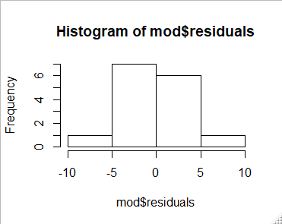
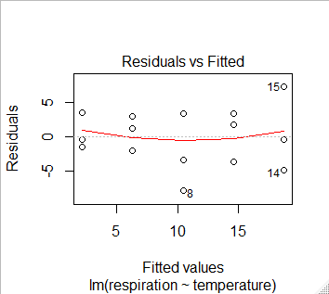
Regression Checking Assumptions
Residuals are calculated for you already!
Histogram of residuals should be normally distributed
hist(mod$residuals)
shapiro.test(mod$residuals)
Shapiro-Wilk normality test
data: (mod$residuals)
W = 0.97969, p-value = 0.9673
plot(mod, which = 1)
Spread of residuals should be similar in each group

Slide 41
Regression Reporting the results
Coefficients:
Estimate Std. Error t value Pr(>|t|)
(Intercept) -6.0359 3.1560 -1.912 0.0781 .
temperature 0.8253 0.1488 5.547 9.43e-05 ***
---
Signif. codes: 0 ‘***’ 0.001 ‘**’ 0.01 ‘*’ 0.05 ‘.’ 0.1 ‘ ’ 1
Residual standard error: 4.074 on 13 degrees of freedom
Multiple R-squared: 0.703, Adjusted R-squared: 0.6801
F-statistic: 30.77 on 1 and 13 DF, p-value: 9.433e-05
Reporting the result: “significance, direction, magnitude”
The temperature explained a significant amount of the variation in respiration rate (ANOVA: F = 30.8; d.f. = 1, 13; p < 0.001). The regression line is: Respiration rate= 0.83 * temperature - 6.04
Notes:
Remember to quote two sets of df for each F

Slide 42
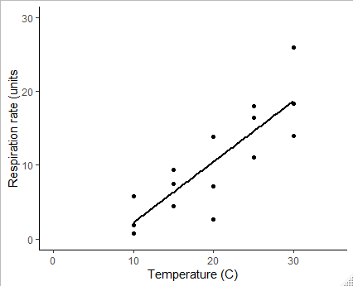
Regression Reporting the results: figure
Notes:
ggplot(data = shrimp, aes(x = temperature, y = respiration)) +
geom_point() +
geom_smooth(method = "lm", se = FALSE, colour = "black") +
xlim(0, 35) +
ylim(0, 30) +
ylab("Respiration rate (units") +
xlab("Temperature (C)") +
theme_classic()

Slide 43
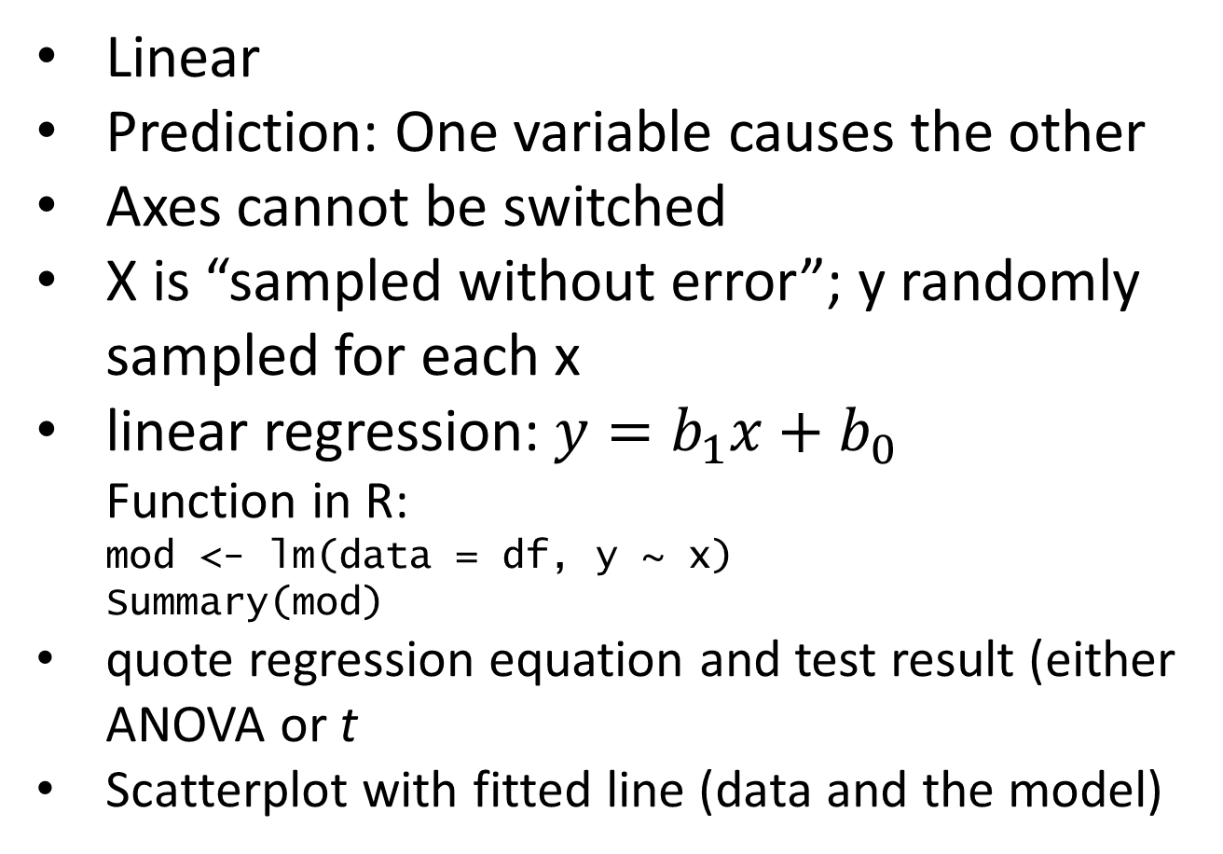
Regression summary
Linear
Prediction: One variable causes the other
Axes cannot be switched
X is “sampled without error”; y randomly sampled for each x
linear regression:$y=b_{1}x+b_{0}$
Function in R:
mod <- lm(data = df, y ~ x)
Summary(mod)
quote regression equation and test result (either ANOVA or t
Scatterplot with fitted line (data and the model)

