Slide 1

Emma Rand Data Analysis in R
Week 3: Hypothesis testing, data types, reading data in to R and saving figures

Slide 2
Summary of this week
We will consider how we can classify variables in terms of the type of values they can take and the logic of hypothesis testing with an example.
In RStudio we will cover reading in data files, summarising and plotting data. We also cover saving figures and laying out a report in word.

Slide 3
Learning objectives for the week
By actively following the material and carrying out the independent study the successful student will be able to:
distinguish between data types (MLO 2)
demonstrate the process of hypothesis testing with an example (MLO 1)
Explain type 1 and type 2 errors (MLO 4)
read in data in to RStudio, create simple summaries and plots using manual pages where necessary (MLO 3)
create neat reports in Word which include text and figures (MLO 4)

Slide 4
Choosing data analysis methods
In Data Analysis in R you will learn several methods for statistically analysing data.
Here we start to consider how we make appropriate choices.
It’s a journey!

Slide 5
The choice of test depends on ….
Type of data
The type of values a variable can take: Discrete or continuous?
Their role in the analysis
Which is the response and which is/are explanatory?

Slide 6
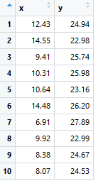
Overview
‘Experiments’
Some things we control, choose or set
Something
we measure
Independent variables
Explanatory variables
The ‘x’ s
Dependent variables
Response variables
The ‘y’ s
Which variable is the response? (2)
Which variables are explanatory? (2)
What kind of values can they take? (1)

Slide 7
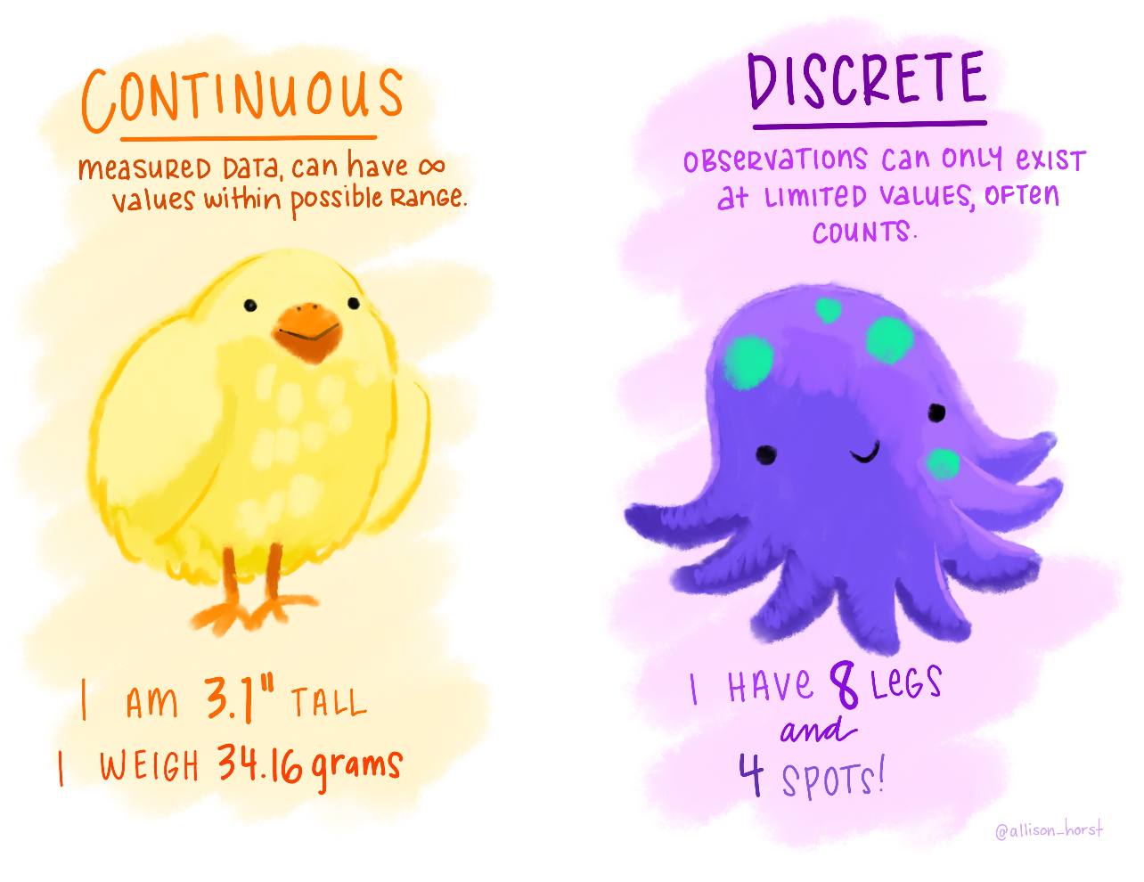
The choice of test depends on: Type of data
Two main types
discrete
continuous

Slide 8
The choice of test depends on: Type of data - discrete
Discrete
Categories (not quantitative)
Counts (quantitative but discrete)

Slide 9
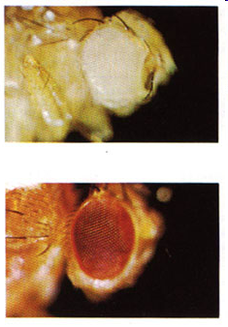
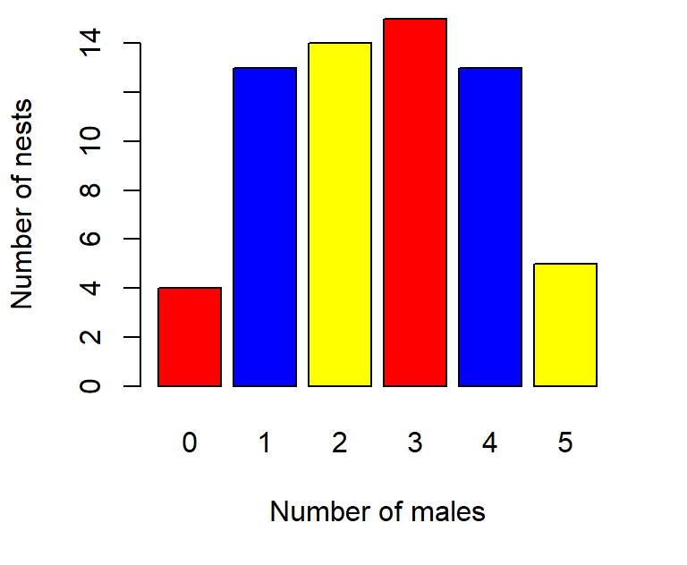
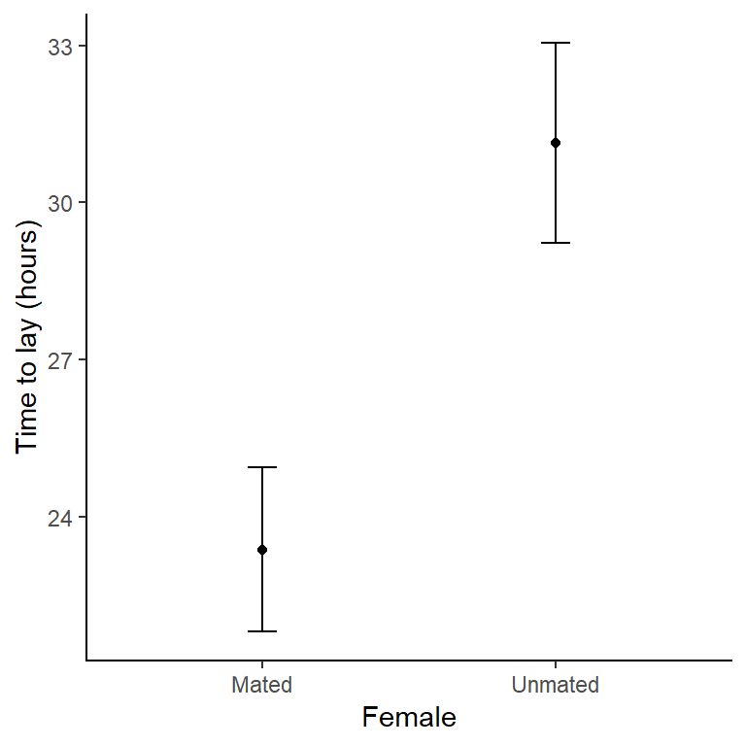
The choice of test depends on: Type of data - discrete
Categories
No scale e.g., colour, species
Often an ‘explanatory’ variable
Category

Slide 10
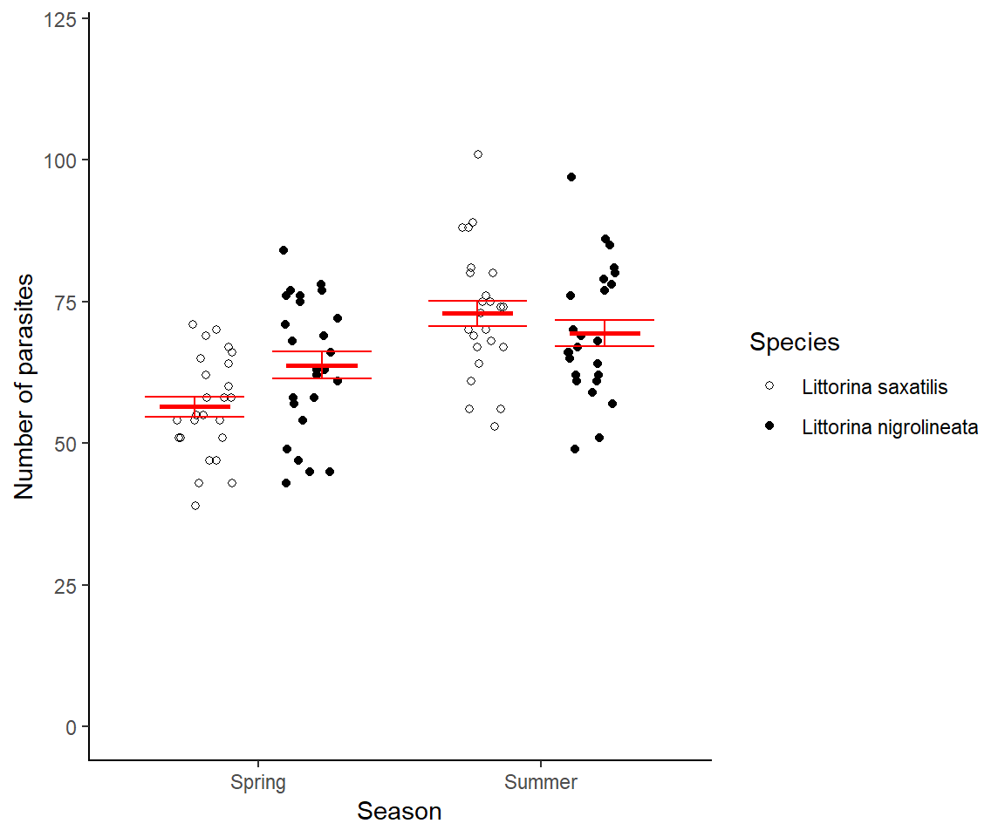
The choice of test depends on: Type of data - discrete
Counts
Normally a ‘response’ variable

Slide 11
The choice of test depends on: Type of data - continuous
e.g., length, height, concentration
Infinite number of possible values
Can be a response or an explanatory
Normally a response variable

Slide 12
The choice of test depends on: Type of data
Theory vs practice
Limit of measurement
Numbers of hairs on head: discrete but can be treated as continuous
Height to nearest metre: continuous but discretised by measurement
Notes:
Not as clear cut as it seems. Some discrete data can be treated as continuous and some continuous data are effectively discretised.

Slide 13
The choice of test depends on ….
Type of data
What kind of values? Discrete or continuous?
Their role in the analysis
Which is the response and which are the
explanatory
What is the relationship between them?
Rest of the module!

Slide 14
R data types

Slide 15
The logic of ‘hypothesis’ testing
Slide from last week:
Have a ‘null’ hypothesis’
Calculate probability of getting your data if that null hypothesis is true
If the probability is less than 0.05 reject the null hypothesis
Frequentist/classical statistics

Slide 16
Hypothesis Testing: steps
Set up H₀ “no effect”
Collect data
Determine the probability of our data if H₀ is true
p ≤ 0.05 reject H₀; p > 0.05 do not reject H₀

Slide 17
Hypothesis Testing example
Question: National average birthweight is 3300 grams with an s.d. = 900 grams. Does maternal poverty influence birthweight?
Set up H_{0 :} There is no effect of maternal poverty on birthweight
Notes:
Relate to binomial test we carried out

Slide 18
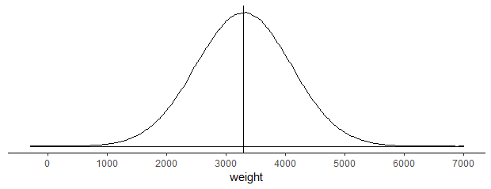
The null hypothesis. H₀
What you expect to happen if nothing interesting biologically is occurring. We would expect a mean of 3300 if poverty has no effect.

Slide 19
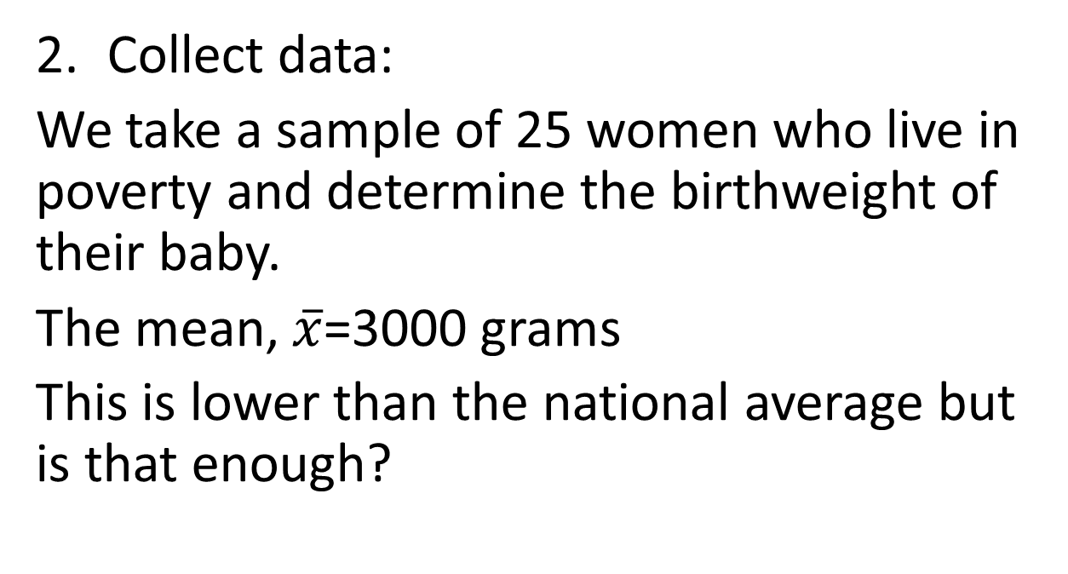
Hypothesis Testing example
Collect data:
We take a sample of 25 women who live in poverty and determine the birthweight of their baby.
The mean, $\overline{x}$=3000 grams
This is lower than the national average but is that enough?
Notes:
If we took another sample would that be lower too? Or was it just chance that we got a mean that much lower?

Slide 20
How far is too far? Distributions

Slide 21
Hypothesis Testing example
Determine the probability of our data if H₀ is true

Slide 22
How far is too far? Distributions
We calculate the probability of 3000 g if we expect 3300 g on average
What is P(3000) or lower from a distribution with mean 3300
Don’t worry how p was calculated
p = 0.048

Slide 23
But more appropriately
What is P(3000) or a mean as unlikely or more unlikely from a distribution with mean 3300?
Values >3600 are just as unlikely
p = 0.096

Slide 24
Hypothesis Testing – relationship to L1 example
Compare our p-value to 0.05
p ≤ 0.05 reject H₀
p > 0.05 do not reject H₀
Our p-value was 0.096 Thus: We do not reject the null hypothesis.
Our sample is consistent with poverty having no effect.

Slide 25
Hypothesis Testing example
p ≤ 0.05 reject H₀; p > 0.05 do not reject H₀
Our p-value was 0.096 Thus: We do not reject the null hypothesis.
Our sample is consistent with poverty having no effect.

Slide 26
Hypothesis Testing: The p-value
Probability of data if null hypothesis true
0.05 is the crucial level
If p ≤ 0.05. We reject the null hypothesis
And conclude there is a significant difference between our sample and what we would expect if there was no effect

Slide 27
Hypothesis Testing: Type 1 and type 2 errors
Inherent in the approach - not ‘mistakes’ you can prevent
Decision after testing | (unknown) True state of H₀
 | True | False
Reject (evidence it is false) | Type 1 error | Correct
Do not reject (no evidence it is false) | Correct | Type 2 error

Slide 28
Hypothesis Testing: Type 1 and type 2 errors
For our birthweight example…..p > 0.05 (0.096)
Decision after testing | (unknown) True state of H₀
 | True | False
Reject (evidence it is false) | Type 1 error | Correct
Do not reject (no evidence it is false) | Correct | Type 2 error

