Slide 1

Emma Rand Data Analysis in R
More than one explanatory variable: Two-way ANOVA

Slide 2
Last week
Extended our ability to test for differences between two or more groups with the one-way ANOVA and its non-parametric equivalent Kruskal-Wallis
Rationale for ANOVA rather than multiple t-tests
ANOVA terminology and concepts: SS, MS, F
Post-hoc tests
In RStudio
Importing data from csv files
One way ANOVA and Kruskal-Wallis and their post-hoc tests
Summarising and reporting
Figure annotations

Slide 3
Summary of this week
Extend of our understanding to testing with two explanatory variables using the two-way ANOVA
Comparison with one-way ANOVA
The three null hypotheses
Running, interpreting and reporting a two-way ANOVA
Investigating the assumptions
Understanding the interaction
Post-hoc analysis (after a significant two-way ANOVA)

Slide 4
Learning objectives for the week
By the end of this week the successful student should be able to:
List the sheets in, and read data from, Excel files (MLO 3)
Combine dataframes of the same structure (MLO 3)
Select, appropriately two-way ANOVA (MLO 2)
Understand the meaning of the interaction term (MLO 2)
Apply and interpret the two-way ANOVA (including the interaction), and post-hoc tests in R (MLO 3 and 4)
Evaluate whether the assumptions of the test are met (MLO 2)
Summarise and illustrate with appropriate R figures test results scientifically (MLO 3 and 4)

Slide 5
Review and rationale

Slide 6
Choosing tests: 3 steps
What is a one sentence description of what you want to know?
What are your explanatory variables?
Categories: t-tests, ANOVA, Wilcoxon, Mann-Whitney
Continuous: Regression, correlation
What is your response variable?
Normally distributed: t-tests, ANOVA, regression
Counts: Chi-squared or stage 2 ☺

Slide 7
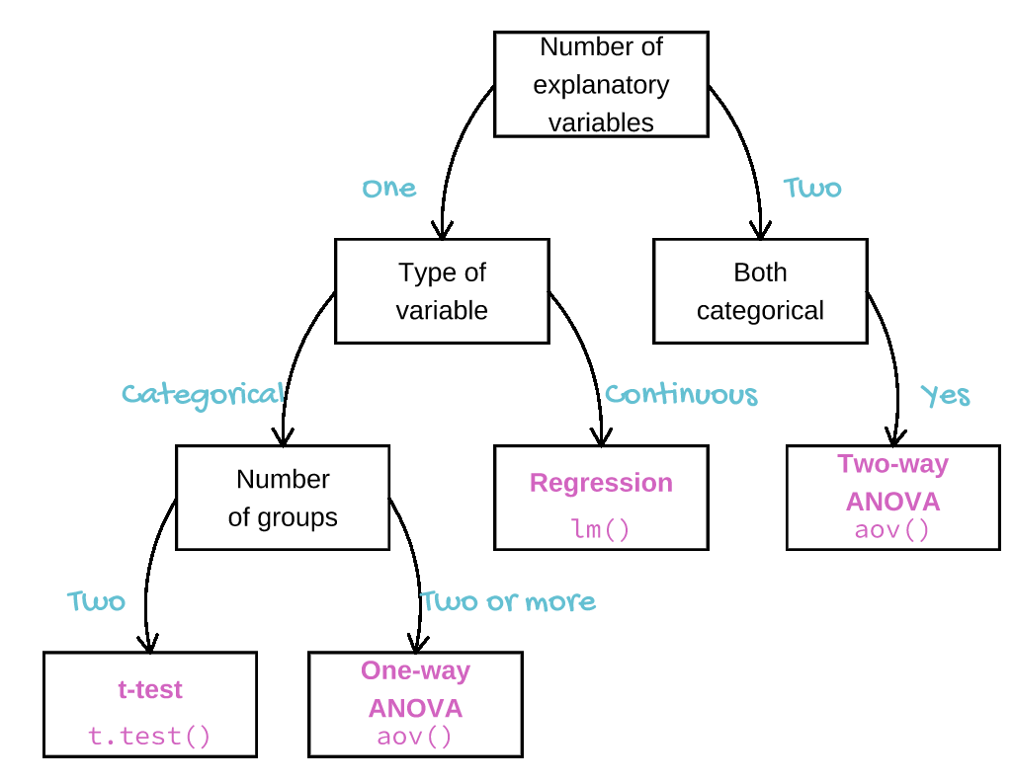

Slide 8
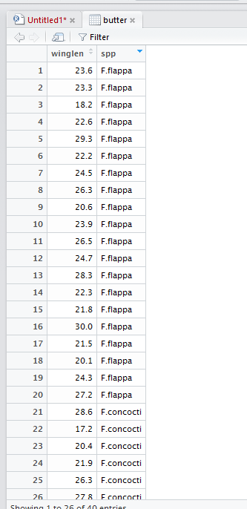
Choosing tests Choosing between one-way and two-way ANOVA?
Response:
wing lengths
Explanatory:
species

Slide 9
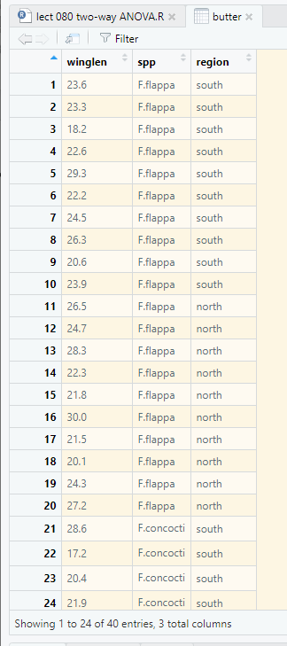
Choosing tests Choosing between one-way and two-way ANOVA?
What if we have two explanatory variables?
Two one-way ANOVAs?? NO
A Two-way ANOVA YES
Note: tidy data format
Explanatory:
species
region

Slide 10
Two-way ANOVA Assumptions
Same as for one-way ANOVA
Normality and homogeneity of variance in residuals
Common sense
Check after ANOVA using the $residuals variable and diagnostic plots (as we did after one-way ANOVA)

Slide 11
The two-way ANOVA
A parametric test

Slide 12
Two-way ANOVA Example
Response: wing lengths
Explanatory variables:
region: two levels
spp: two levels

Slide 13
Two-way ANOVA example What does it test?
The null hypotheses here are:
mean of F.flappa (averaged over the regions) = mean of F.concocti (averaged over the regions),
mean of north (averaged over the spp) = mean of south (averaged over the spp) and
the effects of the two factors are independent.

Slide 14
Two-way ANOVA example What does it test?
The null hypotheses here are:
mean of F.flappa (averaged over the regions) = mean of F.concocti (averaged over the regions),
mean of north (averaged over the spp) = mean of south (averaged over the spp) and
the effects of the two factors are independent.

Slide 15
Two-way ANOVA example Reading in and examining the structure of the data
butter <- read_table(“../data/butterf.txt")
glimpse(butter)
Observations: 40
Variables: 3
$ winglen <dbl> 23.6, 23.3, 18.2, 22.6, 29.3, 22.2, 24.5, 26.3, 20.6, 23.9...
$ spp <fct> F.flappa, F.flappa, F.flappa, F.flappa, F.flappa, F.flappa...
$ region <fct> south, south, south, south, south, south, south, south, so...
Assumptions
Common sense
Can be checked after analysis

Slide 16
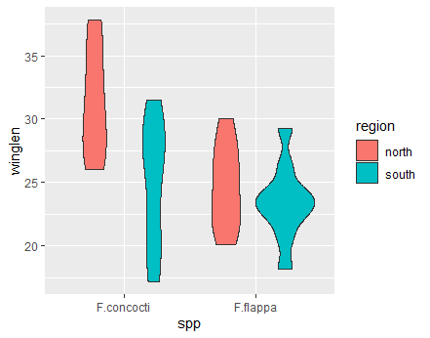
Two-way ANOVA example Plot your data
Plot your data: roughly – perhaps..
ggplot(data = butter,
aes(x = spp, y = winglen, fill = region)) +
geom_violin()

Slide 17
Two-way ANOVA example Example
Sumarise
buttersum <- butter %>%
group_by(region, spp) %>%
summarise(mean = mean(winglen),
median = median(winglen),
sd = sd(winglen),
n = length(winglen),
se = sd/sqrt(n))
buttersum
# A tibble: 4 x 7
# Groups: region [2]
region spp mean median sd n se
<fct> <fct> <dbl> <dbl> <dbl> <int> <dbl>
1 north F.concocti 31.4 31.0 4.28 10 1.35
2 north F.flappa 24.7 24.5 3.27 10 1.03
3 south F.concocti 25.0 27.0 4.96 10 1.57
4 south F.flappa 23.4 23.5 3.01 10 0.953

Slide 18
Two-way ANOVA example Example
Run the ANOVA
mod <- aov(data = butter,
winglen ~ region * spp)
Assign result because we will be able to access residuals from this object later

Slide 19
Two-way ANOVA example Example
Run the anova
mod <- aov(data = butter,
winglen ~ region * spp)
The model: explain winglen by region, spp and the interaction between them

Slide 20
Two-way ANOVA example Understanding the test output
mod <- aov(data = butter, winglen ~ region * spp)
summary(mod)
Df Sum Sq Mean Sq F value Pr(>F)
region 1 145.16 145.161 9.2717 0.004334 **
spp 1 168.92 168.921 10.7893 0.002280 **
region:spp 1 67.08 67.081 4.2846 0.045692 *
Residuals 36 563.63 15.656
---
Signif. codes: 0 ‘***’ 0.001 ‘**’ 0.01 ‘*’ 0.05 ‘.’ 0.1 ‘ ’ 1
Three tests
Three p values

Slide 21
Two-way ANOVA example Understanding the test output
mod <- aov(data = butter, winglen ~ region * spp)
summary(mod)
Df Sum Sq Mean Sq F value Pr(>F)
region 1 145.16 145.161 9.2717 0.004334 **
spp 1 168.92 168.921 10.7893 0.002280 **
region:spp 1 67.08 67.081 4.2846 0.045692 *
Residuals 36 563.63 15.656
---
Signif. codes: 0 ‘***’ 0.001 ‘**’ 0.01 ‘*’ 0.05 ‘.’ 0.1 ‘ ’ 1
There is an effect of region (difference between regions)
There is an effect of species (difference between species)
There is an interaction between region and species…..

Slide 22
Two-way ANOVA example Understanding the test output
mod <- aov(data = butter, winglen ~ region * spp)
summary(mod)
Df Sum Sq Mean Sq F value Pr(>F)
region 1 145.16 145.161 9.2717 0.004334 **
spp 1 168.92 168.921 10.7893 0.002280 **
region:spp 1 67.08 67.081 4.2846 0.045692 *
Residuals 36 563.63 15.656
---
Signif. codes: 0 ‘***’ 0.001 ‘**’ 0.01 ‘*’ 0.05 ‘.’ 0.1 ‘ ’ 1
Total d.f. is no. of values – 1: 40 – 1 = 39
region d.f. is no. regions – 1: 2 – 1 = 1
spp d.f. is no. spp – 1: 2 – 1 = 1
Interaction d.f. is region d.f. * spp d.f. : 1* 1 = 1
Residual d.f. is total d.f. – all other d.f.: 39 – 1 – 1 – 1 = 36

Slide 23
Two-way ANOVA example Understanding the test output
mod <- aov(data = butter, winglen ~ region * spp)
summary(mod)
Df Sum Sq Mean Sq F value Pr(>F)
region 1 145.16 145.161 9.2717 0.004334 **
spp 1 168.92 168.921 10.7893 0.002280 **
region:spp 1 67.08 67.081 4.2846 0.045692 *
Residuals 36 563.63 15.656
---
Signif. codes: 0 ‘***’ 0.001 ‘**’ 0.01 ‘*’ 0.05 ‘.’ 0.1 ‘ ’ 1
‘Error term’ for all 3 tests

Slide 24
Two-way ANOVA example Checking Assumptions
- Common sense
response should be continuous
No/few repeats
- Plot the residuals
- Using a test in R

Slide 25
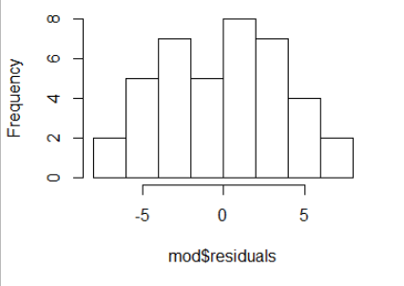
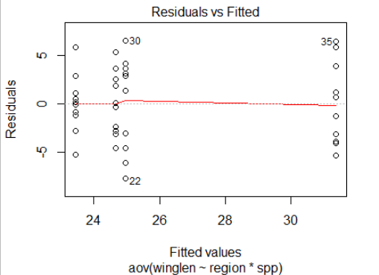
Two-way ANOVA Checking Assumptions
Residuals are calculated for you already!
Histogram of residuals should be normally distributed
hist(mod$residuals)
shapiro.test(mod$residuals)
Shapiro-Wilk normality test
data: mod$residuals
W = 0.97306, p-value = 0.4474
plot(mod, which=1)
Spread of residuals should be similar in each group

Slide 26
Two-way ANOVA example Reporting the result
Reporting the result: “significance, direction, magnitude”
There was a significant difference between the species (ANOVA: F = 10.79; d.f. = 1,36; p =0.002) and between the regions (F = 9.27; d.f. = 1,36; p =0.004). However, there was also a significant interaction between region and species (F = 4.28; d.f. = 1,36; p =0.046)
What about direction and magnitude??

Slide 27
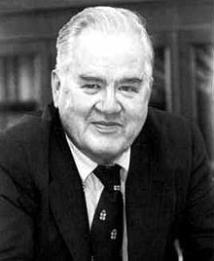
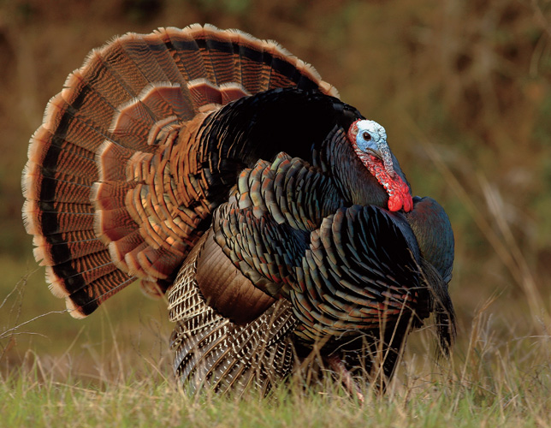

Two-way ANOVA example Reporting the result: Post-hoc?
Post-hoc test e.g., Tukey
John Wilder Tukey
Wild Turkey
Wild Turkey

Slide 28
Two-way ANOVA example Reporting the result
Which means differ? Post-hoc test needed e.g., Tukey
3 parts to the output. First two parts for region and spp
TukeyHSD(mod)
Tukey multiple comparisons of means
95% family-wise confidence level
Fit: aov(formula = winglen ~ region * spp, data = butter)
$region
diff lwr upr p adj
south-north -3.81 -6.347658 -1.272342 0.004334
$spp
diff lwr upr p adj
F.flappa-F.concocti -4.11 -6.647658 -1.572342 0.0022796

Slide 29
Two-way ANOVA example Reporting the result
Which means differ? Post-hoc test needed e.g., Tukey
3 parts to the output. Third part for the interaction
$`region:spp`
diff lwr upr p adj
south:F.concocti-north:F.concocti -6.40 -11.165769 -1.634231 0.0048102
north:F.flappa-north:F.concocti -6.70 -11.465769 -1.934231 0.0030099
south:F.flappa-north:F.concocti -7.92 -12.685769 -3.154231 0.0004123
north:F.flappa-south:F.concocti -0.30 -5.065769 4.465769 0.9982343
south:F.flappa-south:F.concocti -1.52 -6.285769 3.245769 0.8257284
south:F.flappa-north:F.flappa -1.22 -5.985769 3.545769 0.9004525

Slide 30
Two-way ANOVA example Reporting the result: direction and magnitude
$`region:spp`
diff lwr upr p adj
south:F.concocti-north:F.concocti -6.40 -11.165769 -1.634231 0.0048102
north:F.flappa-north:F.concocti -6.70 -11.465769 -1.934231 0.0030099
south:F.flappa-north:F.concocti -7.92 -12.685769 -3.154231 0.0004123
north:F.flappa-south:F.concocti -0.30 -5.065769 4.465769 0.9982343
south:F.flappa-south:F.concocti -1.52 -6.285769 3.245769 0.8257284
south:F.flappa-north:F.flappa -1.22 -5.985769 3.545769 0.9004525
buttersum
# A tibble: 4 x 7
# Groups: region [2]
region spp mean
<fct> <fct> <dbl>
1 north F.concocti 31.4
2 north F.flappa 24.7
3 south F.concocti 25.0
4 south F.flappa 23.4

Slide 31
Two-way ANOVA example Reporting the result: direction and magnitude
F.concocti had significantly longer wings on average than F.flappa (ANOVA: F = 10.79; d.f. = 1,36; p = 0.002) and individuals were significantly bigger in the North than the South (F = 9.27; d.f. = 1,36; p = 0.004). However, this was primarily because northern F.concocti were significantly larger than the other three groups (Tukey Honest Significant difference: southern F.concocti p = 0.0048, southern F.flappa p = 0.0004, northern F.flappa p = 0.003, ). See Figure 1.

Slide 32
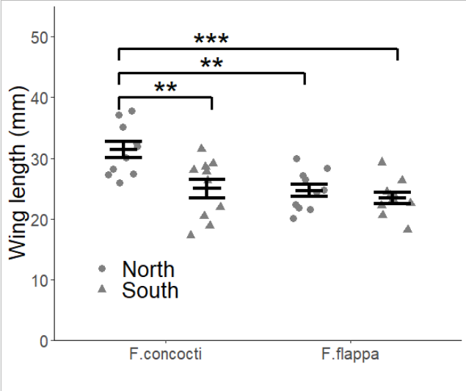
Two-way ANOVA example Reporting the result: figure

Slide 33
Two-way ANOVA summary
Parametric
Two explanatory categorical variables
Three null hypotheses: main effects and interaction
Function in R:
mod <- aov(data = df, response ~ explanatory1 * explanatory2)
summary(mod)
assumptions: normally and homogenously distributed residuals
continued

Slide 34
t-tests Two-way ANOVA summary
ANOVA tells at lest two means differ and a post-hoc test is need to determine which means differ
Tukey Honest Significant Difference is the post-hoc we used
Function in R:
TukeyHSD(mod)
Interpret the interaction
Significance, direction, magnitude
Figure: data and ‘model’

Slide 35
Understanding the interaction
in two-way ANOVA

Slide 36
Two-way ANOVA example Understanding the interaction from the figure
region – Sig
Spp – Sig
Int – Sig
Effect of region is greater in F.concocti (i.e., the gap between regions is bigger)
‘effect of one factor depends on the level of another’

Slide 37
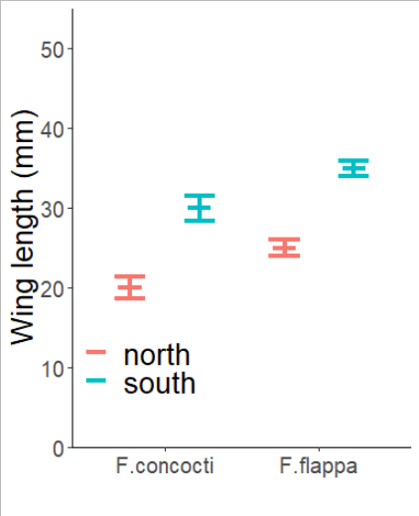
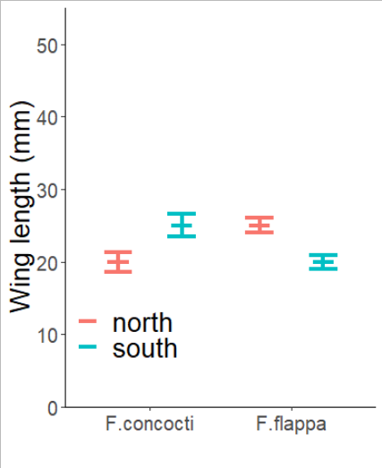
Two-way ANOVA example Understanding the interaction from the figure
Some other possible results
No interaction: Gap the same Interaction: Gap the reversed

Slide 38
Two-way ANOVA example Understanding the interaction from the figure
Region – NS
Spp – NS
Int – Sig
But region does have an effect!
It is just reversed!
If you have a significant interaction, interpret main effects with care. Look at the Post-hoc test

