Slide 1
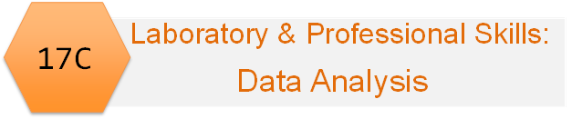
Emma Rand Data Analysis in R
Chi-squared tests

Slide 2
Summary of this week
Analysing data that are counts falling into mutually exclusive categories’
Two types of chi-squared test and the difference between these two tests.
In the workshop we will discover how to apply chi-squares to data in both frequency tables and in a more raw state (i.e., tabulate the data yourself)

Slide 3
Learning objectives for the week
By the end of this week the successful student should be able to :
Explain the principles of chi-squared Goodness of Fit and Contingency tests and know when each can be applied (MLO 2)
Apply and interpret Goodness of fit and Contingency chi-squared tests R on data in frequency tables and in raw format (MLO 3 and 4)
Summarise and illustrate with appropriate R figures test results scientifically (MLO 3 and 4)

Slide 4
Why chi-squared?
When we count the number of things in categories and compare the numbers we observe to numbers we expect under a null hypothesis.

Slide 5
The null hypothesis might be:
Same number in each category
1:1
1:1:1:1
1:1:1:1:1:1:1
smooth | wrinkled
13 | 17
red | blue | green | yellow
8 | 11 | 12 | 9
Mon | Tues | Wed | Thurs | Fri | Sat | Sun
23 | 29 | 11 | 14 | 20 | 15 | 21
Goodness of fit

Slide 6
The null hypothesis might be:
Follow a particular pattern
1:3
1:3:3:9
smooth | wrinkled
13 | 58
Yellow plain | Yellow spot | Red plain | Red spot
4 | 14 | 12 | 30
Goodness of fit

Slide 7
The null hypothesis might be:
match the pattern in another group
?
But same as
 | blue | green | yellow
Group A | 11 | 12 | 9
Group B | 3 | 12 | 9
Contingency

Slide 8
Why chi-squared?
When we count the number of things in categories and compare the numbers we observe to numbers we expect under a null hypothesis.
H₀ might expect numbers to
be the same, or
follow a particular pattern, or
match the pattern in another group
Chi-squared allows us to make the comparison statistically
Goodness of fit
Contingency

Slide 9
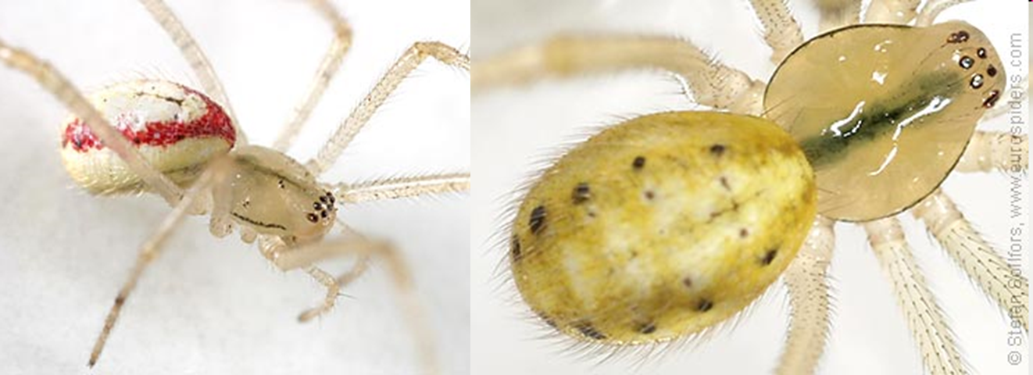
Our two example scenarios
The Candy-striped spider can be plain or striped
2 alleles at one locus, striped dominant to plain
We perform: Ss x ss = Ss, Ss, ss,ss
We expect the ratio of striped : plain to be 1:1

Slide 10
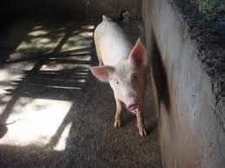
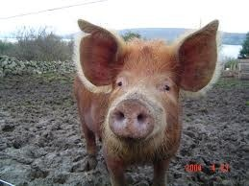
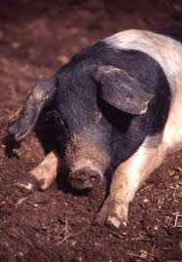

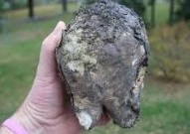
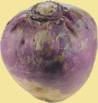
Example scenarios
Food choice by pig breeds
We don’t know what proportions are expected but do expect it to be same for each breed
Welsh Tamworth Essex
cabbage
sugarbeet
swede

Slide 11
Two types of scenario thus two types of χ² test
We know what the proportions should be (known as a priori expectations)
Goodness of fit (e.g., candy striped spiders)
We don’t know what the proportions should be (without a priori expectations) but we know they should be the same in each group
Contingency (e.g., pigs and food)

Slide 12
The Chi-squared formula
O – observed number
E – expected numbers
Σ – take the sum of

Slide 13
The Chi-squared formula
The difference between what we see and what we expect to see if H₀ is true
…squared so positive
……..relative to expected value
Gets bigger as the difference increases.
Also as number of categories increase therefore d.f. matter

Slide 14
χ² Goodness of fit test

Slide 15
χ² Goodness of fit test
The expected values (null hypothesis) are derived from some theory
We test the fit of our data to the theory
The ‘theory’ can be a uniform distribution
In our first example the theory is Mendel’s Law (and happens to be uniform too)

Slide 16
Our two example scenarios
The Candy-striped spider can be plain or striped
2 alleles at one locus, striped dominant to plain
We perform: Ss x ss = Ss, Ss, ss,ss
We expect the ratio of striped : plain to be 1:1

Slide 17

χ² Goodness of fit test: example
The Candy-striped spider: Striped : plain is 1:1
63 offspring
Observed | 28 | 35
Expected | 31.5 | 31.5

Slide 18
χ² Goodness of fit test: example
At least two ways to conduct in R.
By coding the formula
By using the inbuilt function
We’ll do both; you can use either.

Slide 19

χ² Goodness of fit test: example
By coding the formula
Observed values
Observed | 28 | 35
expected | 31.5 | 31.5
##################################################
# CHI-SQUARED BY CODING THE FORMULA #
##################################################
# the observed data
obs <- c(28, 35)
# total number of observations
total <- sum(obs)

Slide 20
χ² Goodness of fit test: example
By coding the formula
Expected values
Observed | 28 | 35
expected | 31.5 | 31.5
# calculate the expected values
# the H0 is for a 1:1 ratio
# i.e., half the total in each
exp <- c(total / length(obs), total / length(obs))
I used length(obs) rather than 2 because it makes the code more reusable

Slide 21
χ² Goodness of fit test: example
By coding the formula
Code the formula
Observed | 28 | 35
expected | 31.5 | 31.5
# code the formula
chi <- sum(((obs - exp)^2) / exp)
# [1] 0.7777778

Slide 22
χ² Goodness of fit test: example
By coding the formula
Find the probability of getting a χ² of 0.778 or more extreme (bigger)
Observed | 28 | 35
expected | 31.5 | 31.5
# look up the probability of getting a chi squared
# of 0.778 or more extreme (bigger)
#
# the degrees of freedom are the number of
# categories minus 1
df <- length(obs) - 1
pchisq(chi, df = df, lower.tail = FALSE)
# [1] 0.3778216

Slide 23
χ² Goodness of fit test: example Conclusion
χ² = 0.78; d.f. = 1; p = 0.38
p > 0.05, therefore the test is not significant
Results are consistent with a 1:1 ratio
“There was no significant difference between the observed and the expected ratio.”

Slide 24
χ² Goodness of fit test: example Conclusion
IF you had χ² = 4.6; d.f. = 1; p = 0.032
p < 0.05 therefore the test is significant
Results are NOT consistent with a 1:1 ratio
“There was a significant difference between the observed and expected ratio (χ² = 4.6; d.f. = 1; p = 0.032).”
“There were significantly more xxxx and fewer xxxx than expected (χ² = 4.6; d.f. = 1; p = 0.032).” includes direction

Slide 25
χ² Goodness of fit test: example
By using the inbuilt function
Observed | 28 | 35
expected | 31.5 | 31.5
##################################################
# CHI-SQUARED BY CODING THE FORMULA #
##################################################
# we can use the same obs vector
chisq.test(obs)
# Chi-squared test for given probabilities
#
# data: obs
# X-squared = 0.77778, df = 1, p-value = 0.3778

Slide 26
χ² Goodness of fit test: example
But what to use?? What you prefer but….
By coding the formula
Useful when your expected are derived from a more complex theory/idea (e.g., poisson distribution, binomial distribution) or you need to alter the d.f.
By using the inbuilt function
Easy when the ratio is 1:1, 1:1:1, 1:1:1 etc
But take care – other H₀ must be specified

Slide 27
Summary
Goodness of fit
We know what the proportions should be (known as a priori expectations)
fit to a theory or distribution
Single row/column of observations
One explanatory
Inbuilt chisq.test() function is good for 1:1:1 expectations, otherwise specify prob
For complex cases, calculate expected values and code the test.

Slide 28
χ² Contingency test

Slide 29



χ² Contingency test
Food choice by pig breeds
We don’t know what proportions are expected but do expect it to be same for each breed
Null hypothesis: proportion of foods taken by each breed is the same, i.e., no association between breed and food type
Welsh Tamworth Essex
cabbage
sugarbeet
swede

Slide 30
χ² Contingency test: example The Data
Welsh Tamworth Essex
cabbage
sugarbeet
swede
11 | 19 | 22 | 52
21 | 16 | 8 | 44
7 | 12 | 11 | 30
39 | 47 | 41 | 127
Expected values are derived from the data
Overall pref for cabbage = 52/127
We expect (the H₀)same for each breed

Slide 31
χ² Contingency test example Where do the expected values come from?
Welsh Tamworth Essex
cabbage
sugarbeet
swede
11 | 19 | 22 | 52
21 | 16 | 8 | 44
7 | 12 | 11 | 30
38 | 47 | 41 | 127
Overall preference for cabbage = 45/127
Thus: Exp no. of welsh preferring cabbage = 52/127 * 38 = 15.97
Exp no. of tamworth preferring cabbage 52/127 * 47 =19.24
Exp no. of essex preferring cabbage 52/127 * 41 = 16.79
RULE: Expected number for each cell:
Row total * Column total / Overall total

Slide 32

χ² Contingency test example Where do the expected values come from?
Wow, that’s a pain!
R to the rescue!
@allison_horst

Slide 33
χ² Contingency test example
R’s inbuilt function will do that!
First, add the data
# create the data
food_pref <- matrix(c(11, 21, 7,
19, 16, 12,
22, 8, 11),
nrow = 3,
byrow = TRUE)
[,1] [,2] [,3]
[1,] 11 21 7
[2,] 19 16 12
[3,] 22 8 11
Note: this is the only time we’ll use a matrix datatype – we normally use dataframes.

Slide 34
χ² Contingency test example
It’s helpful to name the rows and columns
# make a list object to hold two vectors
# in a list the vectors can be of different lengths
vars <- list(breed = c("welsh",
"tamworth",
“essex"),
food = c("cabbage",
"sugarbeet",
"swede"))
food_pref <- matrix(c(11, 21, 7,
19, 16, 12,
22, 8, 11),
nrow = 3,
byrow = TRUE,
dimnames = vars)
And this is partly why! Dataframes always have named columns.

Slide 35
χ² Contingency test example
Now we have…
food
breed cabbage sugarbeet swede
welsh 11 21 7
tamworth 19 16 12
essex 22 8 11
Run the inbuilt test
chisq.test(food_pref)
Pearson's Chi-squared test
data: food_pref
X-squared = 10.64, df = 4, p-value = 0.03092

Slide 36
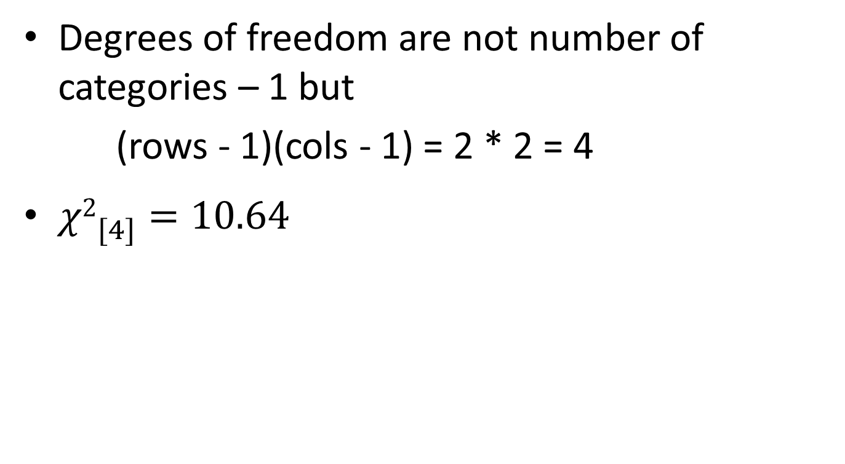
χ² Contingency test: example degrees of freedom
Degrees of freedom are not number of categories – 1 but
(rows - 1)(cols - 1) = 2 * 2 = 4
${χ2}_{[4]}^{}=10.64$

Slide 37
χ² Contingency test Conclusion
Thus the test is significant (we reject the null hypothesis)
Conclude: evidence of a preference for particular foods by different breeds
But in what way? (“direction of effect”)
Who likes what?

Slide 38
χ² Contingency test Conclusion
In what way – examine the observed and expected values.
Observed:
# food
# breed cabbage sugarbeet swede
# welsh 11 21 7
# tamworth 19 16 12
# essex 22 8 11
Expected:
chisq.test(food_pref)$expected
# food
# breed cabbage sugarbeet swede
# welsh 15.96850 13.81890 9.212598
# tamworth 19.24409 16.65354 11.102362
# essex 16.78740 14.52756 9.685039

Slide 39
χ² Contingency test Conclusion
Higher than expected
Less than 1 different
Lower than expected
Direction of deviations; size of deviation
Observed:
# food
# breed cabbage sugarbeet swede
# welsh 11 21 7
# tamworth 19 16 12
# essex 22 8 11
Expected:
chisq.test(food_pref)$expected
# food
# breed cabbage sugarbeet swede
# welsh 15.96850 13.81890 9.212598
# tamworth 19.24409 16.65354 11.102362
# essex 16.78740 14.52756 9.685039

Slide 40
χ² Contingency test Conclusion
Different pig breeds showed a significant preference for the different food types (χ² = 10.64; d.f. = 4; p = 0.031) with Essex much preferring cabbage and disliking sugarbeet, Welsh showing a strong preferencing for sugarbeet and a dislike of cabbage and Tamworth showing no clear preference.
# food
# breed cabbage sugarbeet swede
# welsh 11 21 7
# tamworth 19 16 12
# essex 22 8 11

Slide 41
Summary
Contingency
We don’t know what the proportions should be (without a priori expectations) but we know they should be the same in each case
At least 2 x 2 table
Two explanatory
Inbuilt chisq.test() function is good

