Slide 1

Emma Rand Data Analysis in R
More than two samples: One-way ANOVA and Kruskal-Wallis

Slide 2
Last week
Independent and non-independent samples
Two-sample-tests
The two-sample t-test
The two sample Wilcoxon, also known as the Mann-Whitney
In RStudio
t-tests and their non-parametric equivalents
Summarising, plotting and reporting

Slide 3
Summary of this week
Extend our ability to test for differences between two or more groups: one-way ANOVA and its non-parametric equivalent Kruskal-Wallis
Why not do several two-sample tests?
ANOVA terminology and concepts
ANOVA assumptions
Running, interpreting and reporting an ANOVA
Post-hoc analysis (after a significant ANOVA)
When assumptions are not met: Kruskal-Wallis
Running, interpreting and reporting Kruskal-Wallis
Post-hoc analysis (after a significant Kruskal-Wallis)

Slide 4
Learning objectives for the week
By attending the lectures and practical the successful student will be able to
Explain the rationale behind ANOVA understand the meaning of the F values (MLO 1 and 2)
Select, appropriately, one-way ANOVA and Kruskal-Wallis (MLO 2)
Know what functions are used in R to run these tests and how to interpret them(MLO 3 and 4)
Know how to state the results of these tests scientifically (MLO 3 and 4)
Create figures for these tests which are suitable for including in a scientific report (MLO 3 and 4)

Slide 5
Review and rationale

Slide 6
Reminder: The choice of test depends on ….
Type of data
The type of values a variable can take: Discrete or continuous?
Their role in the analysis
Which is the response and which is/are explanatory?
(week 3 Hypothesis testing, data types, reading data in to R and saving figures

Slide 7
Choosing tests: 3 steps
What is a one sentence description of what you want to know?
What are your explanatory variables?
Categories: t-tests, ANOVA, Wilcoxon, Mann-Whitney
Continuous: Regression, correlation
What is your response variable?
Normally distributed: t-tests, ANOVA, regression
Counts: Chi-squared or stage 2 ☺

Slide 8
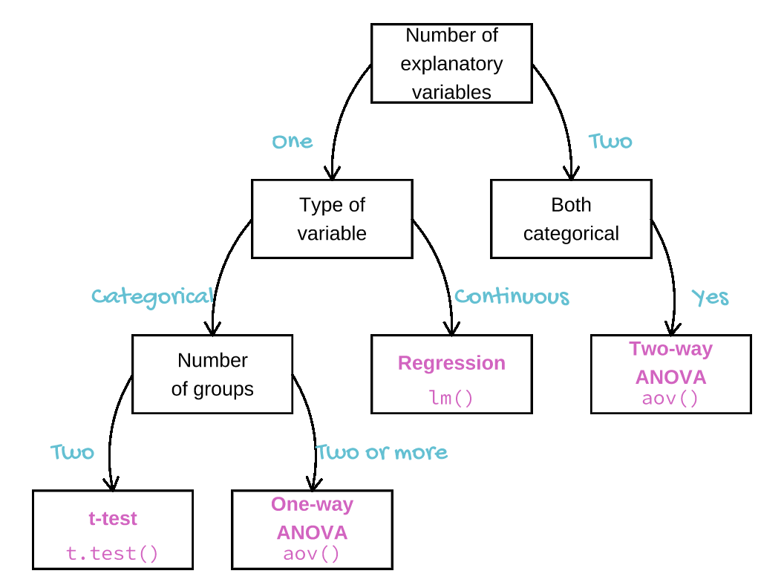

Slide 9
Choosing tests Why ANOVA, not several t–tests?
Type I error: Rejecting the null hypothesis when it is true
This will happen with a probability of 0.05
Doing lots of comparisons increases the type 1 error rate
ANOVA tests for an effect of the explanatory variable without increasing type 1 error rate

Slide 10
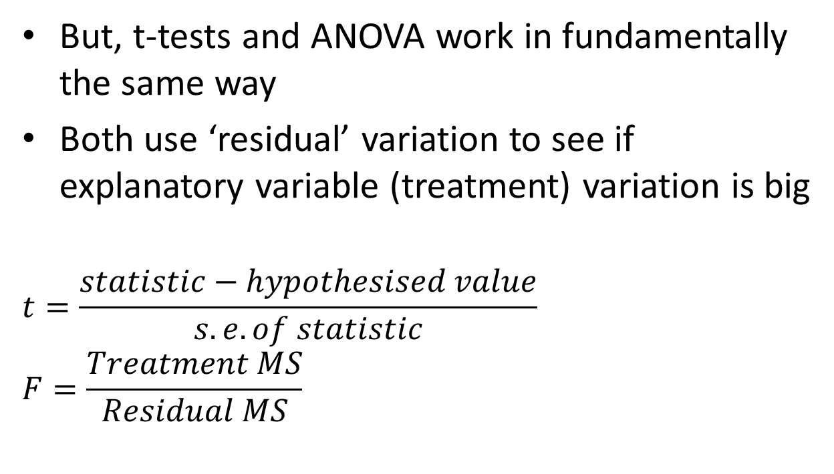
Choosing tests Why ANOVA, not several t–tests?
But, t-tests and ANOVA work in fundamentally the same way
Both use ‘residual’ variation to see if explanatory variable (treatment) variation is big
$$t=\frac{statistic−hypothesised value}{s.e. of statistic}$$
$$F=\frac{Treatment MS}{Residual MS}$$
Notes:
Ratio of difference between observed stat and expected and standard dev of obs stat. Is diff big relative to variance? T is a standard error

Slide 11
One-way ANOVA Assumptions and alternative
ANOVA, like t-tests assumes the “residuals” are normally distributed and have homogeneity of variance
Kruskal-Wallis is the non-parametric equivalent when assumptions are not met.

Slide 12
The one-way ANOVA
A parametric test

Slide 13
One-way ANOVA Example
Which growth medium is best for growing bacterial cultures?
Explanatory variable is type of media: categorical with 3 groups
Control
Control + sugar
Control + sugar + amino acids
Response variable is colony diameters (mm)

Slide 14
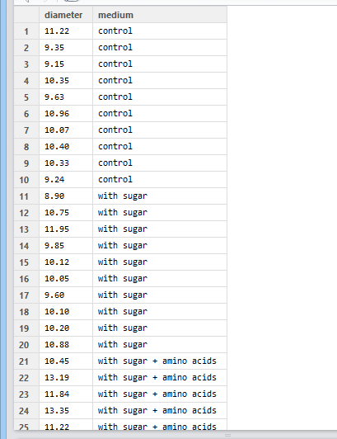
One-way ANOVA Example
One response, one categorical explanatory variable (“one-way ANOVA” or “one-factor ANOVA”)
These data are in tidy format.

Slide 15
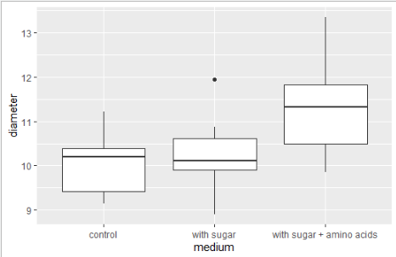
One-way ANOVA Example
Plot your data: roughly – perhaps..
ggplot(data = culture,
aes(x = medium, y = diameter)) +
geom_boxplot()

Slide 16
One-way ANOVA Example
Summarise the data:
culturesum <- culture %>%
group_by(medium) %>%
summarise(mean = mean(diameter),
std = sd(diameter),
n = length(diameter),
se = std/sqrt(n))
culturesum
# A tibble: 3 x 5
medium mean std n se
<fct> <dbl> <dbl> <int> <dbl>
1 control 10.1 0.716 10 0.226
2 with sugar 10.2 0.818 10 0.259
3 with sugar + amino acids 11.4 1.18 10 0.373

Slide 17
One-way ANOVA Example
Run the anova
mod <- aov(data = culture,
diameter ~ medium)
Assign result because we will be able to access residuals from this object later

Slide 18
One-way ANOVA Example
Name of the dataframe
mod <- aov(data = culture,
diameter ~ medium)
The model: explain diameter by medium

Slide 19
One-way ANOVA Example
Examine the result
P value
summary(mod)
Df Sum Sq Mean Sq F value Pr(>F)
medium 2 10.49 5.247 6.113 0.00646 **
Residuals 27 23.18 0.858
---
Signif. codes:
0 ‘***’ 0.001 ‘**’ 0.01 ‘*’ 0.05 ‘.’ 0.1 ‘ ’ 1
A key for the line annotation

Slide 20
One-way ANOVA Terminology
Df Sum Sq Mean Sq F value Pr(>F)
medium 2 10.49 5.247 6.113 0.00646 **
Residuals 27 23.18 0.858
---
Signif. codes:
0 ‘***’ 0.001 ‘**’ 0.01 ‘*’ 0.05 ‘.’ 0.1 ‘ ’ 1
Sum Sq: “Sums of squares ” (SS): (“sum squared deviation from the mean”)
Mean Sq: “Mean square” (MS): variance SS / df
(“average squared deviation from the mean”)
Notes:
Ratio of difference between observed stat and expected and standard dev of obs stat. Is diff big relative to variance? T is a standard error

Slide 21
One-way ANOVA Terminology
Df Sum Sq Mean Sq F value Pr(>F)
medium 2 10.49 5.247 6.113 0.00646 **
Residuals 27 23.18 0.858
---
Signif. codes:
0 ‘***’ 0.001 ‘**’ 0.01 ‘*’ 0.05 ‘.’ 0.1 ‘ ’ 1
Not in output: Total MS: total variation
5.247 - Treatment/factor MS: variation due to categorical variable
0.858 - Residual MS: background/random/left over variation
Notes:
Ratio of difference between observed stat and expected and standard dev of obs stat. Is diff big relative to variance? T is a standard error

Slide 22
One-way ANOVA Terminology
Df Sum Sq Mean Sq F value Pr(>F)
medium 2 10.49 5.247 6.113 0.00646 **
Residuals 27 23.18 0.858
---
Signif. codes:
0 ‘***’ 0.001 ‘**’ 0.01 ‘*’ 0.05 ‘.’ 0.1 ‘ ’ 1
F is the test statistic
It is variable MS / Residual MS
5.247 / 0.858 = 6.113
There is 6.113 times the variance between groups than within them
Notes:
Ratio of difference between observed stat and expected and standard dev of obs stat. Is diff big relative to variance? T is a standard error

Slide 23
One-way ANOVA Checking Assumptions
ANOVA assumes the “residuals” are normally distributed and have homogeneity of variance
First use common sense: colony diameter is continuous and we would expect it to be normally distributed thus we would expect the residuals to be normally distributed

Slide 24
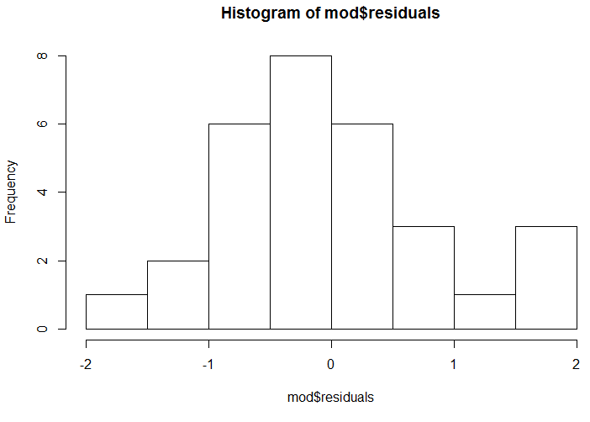
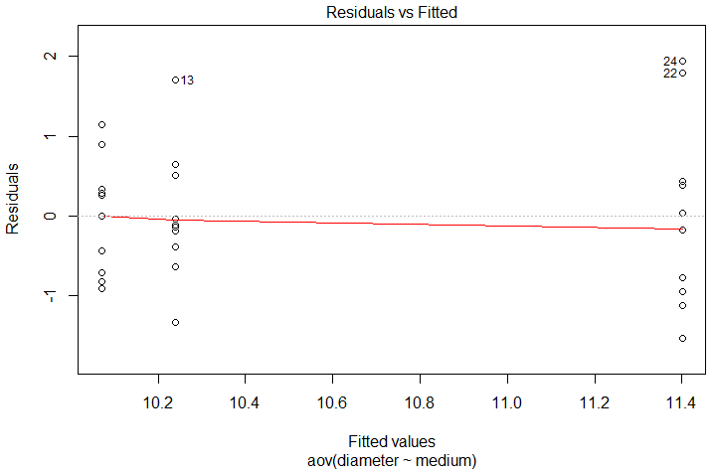
One-way ANOVA Checking Assumptions
Residuals are calculated for you already!
Should be normally distributed
hist(mod$residuals)
shapiro.test(mod$residuals)
Shapiro-Wilk normality test
data: mod$residuals
W = 0.96423, p-value = 0.3953
plot(mod, which=1)
Spread should be similar in each group

Slide 25
One-way ANOVA Example: reporting the result
Reporting the result: “significance, direction, magnitude”
There is a significant effect of media on the diameter of bacterial colonies (ANOVA: F = 6.11; d.f. = 2, 27; p = 0.006).
Or
There is a significant difference in diameters between colonies grown on different media (ANOVA: F = 6.11; d.f. = 2, 27; P=0.006).
What about direction and magnitude??

Slide 26
One-way ANOVA Example: direction and magnitude
Which means differ? Post-hoc test needed e.g., Tukey
TukeyHSD(mod)
Tukey multiple comparisons of means
95% family-wise confidence level
Fit: aov(formula = diameter ~ medium)
$medium
diff lwr upr p adj
with sugar-control 0.170 -0.857331 1.197331 0.9116894
with sugar + amino acids-control 1.331 0.303669 2.358331 0.0092052
with sugar + amino acids-with sugar 1.161 0.133669 2.188331 0.0243794

Slide 27
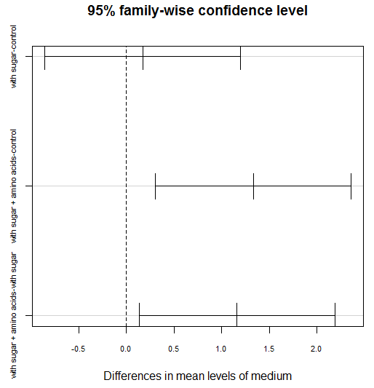
Which means differ?
diff lwr upr p adj
with sugar-control 0.170 -0.857331 1.197331 0.9116894
with sugar + amino acids-control 1.331 0.303669 2.358331 0.0092052
with sugar + amino acids-with sugar 1.161 0.133669 2.188331 0.0243794
Visualise with post-hoc plot
A difference of zero
plot(TukeyHSD(mod))
comparison
95% CI

Slide 28
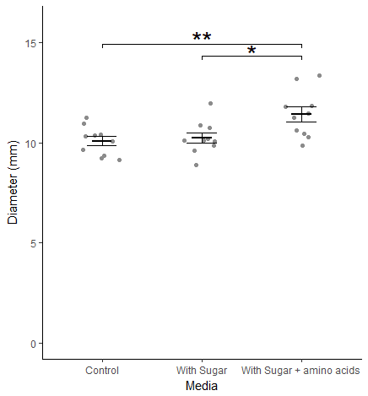
One-way ANOVA Example: Reporting the result
There is a significant effect of media on the diameter of bacterial colonies (ANOVA: F = 6.11; d.f. = 2, 27; p = 0.006) with colonies growing significantly better when both sugar and amino acids are added to the medium (see Figure 1).
Figure 1. Colony diameter for bacteria grown on different media. Heavy lines are group means with error bars being +/-1 S.E. Significant comparisons are indicated.

Slide 29
One-way ANOVA Example: reporting the result
NOT LIKE THIS!!
There was a significant difference between media and growth rates ………..
It doesn’t make sense

Slide 30
One-way ANOVA Example: reporting the result
There was a significant difference between media in growth rates ………..
OR…..
factor levels
response
There was a significant effect of media on growth………..
factor
response

Slide 31
t-tests One-way ANOVA summary
Parametric
To test for a difference between two OR more independent means
F is a variance ration
Function in R:
mod <- aov(data = df, response ~ explanatory)
summary(mod)
If p < 0.05 the test is significant
assumptions: normally and homogenously distributed residuals
continued

Slide 32
t-tests One-way ANOVA summary
ANOVA tells at lest two means differ and a post-hoc test is need to determine which means differ
Tukey Honest Significant Difference is the post-hoc we used
Function in R:
TukeyHSD(mod)
Significance, direction, magnitude
Figure: data and ‘model’

Slide 33
Kruskal-Wallis
Non-parametric equivalent of the one-way ANOVA

Slide 34
One-way ANOVA Non-parametric equivalent: Kruskal Wallis
When assumptions are not met
Residuals not normal
Unequal variance
Likely when:
Repeated values
Small sample size
Unequal sample size

Slide 35
Non-parametric equivalent of one-way ANOVA Kruskal Wallis: example on same data
Same data – to compare power
Test statistic follows a chi-squared distribution
kruskal.test(data = culture, diameter ~ medium)
Kruskal-Wallis rank sum test
data: diameter by medium
Kruskal-Wallis chi-squared = 8.1005, df = 2, p-value = 0.01742
There is a significant effect of media on diameter

Slide 36
Non-parametric equivalent of one-way ANOVA Kruskal Wallis: example on same data
Which groups differ? Post-hoc test needed e.g., kruskalmc() in pgirmess package
True = significant
library(pgirmess)
kruskalmc(data = culture, diameter ~ medium)
Multiple comparison test after Kruskal-Wallis
p.value: 0.05
Comparisons
obs.dif critical.dif difference
control-with sugar 0.85 9.425108 FALSE
control-with sugar + amino acids 10.10 9.425108 TRUE
with sugar-with sugar + amino acids 9.25 9.425108 FALSE

Slide 37
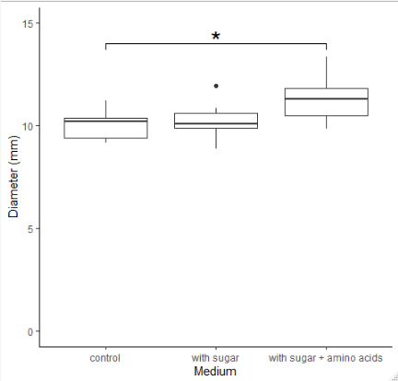
Non-parametric equivalent of one-way ANOVA Kruskal Wallis: example on same data
Reporting the result: “significance, direction, magnitude”
There is a significant effect of media on the diameter of bacterial colonies (Kruskal-Wallis: χ²= 8.1; d.f. = 2; p =0.017) with a significant difference only between the control and when sugar and amino acids are added to the medium (see Figure 1).

Slide 38
t-tests Kruskal-Wallis summary
Non-parametric
when assumptions for one-way ANOVA not met
To test whether the mean ranks differ
Function in R:
kruskal.test(data = df, response ~ explanatory)
If p < 0.05 the test is significant
Few assumptions
Figure: boxplot

