Slide 1
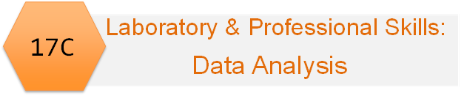
Emma Rand Data Analysis in R
Week 4: Normal distributions, calculating probabilities and Confidence Intervals

Slide 2
Last week
types of variable: Discrete (categories and counts) or Continuous
the logic of hypothesis testing
In RStudio:
reading in data files
Working directories and paths
summarising and plotting data.
saving figures and laying out a report in Word.

Slide 3
Summary of this week
Continuous variables: The normal distribution. Because it is the basis of many tests (parametric tests such as t-test, regression and ANOVA)
Properties of normal distributions
Sampling distribution of the mean and the standard error
Confidence intervals
In RStudio
Calculate probabilities and quantiles from normal distributions
Calculate confidence intervals

Slide 4
Learning objectives for the week
By actively following the material and carrying out the independent study the successful student will be able to:
Explain the properties of ‘normal distributions’ (MLO 1 and 2)
Define the sampling distribution of the mean and the standard error (MLO 1 and 4)
Explain what a confidence interval is (MLO 1 and 4)
Calculate probabilities and quantiles and in R (MLO 3 and 4)
Calculate confidence intervals for large and small samples in R (MLO 3 and 4)

Slide 5
To understand confidence intervals
We need to understand the standard error
To understand the standard error we need to understand the sample distribution of the mean
To understand the sampling distribution of the mean we need to understand a distribution

Slide 6
To understand confidence intervals
We need to understand the standard error
To understand the standard error we need to understand the sample distribution of the mean
To understand the sampling distribution of the mean we need to understand a distribution
1. We will learn what the normal distribution is

Slide 7
To understand confidence intervals
We need to understand the standard error
To understand the standard error we need to understand the sample distribution of the mean
To understand the sampling distribution of the mean we need to understand a distribution
2. We will learn what the sample distribution of the mean is
1. We will learn what the normal distribution is

Slide 8
To understand confidence intervals
3. We will learn what the standard error is
We need to understand the standard error
To understand the standard error we need to understand the sample distribution of the mean
To understand the sampling distribution of the mean we need to understand a distribution
2. We will learn what the sample distribution of the mean is
1. We will learn what the normal distribution is

Slide 9
What is the normal distribution?

Slide 10
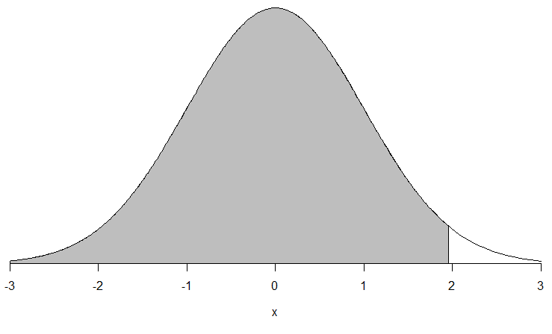
What do we mean by distribution?
What do we mean by distribution?
any variable has a distribution
A distribution is the values a variable can take and the chance of them occurring
Distribution is a function (relationship)
Parameters tune the shape of the distribution

Slide 11
What do we mean by distribution?
What do we mean by distribution?
any variable has a distribution
A distribution is the values a variable can take and the chance of them occurring
Distribution is a function (relationship)
Parameters tune the shape of the distribution
function

Slide 12
What do we mean by distribution?
What do we mean by distribution?
any variable has a distribution
A distribution is the values a variable can take and the chance of them occurring
Distribution is a function (relationship)
Parameters tune the shape of the distribution
Value a variable can take

Slide 13
What do we mean by distribution?
What do we mean by distribution?
any variable has a distribution
A distribution is the values a variable can take and the chance of them occurring
Distribution is a function (relationship)
Parameters tune the shape of the distribution
Probability: area

Slide 14
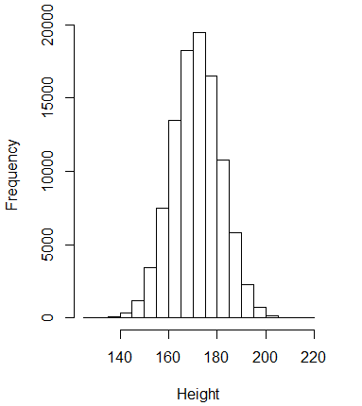
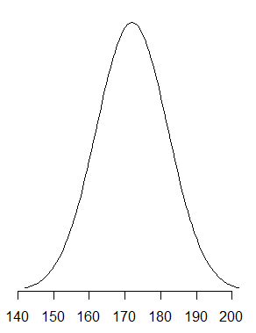
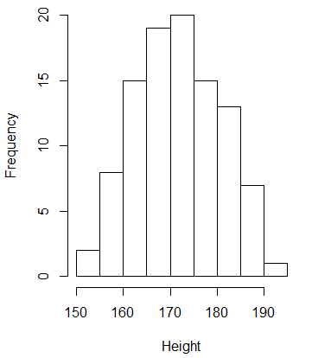
The normal distribution
E.g., height, length, concentration
Notes:
Many continuous variables follow the normal distribution. Also known as the bell-shaped curve or the Gaussian distribution

Slide 15
The normal distribution Can vary in two ways – 2 parameters
Variance – how wide? Mean – where on the axis?

Slide 16
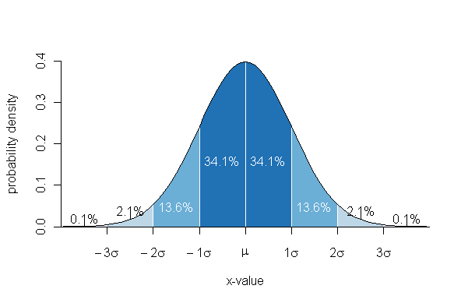
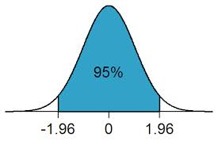
The normal distribution ….but with same properties
68% within 1 SD
of the mean
95% of observations are within 1.96 sd of the mean

Slide 17
The normal distribution Can vary in two ways – 2 parameters
Variance – how wide? Mean – where on the axis?

Slide 18
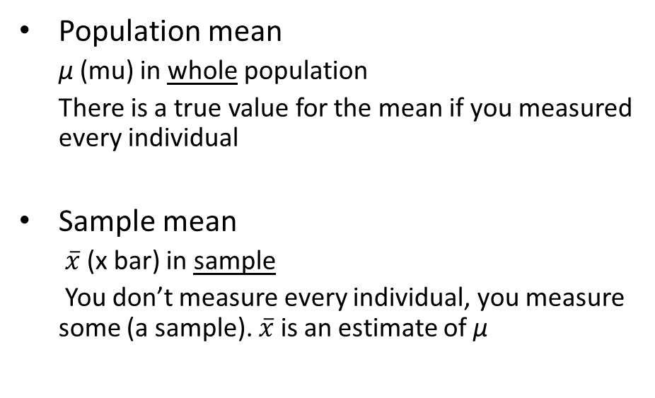
The normal distribution The mean
Population mean
μ (mu) in whole population
There is a true value for the mean if you measured every individual
Sample mean
$\overline{x}$ (x bar) in sample
You don’t measure every individual, you measure some (a sample). $\overline{x}$ is an estimate of μ

Slide 19
In a sample, each sample value differs from the mean. Each difference is called a deviation (or a residual) “average of the squared deviations from the mean”
The normal distribution The variance
Sample variance
s² (s-squared) in sample
You need to understand the concept rather than remember the formula

Slide 20
The normal distribution The standard deviation
“The average of the (absolute) deviations from the mean”
the square root of the variance
Sample standard deviation: s
Tells you how variable the values are
95% of observations are within 1.96 standard deviation of the mean
Notes:
Why we square.

Slide 21
Sampling distribution of the mean and the standard error

Slide 22
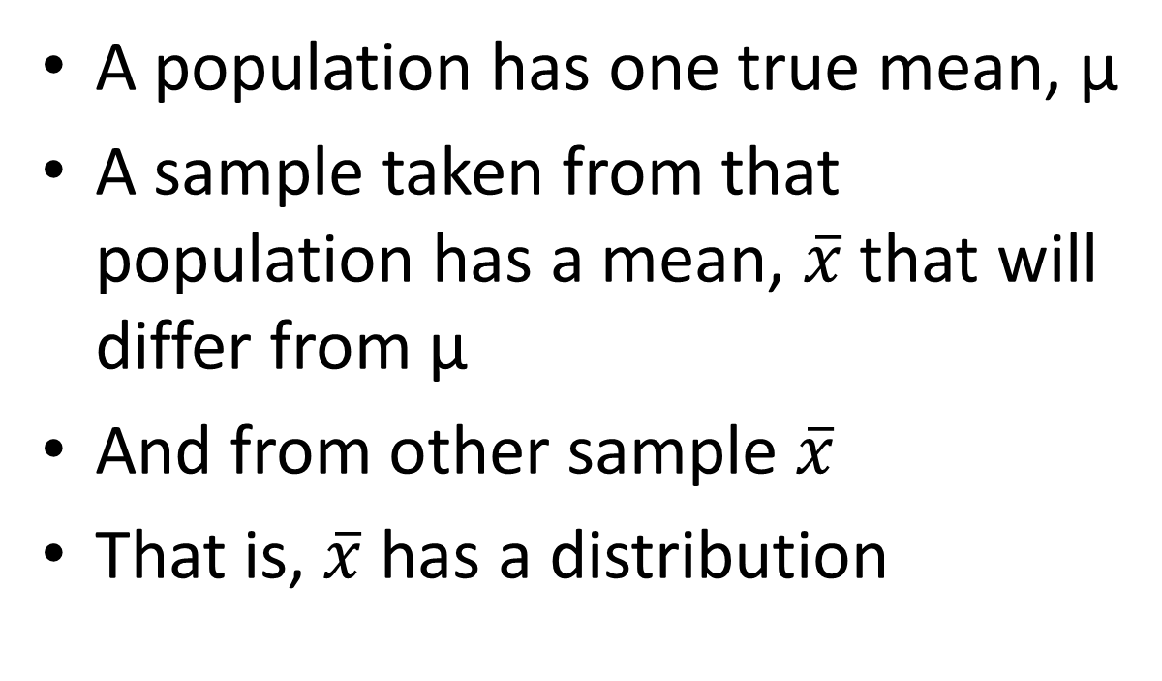
Sampling distribution of the mean
A population has one true mean, μ
A sample taken from that population has a mean, $\overline{x}$ that will differ from μ
And from other sample $\overline{x}$
That is, $\overline{x}$ has a distribution

Slide 23
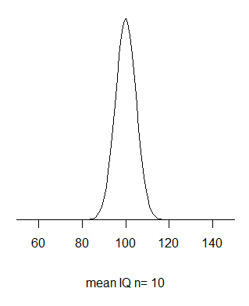
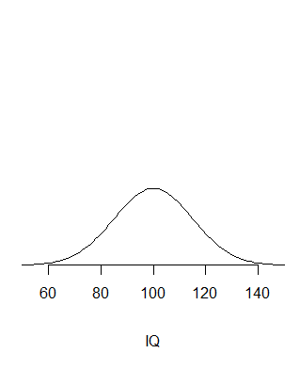
Sampling distribution of the mean
Many samples
All same size
e.g., n=10
Distribution – whole population
mean = 100
sd = 15
Each sample mean differs from 100 by chance
Distribution of the means

Slide 24
Sampling distribution of the mean
Has the same mean as the parent
But a different (lower) standard deviation
And we call it the ‘standard error’

Slide 25
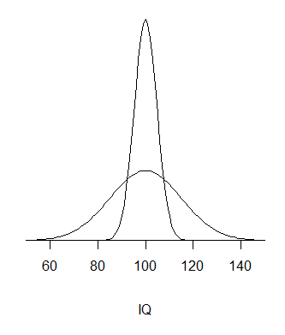
Sampling distribution of the mean
Whole population
mean = 100
sd = 15
Distribution of the means
mean = 100
se is related to sd in predictable way
se = sd/√n
Standard error: the standard deviation of the sample means.
Tells you how variable the sample means are

Slide 26
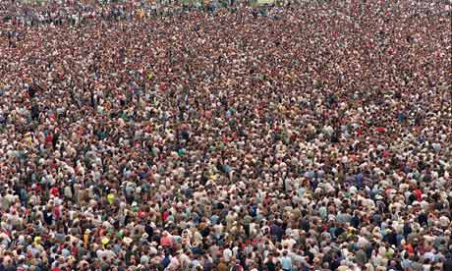


Sampling distribution of the mean
mean?
Why does it matter?
We usually only have samples!
We do not know population parameters
We use samples to estimate
…….
$$\overline{x}$$

Slide 27
Confidence intervals

Slide 28
Confidence intervals
How confident can we be that our sample mean is a good estimate of the true value?
Confidence intervals give the highest and lowest likely values
Likely means 95%, 99%, 99.9%

Slide 29
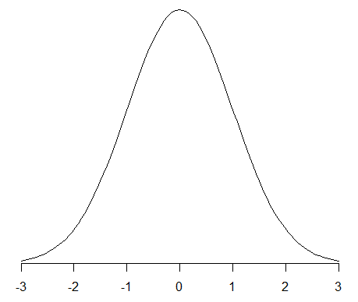
The normal distribution Confidence intervals: large samples
99%
95%
95% of sample means are within 1.96 s.e. of the population mean
99% of sample means are within 2.58 s.e. of the population mean
Notes:
Area under curve

Slide 30
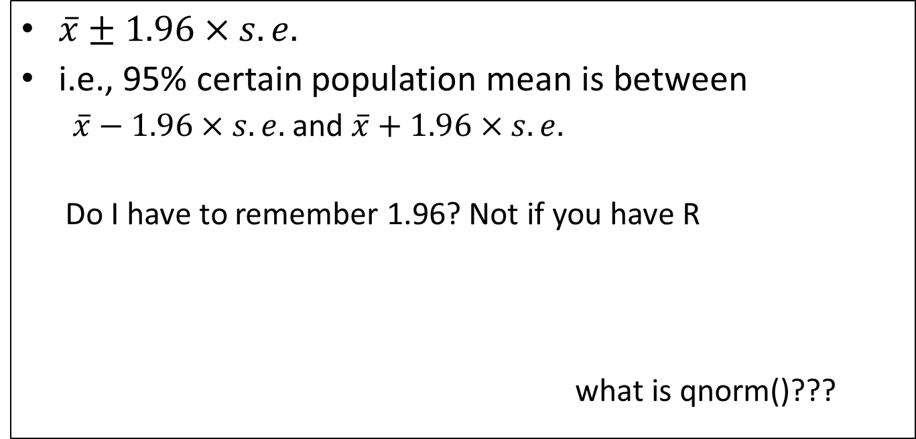
Confidence intervals: large samples
The mean plus or minus a bit
$\overline{x}±1.96×s.e.$
i.e., 95% certain population mean is between
$\overline{x}−1.96×s.e.$ and $\overline{x}+1.96×s.e.$
Do I have to remember 1.96? Not if you have R
what is qnorm()???
> qnorm(0.975)
[1] 1.959964

Slide 31
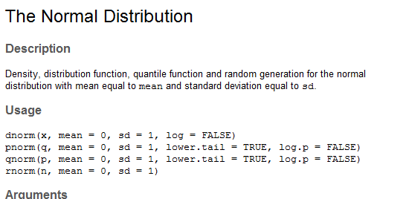
Confidence intervals: large samples
pnorm() and qnorm()

Slide 32
Confidence intervals: large samples
pnorm(x)
Returns probability
x

Slide 33
Confidence intervals: large samples
qnorm(Probability)
probability
Returns x

Slide 34
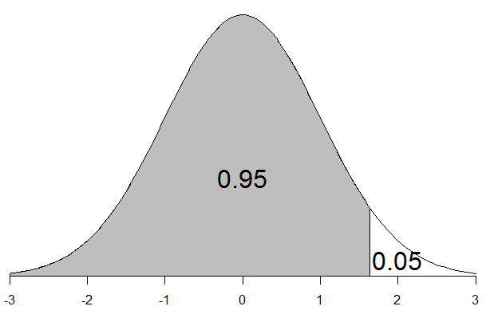
Why qnorm(0.975) and not qnorm(0.95)?
Confidence intervals: large samples
Because qnorm() gives ‘one-tailed’ probabilities
uses the lower tail = TRUE
(By default)

Slide 35
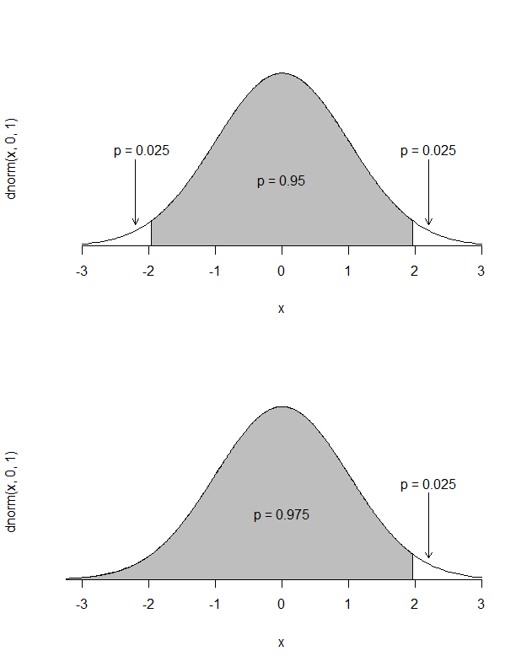
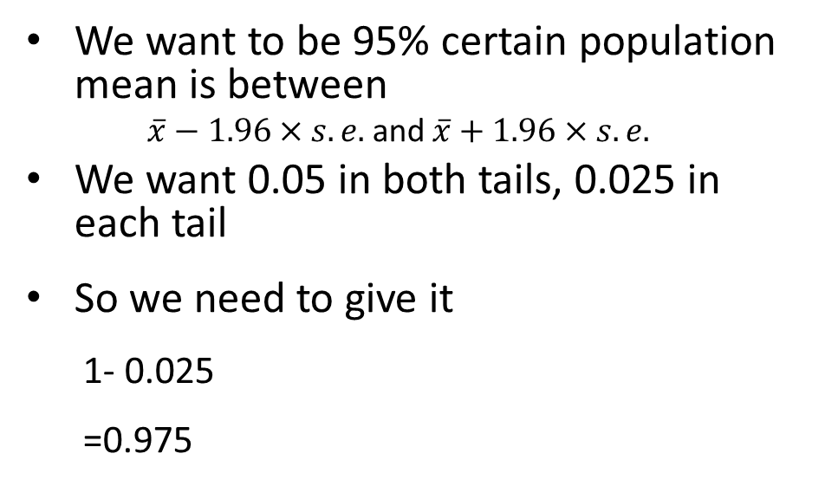
Why qnorm(0.975) and not qnorm(0.95)?
The normal distribution Confidence intervals: large samples
We want to be 95% certain population mean is between
$\overline{x}−1.96×s.e.$ and $\overline{x}+1.96×s.e.$
We want 0.05 in both tails, 0.025 in each tail
So we need to give it
1- 0.025
=0.975

Slide 36
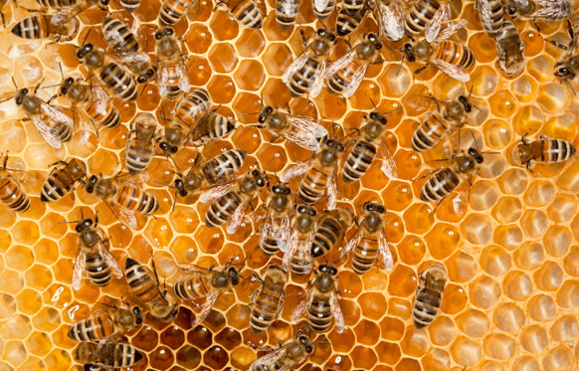
New population of honey bees – how big are their left wings?
The normal distribution Confidence intervals: large samples
Take a ‘representative’ sample

Slide 37
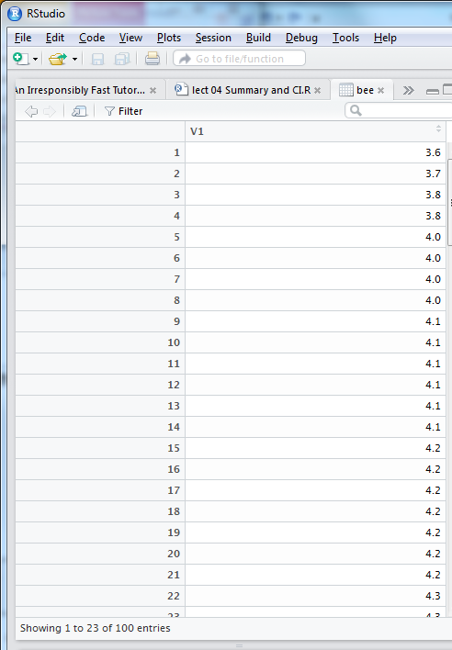
The normal distribution Confidence intervals: large samples
Left wing widths of 100 honey bees (mm)

Slide 38

The normal distribution Confidence intervals: large samples
Left wing widths of 100 honey bees (mm)
$$\overline{x}±1.96×s.e.$$
Mean
Standard error
quantile
amount to add/subtract
Upper confidence limit
Lower confidence limit
m <- mean(bee$V1)
[1] 4.55
se = sd/√n
se <- sd(bee$V1)/sqrt(length(bee$V1))
[1] 0.03919647
q <- qnorm(0.975)
[1] 1.959964
q * se %>% round(2)
[1] 0.08
m + q * se %>% round(2)
[1] 4.63
m - q * se %>% round(2)
[1] 4.47

Slide 39
The normal distribution Confidence intervals: large samples
Left wing widths of 100 honey bees (mm)
Sample mean = 4.55 mm
95% certain population mean is between: 4.63 mm and 4.47 mm
We would normally summarise as:
The 95% confidence interval on the mean was 4.55 ± 0.08 mm.

Slide 40
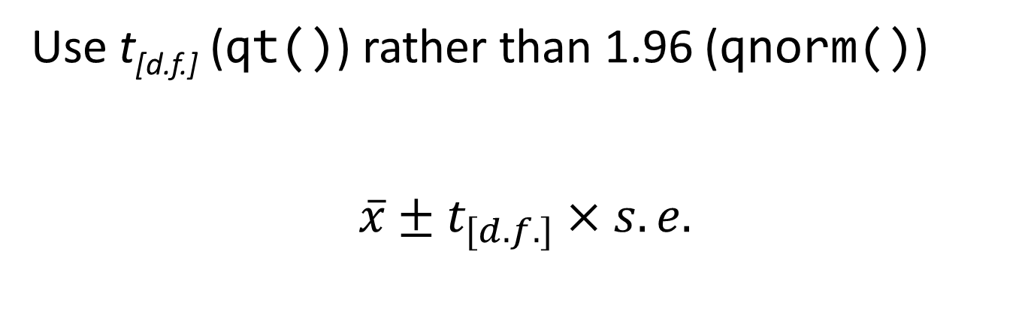
The normal distribution Confidence intervals: small samples
Use t_{[d.f.]} (qt()) rather than 1.96 (qnorm())
$$\overline{x}±t_{[d.f.]}×s.e.$$
Small is less than about 20
Sampling distribution of the mean for small samples is not quite normal but instead follows a t distribution

Slide 41
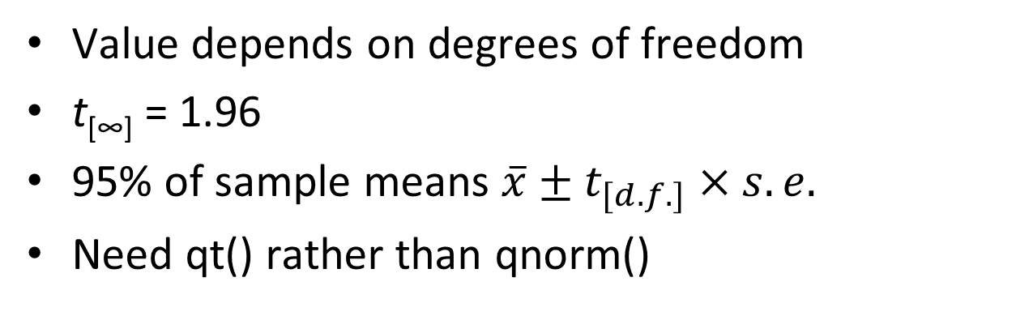
The normal distribution Confidence intervals: small samples
Value depends on degrees of freedom
t[∞] = 1.96
95% of sample means $\overline{x}±t_{[d.f.]}×s.e.$
Need qt() rather than qnorm()
> qt(0.975, df = 4)
[1] 2.776445
> qt(0.975, df = 9)
[1] 2.262157
> qt(0.975, df = 99)
[1] 1.984217
> qt(0.975, df = 999)
[1] 1.962341

Slide 42

The normal distribution Confidence intervals: small samples
19 lactate dehydrogenase solutions to a recipe that should yield a concentration of 1.5 μmols l⁻¹
How good is the recipe/ability to follow the recipe?

Slide 43
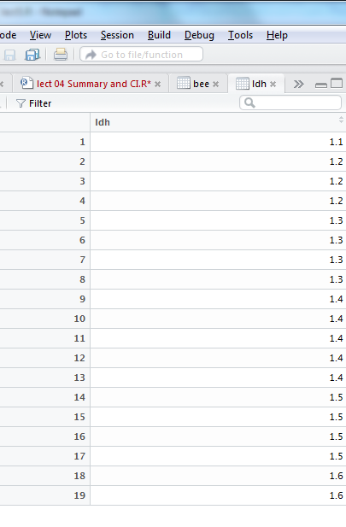
The normal distribution Confidence intervals: small samples
19 lactate dehydrogenase solutions to a recipe that should yield a concentration of 1.5 μmols l⁻¹
mean(ldh$ldh)
[1] 1.373684
Mean of sample is 1.37 μmols l⁻¹
What is an estimate the population mean?

Slide 44

The normal distribution Confidence intervals: small samples
$$\overline{x}±t_{[d.f.]}×s.e.$$
Mean
Standard error
qt – need df
Upper CL
Lower CL
m <- mean(ldh$ldh)
1.373684
se <- sd(ldh$ldh)/sqrt(length(ldh$ldh))
[1] 0.03230167
df <- length(ldh$ldh) -1
[1] 18
t <- qt(0.975, df = df)
[1] 2.100922
(m + t * se) %>% round(2)
[1] 1.44
(m - t * se) %>% round(2)
[1] 1.31

Slide 45
The normal distribution Confidence intervals: small samples
19 lactate dehydrogenase solutions to a recipe that should yield a concentration of 1.5 μmols l⁻¹
The 95% confidence interval on the mean was 1.37 ± 0.07 μmols l⁻¹.
95% certain population mean is between: 1.31 and 1.44 μmols l⁻¹
What does this tell us about the recipe/ability to follow recipe?

Slide 46
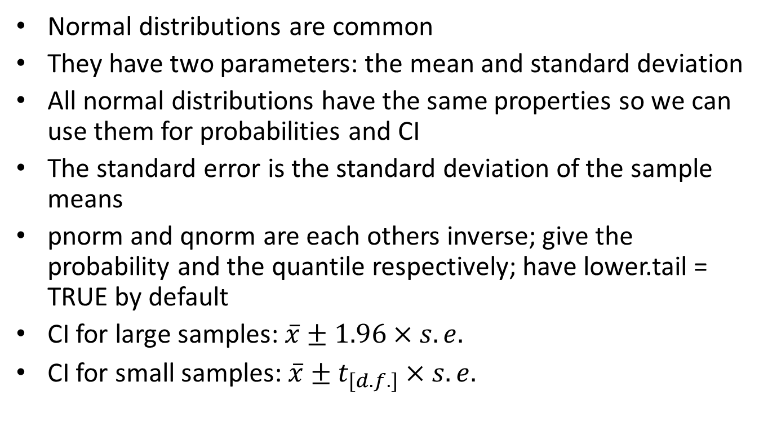
Summary
Normal distributions are common
They have two parameters: the mean and standard deviation
All normal distributions have the same properties so we can use them for probabilities and CI
The standard error is the standard deviation of the sample means
pnorm and qnorm are each others inverse; give the probability and the quantile respectively; have lower.tail = TRUE by default
CI for large samples: $\overline{x}±1.96×s.e.$
CI for small samples: $\overline{x}±t_{[d.f.]}×s.e.$

