Slide 1
Git & GitHub
May 2018
Forwards Teaching Team

Slide 2
Use both!
The 😡💩😱 will pay off

Slide 3
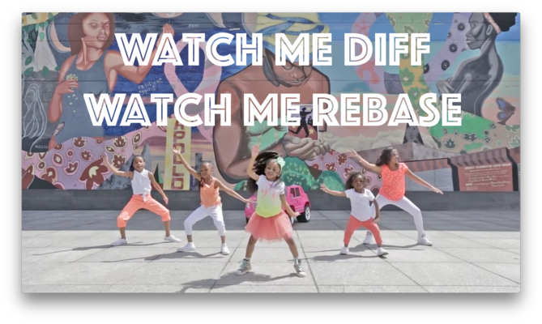
happygitwithr.com

Slide 4
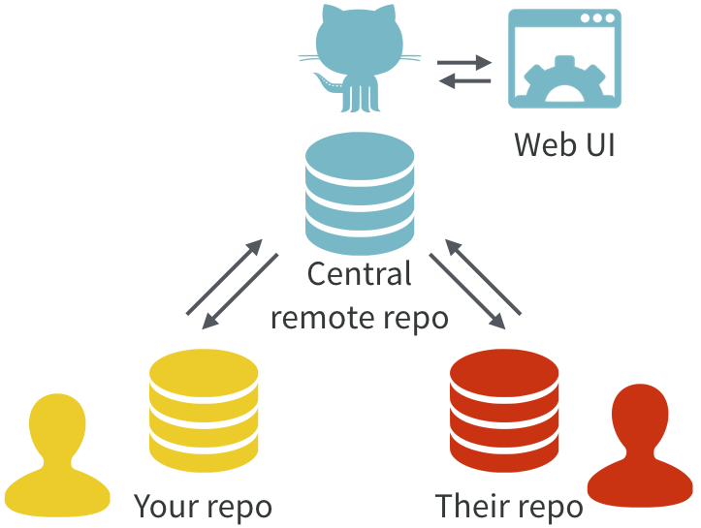
Excuse me, do you have a moment to talk about version control?
https://doi.org/10.7287/peerj.preprints.3159v2

Slide 5
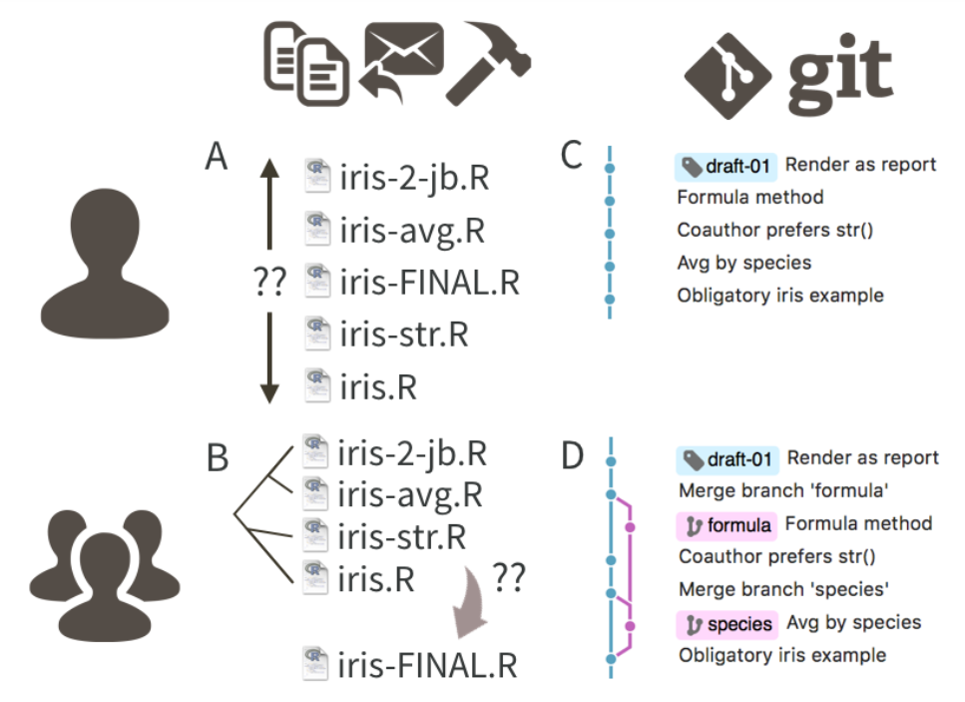

Slide 6
Demo
A look around a GitHub repo
(README, commits, issues)

Slide 7
Your turn
Let’s make a repo!
(Sign up for free and) log in to GitHub.
Click ‘+’ to create a public repository - choose to initialize with a README
Click to open README.md, select pencil icon (`Edit this file`) and write a sentence or two.
Commit your changes with a comment.

Slide 8
Demo
A look at a repo in RStudio
(history, stage, commit, push)

Slide 9
Your turn
Let’s make a project in RStudio from our repo!
On the repo homepage click `Clone or download` and copy the URL.
In RStudio go to File > New Project… > Version Control > Git, paste the URL to create the project.
Make sure your local git knows who you are usethis::use_gitconfig( scope = "project", # use "user" to set globally user.name = "Jane Doe", user.email = jane@example.com )
Add a new section to your README, stage, commit and push the change.

Slide 10
Collaboration
We have already seen issues as a way to collaborate – but we can do more!
Through `Settings` on the GitHub repo we can add other GitHub users as collaborators.
Any GitHub user can fork a GitHub repo to work on it – then submit a pull request (PR) to propose changes to the original owner.

Slide 11
Your turn
Part 1: Create a PR on a partner’s repo
On your partner’s repo on GitHub, click `Fork`.
In forked repo on GitHub, click `branch:master` to create a new branch: `edit-README`.
Still on GitHub, edit README and commit your changes to the new branch.
Click on `Compare & pull request`, check your changes and create a PR.
Part 2: Merge your partner’s PR on your repo
Go to `Pull requests` tab on your repo, merge PR and delete branch.
In RStudio, do a git pull and look at git history.

Slide 12
Going Further
Charlotte Wickham’s Collaborative Coding talk http://www.cwick.co.nz/talks/collab-code-user17/#/
Lucy D'Agostino McGowan’s Shiny app to find beginner issues on R packages
https://github.com/LucyMcGowan/contributr

