Slide 1
Package development
Hadley Wickham, Di Cook,
Jenny Bryan
@JennyBryan @jennybc

Slide 2
Get to know your R installation

Slide 3
R.home()
list.files(R.home())
R.version

Slide 4
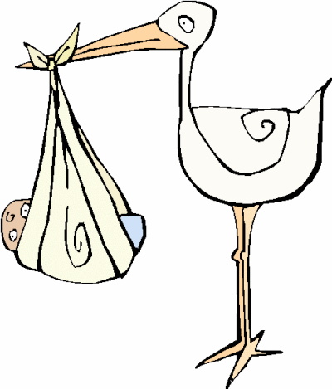
Where do R packages come from?

Slide 5
CRAN and GitHub, mostly
install.packages("foo")
library(devtools)
install_github("jane/foo")

Slide 6
Where do R packages live on your computer?

Slide 7
R packages live in a library

Slide 8
Get to know your R library(ies?)

Slide 9
The default library
.Library
.libPaths()
All the libraries R knows about

Slide 10
?
.Library ==.libPaths()
For many useRs, these are same
Other useRs maintain multiple libraries
E.g., I put add-on packages in a user-level library:
/Users/jenny/resources/R/library

Slide 11
installed.packages()
How many packages do you have installed?
If you have multiple libraries, how many packages in each?
How do the packages break down by Priority (and what does that mean, anyway)?
Do the breakdown for multiple libraries, if applicable.

Slide 12
Startup files
.Rprofile
.Renviron
Code that runs at startup
Load workflow packages
Set options
Use in moderation!
Set lib paths
Set env vars

Slide 13
Make sure you have recent versions of these packages
packageVersion()
install.packages("devtools")
install.packages("testthat") install.packages("usethis")
install.packages("roxygen2")

Slide 14
Oops, Hadley messed up!
(see next slide for lab computer fix)
devtools::install_github(
"r-lib/usethis"
)
packageVersion("usethis")
# Should be 1.1.0.9000

Slide 15
Oops, Hadley messed up!
(see prev slide for your own computer)
install.packages("usethis", dep = F)
t <- system.file("templates",
package = "usethis")
download.file("http://bit.ly/2B8ebyf",
file.path(t, "template.Rproj"))

Slide 16
How is developing a package
same / different
from developing a script?

Slide 17
How same?
Iterate early and often!
Change it, try it, change it, try it, ad nauseum

Slide 18
How different?
Write functions, not “top-level” code.
Dependencies are different,
no library() calls.
Install & Restart (or simulate that),
don’t source().

Slide 19
You write this
… but you use this
Figure from Hadley Wickham’s book, R packages
http://r-pkgs.had.co.nz
https://github.com/hadley/r-pkgs/blob/master/diagrams/installation.png

Slide 20
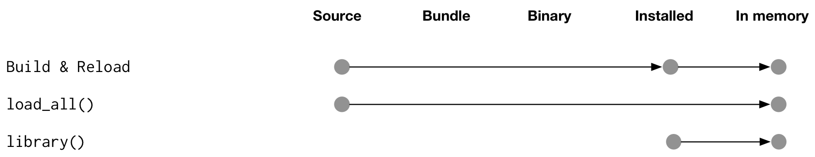
How do packages get into memory?
Development: every couple hours or days?
Development: Every 2 minutes
Install and Restart
Normal day-to-day usage
Figure from Hadley Wickham’s book, R packages
http://r-pkgs.had.co.nz
https://github.com/hadley/r-pkgs/blob/master/diagrams/loading.png

Slide 21
Install and Restart
package development
devtools::load_all()
is to
as
is to
script development
interactive “stepping through” code

Slide 22
Install and Restart
package development
RStudio’s Install & Restart
is to
as
source() or
RStudio’s “Source” or Rscript foo.R
is to
script development

Slide 23
Let’s do this!

