Slide 1
Documentation
December 2017
Hadley Wickham, Jenny Bryan, Di Cook

Slide 2
Function-level with roxygen2
Package-level with rmarkdown
.R
.Rmd
.Rd
.md
.html
.html
.pdf

Slide 3
Markdown
I assume you are already familiar with it

Slide 4
Basic markdown formatting
# This is a top level heading
This is some text. Make text _italic_ with single underscores (or stars). Make it **bold** with double stars (or underscores). Here is a [link to a markdown guide](http://bit.ly/19fAexE).
* This is a list
* This is another item
```R
# Some R code
f <- function() x + 1
```
## This is a secondary heading
You can also do `inline code`, numbered lists and quotes and more.

Slide 5
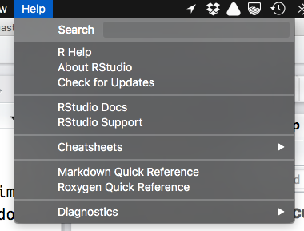

Slide 6
Function documentation with roxygen2

Slide 7
Roxygen2
roxygen2
R
R comments
Rd files
HTML
http://r-pkgs.had.co.nz/man.html

Slide 8
You write specially formatted comments in .R
#' Add a column to a data frame
#'
#' Allows you to specify the position. Will replace existing variable
#' with the same name if present.
#'
#' @param x A data frame
#' @param name Name of variable to create. If a variable of that name
#' already exists it will be replaced
#' @param value Values to insert.
#' @param where Position to insert. Use 1 to insert on LHS, or -1 to insert on
#' RHS.
#' @examples
#' df <- data.frame(x = 1:5)
#' add_col(df, "y", runif(5))
#' add_col(df, "y", runif(5), where = 1)
#'
#' add_col(df, "x", 5:1)

Slide 9
You write specially formatted comments in .R
#' Add a column to a data frame
#'
#' Allows you to specify the position. Will replace existing variable
#' with the same name if present.
#'
#' @param x A data frame
#' @param name Name of variable to create. If a variable of that name
#' already exists it will be replaced
#' @param value Values to insert.
#' @param where Position to insert. Use 1 to insert on LHS, or -1 to insert on
#' RHS.
#' @examples
#' df <- data.frame(x = 1:5)
#' add_col(df, "y", runif(5))
#' add_col(df, "y", runif(5), where = 1)
#'
#' add_col(df, "x", 5:1)
Roxygen comment
Roxygen tag

Slide 10
Roxygen translates to .Rd
In almost all cases you can ignore these files
% Generated by roxygen2: do not edit by hand
% Please edit documentation in R/add_col.R
\name{add_col}
\alias{add_col}
\title{Add a column to a data frame}
\usage{
add_col(x, name, value, where = -1)
}
\arguments{
\item{x}{A data frame}
\item{name}{Name of variable to create. If a variable of that name
already exists it will be replaced}
\item{value}{Values to insert.}
\item{where}{Position to insert. Use 1 to insert on LHS, or -1 to insert on
RHS.}
}
\description{
Allows you to specify the position. Will replace existing variable
with the same name if present.
}

Slide 11
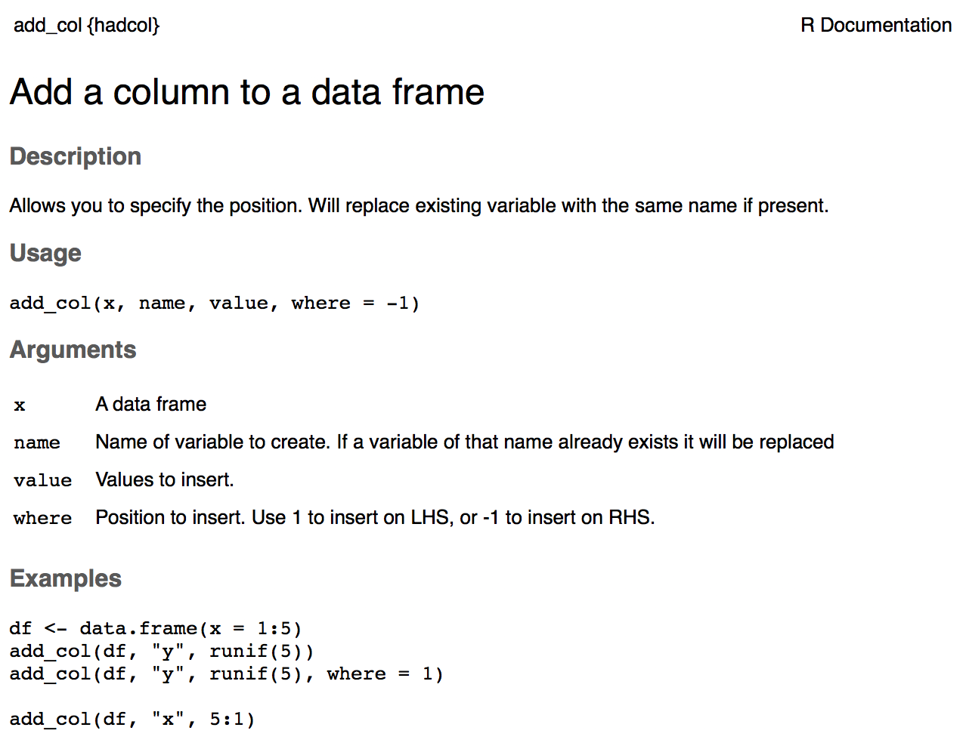
R translates to .html for viewing

Slide 12
Documentation workflow
Modify R comment
Update Rd files
Cmd/Ctrl + Shift + D
devtools::document()
Preview
?topicname

Slide 13
Two caveats
You must have loaded the package with load_all() at least once. Check for message "Using development documentation..."
This technique only builds individual files so links do not work.

Slide 14
Documentation workflow
Modify R comment
Update Rd files
Cmd/Ctrl + Shift + D
devtools::document()
NB: You must have loaded the package with load_all() at least once
Preview html
?topicname
Only shows single file, so links do not work

Slide 15
[hadcol]
Change working directory/project to:

Slide 16
Your turn
Fix the typos in the documentation for add_col.
Run the documentation workflow to check your work

Slide 17
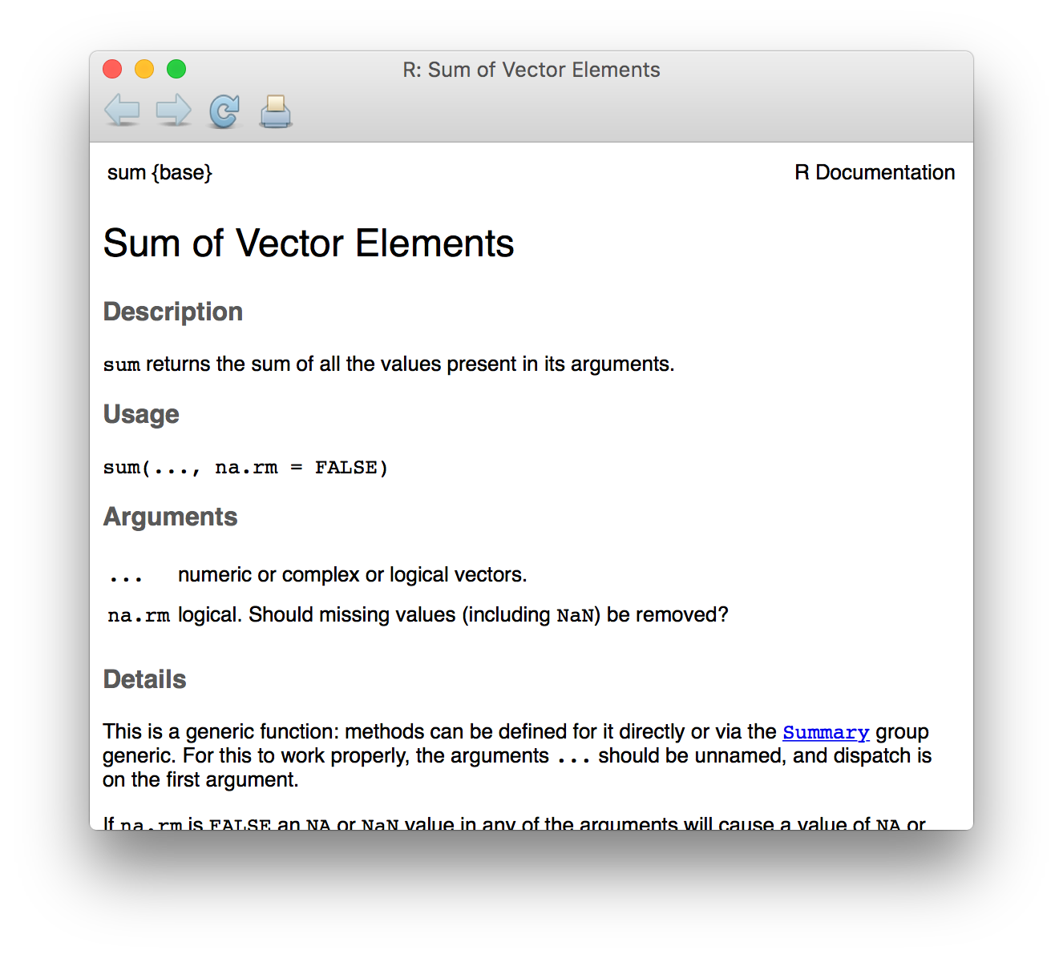
First sentence is the title
Next paragraph is the description
Everything else is the details

Slide 18
The description block
#' Sum of vector elements
#'
#' \code{sum} returns the sum of all the values present in its arguments.
#'
#' This is a generic function: methods can be defined for it directly or via the
#' \code{\link{Summary}} group generic. For this to work properly, the arguments
#' \code{...} should be unnamed, and dispatch is on the first argument.
First sentence is the title
Next paragraph is the description
Everything else is the details

Slide 19
There are five tags you’ll use for most functions
Tag | Purpose
@param arg | Describe inputs
@examples | Show how the function works. (Usual RStudio shortcuts work)
@seealso | Pointers to related functions
@return | Describe outputs (value)
@export | Is this a user-visible function?

Slide 20
Your turn
Document add_cols().
(See next slide for hint)

Slide 21
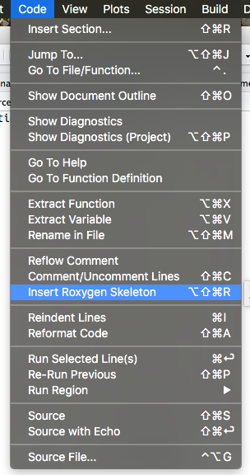
RStudio helps you remember
#' Title
#'
#' @param x
#' @param y
#' @param z
#'
#' @return
#' @export
#'
#' @examples
fun <- function(x, y, z) {
}

Slide 22
Use markdown for formatting
# Activate by running
# use_roxygen_md()
**bold**, _italic_, `code`
* [func()]
* [pkg::func()]
* [link text][func()]
* [link text][pkg::func()]

Slide 23

Documentation workflow 2
Modify R comment
Update Rd files
Cmd/Ctrl + Shift + D
devtools::document()
Install package & restart R
Cmd/Ctrl + Shift + B
Preview
?topicname
This is slower than the previous workflow, but there are fewer caveats

Slide 24
Your turn
Make real link to cbind()
Add a see also section (@seealso) to add_col() and add_cols() that links them together.
What happens if you add @family xyz to both?

Slide 25
roxygen2 comes with other tools to reduce duplication
# Document multiple functions in the same file
#' @rdname add_col
# Inherit the parameter descriptions from
# another function
#' @inheritParams add_col
# Inherit everything from another topic
#' @inherit add_col
# Inherit selectively
#' @inherit add_col parameters return references
#' title description details
#' sections seealso

Slide 26
Read online about how to document other objects
Data
http://r-pkgs.had.co.nz/data.html#documenting-data
Classes & methods
http://r-pkgs.had.co.nz/man.html#man-classes
Packages
http://r-pkgs.had.co.nz/man.html#man-packages

Slide 27
Package documentation with rmarkdown

Slide 28
Vignettes
Lets you combine prose and code to explain your how you package works.
The hard part is the writing, not the technology!
R
Rmd
html
md
pdf
rmarkdown
knitr
pandoc
http://r-pkgs.had.co.nz/vignettes.html

Slide 29
Easiest way to get started is with use_vignette()
usethis::use_vignette("name")
# Adds to DESCRIPTION
Suggests: knitr
VignetteBuilder: knitr
# Creates vignettes/
# Drafts vignettes/name.Rmd

Slide 30
Vignette = Rmarkdown + special metadata
---
title: "Vignette Title"
author: "Vignette author"
date: "`r Sys.Date()`"
output: rmarkdown::html_vignette
vignette: >
%\VignetteIndexEntry{Vignette Title}
%\VignetteEngine{knitr::rmarkdown}
%\VignetteEncoding{UTF-8}
---
Vignettes are long form documentation commonly included in packages. Because they are part of the distribution of the package, they need to be as compact as possible. The `html_vignette` output type provides a custom style sheet (and tweaks some options) to ensure that the resulting html is as small as possible. The `html_vignette` format:
...
Special output format for vignettes
Special metadata needed by R

Slide 31
Vignette workflow
Build entire package & Restart R
Modify R code
Cmd/Ctrl + Shift + B
Modify Rmarkdown file
Preview file
Cmd/Ctrl + Shift + K
Preview whole package
devtools::install(build_vignettes = TRUE)
browseVignettes()

Slide 32
Your turn
Create a vignette that shows how to use add_col() for adding and removing.
Fix the "vignette title"

Slide 33
README

Slide 34
If sharing with others, include a readme
# Your choice: but often useful to include
# results of running code
usethis::use_readme_md()
usethis::use_readme_rmd()
# For public projects this should include a
# brief overview, instructions on how to
# install, and a few examples. For private
# projects, this is a great place to jot down
# notes

Slide 35
NEWS

Slide 36
Also good idea to track changes
usethis::use_news_md()

