Slide 1
Git & GitHub
May 2018
Forwards Teaching Team

Slide 2
Use both!
The 😡💩😱 will pay off

Slide 3
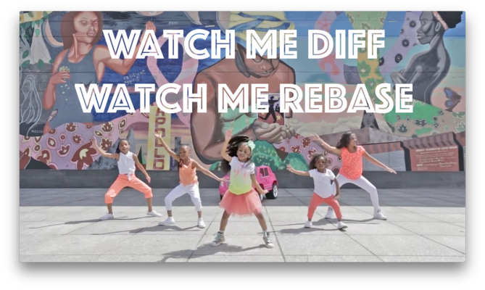
happygitwithr.com

Slide 4
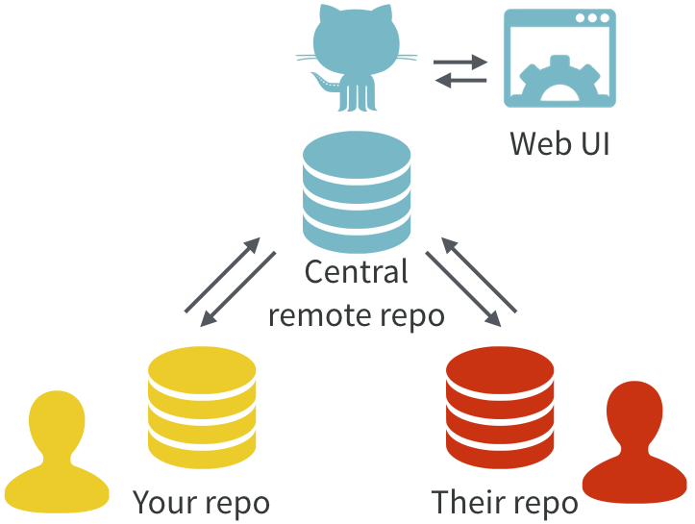
Excuse me, do you have a moment to talk about version control?
https://doi.org/10.7287/peerj.preprints.3159v2

Slide 5
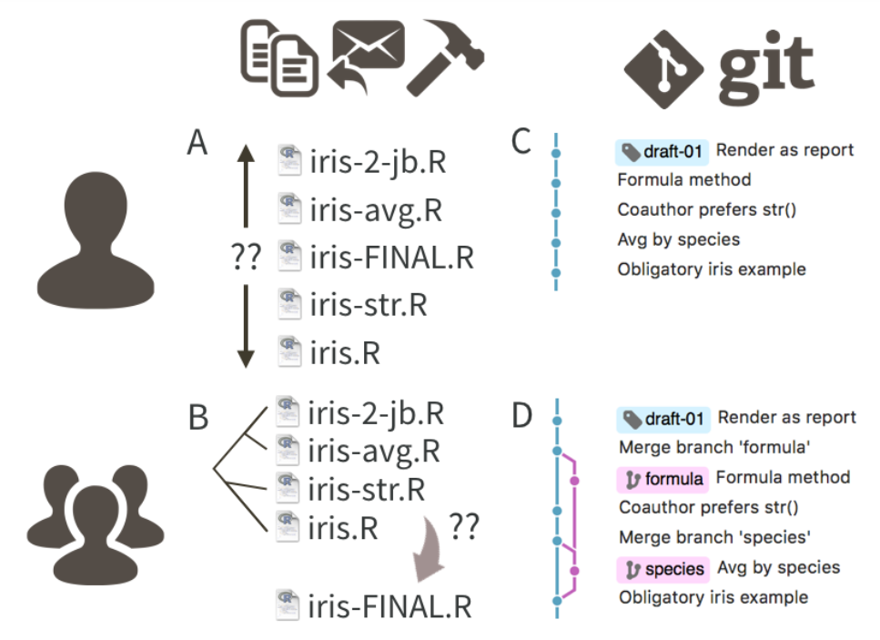

Slide 6
Demo
A look around a GitHub repo
(README, commits, issues)

Slide 7
Your turn
Let’s make a repo!
(Sign up for free and) log in to GitHub.
Click ‘+’ to create a public repository - choose to initialize with a README
Click to open README.md, select pencil icon (`Edit this file`) and write a sentence or two.
Commit your changes with a comment.

Slide 8
Demo
A look at a repo in RStudio
(history, stage, commit, push)

Slide 9
Your turn
Let’s make a project in RStudio from our repo!
On the repo homepage click `Clone or download` and copy the URL.
In RStudio go to File > New Project… > Version Control > Git - paste the URL to create the project
Add a new section to your README, stage, commit and push the change.

Slide 10
Collaboration
We have already seen issues as a way to collaborate – but we can do more!
Through `Settings` on the GitHub repo we can add other GitHub users as collaborators.
Any GitHub user can fork a GitHub repo to work on it – then submit a pull request to propose changes to the original owner.

Slide 11
Your turn
Let’s fork a neighbour’s repo!
Go to the homepage of a neighbour’s repo on GitHub.
Click `Fork` to fork their repo.
On GitHub add some text to their README – maybe a compliment!
Commit direct to the master branch (we’ll discuss the other option after this task)

