Slide 1
Women’s coding workshop
http://bit.ly/forwards-nz
December 2017
Hadley Wickham, Jenny Bryan, Di Cook

Slide 2
Preliminaries

Slide 3
Introductions
Hadley Wickham
Jenny Bryan
Di Cook

Slide 4
Your turn
This means that you have to work!
This course is very hands on, and while we’re here to help you, the best resource is often the person sitting next to you.
Introduce yourself to your neighbours. Who are you and what are you using R for?

Slide 5
Script
One off data analysis
Primarily side-effects
Package
Defines reusable components
No side-effects

Slide 6
Why make a reusable component?
You want to test it
You want to generalise it
You want to document it
You want to share it

Slide 7

The material is mostly drawn from
http://r-pkgs.had.co.nz
https://amzn.com/1491910399

Slide 8

© Allie Brosh
The bad news: It’s going to be frustrating
http://hyperboleandahalf.blogspot.com/2010/09/four-levels-of-social-entrapment.html

Slide 9
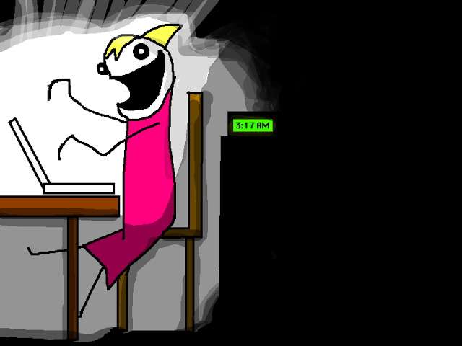
© Allie Brosh
The good news: Frustration is typical and temporary
http://hyperboleandahalf.blogspot.com/2010/06/this-is-why-ill-never-be-adult.html

Slide 11
This work is licensed under the Creative Commons Attribution-Noncommercial 3.0 United States License.
To view a copy of this license, visit http://creativecommons.org/licenses/by-nc/3.0/us/

