Slide 1
Packages & R code
December 2017
Hadley Wickham, Jenny Bryan, Di Cook

Slide 2
Motivation

Slide 3
“Workflow: you should have one” — Jenny Bryan

Slide 4
A package is a set of conventions that (with the right tools) makes your life easier

Slide 5
“Seriously, it doesn’t have to be about sharing your code (although that is an added benefit!). It is about saving yourself time.”
— Hilary Parker

Slide 6
Script
One off data analysis
Primarily side-effects
Package
Defines reusable components
No side-effects

Slide 7
RStudio projects

Slide 8
Why use RStudio projects?
3 reasons

Slide 9
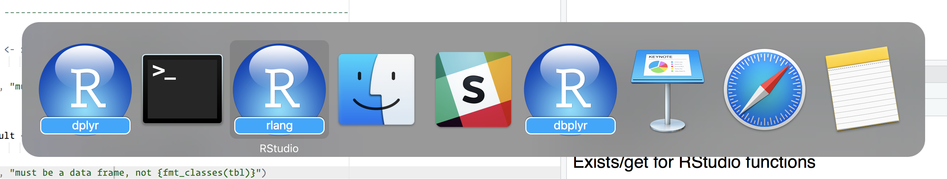
Work on multiple projects simultaneously and independently

Slide 10
Manage working directories
If the first line of your #rstats script is
setwd("C:\Users\jenny\path\that\only\I\have")
I will come into your lab and SET YOUR COMPUTER ON FIRE 🔥.
— Mash-up of rage tweets by @jennybc and @tpoi.

Slide 11
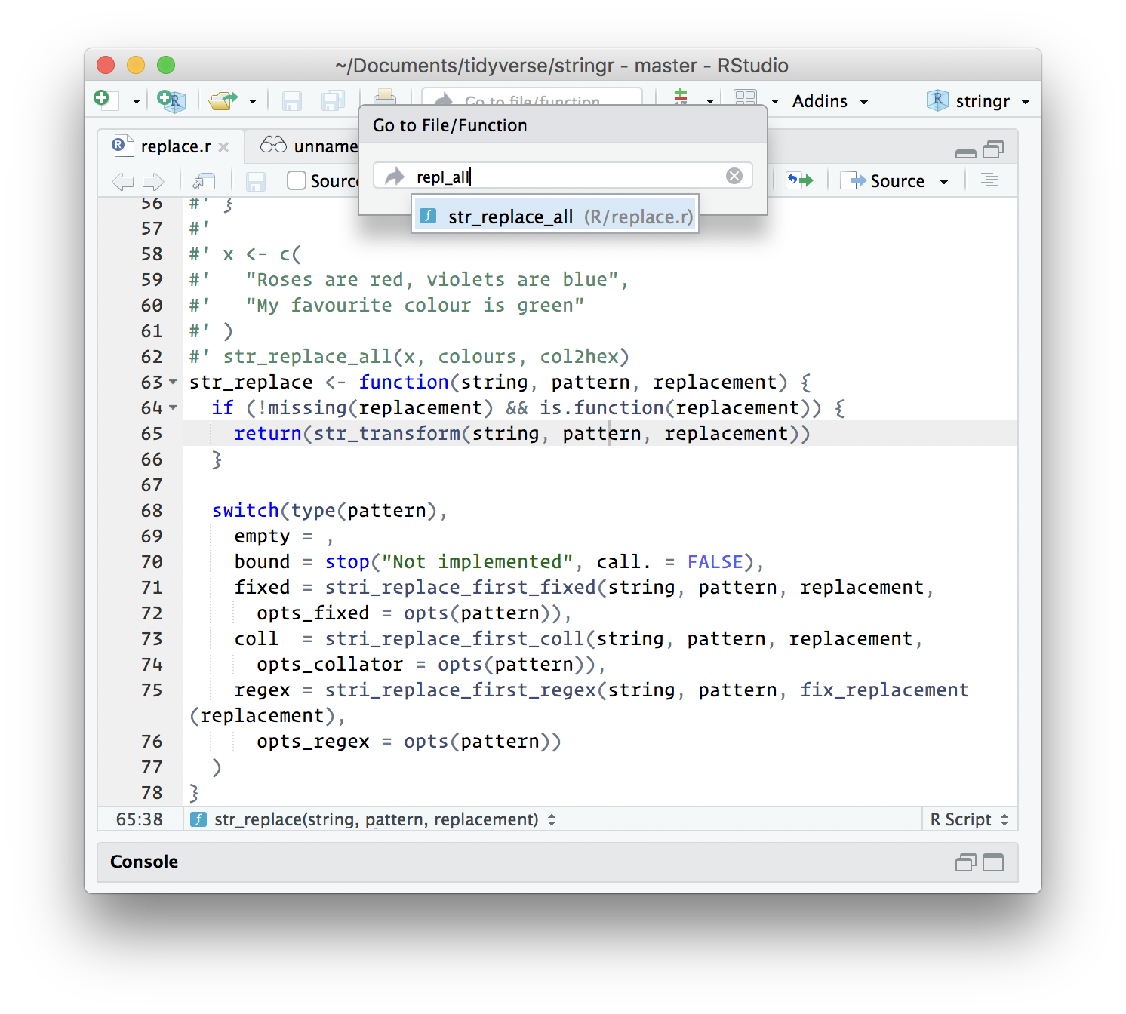
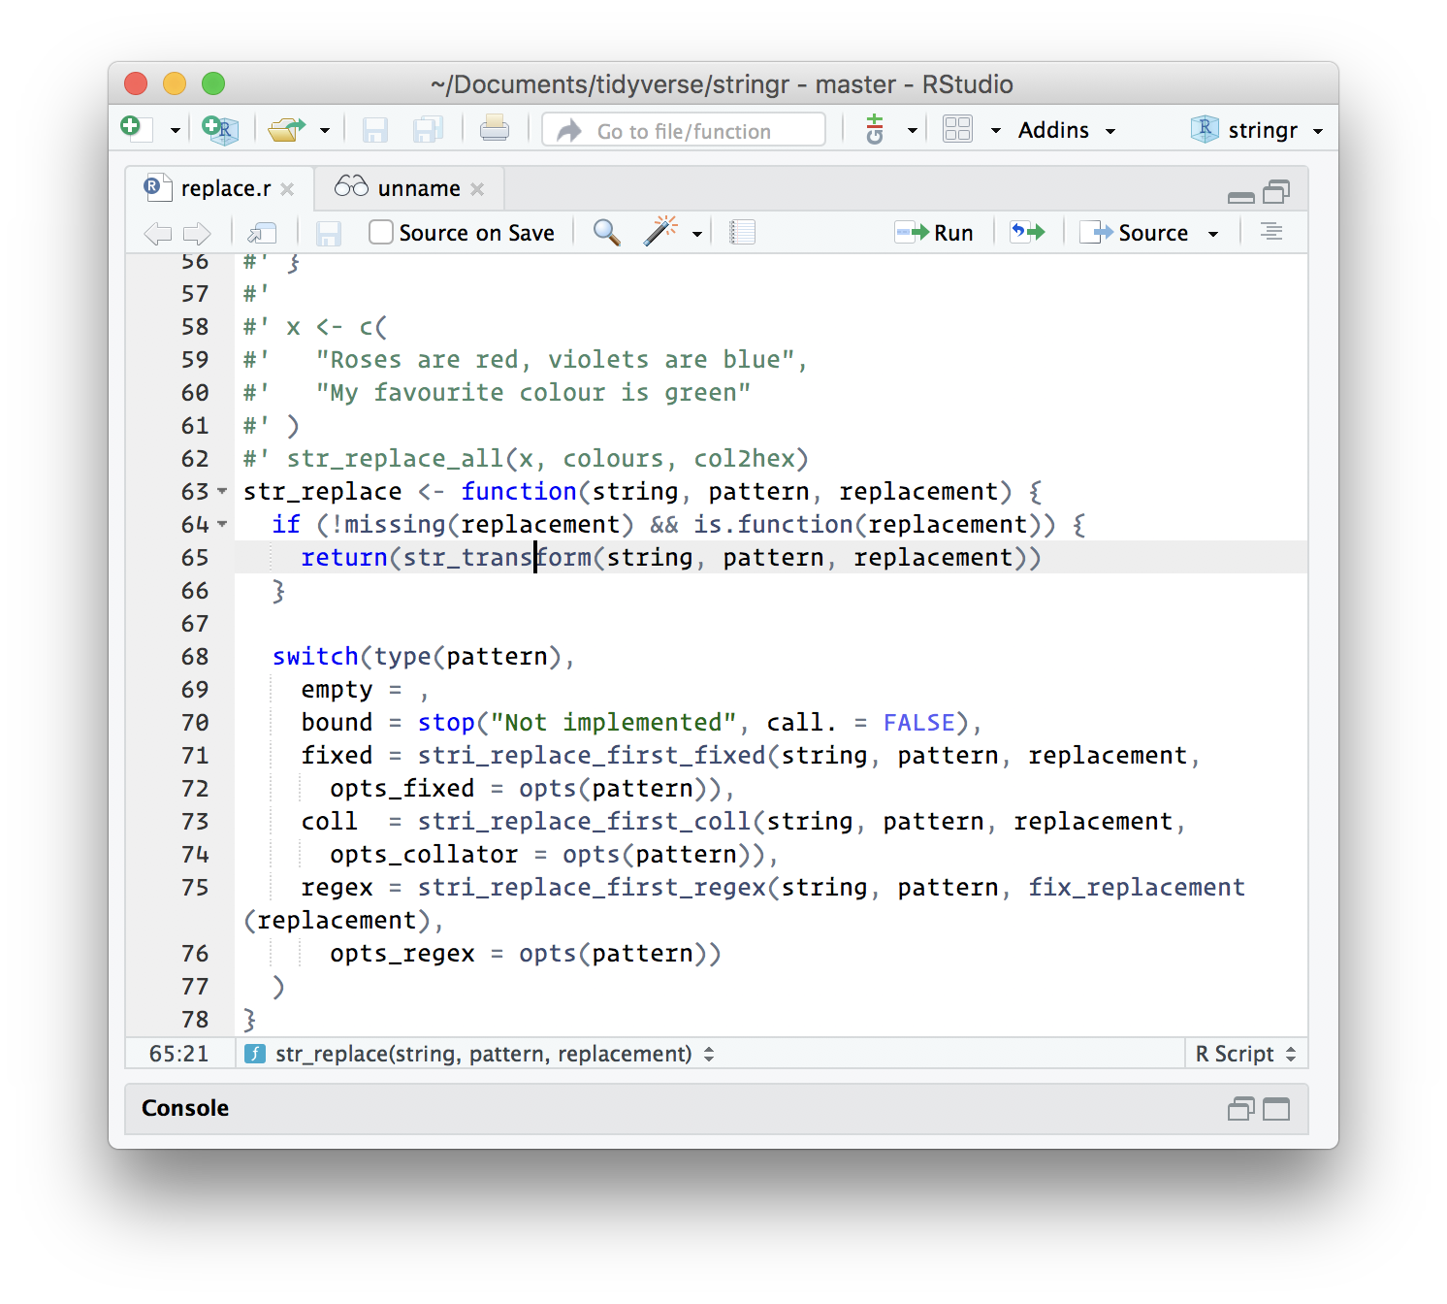
Enhanced navigation
Ctrl + . = find functions/files
F2 = jump to definition

Slide 12
My first package

Slide 13
Your turn
# Verify that you can create a package with:
usethis::create_package("~/Desktop/mypackage")
# What other files and directories are created?
# You can also create new project using RStudio
# but it has some slight differences that will
# cause hassles today (but not in general)

Slide 14
What happens we run create_package()?
mypackage.Rproj
R/
create_package("mypackage")
DESCRIPTION
NAMESPACE

Slide 15
package.skeleton()
Never use this!

Slide 16
Why bother?
You don’t even need to save your code!
Modify code
devtools::load_all()
Cmd/Ctrl + Shift +L
Explore in console

Slide 17
Your turn
Open mylittlepackage.Rproj.
Jump to rpony() using only the keyboard.
Load all the functions, then run rpony(10).
Uhoh! I have forgotten to include Fluttershy in the list of ponies. Add her, reload the code, and verify that your change worked.

Slide 18
What if you need to create a new file?
# There's a usethis helper for that too!
usethis::use_r("file-name")
# Organise files so that related code
# lives together. If you can give a file
# a concise and informative name, it's
# probably about right

Slide 19
Workflow setup: your .Rprofile
# Setup some code that is run every time # you start R
# usethis::edit_r_profile()
if (interactive()) {
suppressMessages(require(devtools))
suppressMessages(require(usethis))
suppressMessages(require(testthat))
}

Slide 20
Never include analysis packages here
if (interactive()) {
suppressMessages(require(ggplot2))
suppressMessages(require(dplyr))
}

Slide 21
While you’re in there, also add
options(
warnPartialMatchArgs = TRUE
warnPartialMatchDollar = TRUE,
warnPartialMatchAttr = TRUE
)

Slide 22
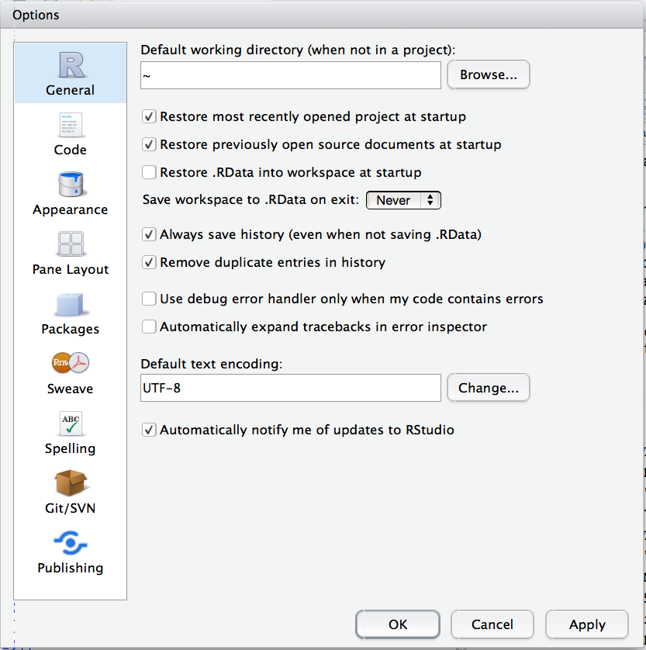
Combine with Ctrl/cmd+ shift + F10

Slide 23
Your turn
Follow the instructions in previous slides and make sure that you’re optimally configured.
Determine the rules for package names via experimentation.

Slide 24
What about scripts?

Slide 25
Currently no strong convention for scripts
It’s optional — you don’t have to put an analysis in a package, and not all packages will have analyses.
For today, I recommend using analysis/. There are no tools, and it might change in the future, but it’s what I’m currently thinking
If you want to use the package in the scripts, you’ll need to build and reload so that the package is installed and available.

Slide 26
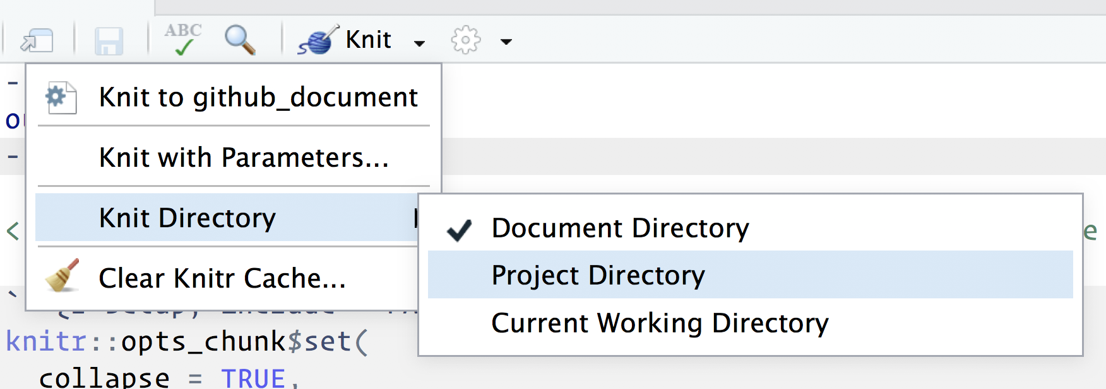
Beware working directory conventions
When you run R code, the working directory is the project directory
When you knit an Rmd, the working directory is changed to the document directory.
Can change from Knitr menu:
Or use the here package
Requires RStudio 1.1

Slide 27
Git + GitHub

Slide 28
Use both!
The 😡💩😱 will pay off

Slide 29
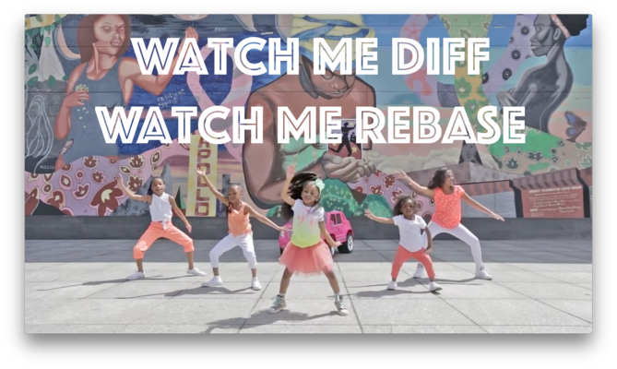
happygitwithr.com

Slide 30
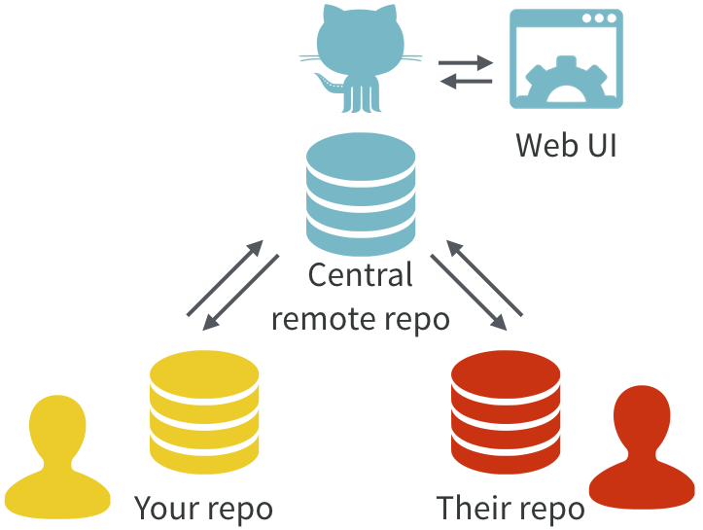
Excuse me, do you have a moment to talk about version control?
https://doi.org/10.7287/peerj.preprints.3159v2

