Slide 1
Share!
December 2017
Hadley Wickham, Jenny Bryan, Di Cook

Slide 2
License
Dependencies
Namespace: imports
Namespace: exports
R CMD check
CRAN

Slide 3
Style

Slide 4
How to organise files?
Again, comes down to naming: can you brief describe the contents of the file in 1-3 words? If not, split it up!
I often have utils.R where I dump little helpers. Sometimes notice that there are a bunch of related ones, and refactor into own file

Slide 5
How do you indent and format code?
The style is not important; consistency is. Eliminate spurious differences to focus on what’s important
http://style.tidyverse.org
Important part of a convention is that tools accrete around it
https://github.com/krlmlr/styler
https://github.com/jimhester/lintr

Slide 6
License

Slide 7
There are three main open source licenses
CC0
“public domain”, best for data packages
MIT
Free for anyone to do anything with
GPL
Changes and bundles must also be GPL
These are gross simplifications!

Slide 8
Use helper to set up
usethis::use_cc0_license()
usethis::use_mit_license()
usethis::use_gpl_license()

Slide 9
You can also make clear that your package isn’t open source
DESCRIPTION:
License: file LICENSE
LICENSE:
Proprietary: do not distribute outside of Widgets Incorporated.

Slide 10
Dependencies

Slide 11
library(xyz)
require(xyz)

Slide 12
Depends:
R (>= 3.0.2) # optional version spec
Imports:
stringr (>= 1.0.0),
lubridate
Suggests:
ggplot2
I need you!
I like having you around

Slide 13
There are three types of dependency
Imports = required. Installed automatically.
Suggests = optional: development only; used in vignette or example. Not installed automatically.
Depends = basically deprecated for packages.(Correct uses exist, but beyond the scope of this class)

Slide 14
Use :: to access functions in imported packages
# In DESCRIPTION
Imports: foo
# In bar.R
new_function <- function(x, y, z) {
foo::bar(x, y) + z
}

Slide 15
Should check if suggested package available
# In DESCRIPTION
Suggests: foo
# In bar.R
new_function <- function(x, y, z) {
if (!requireNamespace("foo", quietly = TRUE)) {
stop("Need foo! Use install.packages('foo').")
}
foo::bar(x, y) + z
}

Slide 16
Reasons to use depends instead of imports
This page has been intentionally left blank

Slide 17
# use_package() will modify the DESCRIPTION
# and remind you how to use the function.
usethis::use_package("ggplot2")
usethis::use_package("ggplot2", "suggests")

Slide 18
Namespace: imports

Slide 19
You might get tired of using :: all the time
# Or you might want to use an infix function
`%>%` <- magittr::`%>%`
col_summary <- function(df, fun) {
stopifnot(is.data.frame(df))
df %>%
purrr::keep(is.numeric) %>%
purrr::modify(fun)
}

Slide 20
You can import functions into the package
#' @importFrom purrr keep modify
#' @importFrom magrittr %>%
col_summary <- function(df, fun) {
stopifnot(is.data.frame(df))
df %>%
keep(is.numeric) %>%
modify(fun)
}

Slide 21
Alternatively, create R/imports.R
# Imports belong to the package, not to
# individual functions, so you might want
# to recognise this by storing in a central
# location
#' @importFrom purrr keep map
#' @importFrom magrittr %>%
NULL

Slide 22
Importing everything from a package seems easy
#' @import purrr
col_summary <- function(df, fun) {
stopifnot(is.data.frame(df))
df %>%
keep(is.numeric) %>%
map_dfc(fun)
}

Slide 23
But is dangerous...
#' @import foo
#' @import bar
fun <- function(x) {
fun1(x) + fun2(x)
}
# Works today
# But next year, bar package adds fun1 function

Slide 24
Description | NAMESPACE
Makes package available | Makes function available
Mandatory | Optional (can use :: instead)
use_package() | #' @importFrom

Slide 25
Namespace: exports

Slide 26
A namespace splits functions into two classes
Internal | External
Only for use within package | For use by others
Documentation optional | Must be documented
Easily changed | Changing will break other people’s code

Slide 27
The default NAMESPACE exports everything
# Generated by roxygen2: fake comment so
# roxygen2 overwrites silently.
exportPattern("^[^\\.]")

Slide 28
Better to export function explicitly
#' @export
fun1 <- function(...) {}
#' @export
fun2 <- function(...) {}
Most important if you’re planning on sharing with others

Slide 29
Export functions that people should use
# Don't export internal helpers
# Defaults for NULL values
`%||%` <- function(a, b) if (is.null(a)) b else a
# Remove NULLs from a list
compact <- function(x) {
x[!vapply(x, is.null, logical(1))]
}

Slide 30
R CMD check

Slide 31
Automated checking
Runs automated checks for common problems in R packages.
Useful for local packages, even with some false positives.
If you want to submit to CRAN, you must pass R CMD check cleanly.
http://r-pkgs.had.co.nz/check.html

Slide 32

To avoid frustration run early and run often

Slide 33
==> R CMD build rv2
* checking for file ‘rv2/DESCRIPTION’ ... OK
* preparing ‘rv2’:
* checking DESCRIPTION meta-information ... OK
* installing the package to build vignettes
* creating vignettes ... OK
* checking for LF line-endings in source and make files
* checking for empty or unneeded directories
* building ‘rv2_0.1.tar.gz’
==> R CMD check rv2_0.1.tar.gz
* using log directory ‘/Users/hadley/Documents/courses/13-devtools/rv2.Rcheck’
* using R version 3.0.2 (2013-09-25)
* using platform: x86_64-apple-darwin10.8.0 (64-bit)
* using session charset: UTF-8
* checking for file ‘rv2/DESCRIPTION’ ... OK
* this is package ‘rv2’ version ‘0.1’
* checking package namespace information ... OK
* checking package dependencies ... OK
* checking if this is a source package ... OK
* checking if there is a namespace ... OK
* checking for executable files ... OK
* checking for hidden files and directories ... OK
* checking for portable file names ... OK

Slide 34
* checking for sufficient/correct file permissions ... OK
* checking whether package ‘rv2’ can be installed ... OK* checking installed package size ... OK
* checking package directory ... OK
* checking DESCRIPTION meta-information ... OK
* checking top-level files ... OK
* checking for left-over files ... OK
* checking index information ... OK
* checking package subdirectories ... OK
* checking R files for non-ASCII characters ... OK
* checking R files for syntax errors ... OK
* checking whether the package can be loaded ... OK
* checking whether the package can be loaded with stated dependencies ... OK
* checking whether the package can be unloaded cleanly ... OK
* checking whether the namespace can be loaded with stated dependencies ... OK
* checking whether the namespace can be unloaded cleanly ... OK
* checking loading without being on the library search path ... OK
* checking dependencies in R code ... OK
* checking S3 generic/method consistency ... OK
* checking replacement functions ... OK
* checking foreign function calls ... OK
* checking R code for possible problems ... OK
* checking Rd files ... OK
* checking Rd metadata ... OK
* checking Rd cross-references ... OK
* checking for missing documentation entries ... OK
* checking for code/documentation mismatches ... OK

Slide 35
* checking Rd \usage sections ... OK
* checking Rd contents ... OK
* checking for unstated dependencies in examples ... OK
* checking installed files from ‘inst/doc’ ... OK
* checking files in ‘vignettes’ ... OK
* checking examples ... OK
* checking for unstated dependencies in tests ... OK
* checking tests ...
Running ‘testthat.R’ OK
* checking for unstated dependencies in vignettes ...
OK
* checking package vignettes in ‘inst/doc’ ... OK
* checking running R code from vignettes ...
‘clt.Rmd’ ... OK
OK
* checking re-building of vignette outputs ... OK
* checking PDF version of manual ... OK
R CMD check succeeded

Slide 36
Types of problem
 | Local | CRAN
ERROR | ✓ | ✓
WARNING |  | ✓
NOTE |  | ✓
ERROR
Must fix!
WARNING
Fix if submitting to CRAN
NOTE
Fix if submitting to CRAN
It is possible to submit with a NOTE, but it’s best avoided

Slide 37
# Cmd/Ctrl + Shift + E
devtools::check()
# If you don't understand an error,
# google it!

Slide 38
CRAN

Slide 39
First submission to CRAN
# First check locally
devtools::check()
# Then on R-hub
devtools::check_rhub()
# Then with CRAN's win-builder
devtools::check_win()
# Write submission notes
usethis::use_cran_comments()
# Then submit to CRAN
devtools::release() # This asks you questions which you should
# carefully read and answer

Slide 40
Modify R code
check()
check_rhub()
check_win_devel()
release()
🎉

Slide 41
cran-comments.md
Goal is to illustrate that you’ve done your due diligence
## Test environments
* local OS X install (R-release)
* win-builder (R-release, R-devel)
## R CMD check results
0 errors | 0 warnings | 1 note
* This is a new release.
There’s always one note for a new submission

Slide 42
If your submission fails
Do not despair! It happens to everyone, even R-core members.
If it’s from the CRAN robot, just fix the problem & resubmit.
If it’s from a human, do not respond to the email and do not argue. Instead update cran-comments.md & resubmit.

Slide 43
For resubmission:
This is a resubmission. Compared to the last submission, I have:
* First change.
* Second change.
* Third change
---
## Test environments
* local OS X install, R 3.2.2
* win-builder (devel and release)
## R CMD check results
...

Slide 44
Subsequent submissions to CRAN
# Proceed as before. If you have reverse dependencies
# you need to also run R CMD check on them, and
# notify CRAN if you have deliberately broken them.
# Fortunately the revdepcheck package makes this
# fairly easy
install_github("r-lib/revdepcheck")
use_revdep_check()
library(revdepcheck)
revdep_check()
revdep_report_cran()

Slide 45
Learning more

Slide 46
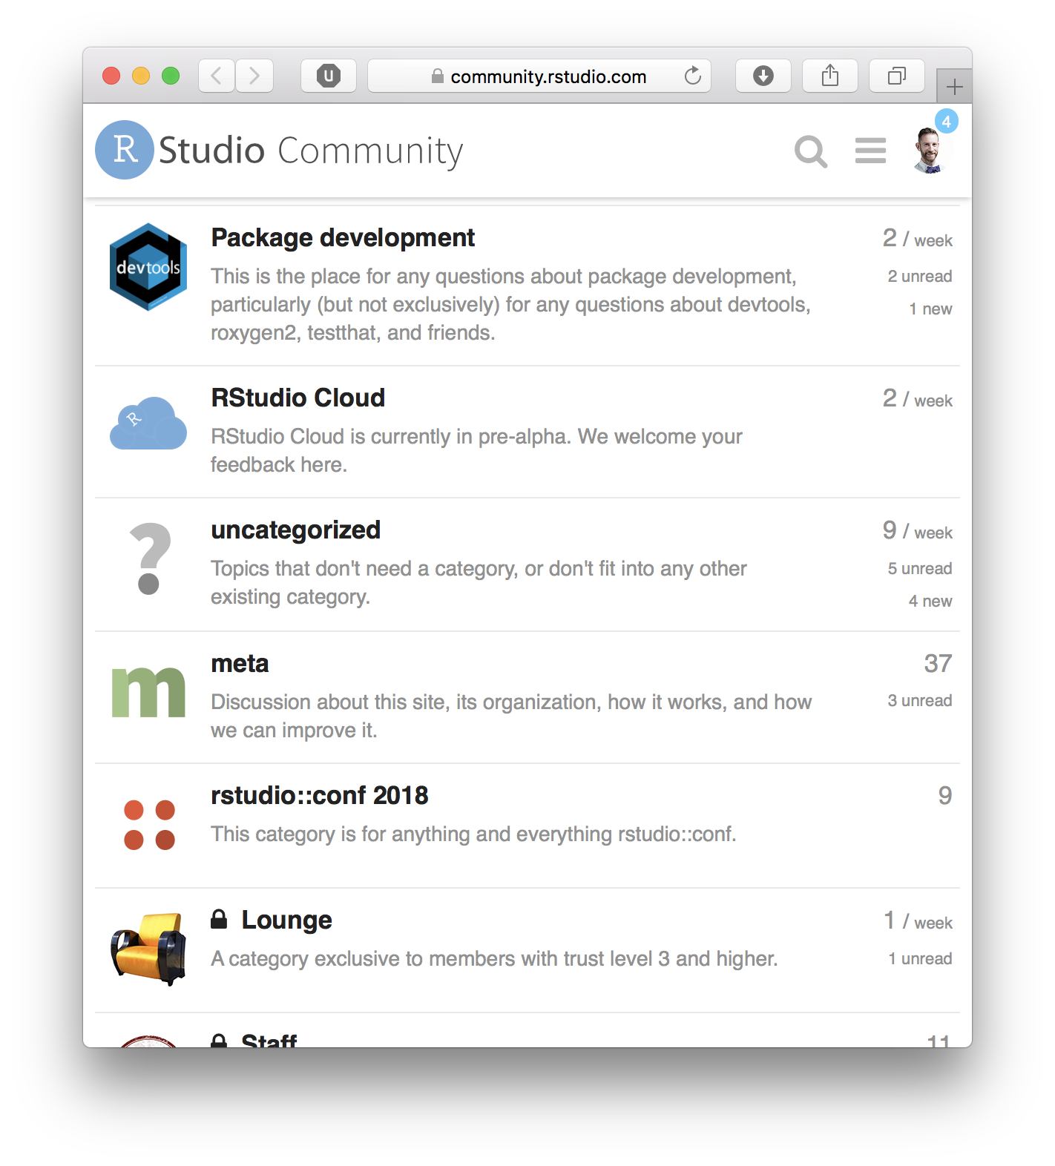
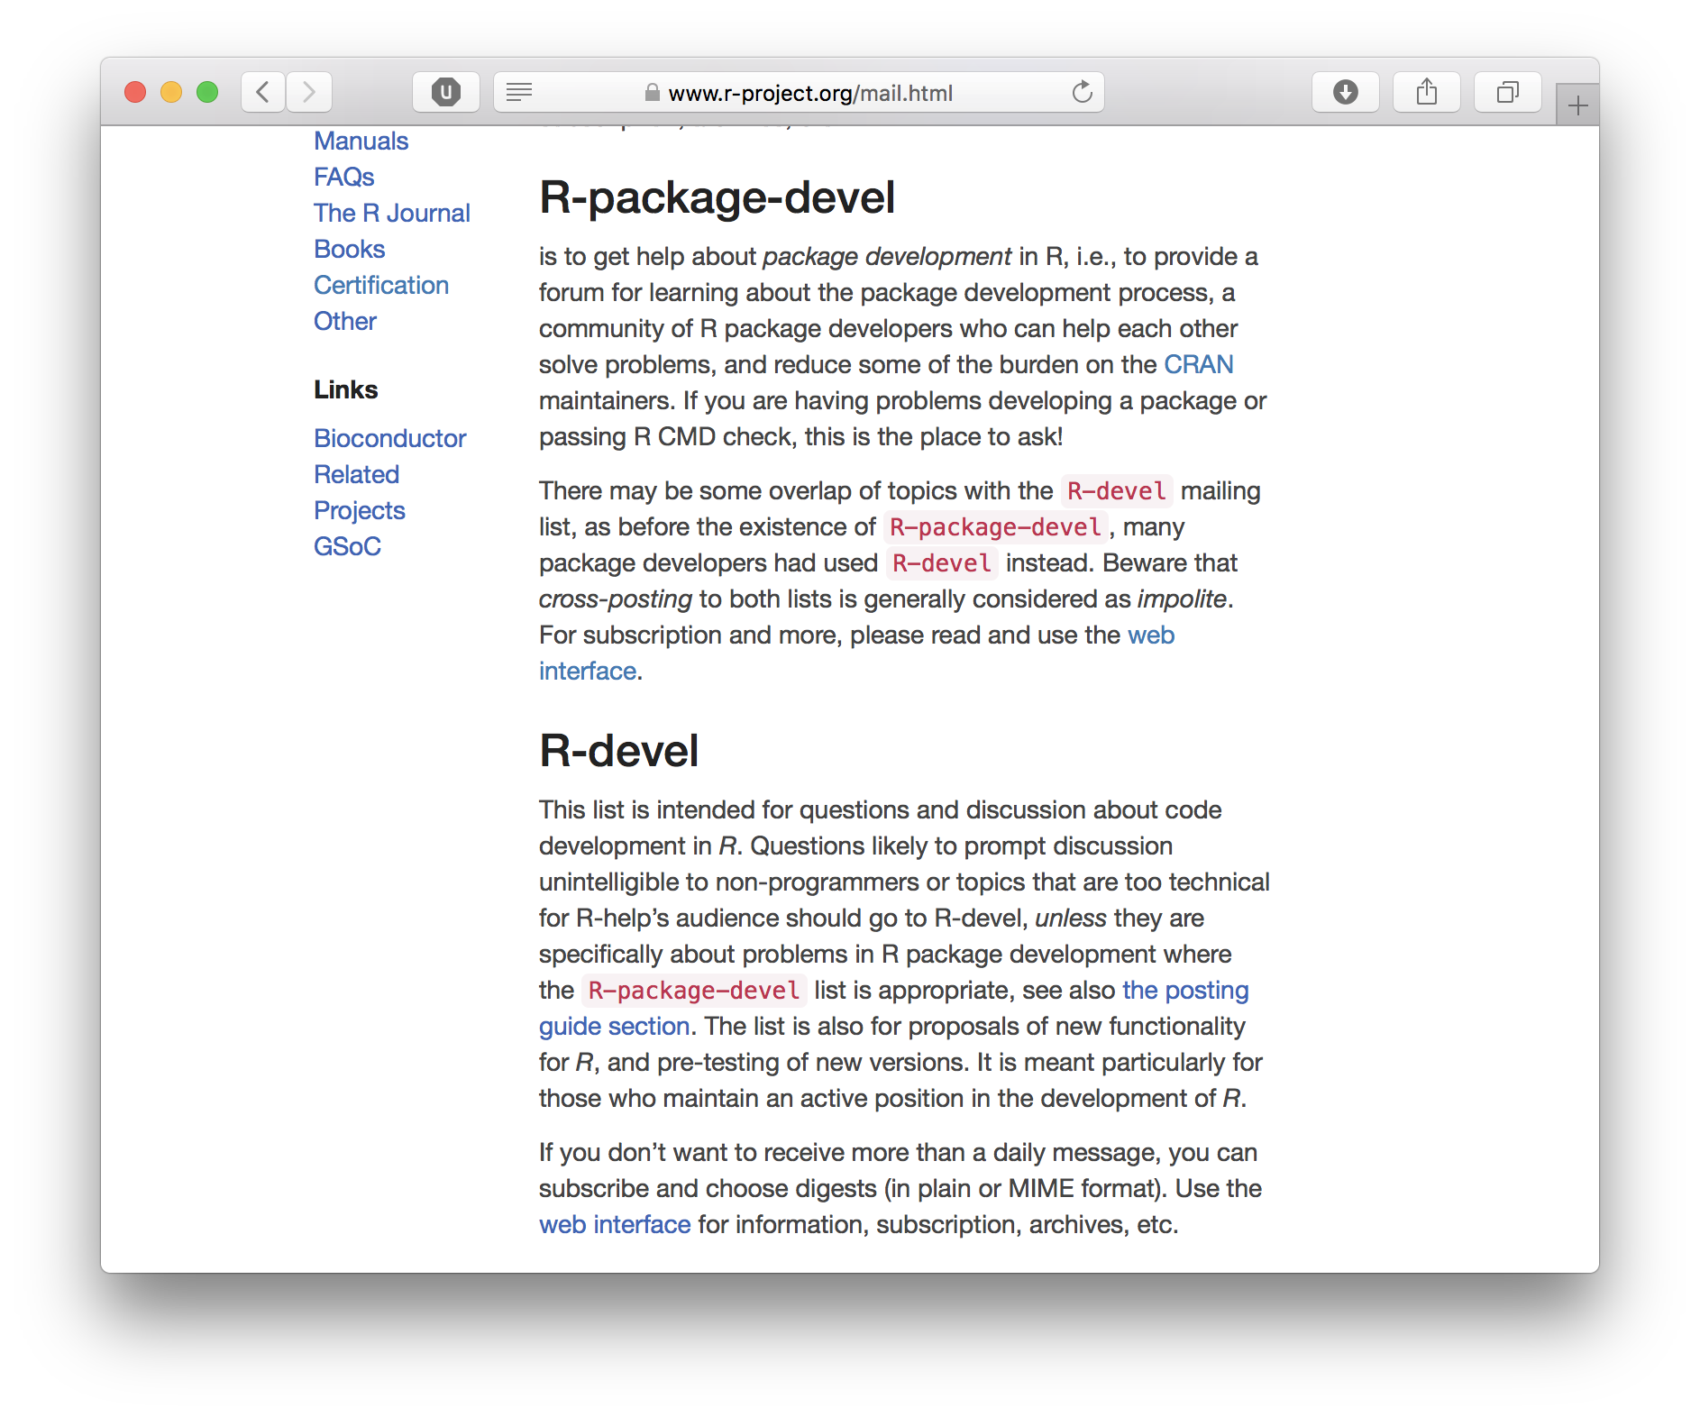
community.rstudio.com
R-package-devel mailing list

Slide 47
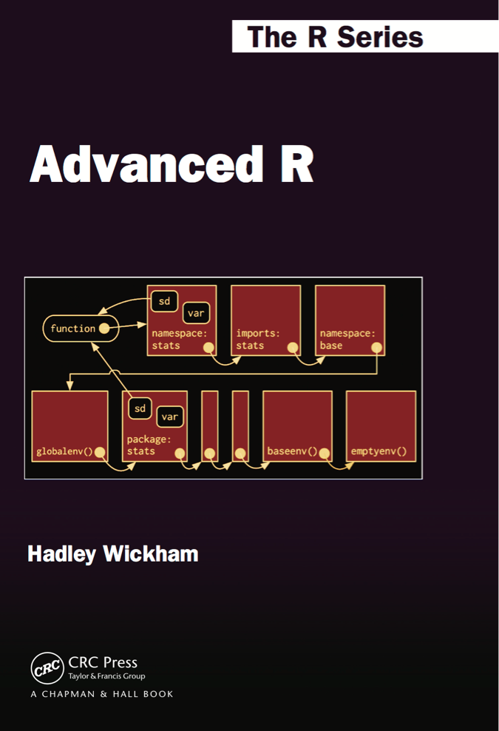
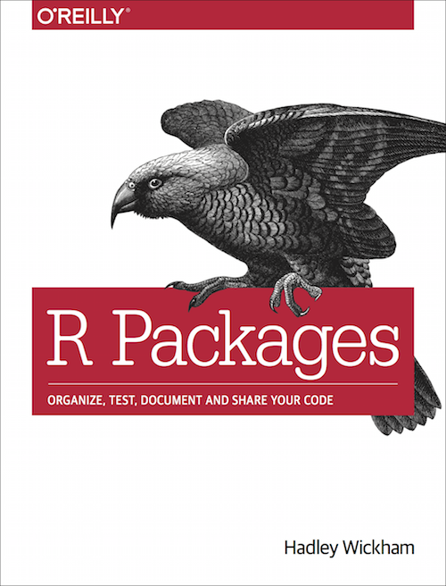
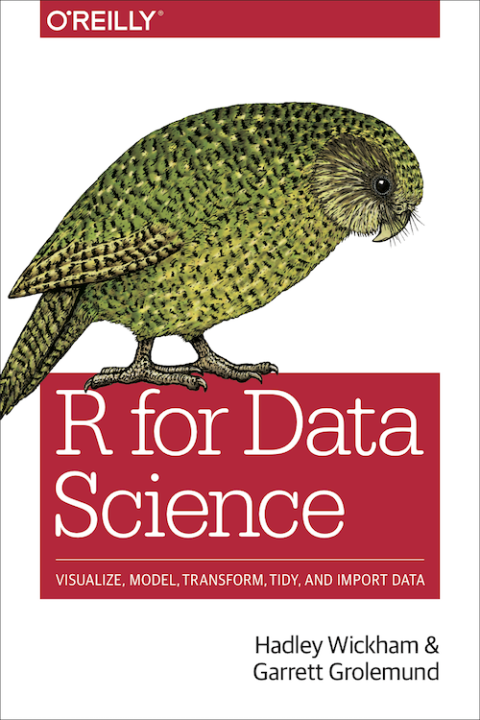
More details on many topics in books
http://adv-r.hadley.nz/
http://r-pkgs.had.co.nz
http://r4ds.had.co.nz
http://amzn.com/1466586966
https://amzn.com/1491910399
https://amzn.com/1491910399

Slide 48
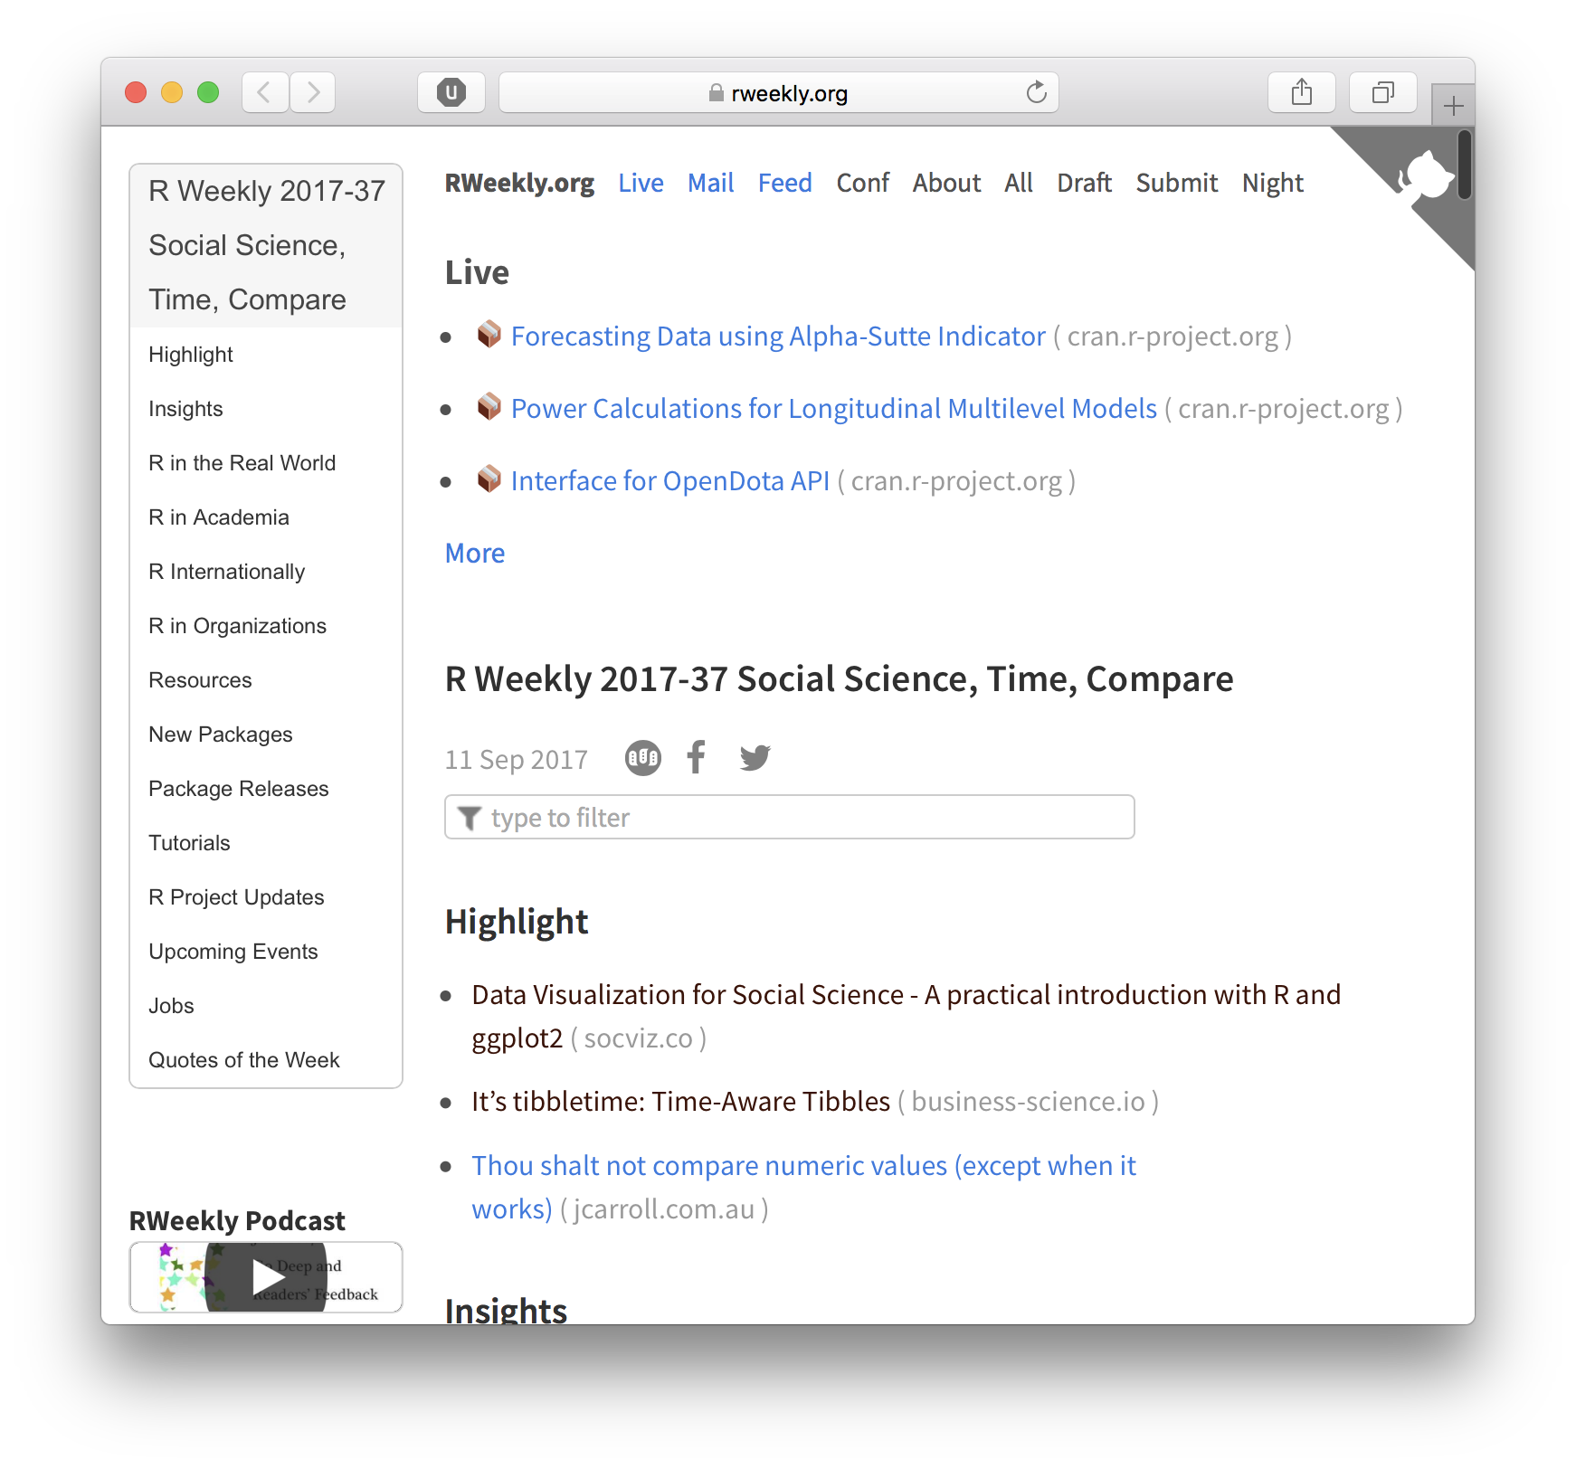
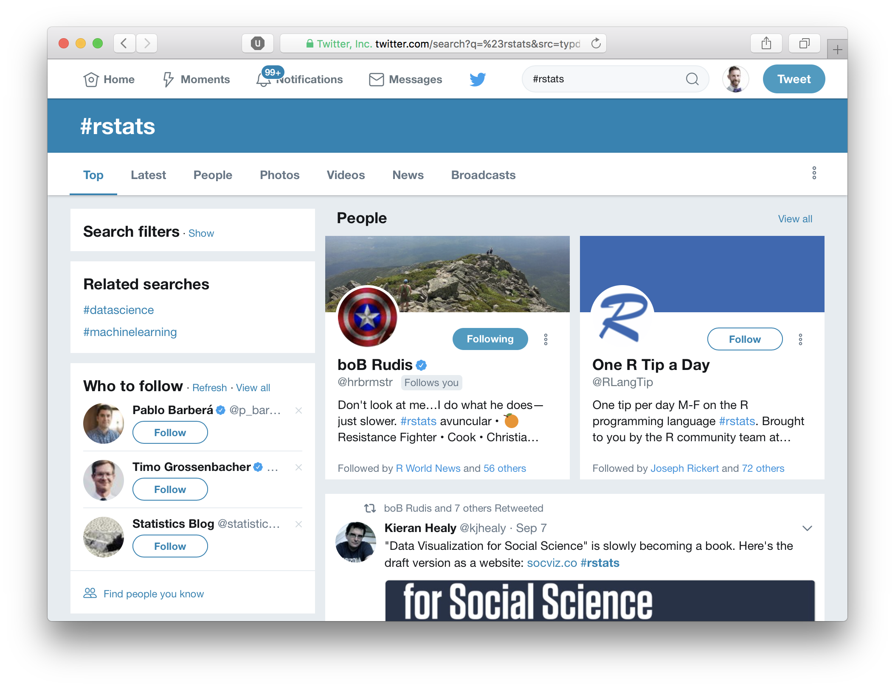
rweekly.org
#rstats
[r] score:5 is:question closed:no

