Slide 1
Configuration files!
UALR ACM
Zachary King
3/16/2017

Slide 2
What are they and why?
Configuration, or data files in general, are meant for storage, manipulation, and sharing of data
With programming, you’ll often need a way to store data for two primary purposes:
Saving, or serializing, data pertaining to the application’s context (such as exported data)
Configuration data for the application itself (application preferences & user preferences)

Slide 3
Common file formats
.INI - “INItialization” file
.DAT - DATa file
.SAV - “SAVe” file
.JSON - “JavaScript Oriented Notation” file
.XML - “eXtensible Markup Language” file
.CSV - “Comma-Separated Value” file
.TSV - “Tab-Separated Value” file
.YAML - “YAML Ain’t Markup Language” file

Slide 4
.ini files
https://en.wikipedia.org/wiki/INI_file
Simple text files with basic structure of sections, properties, and values.
Useful for simple settings and meta-data storage such as:
Database/Server connection settings (may vary by user, service, etc.)
Desktop.ini files on Windows tell the OS how to display the folder/directory
Very easy to read and write.
Parse with Python’s configparser module.

Slide 5
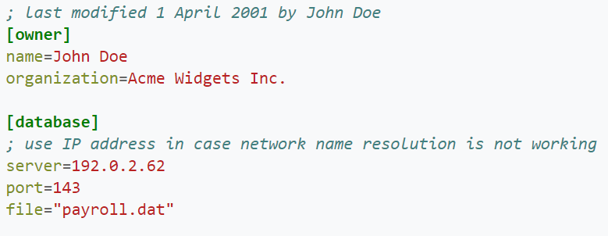
Ini file example

Slide 6
.Dat files
Plain text file (same as .txt), but implies a storage of data to be used somehow.
Structure is up to the programmer/user to decide.
Parsing must be done according to how the file is structured; basic file reading
Typically stores extremely basic data—sometimes just a single column of values
Examples:
temperatures.dat
scores.dat

Slide 7
.sav files
Like .dat, a plain text file with no standard structure
Structure is up to the programmer/user
Parsing must be done according to the defined structure; basic file reading still
Typically used for simple saving of data, or state, from the application.
Might be used for different users (zach.sav, jacob.sav, etc.) for user-specific data

Slide 8
Json files
https://en.wikipedia.org/wiki/JSON
JavaScript-Oriented Notation (JSON) is a more structured way of storing data within data structures (i.e. arrays, dictionaries/maps, booleans, etc.).
Most common for browser/server communication and simple network packets.
Easy to read/write.
Parse with Python’s json module.
Example:
ualr.json (store data on colleges, their departments, staff, etc.)

Slide 9
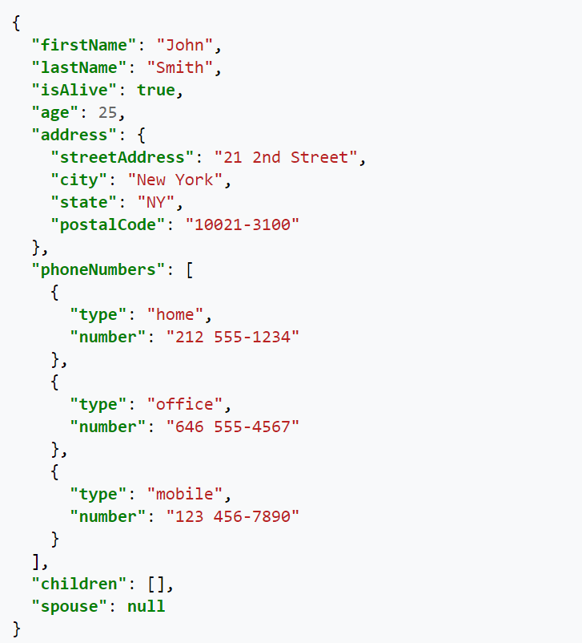
Json example

Slide 10
Xml files
https://en.wikipedia.org/wiki/XML
eXtensible Markup Language (XML) is a markup language for encoding documents and often times for arbitrary data structures.
Precursor to JSON for web contexts (still used some though).
Simple form of custom data structure and data storage.
Used often with Android development (pre-defined XML tags for controls, etc.)
Parse with Python’s xml package.
Examples:
game_level4.xml (may be used to define the level for a game ¯\_(ツ)_/¯ )

Slide 11
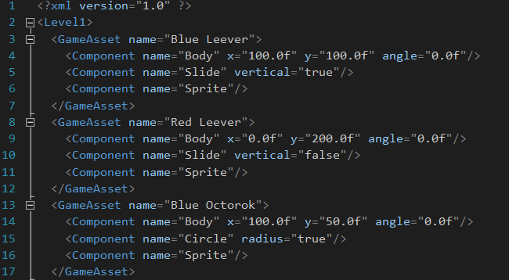
Xml file example

Slide 12
Csv files
https://en.wikipedia.org/wiki/Comma-separated_values
Comma-Separated Value (CSV) files are plaintext files with columns of data, separated by commas.
Very easy to parse and create; can store large amounts of records
Connotatively known as spreadsheets (can be opened in MS Excel, etc.)
Parse with Python’s csv module.
Examples:
exercise_log.csv
finances_export.csv

Slide 13
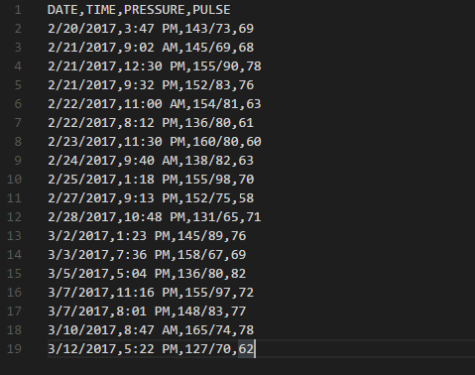
Csv file example

Slide 14
Tsv files
https://en.wikipedia.org/wiki/Tab-separated_values
Tab-Separated Value (TSV) files are similar to CSV files but use Tab as the delimiter.
More readable in raw form than CSV files.
Can also be imported into MS Excel or other spreadsheet applications.
CSV is better for loading into spreadsheets, and TSV is easier to process and read.
Parse with Python’s csv module (same as CSV, but you can specify the delimiter as Tab).
Examples:
marks_health_log.tsv
class_scores.tsv

Slide 15
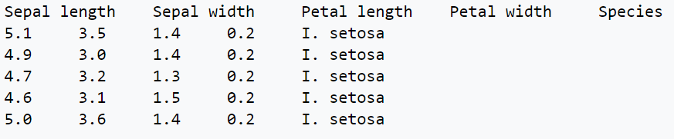
Tsv file example

Slide 16
Yaml files
https://en.wikipedia.org/wiki/YAML
YAML Ain’t Markup Language (YAML) – and yes, it’s a recursive acronym – is a data-oriented format for storing data.
Supports arrays, associative lists, dictionaries, strings, etc. and very readable syntax.
Based off of JSON and very compliant with it.
Parse with PyYAML, an external Python package.
Examples:
receipt.yaml
employees.yaml

Slide 17
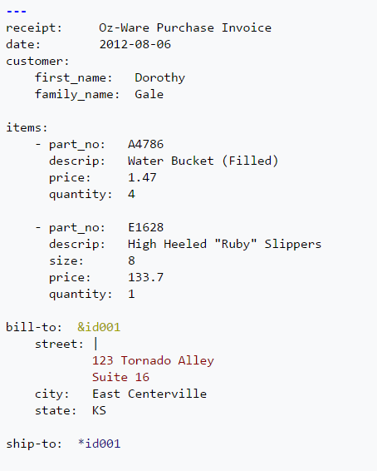
Yaml file example

Slide 18
That’s all folks!
Powerpoint all available on GitHub: https://github.com/UALR-ACM/Practice-Problems/tree/master/2017-3-16
YouTube recording will be available on UALR ACM channel: https://www.youtube.com/channel/UCvgR42AAX_OnL4KaO_uquOw

