Slide 1
Chapter 2 Looking at Computers: Understanding the Parts
Notes:
2
Chapter 2 takes a look at the different parts of a computer.

Slide 2
Chapter Topics
Functions of a computer
Data versus information
Bits and bytes
Input devices
Output devices
Processing
Storage
Ergonomics
Notes:
3
Chapter topics include:
Functions of a computer
The difference between data and information
The definition of bits and bytes
Input devices
Output devices
Processing
Storage
Ergonomics

Slide 3
Computers Are Data Processing Devices
A computer’s four major functions:
Gathers data (users input data)
Processes data into information
Outputs data or information
Stores data and information
Notes:
4
Strictly defined, a computer is a data processing device that performs four major functions:
1. It gathers data (or allows users to input data).
2. It processes that data into information (manipulates, calculates, and organizes data).
3. It outputs data or information.
4. It stores data and information.

Slide 4
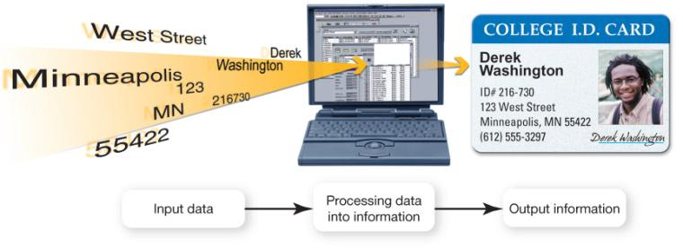
Data vs. Information
Data: Representation of a fact, figure, or idea
Information: Organized, meaningful data
Notes:
5
Data is a representation of a fact, figure, or idea. Data can be a number, a word, a picture, or even a recording of sound. For example, the number 7135553297 and the names Zoe and Richardson are pieces of data.
Information is data that has been organized or presented in a meaningful fashion. When your computer provides you with a contact listing that indicates Zoe Richardson can be reached by phone at (713) 555-3297, the data mentioned earlier suddenly becomes useful—that is, it becomes information.

Slide 5
Bits and Bytes: The Language of Computers
Bit
Binary digit
0 or 1
Byte
8 bits
Each letter, number, and character is a string of eight 0s and 1s
Notes:
6
To process data into information, computers need to work in a language they understand. This language, called binary language, consists of just two digits: 0 and 1. This works like a light switch where it is either on or off.
Everything a computer does is broken down into a series of 0s and 1s. Each 0 and 1 is a binary digit, or bit for short.
Eight binary digits (or bits) combine to create 1 byte.
In computers, each letter of the alphabet, each number, and each special character (such as the @ sign) consists of a unique combination of 8 bits, or a string of eight 0s and 1s. A capital letter K has a different string of 0s and 1s than a lowercase letter k, for instance.
As it turns out, if 8 bits are put together, there are 256 possible combinations. That number of combinations allows for a code that can include all the uppercase and lowercase letters of the alphabet, all 10 digits, punctuation marks, and many other much-used symbols. We call these 8 bits working together a byte. Bytes are the basic measurement for storage in a computer.

Slide 6
How Much Is a Byte?
Name | Abbreviation | Number of Bytes | Relative Size
Byte | B | 1 byte | Can hold one character of data.
Kilobyte | KB | 1,024 bytes (2¹⁰ bytes) | Can hold 1,024 characters or about half of a double-spaced typewritten page.
Megabyte | MB | 1,048,576 bytes (2²⁰ bytes) | Can hold approximately 768 pages of typed text.
Gigabyte | GB | 1,073,741,824 bytes (2³⁰ bytes) | Approximately 786,432 pages of text; 500 sheets of paper is approximately 2 inches, so this represents a stack of paper 262 feet high.
Terabyte | TB | 1,099,511,627,776 bytes (2⁴⁰ bytes) | This represents a stack of typewritten pages almost 51 miles high.
Petabyte | PB | 1,125,899,906,842,62 bytes (2⁵⁰ bytes) | The stack of pages is now 52,000 miles high, or approximately one-fourth the distance from the Earth to the moon.
Exabyte | EB | 1,152,921,504,606,846,976 bytes (2⁶⁰ bytes) | The stack of pages is now 52 million miles high, or just about twice the distance between the Earth and Venus.
Zettabyte | ZB | 1,180,591,620,717,411,303,424 bytes ( bytes) | The stack of pages is now 52 billion miles high, some 20 times the distance between the Earth and Pluto.
Notes:
7
Not only are bits and bytes used as the language that tells the computer what to do, they are also what the computer uses to represent the data and information it inputs and outputs.
Kilobytes, megabytes, gigabytes, and terabytes are simply amounts of bytes and make it easier to measure the size of files.

Slide 7
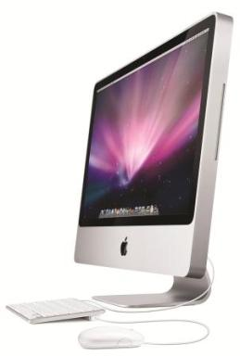
Computer Hardware
Hardware: Any part of the computer you can touch
Notes:
11
Hardware consists of any of the computer components you can touch, such as the monitor, keyboard, mouse, and printer.
Hardware makes the machine run. Without software, though, the computer would be useless.

Slide 8
Computer Software
Software: Programs that enable hardware to perform different tasks
Application software
System software
Notes:
8
Software is the set of computer programs that enables the hardware to perform different tasks.
There are two broad categories of software: application software and system software.
Application software is the set of programs you use on a computer to help you carry out tasks. If you’ve ever typed a document, created a spreadsheet, or edited a digital photo, for example, you’ve used a form of application software.
System software is the set of programs that enables your computer’s hardware devices and application software to work together. The most common type of system software is the operating system (OS). It manages the computer system’s hardware—such as the monitor and the printer. The OS also provides a means by which users can interact with the computer.

Slide 9
Types of Computers
Basic computer designs
Portable
Notebook computers
Netbooks
Tablet PCs
Stationary
Desktop computers
Notes:
8
The two basic designs of computers are portable and stationary.
Notebook computer components such as the keyboard and monitor are integrated into a single computer case.
A netbook is a small, lightweight notebook computer that is generally 7 to 10 inches wide and has a longer battery life than a notebook computer.
A tablet PC is similar to a notebook but features a touch-sensitive screen that can swivel and fold flat. Users input data and commands on a tablet PC via a special pen called a stylus or with their fingers.
A desktop computer is intended for use at a single location, and therefore is stationary. It has a case that houses the system unit and peripheral devices, such as monitors and printers that are connected to the computer.
The Apple iMac, Dell Studio One 19”, and Gateway One pack their components into an all-in-one design.

Slide 10
Types of Computers
Mainframe: Supports hundreds of users simultaneously
Supercomputer: Performs complex calculations rapidly
Embedded: Self-contained computer performing dedicated functions
Notes:
8
Mainframe computers can execute many different computer programs at the same time and are often used in insurance companies and colleges and universities.
Supercomputers are used to perform intensive mathematical calculations such as weather forecasting.
Embedded computers are computer chips that reside inside other devices such as your car, thermostat, or microwave.

Slide 11
Input Devices
Devices used to enter information or instructions into the computer
Keyboard
Mouse/pointing device
Microphone
Scanner
Digital camera
Notes:
12
An input device enables you to enter data (text, images, and sounds) and instructions (user responses and commands) into the computer.
The most common input devices are the keyboard and the mouse.
You use keyboards to enter typed data and commands, whereas you use the mouse to enter user responses and commands, for example, by clicking an icon.
There are other input devices as well: microphones input sounds; scanners and digital cameras input nondigital text and digital images.
Styluses (devices that look like skinny pens but have no ink) are used like a mouse or pen to tap commands or draw on a screen and electronic pens are often used in conjunction with graphics tablets that can translate a user’s handwriting into digital input.

Slide 12
Keyboards
The QWERTY layout is standard on most PCs
Enhanced keyboard features include number, function, and navigation keys
Notebook keys have alternate functions when used in conjunction with the Fn (function) key
Notes:
13
The QWERTY layout gets its name from the first six letters in the top-left row of alphabetic keys on the keyboard.
An alternative keyboard layout is the Dvorak keyboard, where the most commonly used letters in the English language are on keys in the middle row of the keyboard.
Enhanced keyboard features include number, function, and navigation keys.
Notebook keyboards are compact and often do not have a numeric keypad, so some letter keys function as number keys when pressed in combination with another key.
A variety of additional keys such as multimedia and Internet buttons are included on some keyboards to help you work more efficiently.
Wireless keyboards are also available that work via radio frequencies.

Slide 13
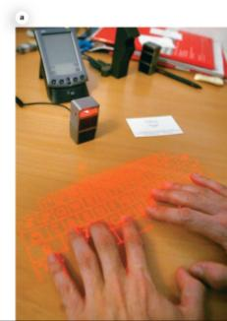
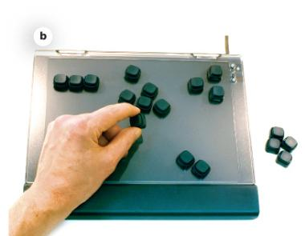
Specialty Keyboards
Virtual laser keyboard
Configurable keyboard
Notes:
14
The virtual laser keyboard projects the image of a keyboard on any surface and sensors detect the motion of your fingers as you “type.”
Flexible roll-up keyboards are an alternative if you want a full-sized keyboard for your notebook; they plug into a USB port.
The DXI keyboard from Ergodex allows gamers to move the keys in any position on the keyboard as well as reprogram them.
Although most desktop PCs ship with wired keyboards, wireless keyboards are available. These keyboards are powered by batteries and send data to the computer using a form of wireless technology.

Slide 14
Mice
Optical mouse
Needs no mouse pad
Doesn’t need cleaning
Trackball
Easier on wrists
Stays stationary on desk
Wireless
Uses radio or light waves
Integrated pointing device
Touchpad
Trackpoint
Notes:
17
The optical mouse uses an internal sensor or laser to detect the mouse’s movement. Optical mice have no moving parts on the bottom, so there is no way for dirt to interfere with the mechanisms and less chance of parts breaking down.
A trackball mouse remains stationary and doesn’t demand much wrist motion, so it’s considered healthier on the wrists.
Wireless mice send data to the computer by radio or light waves.
Notebook computers and tablet PCs do not come with a mouse and instead use an integrated pointing device such as a touchpad or a trackpoint.

Slide 15
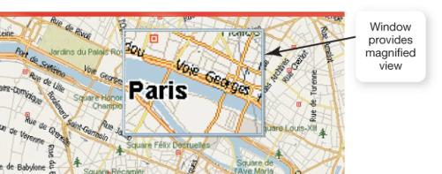
New Mouse Features
Magnifier
Customizable buttons
Web search
File storage
Notes:
17
Magnifier: Pulls up a magnification box that you can drag around the screen to enhance the viewing of hard-to-read images. This feature can be used by people with visual disabilities.
Customizable buttons: Extra buttons on the mouse can be programmed to perform the functions you use most often to help you speed through tasks.
Web search: Allows you to quickly highlight a word or phrase and then press the search button (on the mouse) to start a Web search.
File storage: Includes a USB thumb drive to save your files.

Slide 16
Other Input Devices
Game controllers
Touchscreens
Digital pens
Notes:
17
Game controllers such as joysticks, game pads, and steering wheels are input devices that send data to the computer.
A touchscreen is a display screen found on desktops, notebooks, tablet PCs, and smartphones that responds to commands entered with a finger or a stylus. The Apple iPod Touch, iPad, and iPhone all have touch capability.
The Dane-Elec Digital Pen works in conjunction with a flash drive You can write with the pen on any conventional paper, and your writing is captured and then wirelessly transmitted and stored in the flash drive. When the flash drive is connected to a computer, you can use software to translate your writing into digital text.

Slide 17
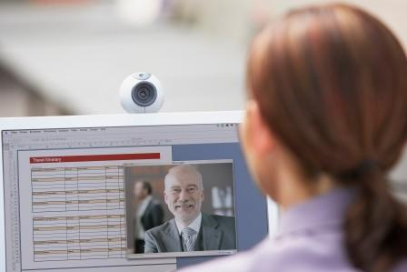
Image Input
Digital cameras, camcorders, and cell phones
Pictures
Video
Scanners
Webcams
Live video
Notes:
17
Digital cameras, camcorders, and cell phones are common input devices for capturing images and video.
Scanners can also input images. They work similar to a photocopy machine, but instead of generating the image on paper, they create a digital image, which can then be printed, saved in storage, or e-mailed.
Webcams are small cameras that usually sit on top of your computer monitor or are built into your notebook computer. Although some webcams are able to capture still images, webcams generally are used to transfer live video directly to your computer.

Slide 18
Sound Input
Microphones are used for:
Podcasts
Videoconferencing
Internet phone calls
Speech recognition
Notes:
17
A microphone allows you to capture sound waves and transfer them in digital format to your computer.
Microphones come with most computers. If you didn’t get a microphone with yours, you might want to buy a desktop microphone if you plan to record your own audio files.
Microphones come in two basic types. Unidirectional microphones pick up sound from only one direction. Omnidirectional microphones pick up sounds from all directions at once.
A headset microphone is best for videoconferencing and speech-recognition uses. Videoconferencing technology allows a person sitting at a computer equipped with a personal video camera and a microphone to transmit video and audio across the Internet (or other communications medium).
In speech-recognition systems, you operate your computer through a microphone, telling it to perform specific commands or to translate your spoken words into data input. Windows 7 includes speech recognition as part of the basic operating system.

Slide 19
Input Devices for the Physically Challenged
Visual impairments
Voice recognition
Keyboards with large keys
Touch-screen keyboards
Motor control issues
Special trackballs
Head-mounted devices
Notes:
22
Visually impaired users can input data from voice recognition or by using large keyboards, including touch-screen keyboards. There are also keyboards designed for individuals who can only use one hand such as the Maltron keyboard.
Users with severe motor control problems can use special trackballs designed for one-finger use that can be mounted anywhere.
When arm motion is severely restrained, head-mounted pointing devices can be used.

Slide 20
Output Devices
Send processed data out of the computer
Monitors
Printers
Output devices make:
Soft copies (video, sounds, control signals)
Hard copies (print)
Notes:
23
Output devices enable you to send processed data out of your computer. This can take the form of text, pictures (graphics), sounds (audio), and video.
One common output device is a monitor, which displays text, graphics, and video as soft copies (copies you can see only on screen).
Another common output device is a printer, which creates tangible or hard copies of text and graphics.
Speakers are output devices for sound.

Slide 21
Monitor Types
LCD: Liquid crystal display
Flat panel
Light and energy efficient
LED: Light-emitting diode
More energy efficient than LCD monitors
Better color accuracy and thinner panels
CRT monitors: Legacy technology
Notes:
23
The most common type of monitor is a liquid crystal display (LCD), also called a flat-panel monitor, which is light and energy efficient.
Some newer LCD monitors use light-emitting diode (LED) technology, which is even more energy efficient, and can have better color accuracy and thinner panels than traditional LCD monitors.
CRT monitors are difficult to find or buy because they have become legacy technology, or computing devices or peripherals that use techniques, parts, and methods from an earlier time that are no longer popular.

Slide 22
LCD Monitor Features
Screens are grids made up of millions of tiny dots called pixels
Each pixel is composed of red, blue, and green subpixels (and sometimes yellow)
Liquid crystal is sandwiched between two transparent layers to form images
Notes:
25
Monitor screens are grids made up of millions of pixels, or tiny dots.
Illuminated pixels create images on the monitor. There are three subpixel colors: red, blue, and green. Some newer TVs on the market have added a fourth color, yellow.
LCD monitors are made of two (or more) sheets of material filled with a liquid crystal solution. A fluorescent panel at the back of the LCD monitor generates light waves. When electric current passes through the liquid crystal solution, the crystals move around, either blocking the fluorescent light or letting the light shine through. This blocking or passing of light by the crystals causes images to be formed on the screen.

Slide 23
LCD Quality Factors
Aspect ratio
Resolution
Contrast ratio
Viewing angle
Brightness
Response time
Notes:
26
The aspect ratio is the width to height proportion of a monitor. Traditionally, aspect ratios have been 4:3, but newer monitors are available with an aspect ratio of 16:9 or 16:10.
The screen resolution, or the clearness or sharpness of the image, reflects the number of pixels on the screen.
The contrast ratio is the measure in the difference in light intensity between the brightest white and the darkest black that the monitor can produce. A contrast ratio between 400:1 and 1,000:1 is preferable.
The viewing angle measures how far you can move to the side of (or above or below) the monitor before the image quality degrades to unacceptable levels. For monitors that measure 17 inches or more, a viewing angle of at least 150 degrees is usually recommended.
Brightness is a measure of the greatest amount of light showing when the monitor is displaying pure white. A brightness level of 300cd/m² or greater is recommended.
Response time is the time it takes for a pixel to change color. A lower response time means faster transitions; therefore moving images will appear less jerky.

Slide 24
Screen Size
21-inch monitor
1680 × 1050 pixels
19-inch monitor
1440 × 900 pixels
1280 × 1024 pixels
HD-DVDs and Blu-ray movies
Require at least 1920 × 1080 pixels
Notes:
28
The larger the monitor, the more pixels it can display. Typical resolutions are listed on the slide.
If you want to watch high-definition or Blu-Ray movies, you would need a resolution of at least 1920 × 1080.

Slide 25
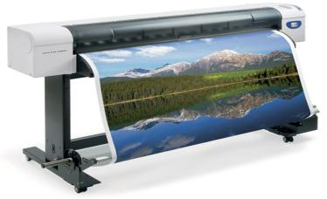
Printers
Inkjet printers
Spray tiny drops of ink onto page
Laser printers
Use laser beams and static electricity to deliver toner to page
All-in-one printers
Plotters
Thermal printers
Notes:
29
Inkjet printers are popular because they are affordable and produce high-quality color printouts quickly and quietly. Inkjet printers work by spraying tiny drops of ink onto paper and are great for printing black-and-white text as well as color images.
Laser printers use laser beams and static electricity to deliver toner (similar to ink) onto the correct areas of the page. Heat is used to fuse the toner to the page, making the image permanent. They have a faster printing speed than inkjet printers and produce higher-quality printouts.
Impact printers have tiny hammer-like keys that strike the paper through an inked ribbon, making a mark on the paper. The most common impact printer is the dot-matrix printer. Impact printers are an example of legacy technology.
An all-in-one printer is a device that combines the functions of a printer, scanner, copier, and fax into one machine. All-in-one printers can use either inkjet or laser technology.
A plotter is another type of printer. They produce oversize pictures that require the drawing of precise and continuous lines, such as maps, detailed images, and architectural plans.
A thermal printer works either by melting wax-based ink onto ordinary paper (a process called thermal wax transfer printing), or by burning dots onto specially coated paper (a process called direct thermal printing).

Slide 26
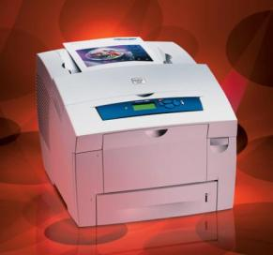
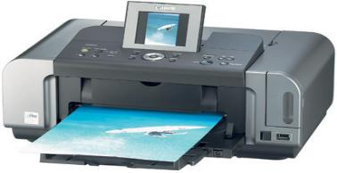
Nonimpact Printers
Inkjet
Less expensive device
Print high-quality color images cost effectively
Laser
More expensive device
Faster printing speed
Color lasers are becoming less expensive
Notes:
30
Inkjet printers work by spraying tiny drops of ink onto paper. When using the right paper, higher-end inkjet printers print images that look like professional-quality photos. Because of their high quality and low price, inkjet printers are the most popular printers for color printing.
Laser printers are often preferred for their quick and quiet production and high-quality printouts. Although more expensive to buy than inkjet printers, over the long run, for high-volume printing, laser printers are more economical than inkjets (they cost less per printed black-and-white page) when you include the price of ink and special paper in the overall cost.
Recently, the prices of color laser printers have fallen, making them price competitive with high-end inkjet printers.

Slide 27
Choosing a Printer
Speed (ppm)
Resolution (dpi)
Color output
Use and cost
Cost of consumables
Notes:
31
Speed: A printer’s speed determines how many pages it can print per minute (called pages per minute, or ppm). Printing speeds range from 8 to 38 ppm for both laser and inkjet printers.
Resolution: A printer’s resolution (or printed image clarity) is measured in dots per inch (dpi). The higher the dpi, the greater the level of detail and quality of the image. For general-purpose printing, 1,200 dpi is sufficient; for printing photos, 4,800 dpi is better.
Color output: Some printers come with a single ink cartridge for all colors; others have two ink cartridges, one for black and one for color. The best setup is to have individual ink cartridges for each color, so you can replace only the specific color cartridge that is empty.
Use and cost: If you will be printing mostly black-and-white, text-based documents or will be sharing your printer with others, a black-and-white laser printer is best because of its printing speed and overall economies for volume printing. If you’re planning to print color photos and graphics, an inkjet printer or color laser printer is a must, even though the cost per page will be higher. Keep in mind a printer’s reported duty cycle, a manufacturer’s figure that refers to how long a machine can keep operating before it needs a rest, or what percentage of the time it’s designed to be in use. Exceeding the duty cycle estimates might lead to printer malfunctions.
Cost of consumables: You should investigate carefully the cost of consumables (printer cartridges and paper) for any printer you are considering purchasing.

Slide 28
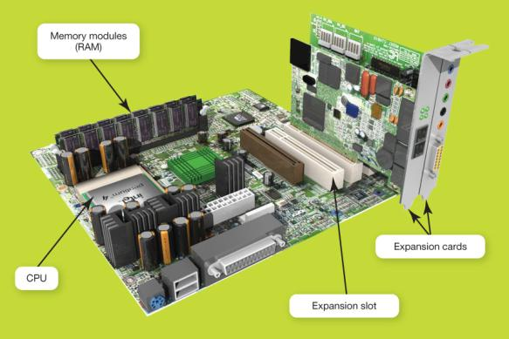
The Motherboard
CPU
RAM
Expansion cards and slots
Built-in components
Notes:
42
The motherboard is the key circuit board holding the essential processing parts. Attached directly to the motherboard are the CPU, ROM, RAM and cache memory, expansion cards, and in many new computers, networking, modem, video, and audio components.

Slide 29
RAM vs. ROM
Random access memory (RAM)
Stores instructions and data
Temporary (volatile) storage
Consists of several memory cards or modules
Read-only memory (ROM)
Stores startup instructions
Permanent storage
Notes:
44
Random access memory (RAM) is a series of small cards or modules plugged into slots on the motherboard. The CPU can request any data in RAM. It is then located, opened, and delivered to the CPU for processing in a few billionths of a second.
Because all the contents of RAM are erased when you turn off the computer, RAM is the temporary or volatile storage location for the computer.
To save data more permanently, you need to save it to the hard drive or to another permanent storage device such as a CD or flash drive.
Read-only memory (ROM) holds all the instructions the computer needs when it is powered on. The data does not get erased when the power is turned off.

Slide 30
Central Processing Unit (CPU)
Referred to as the “brains” of the computer
Controls all functions of the computer
Processes all commands and instructions
Can perform billions of tasks per second
Notes:
43
The central processing unit (CPU, or processor) is the largest and most important chip in the computer.
It is sometimes referred to as the “brains” of the computer because it controls all the functions performed by the computer’s other components and processes all the commands issued to it by software instructions.
Modern CPUs can perform 45 billion tasks per second without error, making them extremely powerful components.

Slide 31
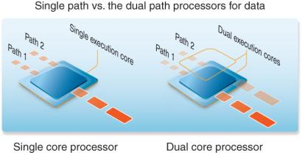
CPU Performance Measures
Speed
Megahertz (MHz)
Gigahertz (GHz)
Cores
Single
Dual
Quad
Notes:
43
CPU clock speed is one measure of the CPU’s performance. Processor speed is measured in hertz or “machine cycles per second.” Older computers ran at speeds measured in megahertz (MHz) or millions of machine cycles per second. Current systems run at speeds measured in gigahertz (GHz) or billions of machine cycles per second.
CPU performance is also affected by the number of cores, or processing paths, the processor has. Processors have been designed that have two, four, and even eight cores.

Slide 32
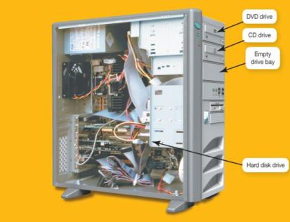
Drive Bays
Internal drive bays
Cannot be accessed from outside the system
Are reserved for internal hard drives
External drive bays
Can be accessed from outside the system
CD or DVD drives
Floppy and Zip drives (legacy technology)
Notes:
36
Drive bays are special shelves reserved for storage devices.
Internal drive bays cannot be seen or accessed from outside the system unit. They are reserved for internal hard drives.
External drive bays can be seen and accessed from outside the system unit. External drive bays house CD and DVD drives, for example. Empty external drive bays are covered by a faceplate.
Some computers still have floppy or disk drives, but these are legacy technologies. However, manufacturers are now charging extra for these and tend to provide more USB ports to accommodate the use of flash drives and external hard drives.

Slide 33
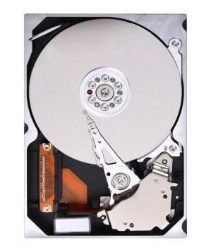
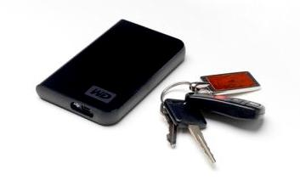
Hard Drive
Permanent (nonvolatile) storage
Internal or external versions
Notes:
36
The hard drive is your computer’s primary device for permanent storage of software and documents and usually holds all permanently stored programs and data.
The hard drive is a nonvolatile storage device, meaning that it holds the data and instructions your computer needs permanently, even after the computer is turned off.
Originally, all hard drives were installed inside the system unit. Today, external hard drives are readily available.

Slide 34
Optical Storage
Compact discs (CDs)
Digital video discs (DVDs)
Blu-ray discs (BDs)
Notes:
Most computers have an optical drive. CDs, DVDs, and BDs store data as tiny pits that are burned into a disc by a high-speed laser.
Blu-ray disc (BD) is the newest means of storing digital media, including high-definition video. An average two-hour standard definition movie can fit on a standard DVD, but the newer high-definition movies require a disc with about five times more storage space than that.
A single-layer Blu-ray disc can hold 25 GB of data and a dual-layer disc holds 50 GB or about 5½ hours of high-definition format movies. By comparison, a CD holds about 700 MB, a DVD 4.7 GB, and a dual-layer DVD 9.4 GB.

Slide 35
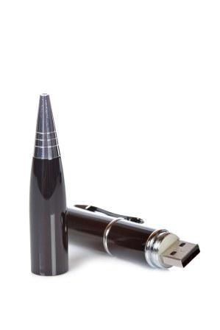
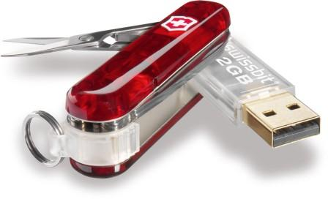
Flash Drives/Flash Memory
Flash drives (jump drives)
Newer storage alternative
Plug into USB ports
Flash memory cards
Slide into slots in the system
Solid state (SSD) hard drives
Notes:
38
Flash drives, sometimes referred to as jump drives, USB drives, or thumb drives, are the new alternative to storing portable data. They plug into USB ports.
Several manufacturers now also include slots on the front of the system unit in which you can insert portable flash memory cards. Many notebooks also include slots for flash memory cards. Flash memory cards let you transfer digital data between your computer and devices such as digital cameras, PDAs, smartphones, video cameras, and printers.
Some hard drives are also based on flash memory. A solid state drive (SSD) does not have any spinning platters or motors, so they are more efficient, run with no noise, emit very little heat, and require very little power.

Slide 36
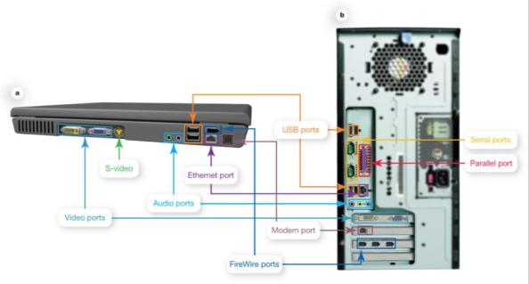
Types of Ports
USB
Serial and parallel
Audio and video
FireWire
Connectivity
Ethernet
Modem
HDMI
Notes:
38
Ports are the places on the system unit where peripheral devices attach to the computer so that data can be exchanged between them and the operating system.
Some ports are on the front of the system unit.
The ports on the back of the computer are mostly designed for long-term connections.
A universal serial bus (USB) port is now the most common port type used to connect input and output devices to the computer. This is mainly because of a USB port’s ability to transfer data quickly.
Serial and parallel ports are legacy technologies due to the advantages of USB ports.
Devices such as external hard drives, digital video cameras, portable music players, and digital media players all benefit from the speedy data transfer capabilities of FireWire.
Ethernet ports can be used to connect computers to a digital subscriber line (DSL) or cable modem, or a network.
Modem ports use a traditional telephone signal to connect to the Internet over a phone line.
The latest digital connector designed for use in high-definition home theater environments is High-Definition Multimedia Interface (HDMI), a compact audio/video interface.

Slide 37
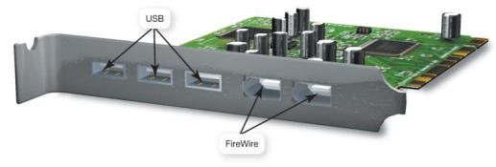
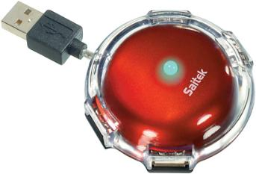
Adding Ports
Expansion cards
New port standards
Expansion hubs
Enable several devices to be connected to a port
Notes:
Special expansion cards are one way to add new types of ports to an older computer or to expand the number of ports on your computer. Like other expansion cards, these cards clip into an open expansion slot on the motherboard.
If there are no open slots on the motherboard and you still need extra ports, you can add an expansion hub, a device that connects to one port, such as a USB port, to provide additional new ports. This is similar to a multiplug extension cord that you use with electrical appliances.

Slide 38
Power Controls
Power-on button: Turns on system
Cold boot: powering on your computer from a fully turned off state
Other options
Sleep mode
Hibernate
Warm boot
Notes:
35
Your system has a power-on button on the front panel. Powering off your computer properly helps to save energy, keeps your computer more secure, and ensures that your data is saved. You can turn your computer off by pressing the computer’s power button, using the Shut down button on the Start menu, or with a notebook, just closing the lid.
Powering on your computer from a completely turned off state is called a cold boot.
When your computer enters Sleep mode, all the documents, applications, and data you were using are stored in RAM, from which they are quickly accessible upon restarting your computer.
Hibernation is another power-saving mode that stores your data in memory and saves it to your computer's hard disk.
If you’re using Windows 7, you can restart the computer by clicking the right arrow button next to the Shut Down button on the Start menu, and choosing Restart. This is called a warm boot. You might need to perform a warm boot if the operating system or other software application stops responding or if you have installed new programs.

Slide 39
Setting It All Up: Ergonomics
Ergonomics: Minimizing injury or discomfort while using the computer
Steps to follow
Position monitor correctly
Use adjustable chair
Assume proper position while typing
Take breaks
Ensure adequate lighting
Notes:
46
In terms of computing, ergonomics refers to how you set up your computer and other equipment to minimize your risk of injury or discomfort.
The following are some guidelines that can help you avoid discomfort, eyestrain, or injuries while you’re working at your computer:
Position your monitor correctly. This should be at least 25 inches from your eyes and at eye level or so that it is at an angle 15 to 20 degrees below your line of sight.
Purchase an adjustable chair. Adjust the height of your chair so that your feet touch the floor. The chair should include back support.
Assume a proper position while typing. Your wrists should be flat with respect to the keyboard, and your forearms should be parallel to the floor. Specially designed ergonomic keyboards and wrist rests can help you achieve the proper position for your wrists.
Take breaks from computer tasks.
Ensure that the lighting is adequate.

Slide 40
Chapter 2 Summary Questions
What exactly is a computer, and what are its four main functions?
Notes:
47
What exactly is a computer, and what are its four main functions?

Slide 41
Chapter 2 Summary Questions
What is the difference between data and information?
Notes:
48
What is the difference between data and information?

Slide 42
Chapter 2 Summary Questions
What are bits and bytes, and how are they measured?
Notes:
49
What are bits and bytes, and how are they measured?

Slide 43
Chapter 2 Summary Questions
What devices do I use to get data into the computer?
Notes:
50
What devices do I use to get data into the computer?

Slide 44
Chapter 2 Summary Questions
What devices do I use to get information out of the computer?
Notes:
51
What devices do I use to get information out of the computer?

Slide 45
Chapter 2 Summary Questions
What’s on the motherboard?
Notes:
52
What’s on the motherboard?

Slide 46
Chapter 2 Summary Questions
Where are information and programs stored?
Notes:
53
Where are information and programs stored?

Slide 47
Chapter 2 Summary Questions
How are devices connected to the computer?
Notes:
54
How are devices connected to the computer?

Slide 48
Chapter 2 Summary Questions
How do I set up my computer to avoid strain and injury?
Notes:
55
How do I set up my computer to avoid strain and injury?

Slide 49
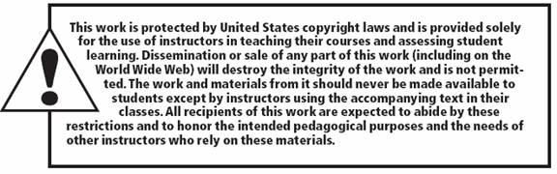
All rights reserved. No part of this publication may be reproduced, stored in a retrieval system, or transmitted, in any form or by any means, electronic, mechanical, photocopying, recording, or otherwise, without the prior written permission of the publisher. Printed in the United States of America.
Copyright © 2012 Pearson Education, Inc.
Publishing as Prentice Hall
49

