Slide 1
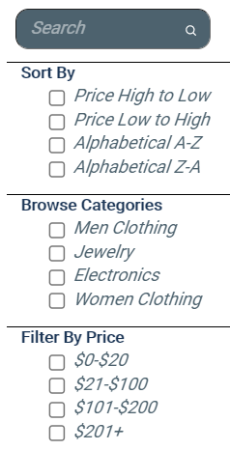
Sort/Filter Process
Original Product List
[ {Product1}, {Product2},….]
Search option
Browse option
Filter option
If(…)
Products that match the above three
Sort
Products to be displayed to the user
[{Product1},…]

