Slide 1
HPPS Project: RTM – Maxeler
Enrico Deiana & Emanuele Del Sozzo

Slide 2
RTM – What it is
Reverse Time Migration (RTM) is the current state-of-the-art in seismic imaging. It aims at constructing an image of the subsurface from recordings of seismic reflections.

Slide 3
RTM – How it works: main
main(){ create_params_fields_data(); if(!RECEIVER_FILE){ prop_source(); CREATION_RECEIVER_FILE(); } prop_source(); migrate_shot(); dump_image_to_file(); clean(); }

Slide 4
RTM – How it works: prop_source
prop_source(){ for(i=0; i<NT; i++){ add_source(SOURCE_CONTAINER); if(!RECEIVER_FILE){ do_step_damping(P, PP, SOURCE_CONTAINER); extract_data(); }else{ do_step(P, PP, SOURCE_CONTAINER); } FLIP_P_PP(); } }
Small data: NT=1000 Medium data: NT=2500 Large data: NT=3000

Slide 5
RTM – How it works: migrate_shot
migrate_shot(){ for(i=0; i<NT; i++){ clean_source(); do_step(P, PP, SOURCE_CONTAINER); add_data(); do_step_damping(P, PP, SOURCE_CONTAINER); image_it(); FLIP_P_PP(); } }
Small data: NT=1000 Medium data: NT=2500 Large data: NT=3000

Slide 6
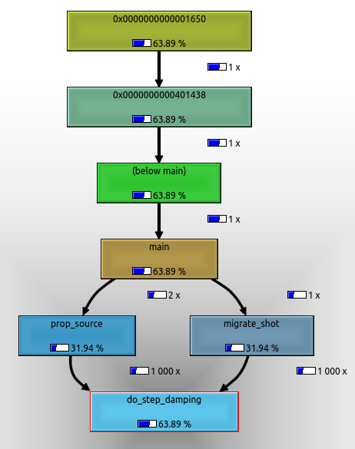
Profiling: callgrind
do_step_damping:

Slide 7
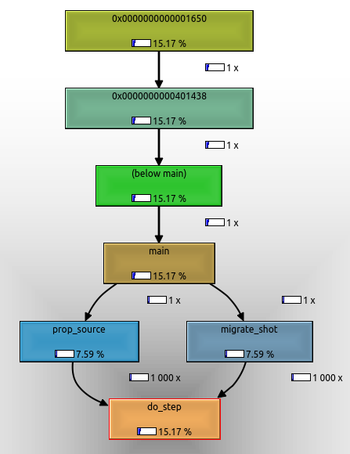
Profiling: callgrind
do_step:

Slide 8
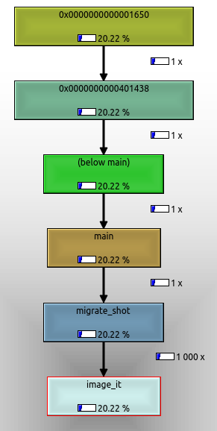
Profiling: callgrind
Image_it:

Slide 9
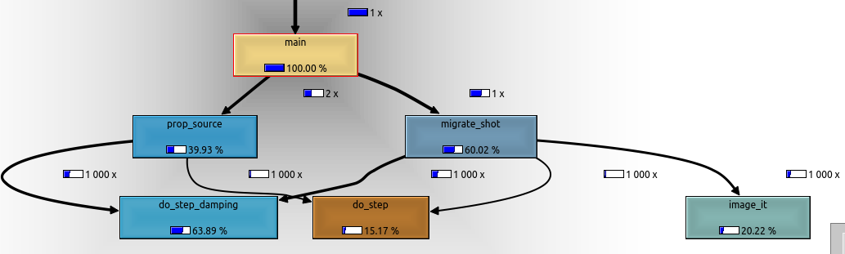
Profiling: callgrind
main:

Slide 10
Profiling: gprof
Respect to callgrind there are some mismatches, especially for do_step and image_it, where gprof states that the program spends 17.7% and 16.9% respectively (instead of 15.17% and 20.22% stated by callgrind). While for the do_step_damping function the amount of time spent is quite similar (64.3% wrt 63.89%).

Slide 11
Approaches: do_step code

Slide 12
Approaches: first simple approaches
For each 3D cross, copy it into an array,
Send it to the DFE,
Return the value of pp.
Feasible but useless (not scalable, not exploiting the machine structure)

Slide 13
Approaches: LMEM Blocked 3D
Move the array p into LMEM as a 3D block,
Select its subcubes of stencil size and compute pp values.
Issues: one of the sizes of p must be multiple of 384 bytes, one of the sizes of subcube must be multiple of 384 bytes, one of the offsets must be multiple of 384 bytes.

Slide 14
Approaches: Stalling Streams
Linearize p into three arrays according to the three dimensions x, y, z (in fact, px and py contain the linearization of the 3D cross that moves along z).
Sinchronize the flowing of the streams to compute pp values.
Two versions: not-optimized, optimized.

Slide 15
Approaches: Stalling Streams
Not-optimized: only do_step moved in hardware, loading of DFE at each call of do_step.
Optimized: do_step and do_step_damping moved in hardware, DFE loaded just once, px, py, controller, scale created once, controller never changes, hence load into LMEM.

Slide 16
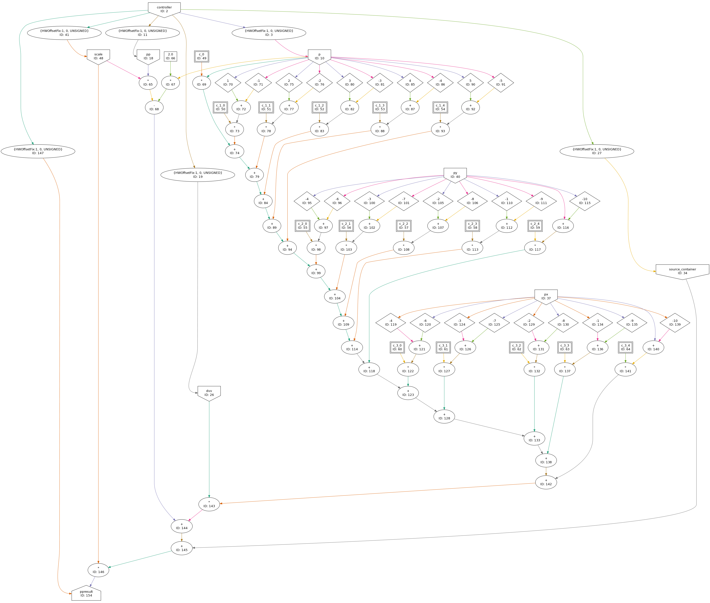
Approaches: Stalling Streams

Slide 17
RTM applications comparison:
 | RTM w/o pragma | RTM with pragma | RTM on DFE | #calls
Small data | 181,5s | 49,5s | 620,25s | 4000
Medium data | 6232,5s | 1747,5s | 9698,25s | 10000
Large data | 19926s | 10756,5s | 93102,75s | 12000

Slide 18
RTM applications comparison:

Slide 19
RTM applications comparison:
x: data size
y: #calls
z: time in sec

Slide 20
Conclusions
Our approach is the slowest one.
The idea of this project of translating in hardware just few sub-routines of RTM application is feasible but unsatisfying.
To improve the performance, it would be better to change almost all the RTM code to make it more suitable for an hardware implementation. It would be necessary to move in hardware not only do_step and do_step_damping sub-routines, but also prop_source and migrate_shot (and all their contents). In this way, it would be possible to keep the data “near to” the FPGA (inside the LMEM) to avoid a frequent streaming of data from CPU to FPGA via PCI Express.

Slide 21
Thanks for the attention!

