Slide 1
QSE @ mbb
Enrique Ortega-Abboud

Slide 2
Bases – what is a command
command -p --par 2 --param=3 arg1 arg2
Options or flags
  Short
  Long
  With parameters
Arguments
  No spaces !!
Spaces
  Separators of terms

Slide 3
Bases – prompt
user@machine:cwd $ _
~ = home
. = here / this dir
.. = parent dir
- = last dir

Slide 4
Bases – base commands (1)
user@machine:cwd $ _
~ = home
. = here / this dir
.. = parent dir
- = last dir
pwd
cd
ls
ls -halt

Slide 5
Bases – base commands (2)
user@machine:cwd $ _
mkdir
rm
rmdir
rm -rf
date
cat
more / less
vim / nano

Slide 6

Server

Slide 7
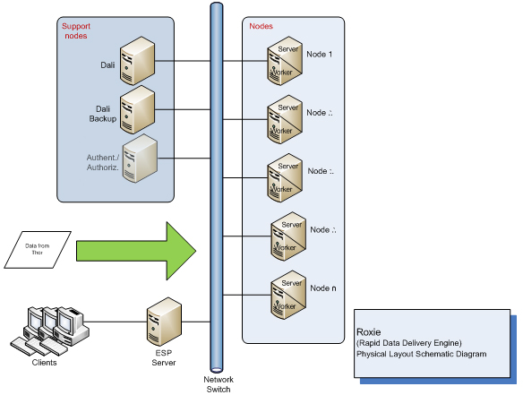
HPCC

Slide 8
HPCC
NAS

Slide 9
But first !
What’s in your ~ ?
Open and edit .bashrc
What are environmental variables ?
Make a script !!
  Name = good_morning
  echo Good morning Dave
  Make it executable: chmod +x good_morning

Slide 10

Make your own command !
Make a script !!
  Name = good_morning
  echo Good morning Dave
Save it to
  ~/bin
Add ~/bin to your path
  export PATH=$PATH:~/bin

Slide 11

Practice time !

Slide 12
Mail (1)
Job 543834 (po_mem_mail) Started
User = eortega
Queue = cemeb.q
Host = compute-0-1.local
Start Time = 03/06/2019 16:05:07
Job 543832 (po_mem_mail) Complete
User = eortega
Queue = cemeb.q@compute-0-18.local
Host = compute-0-18.local
Start Time = 03/06/2019 15:26:07
End Time = 03/06/2019 15:26:13
User Time = 00:00:00
System Time = 00:00:00
Wallclock Time = 00:00:06
CPU = 00:00:00
Max vmem = 43.293M
Exit Status = 0

Slide 13
Mail (2)
Job 543834 (po_mem_mail) Started
User = eortega
Queue = cemeb.q
Host = compute-0-1.local
Start Time = 03/06/2019 16:05:07
Job 543834 (po_mem_mail) Aborted
Exit Status = 137
Signal = KILL
User = eortega
Queue = cemeb.q@compute-0-1.local
Host = compute-0-1.local
Start Time = 03/06/2019 16:05:07
End Time = 03/06/2019 16:05:08
CPU = 00:00:00
Max vmem = 43.285M
failed assumedly after job because:
job 543834.1 died through signal KILL (9)

Slide 14
Loops
for i in a b c
do
echo $i
done

Slide 15

You know nothing about boucles
for i in a b c
do
echo $i
done
Loop on
*
path
$(seq 1 5)

Slide 16
qsub loops
for i in a b c
do
qsub -N run_$i -o output_$i.txt myscript.sh
done

