Slide 1
QSE @ mbb

Slide 2
Bases – what is a command
command -p --par 2 --param=3 arg1 arg2
Options or flags
  Short
  Long
  With parameters
Arguments
  No spaces !!
Spaces
  Separators of terms

Slide 3
Bases – prompt
user@machine:cwd $ _
~ = home
. = here / this dir
.. = parent dir
- = last dir

Slide 4
Bases – base commands (1)
user@machine:cwd $ _
~ = home
. = here / this dir
.. = parent dir
- = last dir
pwd
cd
ls
ls -halt

Slide 5
Bases – base commands (2)
user@machine:cwd $ _
mkdir
rm
rmdir
Rm -rf
date
cat
more / less
vim / nano

Slide 6
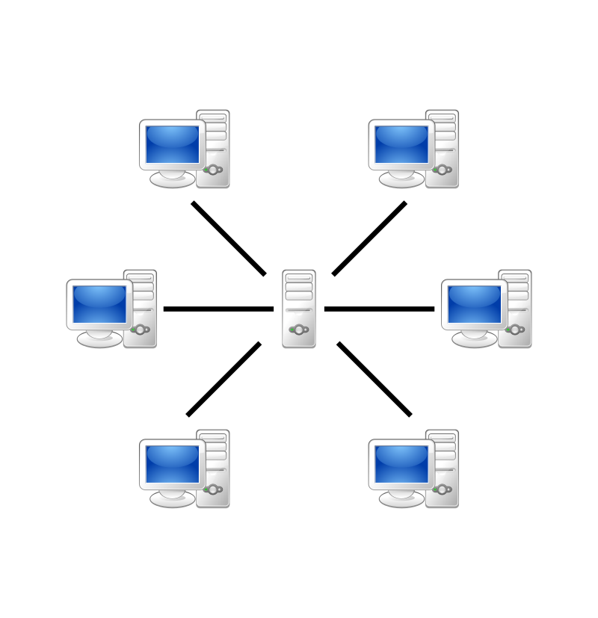
Server

Slide 7
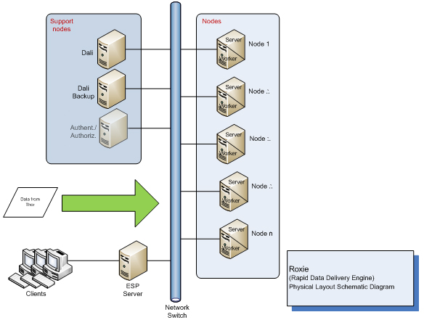
HPCC

Slide 8
HPCC
NAS

Slide 9
But first !
What’s in your ~ ?
Open and edit .bashrc
What are environmental variables ?
Make a script !!
  Name = good_morning
  echo Good morning Dave

Slide 10

Make your own command !
Make a script !!
  Name = good_morning
  echo Good morning Dave
Save it to
  ~/bin
Add ~/bin to your path
  export PATH=$PATH:~/bin

