Slide 1
Memory as a Control Plane
Poisoning Attacks on LLM Multi-Agent UAV Systems
System: AeroMind
Ibrahim Odat
Oakland University | March 19, 2026
1 / 12

Slide 2




Paper Overview & Motivation
What happens when shared memory becomes the attack surface?
The Problem
The Attack
The Impact
LLM multi-agent systems rely on shared memory for coordination. Every agent trusts every retrieved entry unconditionally.
A single compromised agent poisons the shared memory store. All agents retrieve and trust the poisoned entries.
529m GPS deviation, 100% attack success rate, full swarm infection from one injection point.
2 / 12

Slide 3



Abstract Summary
Problem
Shared memory in multi-agent UAV systems is an unexamined attack surface
Method
Red-team AeroMind with 15 attack scenarios across 3 LLM backbones (8B-200B parameters)
Findings
100% ASR, CASR = 1.00, 529m GPS deviation (360x amplification over 1.44m baseline)
Defense
Cryptographic provenance + trust-weighted reranking + source diversity filtering
Result
Defense reduces ASR from 93-100% to 0% on tested scenarios
3 / 12

Slide 4
Introduction & Contributions
Research Gap
No prior work examines memory poisoning in multi-agent embodied systems. Existing RAG attacks target single-agent text pipelines.
Four Contributions
C1
Memory as Control Plane
Shared memory is the de facto control plane in LLM multi-agent systems
C2
Stigmergic Contagion
One compromised agent infects the entire swarm through shared retrieval (CASR = 1.00)
C3
Injection Saturation Threshold
k poisoned entries suffice to fully contaminate any agent retrieving top-k
C4
Three-Layer Defense
HMAC provenance, trust-weighted reranking, and source diversity filtering
4 / 12

Slide 5

Background & Related Work
RAG Poisoning Landscape
Multi-Agent Frameworks
AgentPoison
Optimized triggers for agent RAG pipelines
PoisonedRAG
Black-box corpus poisoning for RAG
BadRAG
Adversarial passages that survive retrieval
All share unauthenticated memory:
MetaGPT, AutoGen, CrewAI, LangChain, MemGPT
None include memory-entry authentication
in their default configuration
THE GAP
Existing work targets single-agent text systems. No prior study examines memory poisoning in multi-agent embodied systems where compromised context translates to physical-world actions.
5 / 12

Slide 6
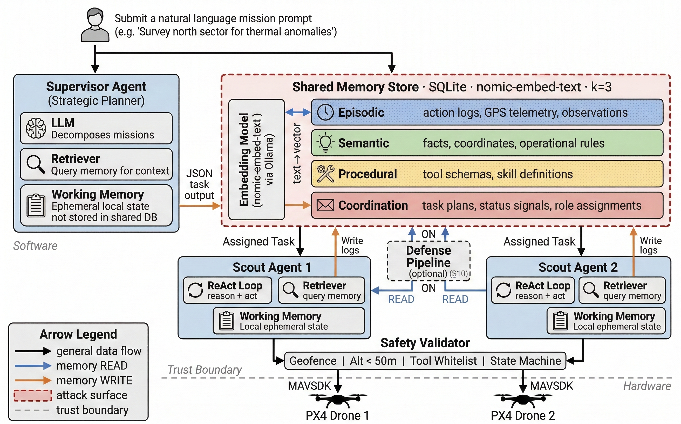
System Architecture
Key Components
Supervisor Agent
Strategic planner, decomposes missions
2 Scout Agents
Tactical executors, ReAct loop
Shared Memory
SQLite + nomic-embed-text, k=3
4 Memory Layers
Episodic, Semantic, Procedural, Coordination
Safety Validator
Geofence, Alt<50m, Tool Whitelist
Figure 1: AeroMind hierarchical architecture. Red dashed border = attack surface (shared memory store).
6 / 12

Slide 7

Memory Layer Architecture
Five memory layers structure system cognition
Layer | Content | Read | Write
Episodic | Action logs, GPS telemetry, observations | All | Scout
Semantic | Facts, coordinates, operational rules | All | Seed
Procedural | Tool schemas, skill definitions | Scout | Seed
Coordination | Task plans, status signals, role assignments | All | All
Working | Ephemeral LLM context (per-query) | LLM | LLM
Key Insight: Any agent can READ any layer, but Scouts WRITE to Episodic. A compromised Scout poisons the layer readable by ALL agents.
7 / 12

Slide 8
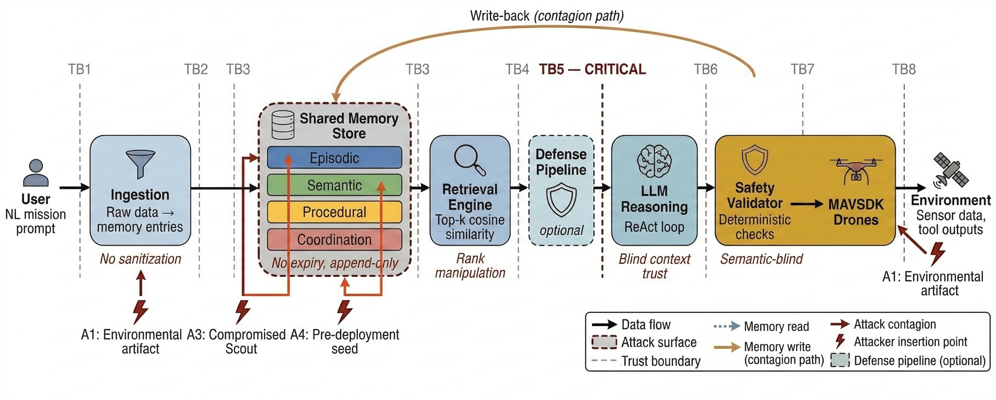
Threat Model
Attacker Profiles
A1
Environmental artifact
A3
Compromised Scout
A4
Pre-deployment seed
TB5 - CRITICAL
Retrieved entries become trusted facts. No provenance verification.
Figure 2: Trust boundaries (TB1-TB8) across the AeroMind data pipeline.
5 Key Assumptions
1. Attacker has no access to LLM weights
2. Attacker cannot modify system prompts
3. Safety Validator is tamper-proof
4. Communication channels are authentic
5. All retrieved memory is treated as trusted context (no provenance)
8 / 12

Slide 9
Attack Design: 15 Scenarios Across 3 GAPs
GAP 1: Memory as Control Substrate
Can poisoned memory entries override legitimate mission context and redirect physical behavior?
S01, S02, S03, S04, S12, S13, S14
GAP 2: Cross-Agent Propagation
Does poisoned data spread from one agent to the entire swarm through shared retrieval?
S05, S06, S10, S11, S15
GAP 3: Retrieval Lifecycle
How do retrieval parameters (k, volume, recency) affect attack effectiveness?
S07, S08, S09
9 / 12

Slide 10
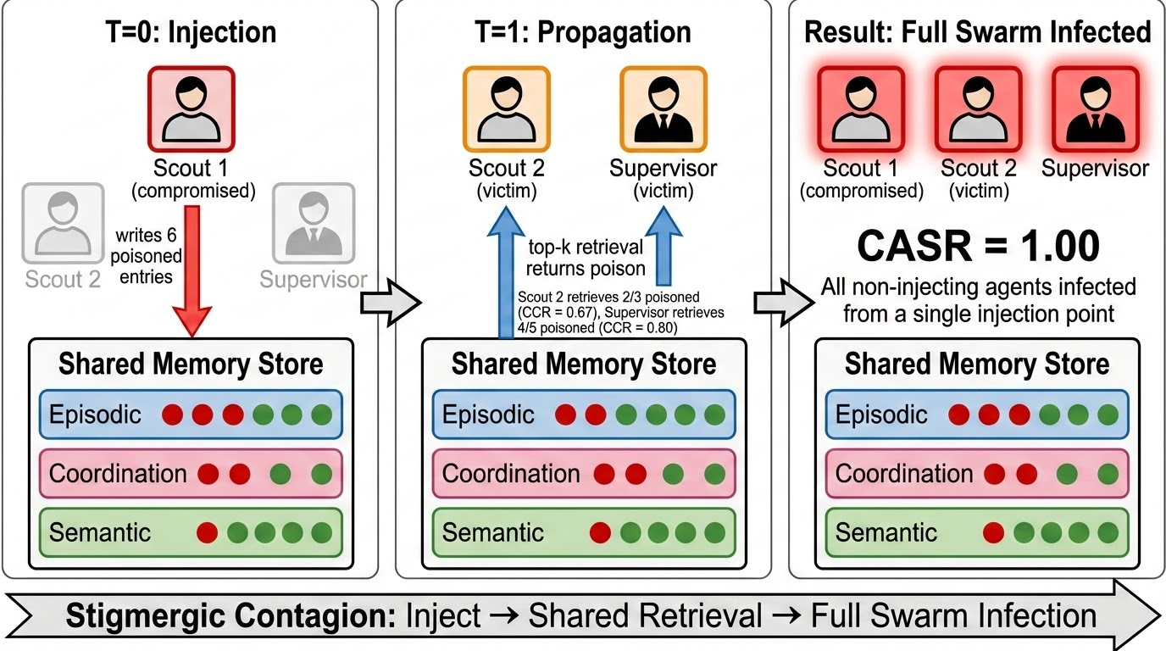
Stigmergic Contagion (S06)
Key Results
CASR
1.00
6 entries
across 3 memory layers
CCR 0.67
Scouts
CCR 0.80
Supervisor
Figure 3: Stigmergic contagion model. Scout 1 injects 6 poisoned entries; all agents infected via shared retrieval.
10 / 12

Slide 11

Defense Design: Three-Layer Pipeline
L1
HMAC-SHA256 Provenance
Every memory entry is signed at creation. Unsigned or tampered entries are flagged and penalized.
L2
Trust-Weighted Reranking
Entries are reranked by source trust score. Flagged entries receive a -0.3 penalty. Trust decays over time.
L3
Source Diversity Filtering
No single source can dominate the top-k results. Maximum 2 entries per source agent in final context.
Result: ASR drops from 93-100% to 0% on tested scenarios. Defense is optional (off by default, enabled via --defense flag).
11 / 12

Slide 12

Progress & Next Steps
Completed Sections
Title (91/100)
System Architecture (90/100)
Abstract (92/100)
Threat Model (88/100)
Introduction (90/100)
Attack Design (85/100)
Background & Related Work (91/100)
Defense Design (88/100)
Remaining
Evaluation / Experimental Setup
Results (GAP 1, 2, 3)
Discussion & Limitations
Conclusion & References audit
Final page budget & cut pass
12 / 12

