Slide 1
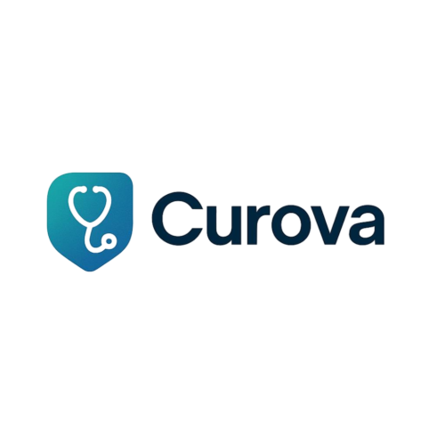

CURAVO

Slide 2



Problem Statments
1. Inability to Identify the Right Drug: Many patients struggle to accurately determine the appropriate medication for their condition, often resorting to self diagnosis or unreliable sources. This leads to ineffective or even dangerous treatment outcomes.
2. Limited Emergency Medical Access: During emergencies, patients frequently face delays in locating nearby medical facilities, while slow ambulance response times exacerbate health risks and increase the likelihood of complications
3. Difficulty in Obtaining Home Nursing Services: Individuals requiring home healthcare such as the elderly, chronic ilness patients, or post-surgery recoverees encounter significant chalenges in securing qualified nursing services, disrupting their care continuity.
4. Barriers to Buying Medicine: Patients often experience obstacles in accessing essential medications due to pharmacy location constraints, stock shortages, or personal mobility limitations, leaving critical treatments out of reach.

Slide 3




High level solution
1. Patient interface: a mobile application that defines the problem of the patient by knowing his symptoms, an assistant that you can request a nurse to care with the patient from the App, and an emergency alert.
2. AI Engine: that AI analyzes data of patient symptoms, then gives him the result and the problem with the treatment algorithm recommendation.
3. Health care provider network: so that you can know your problem from your home AI analysis data to give you your drug, our application wil be connected with a famous pharmacy to deliver your drug

Slide 4
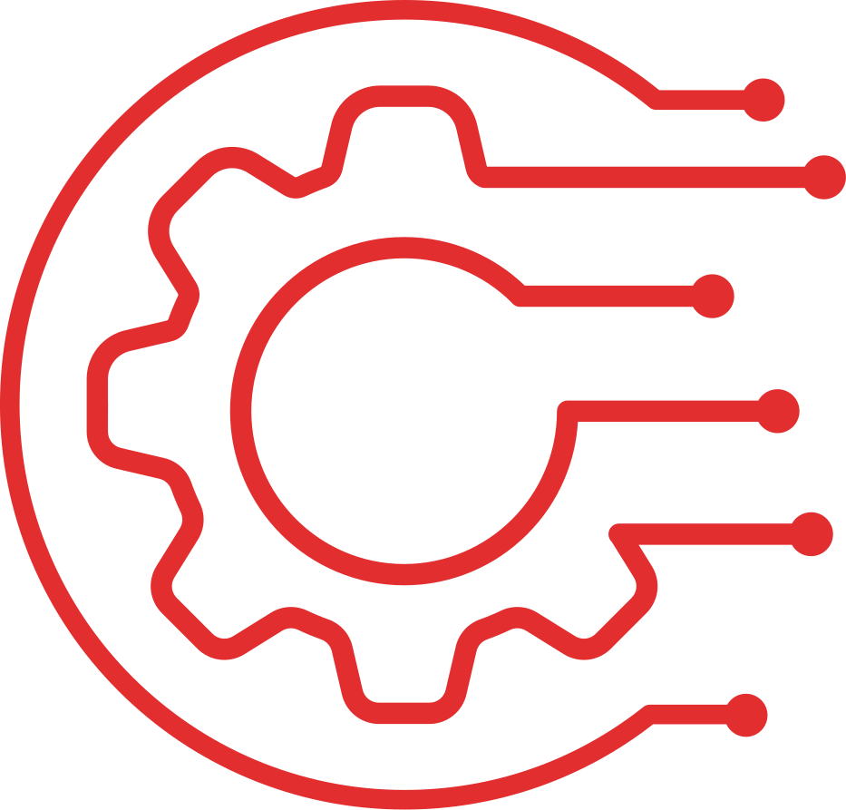

Technologies Used
1.AI/ML Engine: NLP:
BERT/Med-BERT for symptom analysis. Predictive Models: XGBoost for Risk Stratification.
Computer Vision: CNN-based medical imaging (future phase)
2.Mobile Platform:
Flutter (cross-platform app).Firebase Auth and Secure Storage. Google Maps API for service location
3.Backend:
Node.js/Python microservices.HL7 FHIR for healthcare data standards. HIPAA-compliant AWS infrastructure (EC2, RDS)
Integration and Specialized Tools Used
1.Healthcare Interoperability:
Redox Engine for EHR integration. Apple Health Kit/Google Fit sync.Twilio API for emergency alerts 2.Operational Tools:
Docker/Kubernetes for containerization. TensorFlow Serving for model deployment .
Tableau for admin analytics dashboards
3.Security:
Blockchain-based audit trail (Hyperledger Fabric). End-to-end encryption (OpenSSL) .
Biometric authentication (Android/iOS native APIs)

Slide 5

Development road map
Phase 1
( we make a small model training AI in one month, but we work to improve it to know more about the symptoms of patients ) ·
AI development and training. Patient app key challenge: the privacy of medical data.
Phase 2
(1 month to 2 months ) ·Provider network ·Testing the accuracy of diagnostic Key chalenge: Physician adoption resistance

Slide 6
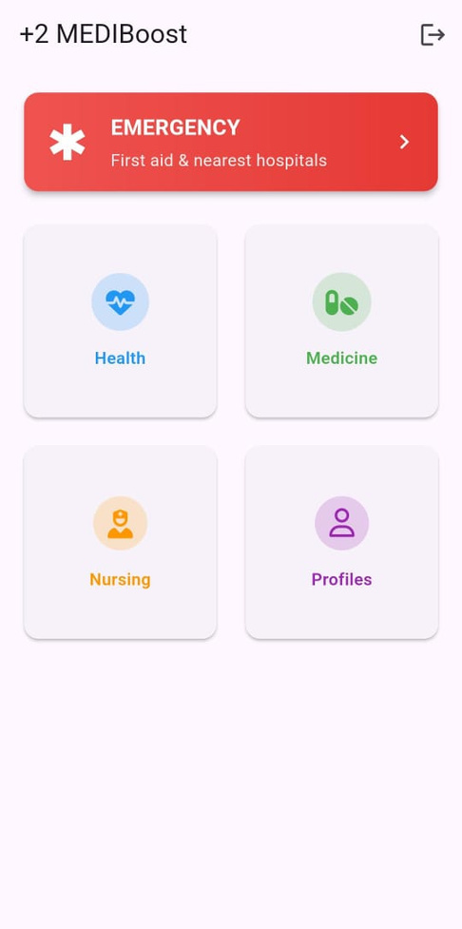
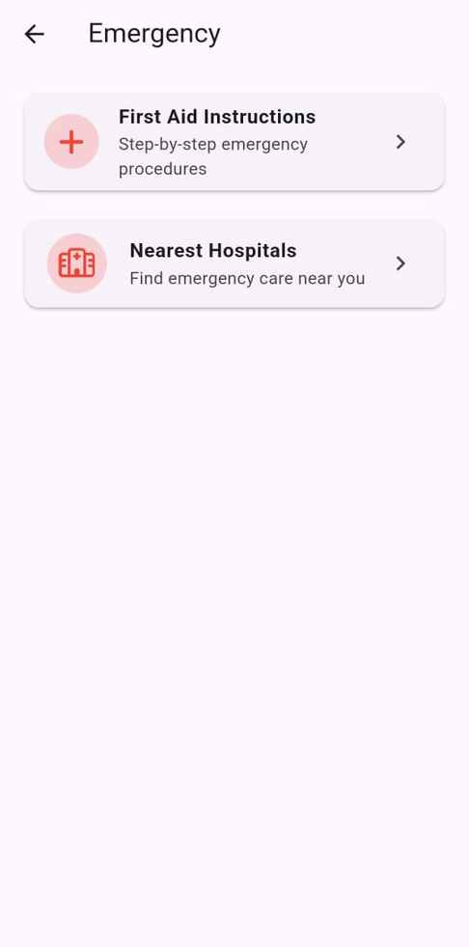
Prototype Showcase
1. Input your symptoms
2. AI give the result
3. Nearby service map ( hospitals \ with wait time )
_These results come from searches and our business plan Time: wil reduce from 4.2 hrs. → 22 min Diagnostic costs wil be lowered by 63% Overcrowding: wil decrease by 38 %

Slide 7
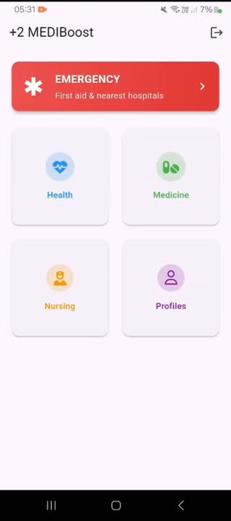
Prototype Showcase

Slide 8
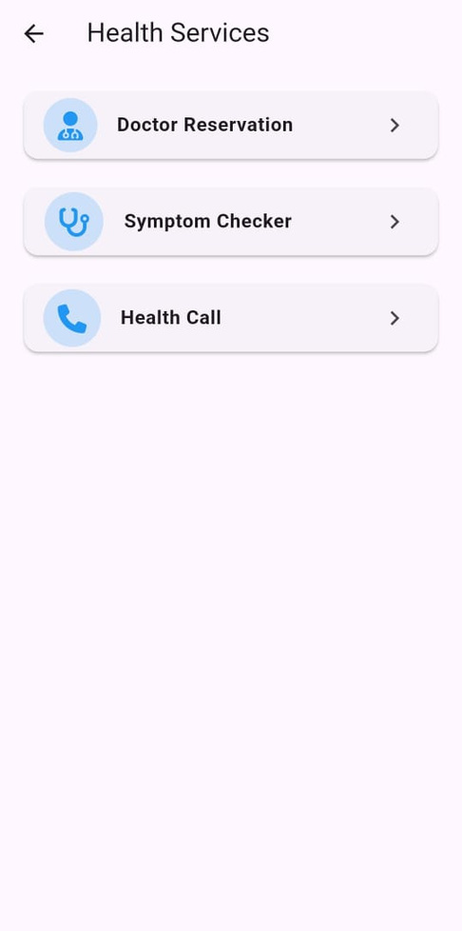
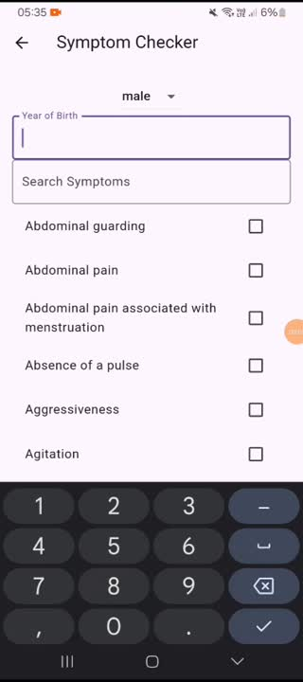
Prototype Showcase

Slide 9
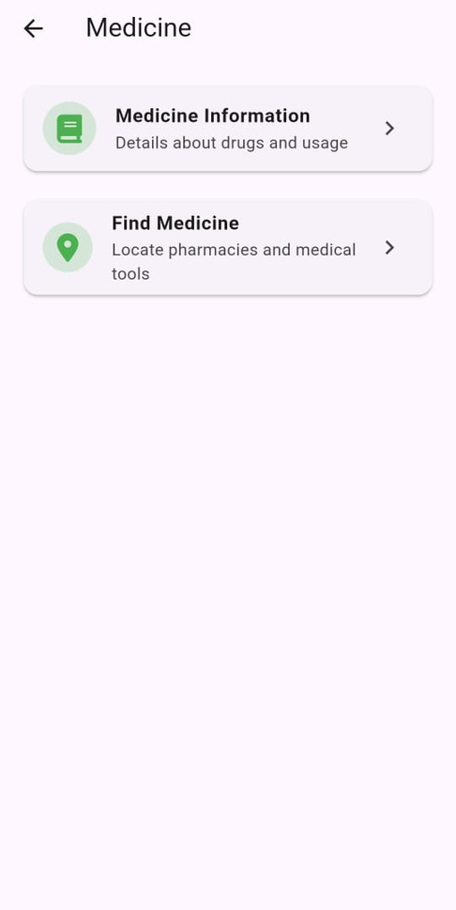
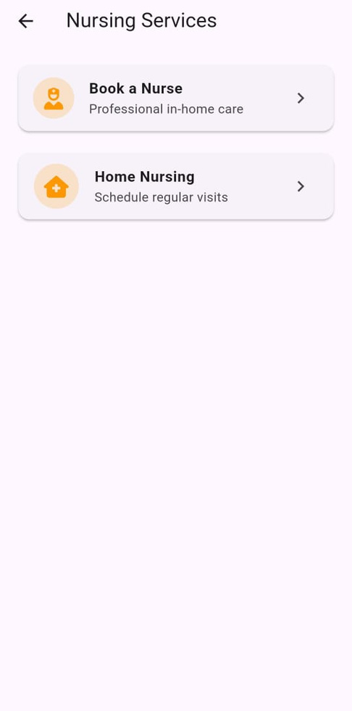
Prototype Showcase

Slide 10

Market Potential
Expanding Healthcare Access Globaly
Target Audience:
1. Patients in rural and underserved areas with limited medical infrastructure.
2.Elderly, disabled individuals, and chronic ilness patients requiring home healthcare.
3.Emergency patients in need of fast medical assistance.
Market Need:
1. Growing demand for telemedicine and AI driven healthcare solutions.
2. 3.5 bilion+ smartphone users worldwide.
3.Rising healthcare costs are driving demand for cost, effective, accessible solutions

Slide 11
Market Potential
Competitive Advantage:
1. AI powered symptom assessment reduces misdiagnosis risks.
2.Few competitors offer integrated emergency guidance with home nursing support.
Revenue Streams:
1. Freemium model like (basic features free, premium AI diagnostics paid).
2. Partnerships with pharmacies, hospitals, and insurance providers.
3. Government colaborations for public health initiatives.

Slide 12

conclusion
Our AI-powered healthcare solution revolutionizes medical access by combining inteligent diagnosis with seamless care delivery. The mobile app instantly analyzes symptoms using advanced AI, recommends precise treatments, and connects users to nearby medical services with real-time availability. For urgent needs, our emergency alert system accelerates response times by identifying the closest facilities and sharing critical patient data. The platform also offers one-tap access to qualified home nurses and guarantees reliable medication delivery through partnered pharmacies. Particularly transformative for elderly and chronic care patients, our solution reduces hospital burdens while providing continuous, professional medical support. By integrating cutting-edge technology with healthcare expertise, we're making professional medical assistance accessible to everyone— anytime, anywhere—with just a smartphone.

Slide 13

Presented by:
Anas Ashraf Shredah
Abdallah Mohamed Anwar
Omar Mohamed Radwan
Yousef Mohamed Sayed

Slide 14
Thank You

