Slide 1
Java Parallel Image Segmentation

Slide 2

Problem Statement
Image Segmentation: What it is, why it's important (e.g., medical imaging, computer vision).
The Challenge with Color Images:
More computationally demanding than grayscale.
Sequential processing of high-resolution RGB images:
Slow execution times.
High CPU idling (inefficient resource utilization).
The Goal: Overcome these limitations through parallelization.

Slide 3

Project Goal
Core Objective: Implement parallel color image segmentation using Java concurrency.
Specific Aims:
Achieve significant speed-up over sequential execution.
Ensure high CPU utilization during computation.
Develop a user-friendly Graphical User Interface (GUI) for intuitive interaction and live visualization.
Provide performance metrics for data-driven analysis (Speed-up, Scalability, Memory Overhead).

Slide 4
Sequential Baseline
How it Works:
Loads an RGB image.
Processes pixel by pixel, row by row.
Applies simple RGB thresholding logic (e.g., grayscale, color channel highlight).
Produces a new segmented image.
Limitations:
Single-threaded execution.
Doesn't utilize multi-core CPUs.
Becomes a bottleneck for large images.

Slide 5
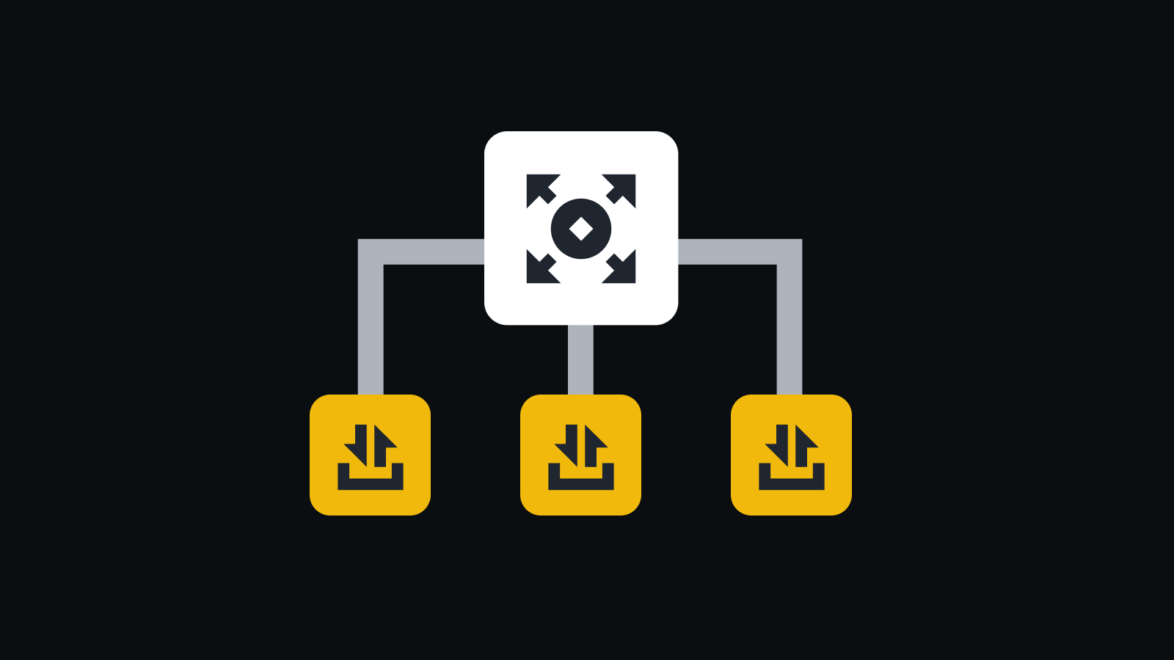
Parallelization Strategy
Core Technology: Java's Forkjoinpool framework.
Divide and Conquer:
Image is split into smaller, independent horizontal strips (blocks of rows).
Each strip is processed concurrently by a RecursiveAction task.
Benefits:
Efficiently distributes workload across multiple CPU cores.
Minimizes communication overhead between tasks.
Granularity Tuning: LEAF_TASK_THRESHOLD dynamically adjusted to balance task creation overhead and parallel workload.

Slide 6
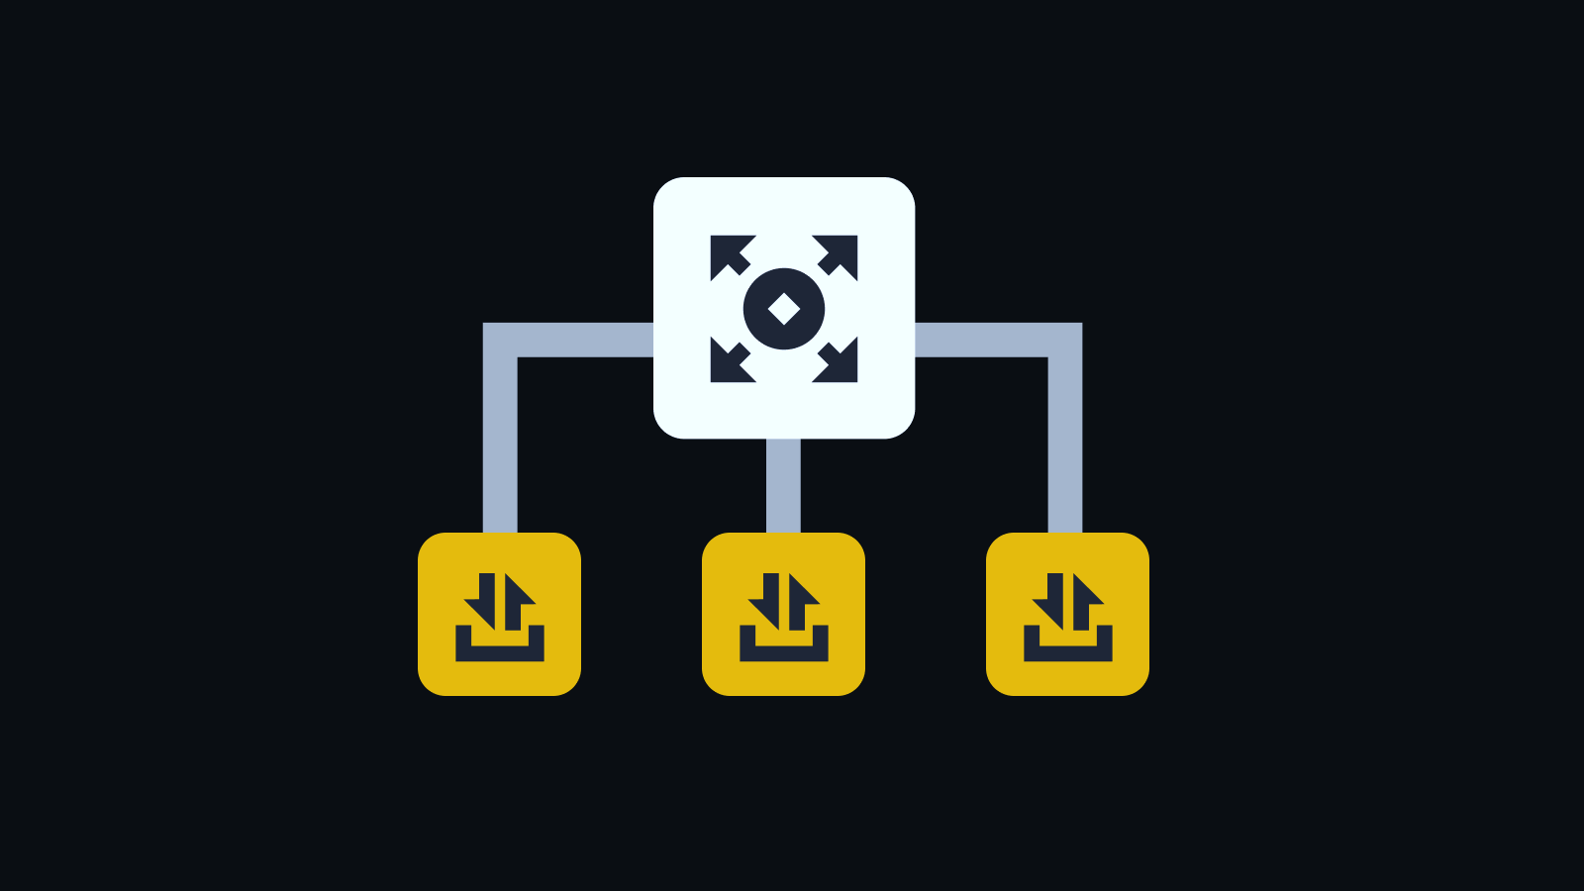
Understanding LEAF_TASK_THRESHOLD
Why This Formula?
LEAF_TASK_THRESHOLD = Math.max(10, imageHeight / (numThreads * 4));
Ensures small but not tiny tasks.
Multiplies numThreads × 4 to create 4x more tasks than threads.
More tasks → better load balancing in the pool.
Example: 800×600 Image, 4 Threads, Threshold = 128
LEAF_TASK_THRESHOLD = 600 / (4 × 4) = 37
So, image is broken into 37-row chunks.
About 16 tasks total (600 / 37 ≈ 16)
4 threads pick them up in parallel.

Slide 7

User Interface (UI)
Purpose: User-friendly interaction, real-time visualization, and clear metric display.
Key Features:
Image Upload: Easy selection of input photos.
Configurable Parameters: Threshold, Segmentation Type, Number of Threads, Visualization Delay.
Live Progress Panels: Side-by-side display of sequential vs. parallel image transformation in real-time.
Performance Metrics Area: Dedicated text area for displaying detailed results.
Action Buttons: "Start Segmentation" and "Run Scalability Test".
Combined Output: Final side-by-side image comparison.
Benefit: Allows direct observation of performance differences and parallel behavior.

Slide 8
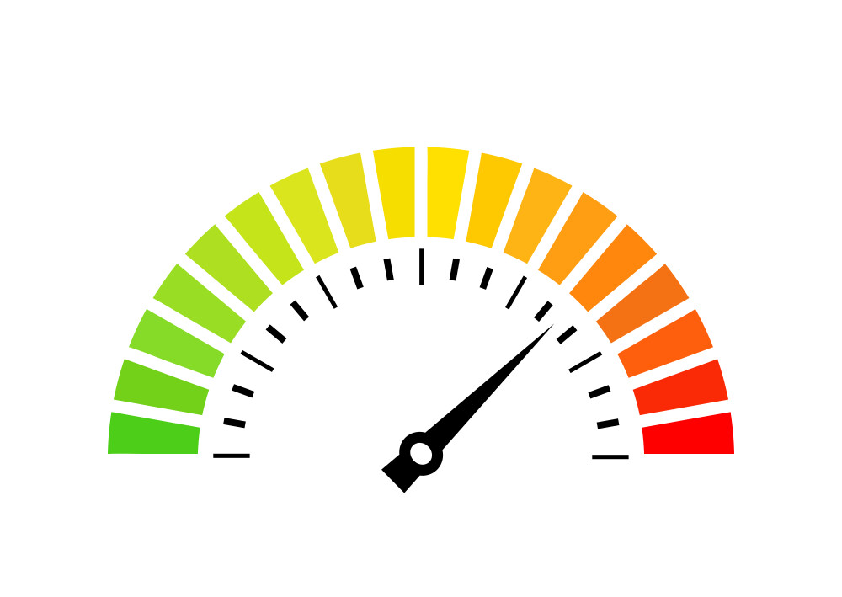
Key Performance Metrics & Targets
Speed-up (Sp​=Ts​/Tp​):
Target: ≥3× on an 8-core CPU (aim for 70% of ideal).
Why: Measures how much faster parallel is than sequential.
Scalability:
Target: Performance improves with more cores (explain plateau).
Why: Shows how well the solution utilizes increasing CPU resources.
CPU Utilization:
Target: ≥85 during compute phase.
Why: Indicates efficient use of CPU capacity.
Memory Overhead:
Target: ≤2× sequential footprint.
Why: Ensures parallel implementation doesn't consume excessive memory.

Slide 9
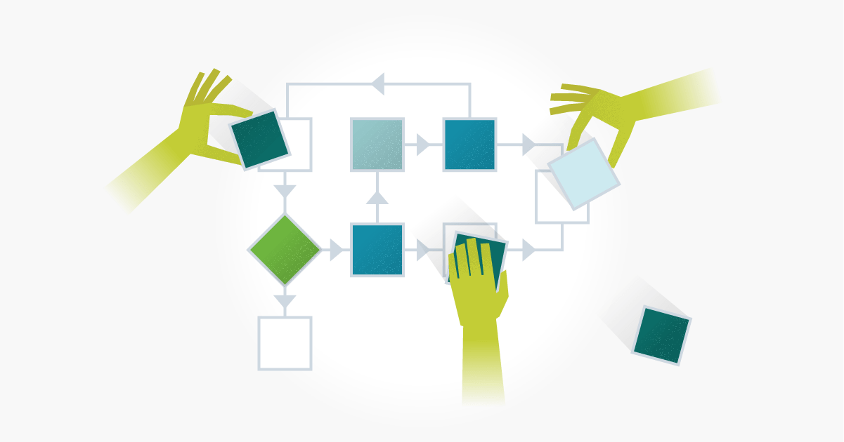
Method of Testing
Precise Timing: Using System.nanoTime() for accurate measurement of computation time, excluding I/O.
Correctness Validation: Visual comparison of segmented outputs (sequential vs. parallel).
Performance Phases:
Baseline Timing: Running sequential algorithm.
Thread-Sweep (Scalability Test): Running parallel algorithm with 1, 2, 4, 8, N (max cores) threads.
Environment: Consistent hardware, large input images (e.g., 4K) for meaningful speed-up.

Slide 10

Future Work
More Complex Algorithms: Extend to other image processing techniques (e.g., convolution filters, edge detection).
Advanced Visualization: Incorporate graphical charting libraries for scalability curves directly in the GUI.
Dynamic Load Balancing: Explore more sophisticated task distribution for uneven workloads.
Error Handling and Robustness: Further improve error messages and graceful handling of unexpected inputs.

Slide 11

Q&A
Thank you for your attention. We are now ready to answer any questions.

