Slide 1
IMA5002
Multimedia content protection
TP2 – 2D image filtering
Mihai MITREA, Département ARTEMIS
mihai.mitrea@telecom-sudparis.eu

Slide 2
TP2 – 2D image filtering
Objective – relate the transform representation and visual impact
TP outline
DCT – Discrete Cosine Transform
  Direct transform
  Inverse transform
Low-pass filtering
  Study the effect of a fixed fc
  Varying the fc
High-pass filtering
DWT – Discrete Wavelet Transform
Conclusion

Slide 3
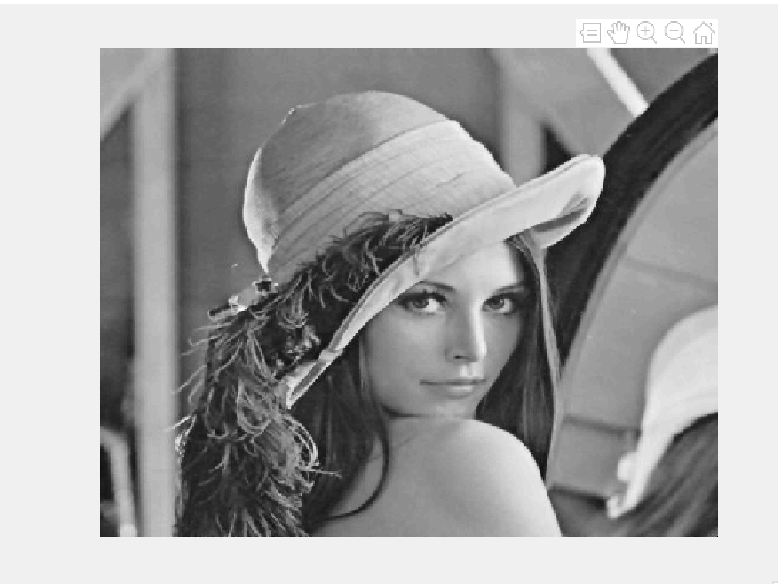
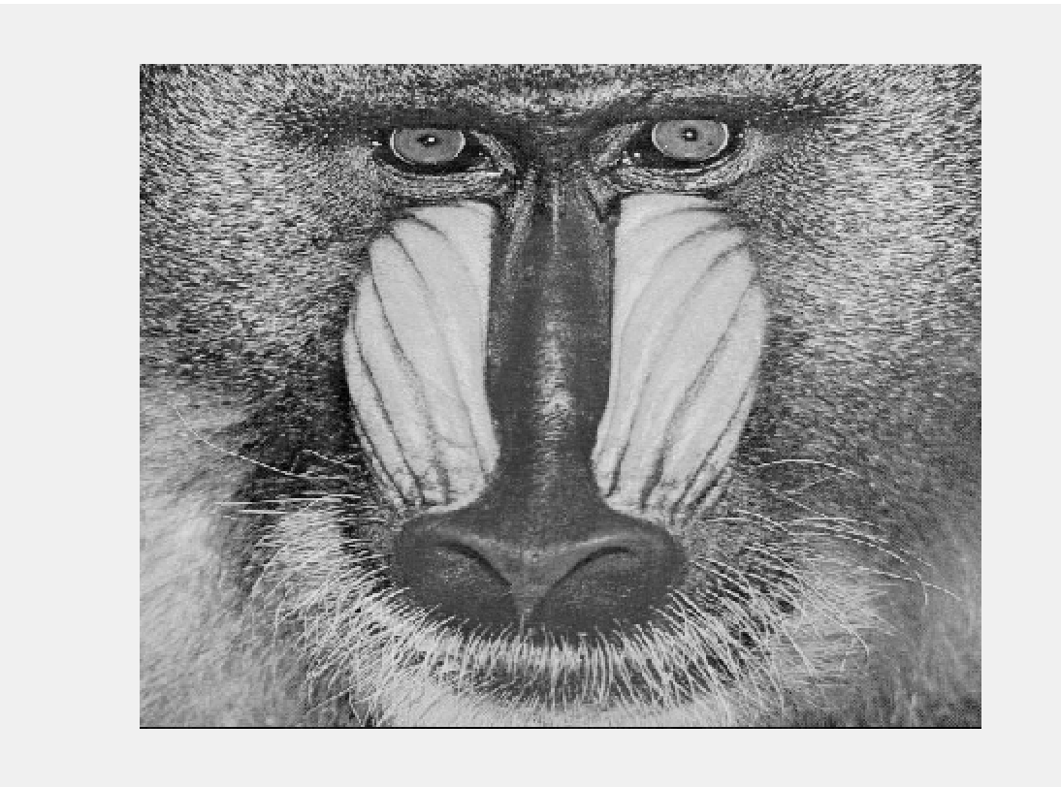
TP2 – 2D image filtering
Objective – relate the transform representation and visual impact
Prerequisites
Lena and Babbon images (to be downloaded in your working environment)
  512x512
  Gray levels
  Jpg format
Matlab (or Python) working environments

Slide 4
TP2 – 2D image filtering
Objective – relate the transform representation and visual impact
TP outline
DCT – Discrete Cosine Transform and IDCT – Inverse DCT
  Direct transform
  Inverse transform
Low-pass filtering
  Study the effect of a fixed fc
  Varying the fc
High-pass filtering
DWT – discrete Wavelet Transform
Conclusion

Slide 5
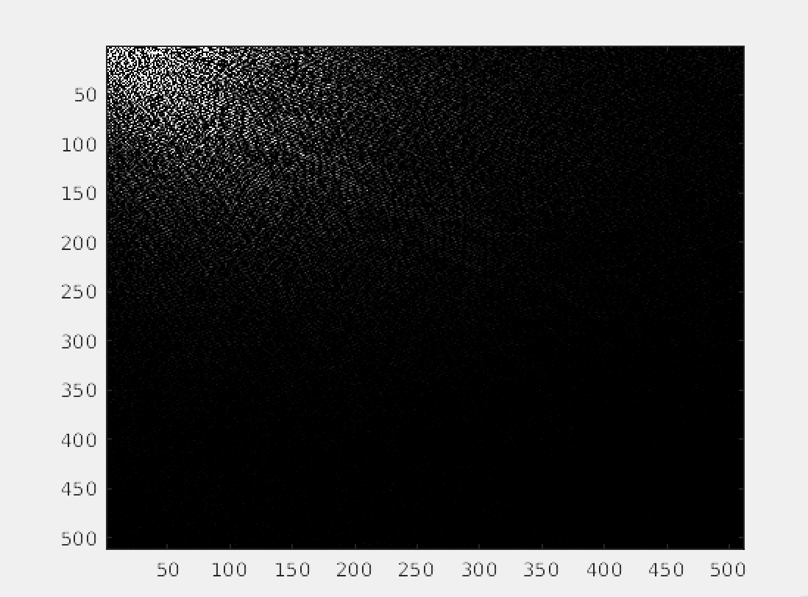
TP2 – 2D image filtering
2D – DCT : 2D Discrete Cosine Transform
Example 1: Compute the 2D-DCT for the images
Read the Lena image and represent it as a matrix named lena
Make the required format conversion (if required)
Compute the matrix lena_dct as the 2D-DCT transform of lena
Display the results
Discuss the result
  What do you notice?
  How do you explain the difference between the lower frequencies (upper-left corner) and the higher frequencies (lower-right corner)?

Slide 6
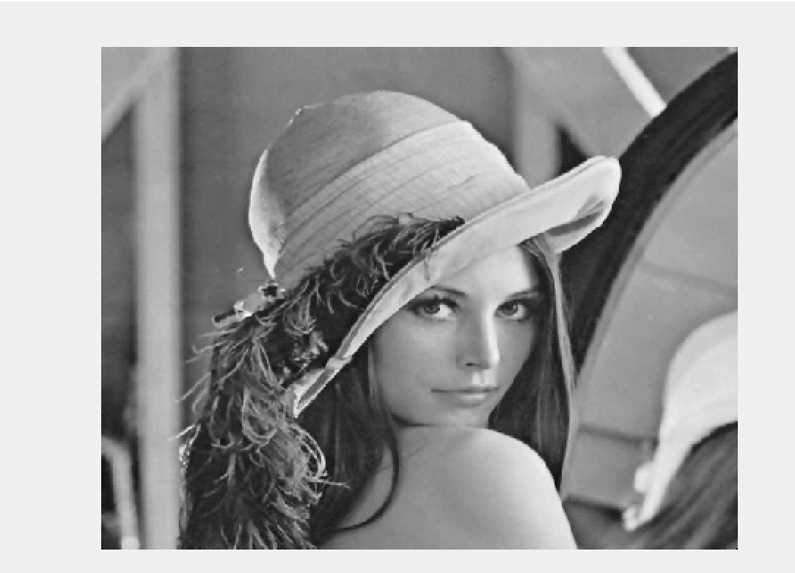
TP2 – 2D image filtering
2D – DCT : 2D Discrete Cosine Transform
Example 2: Compute the 2D-IDCT for the images
Compute the matrix lena_inverse as the 2D-IDCT transform of lena_dct
Display the results
Discuss the result
  What do you notice?
  How are the two matrices lena and lena_inverse?
  Which are the maximal and minimal absolute values of the difference between these two matrices?
  Explain why …

Slide 7
TP2 – 2D image filtering
Objective – relate the transform representation and visual impact
TP outline
DCT – Discrete Cosine Transform
  Direct transform
  Inverse transform
Low-pass filtering
  Study the effect of a fixed fc
  Varying the fc
High-pass filtering
DWT – discrete Wavelet Transform
Conclusion

Slide 8
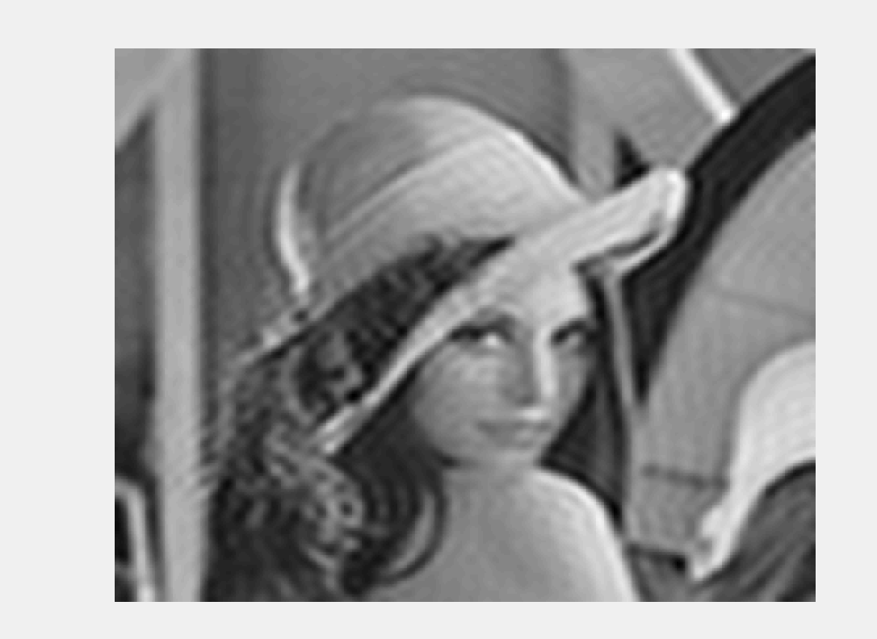
TP2 – 2D image filtering
Low-pass filtering – the ideal filter
Example 3: Study the visual impact of low-pass filtering, f_{c} = 64
Consider the matrix lena_dct previously computed
Compute the matrix lena_dct_lp that:
  has 512x512 elements
  it is equal to lena_dct for elements having the two coordinates lower than fc
  it is 0 eleswere
Compute the matrix lena_lp which is the 2D-IDCT of lena_dct_lp and display it
Discuss the result
  What do you notice?
  How would you describe the visual modifications induced by lp filtering?

Slide 9
TP2 – 2D image filtering
Low-pass filtering – the ideal filter
Example 4: Study the visual impact of low-pass filtering, as a function of f_{c}
Resume the Example 3 for f_{c} belonging to 256, 128, 64, 32, 16, 8, 4, 2
Display the corresponding images
Discuss the result
  What do you notice?
  How would you describe the visual modifications induced by lp filtering?
  Compare the results obtained for various fc values

Slide 10
TP2 – 2D image filtering
Low-pass filtering – the ideal filter
Example 5: Study the visual impact of low-pass filtering, as a function of f_{c} and for different images
Resume the Example 4 for the Baboon image
Display the corresponding images
Discuss the result
  What do you notice?
  How would you describe the visual modifications induced by lp filtering in this case?
  Compare the results obtained for various fc values and for both Lena and Baboon images

Slide 11
TP2 – 2D image filtering
Objective – relate the transform representation and visual impact
TP outline
DCT – Discrete Cosine Transform
  Direct transform
  Inverse transform
Low-pass filtering
  Study the effect of a fixed fc
  Varying the fc
High-pass filtering
DWT – discrete Wavelet Transform
Conclusion

Slide 12
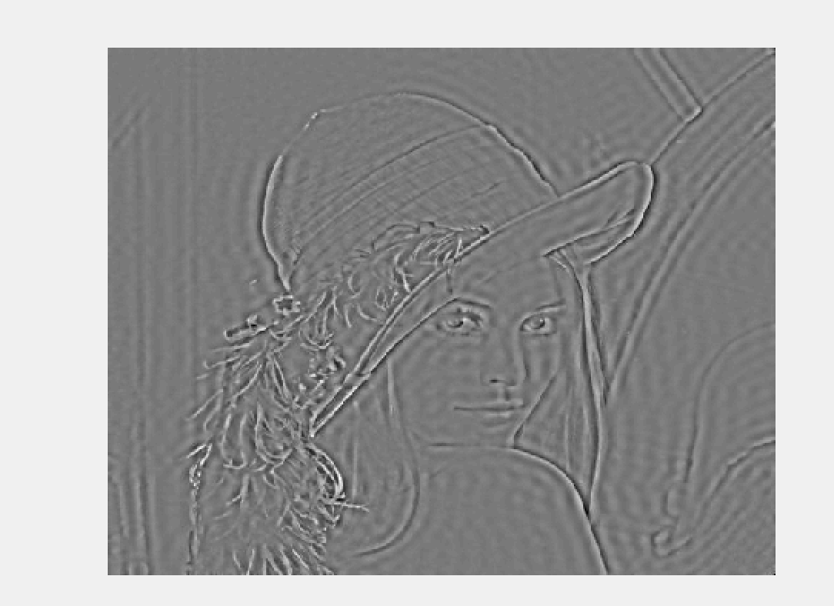
TP2 – 2D image filtering
HIGH-pass filtering – the ideal filter
Example 6: Study the visual impact of high-pass filtering, f_{c} = 64
Consider the matrix lena_dct previously computed
Compute the matrix lena_dct_hp that:
  has 512x512 elements
  it is equal to lena_dct for elements having one and only one coordinate lower than fc
  it is 0 eleswere
Compute the matrix lena_hp which is the 2D-IDCT of lena_dct_hp and display it
Discuss the result
  What do you notice?
  How would you describe the visual modifications induced by hp filtering?

Slide 13
TP2 – 2D image filtering
HIGH-pass filtering – the ideal filter
Example 7: Study the visual impact of high-pass filtering, as a function of f_{c}
Resume the Example 6 for f_{c} belonging to 256, 128, 64, 32, 16, 8, 4, 2
Display the corresponding images
Discuss the result
  What do you notice?
  How would you describe the visual modifications induced by hp filtering?
  Compare the results obtained for various fc values

Slide 14
TP2 – 2D image filtering
HIGH-pass filtering – the ideal filter
Example 8: Study the visual impact of high-pass filtering, as a function of f_{c} and for different images
Resume the Example 6 for the Baboon image
Display the corresponding images
Discuss the result
  What do you notice?
  How would you describe the visual modifications induced by hp filtering in this case?
  Compare the results obtained for various fc values and for both Lena and Baboon images

Slide 15
TP2 – 2D image filtering
Objective – relate the transform representation and visual impact
TP outline
DCT – Discrete Cosine Transform
  Direct transform
  Inverse transform
Low-pass filtering
  Study the effect of a fixed fc
  Varying the fc
High-pass filtering
DWT – discrete Wavelet Transform
Conclusion

Slide 16
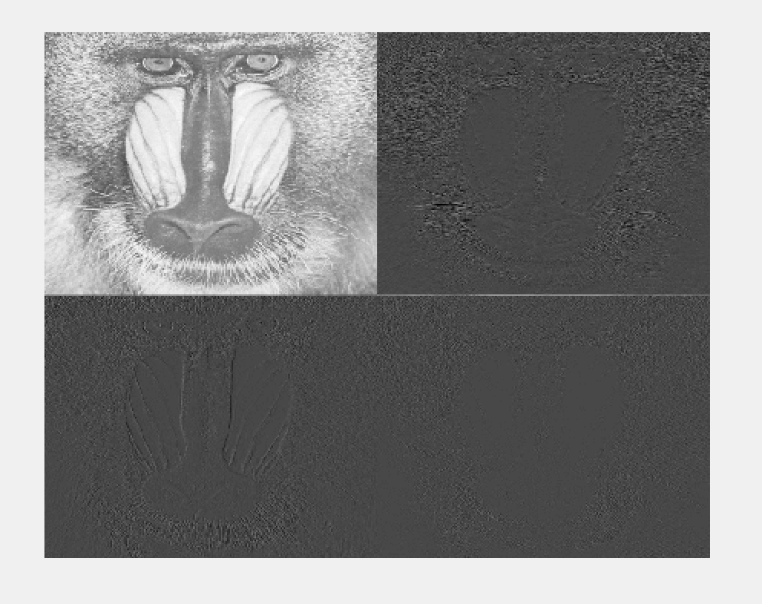
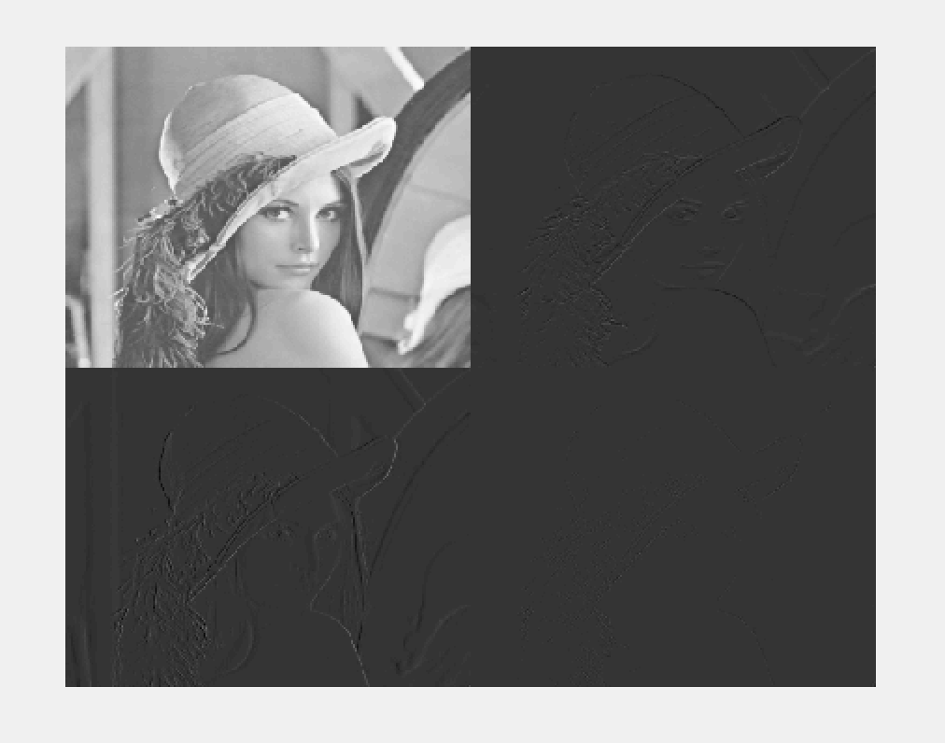
TP2 – 2D image filtering
DWT – Discrete wavelet transforms
Example 9: Study the computing of the direct and inverse DWT
Resume the Examples 1 and 2 for the Lena image and DWT (chose the Daubechies’s filters)
Resume the Examples 1 and 2 for the Baboon image and DWT (chose the Daubechies’s filters)

Slide 17
TP2 – 2D image filtering
DWT – Discrete wavelet transforms
Example 10: Study the low-pass filtering in the DWT domain
How would you define a low-pass filtering in the DWT domain?
Which would be the corresponding visual impact?

Slide 18
TP2 – 2D image filtering
DWT – Discrete wavelet transforms
Example 10: Study the high-pass filtering in the DWT domain
How would you define a high-pass filtering in the DWT domain?
Which would be the corresponding visual impact?

Slide 19
TP2 – 2D image filtering
Objective – relate the transform representation and visual impact
TP outline
DCT – Discrete Cosine Transform
  Direct transform
  Inverse transform
Low-pass filtering
  Study the effect of a fixed fc
  Varying the fc
High-pass filtering
DWT – discrete Wavelet Transform
Conclusion

Slide 20
TP2 – 2D image filtering
Final relarks
Example 11: Add an objective ground to the previous examples
Write the code (Matlab or Python) for computing the PSNR (Peak Signal to Noise Ratio) and NCC (Normalized Cross-Correlation),SSIM
Compute these two measures for the above examples (i.e. for both Mena and Baboon, both low-pass and high-pass filtering, and for all studied f_{c} values)

Slide 21
TP2 – 2D image filtering
Final remarks
Example 12: Illustrating how the spatial DCT frequencies are related to the visual content
Consider the Lena and Baboon images
Consider the 8 above-studied fc values
For a given fc=256 value, compute the following two would-be images:
  Lena_baboon – obtained by considering the lower frequencies from Lena and the higher frequencies from Baboon
  Baboon_lena – obtained by considering the lower frequencies from Baboon and the higher frequencies from Lena
Repeat the point above for the other 7 fc values
Discuss the result

Slide 22
TP2 – 2D image filtering
Final remarks
Example 13: Illustrating how the spatial DWT frequencies are related to the visual content
Resume the previous Example 12 for the DWT

