Slide 1
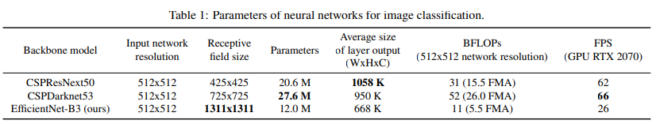
Architecture used in paper
The architecture is basically a model with a larger receptive field size(with a larger number of
convolutional layers 3 × 3) and a larger number of parameters should be selected as the backbone.
Table 1 shows the information of CSPResNeXt50, CSPDarknet53, and EfficientNet B3. The
CSPResNext50 contains only 16 convolutional layers 3 × 3, a 425 × 425 receptive field and 20.6 M
parameters, while CSPDarknet53 contains 29 convolutional layers 3 × 3, a 725 × 725 receptive field
and 27.6 M parameters.
We use PANet as the method of parameter aggregation from different backbone levels for different
detector levels, instead of the FPN used in YOLOv3.
Finally, we choose CSPDarknet53 backbone, SPP additional module, PANet path-aggregation neck,
and YOLOv3 (anchor based) head as the architecture of YOLOv4

Slide 2
Dataset details
The dataset before augmentation
Link : https://www.kaggle.com/datasets/mbkinaci/fruit-images-for-object-detection
Number of classes : 3 classes (apple, orange, banana).
Number of images: 100 per class.
The dataset after augmentation
Augmentation used : blur, brightness, crop, mosaic.
New number of images: 900.

Slide 3
Implementation details
Step 1. Installing cuDNN according to the current CUDA version.
Step 2: Installing Darknet for YOLOv4 on Colab.
!git clone https://github.com/roboflow-ai/darknet.git
In above code we clone the fork of darknet maintained by roboflow from github.
%rm Makefile
Here we remove the file “Makefile” from darknet.
Then we rewrite the “Makefile” file after changing some values like GPU and CUDNN.
!wget https://github.com/AlexeyAB/darknet/releases/download/darknet_yolo_v3_optimal/yolov4.conv.137
In above code we download pretrained initial weights.
Step3: Setting up Custom Dataset for YOLOv4.
Step4: Writing Custom Training Config for YOLOv4.
Here we setup the hyperparameters from configuration file like batch and subdivistions.
Step5: Training Custom YOLOv4 Detector.
!./darknet detector train data/obj.data cfg/custom-yolov4-detector.cfg yolov4.conv.137 -dont_show -map
We here we used the initialed weights and the hyperparameters for the training.
Step 6: Infer Custom Objects with Saved YOLOv4 Weights.
!./darknet detect cfg/custom-yolov4-detector.cfg backup/custom-yolov4-detector_final.weights {img_path} -dont-show
imShow('/content/darknet/predictions.jpg’)
Here we start our testing.

Slide 4
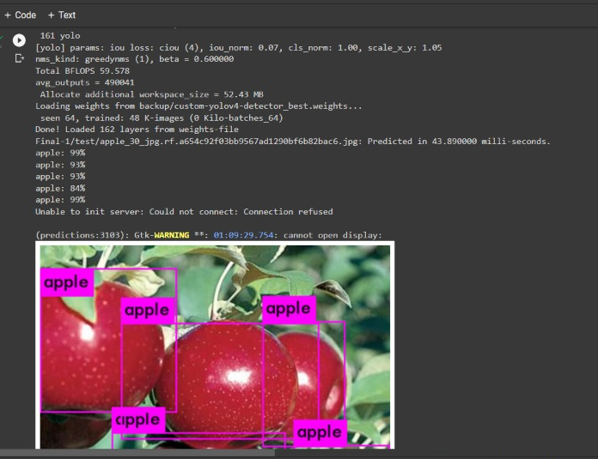
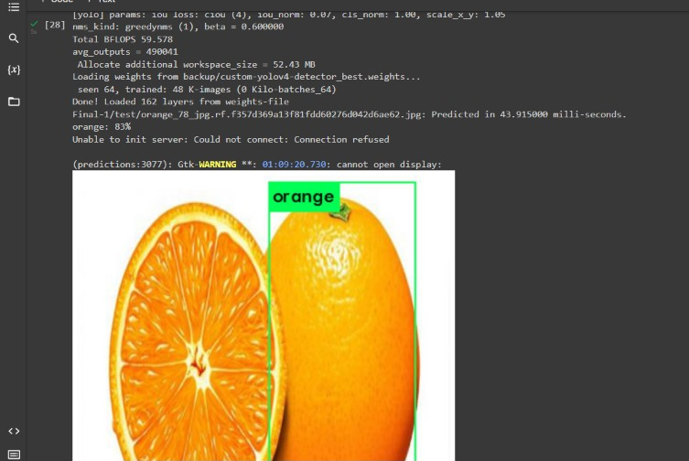
Results and visualizations

