Slide 1

Swap Contract Design
Presented by:
Mouwafak Alioui
Mohamed Haroun Cheriha
Haifa Taghouti
Chayma Ben Othmen

Slide 2

1- Project outline
2- Definition of a swap
4- Overview on TMM
7- Swap Terms
3- ISDA Agreements
6- Swap Valuation
5- Legal Framework in Tunisia

Slide 3

1- Project Outline
Establish a contact between a leasing company (BH Leasing), and a financial institution (Union Internationale des Banques UIB).
Under the terms of this contact, we are required to design a swap contract to mitigate the risk of both parties
The swap contract, « plain vanilla swap », aims to exchange fixed payments for floating payments.
Pricing the swap contract.
Presenting the contract to both parties.

Slide 4
2- Definition of a swap
A swap contract is a financial derivative agreement between two parties to exchange or "swap" cash flows or financial instruments over a specific period of time. It involves the exchange of future payment obligations, typically based on interest rates or currencies.
In a typical interest rate swap, two parties agree to exchange fixed and floating interest rate payments based on a notional amount. One party pays a fixed interest rate, while the other party pays a floating interest rate, usually based on a reference rate such as TMM (Taux Moyen de Marché Monétaire). The purpose of such a contract is to manage or hedge interest rate risks, or to take advantage of different borrowing costs.

Slide 5
3- ISDA Agreements
ISDA agreements are legal contracts used in the global financial industry to govern over-the-counter derivative transactions.
They provide a standardized framework for parties entering into derivatives contracts, helping to clarify the rights, obligations, and responsibilities of each party involved.
ISDA agreements cover various aspects, including definitions of key terms, payment obligations, events of default, termination provisions, and dispute resolution mechanisms.
ISDA agreements promote consistency and clarity, contributing to the efficiency and stability of the derivatives market.

Slide 6
4- Legal Framework in Tunisia
The Central Bank of Tunisia issued on May 31st 2019 a directive entitled: “Circulaire aux intermédiares egrées n° 2021-02 objet: instruments de couverture contre les risques de change, de taux d’intérêt, et des prix des produits de base” to streamline and regulate the activity of interest rate swaps (plain vanilla) and currency swaps.

Slide 7
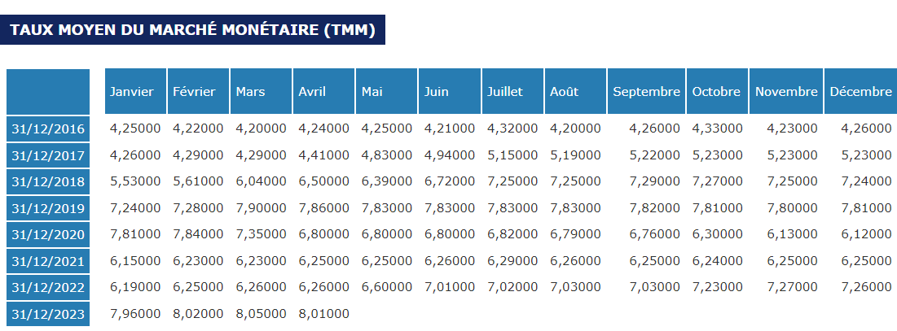
5- Overview of TMM
This Table shows the past values of TMM (Taux Moyen de Marché Monétaire).

Slide 8
Comments about the variation of TMM:
From January 2016 to April 2017, TMM remained relatively stable (4.25%-4.41%). However, a turning point occurred following the outbreak of the global pandemic caused by the novel coronavirus.
Subsequently, interest rates started a gradual ascent, reaching their peak after a two-year period (7.9%). This sustained level was maintained for an additional year until January 2022 when interest rates reached their lowest point.
Following this trough, interest rates began to rise once again, reaching a peak of 8.05% in March 2023.
Moving forward, financial experts and central banks anticipate a subsequent decline in interest rates by the end of the year, with an expectation of returning to more typical levels.

Slide 9

6- Swap Valuation
Here is how the swap was valued:
Group_28_DERIVATIVES_Project_EXCEL.xlsm

Slide 10
7- Swap Terms
Float = TMM + 2.6818%
BH Leasing
UIB
Fixed=9.47 %

Slide 11

Thank You For Your Attention

