Slide 1
Building frameworks in ios sdk
-swift frameworks-

Slide 2
agenda
What kind of product are you building ?
Integrating a dynamic library into an iOS project
Integrating a swift static library into a swift project
Integrating a swift static library into an objective C project
Generating the documentation

Slide 3
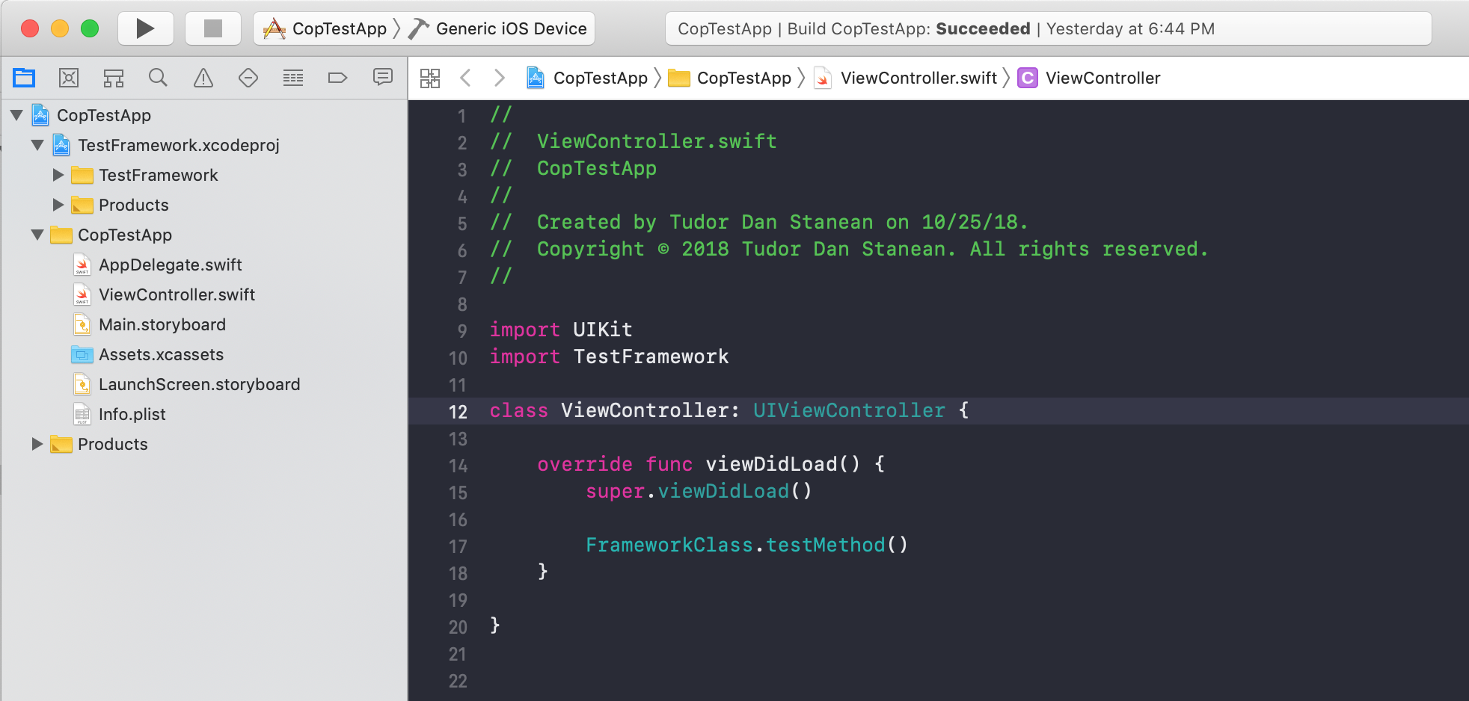
STEp 1
Build and test the framework project in dynamic library mode, both in swift & objective C

Slide 4
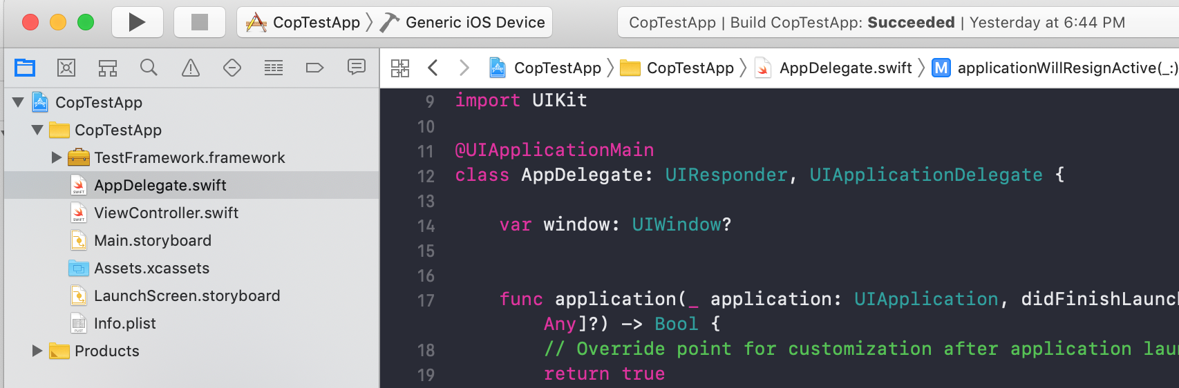
Step 2
Create the static mode library for swift

Slide 5
Step 3
Create static library for Objective C
Add scripts for building Universal framework
Add “@objc” labels for the classes and methods to be exposed
Set embbeded swift libraries to true

Slide 6
Step 4
Generate documentation < e.g. jazzy >
cd <your project location>
sudo gem jazzy
jazzy --min-ac internal

