Slide 1

<Client server architecture used by google drive and its performance, security and availability
Group ID : SE3030_WD_13
System : Google Drive
Student ID | Name with initials
IT20204648 | Nethu Nipuna M.
IT20186906 | Tharuka Gayashan F.
IT20068578 | V.G.A.P Kumara
IT20046552 | Abeywardhanage S.R.D
Architecture : Client - Server
Key Qualities : Performance, Security,
Availability

Slide 2
Client server architecture used by google drive and its performance, security and availability.

Slide 3
Introduction
Google Drive is a free cloud-based storage service that enables users to store and access files online.
Google drive displays a typical client-server model. It in server-side, provide service-based access to application data for users, in client-side.
Sharing is one of the main features of Google Drive, which connect unlimited users through its services, Files sharing can be easily accomplished via public folders or shared links.
Google Drive is stored data securely encrypted in-transit and at-rest.

Slide 4
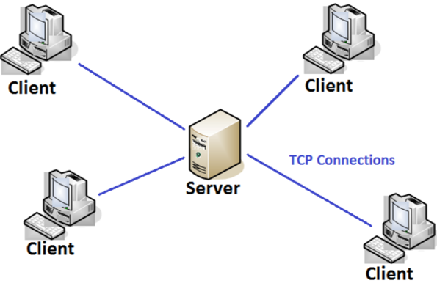
What is client server architecture?
Client Server Architecture is a computing model in which the server hosts, delivers and manages most of the resources and services to be consumed by the client. This type of architecture has one or more client computers connected to a central server over a network or internet connection.
Client-server architecture is an architecture of a computer network in which many clients request and receive service from a centralized server.
Servers wait for requests to arrive from clients and then respond to them.
Clients are often situated at workstations or on personal computers; servers are located elsewhere on the network

Slide 5

Characteristics of a Client-Server Architecture
Client and server machines need different amount of hardware and software resources.
Client and server machines may belong to different vendors.
Horizontal scalability (increase of the client machines) and vertical scalability (migration to a more powerful server or to a multimerger solution)
A client or server application interacts directly with a transport layer protocol to establish communication and to send or receive information.
The transport protocol then uses lower layer protocols to send or receive individual messages. Thus, a computer needs a complete stack of protocols to run either a client or a server.
A single server-class computer can offer multiple services at the same time; a separate server program is needed for each service.

Slide 6
Why the system was built around the selected architecture style
Improved Data Sharing
Integration of Services
Shared Resources amongst Different Platforms
Security
Easy maintenance

Slide 7
Quality Attributes
Performance
Definition - Cloud Drive performance is how users respond to the features and functions provided by cloud drives.
Security
Definition- Cloud drive security iscollection of security measures design to protect data and applications.Encryption methods are widely used for this purpose.
Availability
Definition- Availability, in the context of a computer system refers to the ability of a user to access information or resources in a specified location and in the correct format.

Slide 8
Contribution of Security for System success
Google drive uses 256-bit SSL/TSL encryption for files in transit and 128-bit AES keys for files at rest.
RSA encryption key lengths are doubled to 2048 bits and changed every few weeks to ensure the security of personal data.
Cryptomater is an excellent open-source option for securing Google drive files.
Box Cryptor is an encryption solution available for individuals as well as companies that will help Google drive secure.
IT20186906

Slide 9
Contribution of availability for System success
Google Drive has 1 minute of downtime, 100.00% uptime.
Every Google Account comes with 15 GB of storage that’s shared across Google Drive, Gmail, and Google photos. If you want upgrade, total storage increases to 100GB or more depending on a plan you choose.
Google drive can access document various devices. Those are Computer, phone, or tablet. When you finish making your changes, Drive automatically syncs the latest changes.
IT20186906

Slide 10
Contribution of performance for System success
Google drive provide file organization and management.
User can access to edit files, search files and ability to view different file types.
A large collection of files, many sharing permissions, and high file performance can cause the file owner's Google Drive account to be "overloaded" and thus have a visual impact on end users.
The biggest source of Google Drive's "server role" is licensing advertising. Each time a single permission is added or removed on a file or folder; Google Drive servers have to update their internal database. Therefore, the amount of work that Google Drive servers have to do is closely related to the average number of shared permissions per file and folder.
IT20186906

Slide 11
Trade-offs in google drive Quality attributes
Performance vs availability
Performance is depend on availability.
When increasing the availability, performance is also increasing, and it contributes to competitiveness, efficiency, reputation, and quality.
When increasing these key quality attributes, performance will be increased, and latency will be decreased.
IT20186906

Slide 12
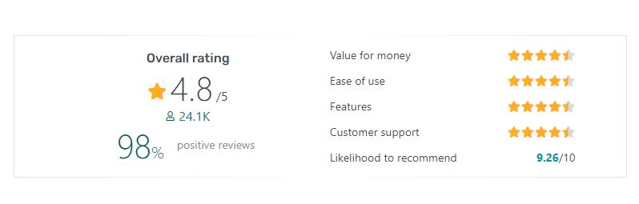
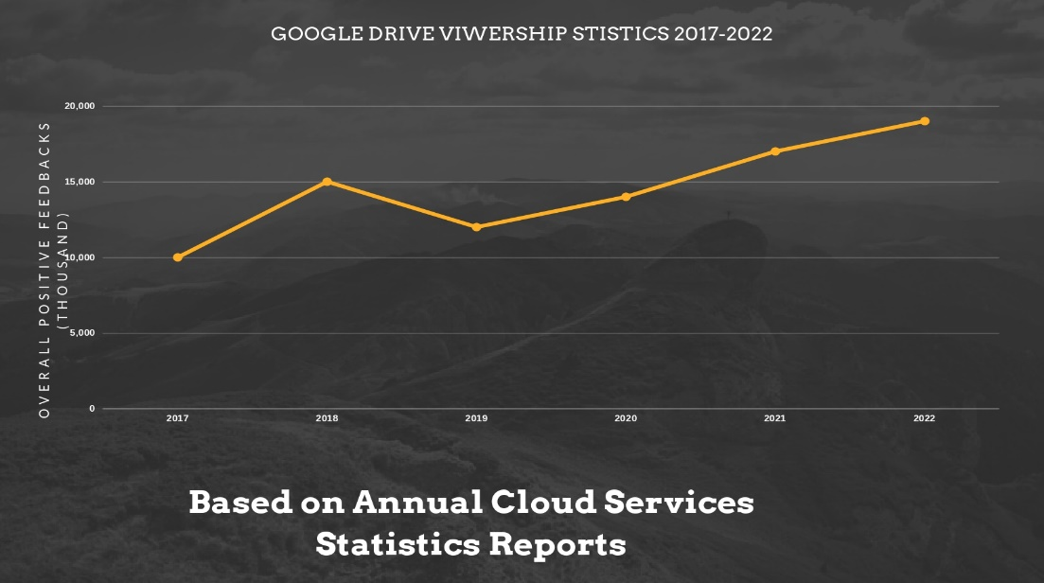
Viewer ship statistics of google drive
Google Drive reached 1 billion users and over 5 billion installs with many positive reviews and feedbacks among past few years.
Many of the viewership feedbacks posted by users on Google Drive in the year 2021 were compliments.
Google make many changes to their cloud storage services according to the feedbacks of the users. That is the reason why they build up their user base.
IT20068578

Slide 13
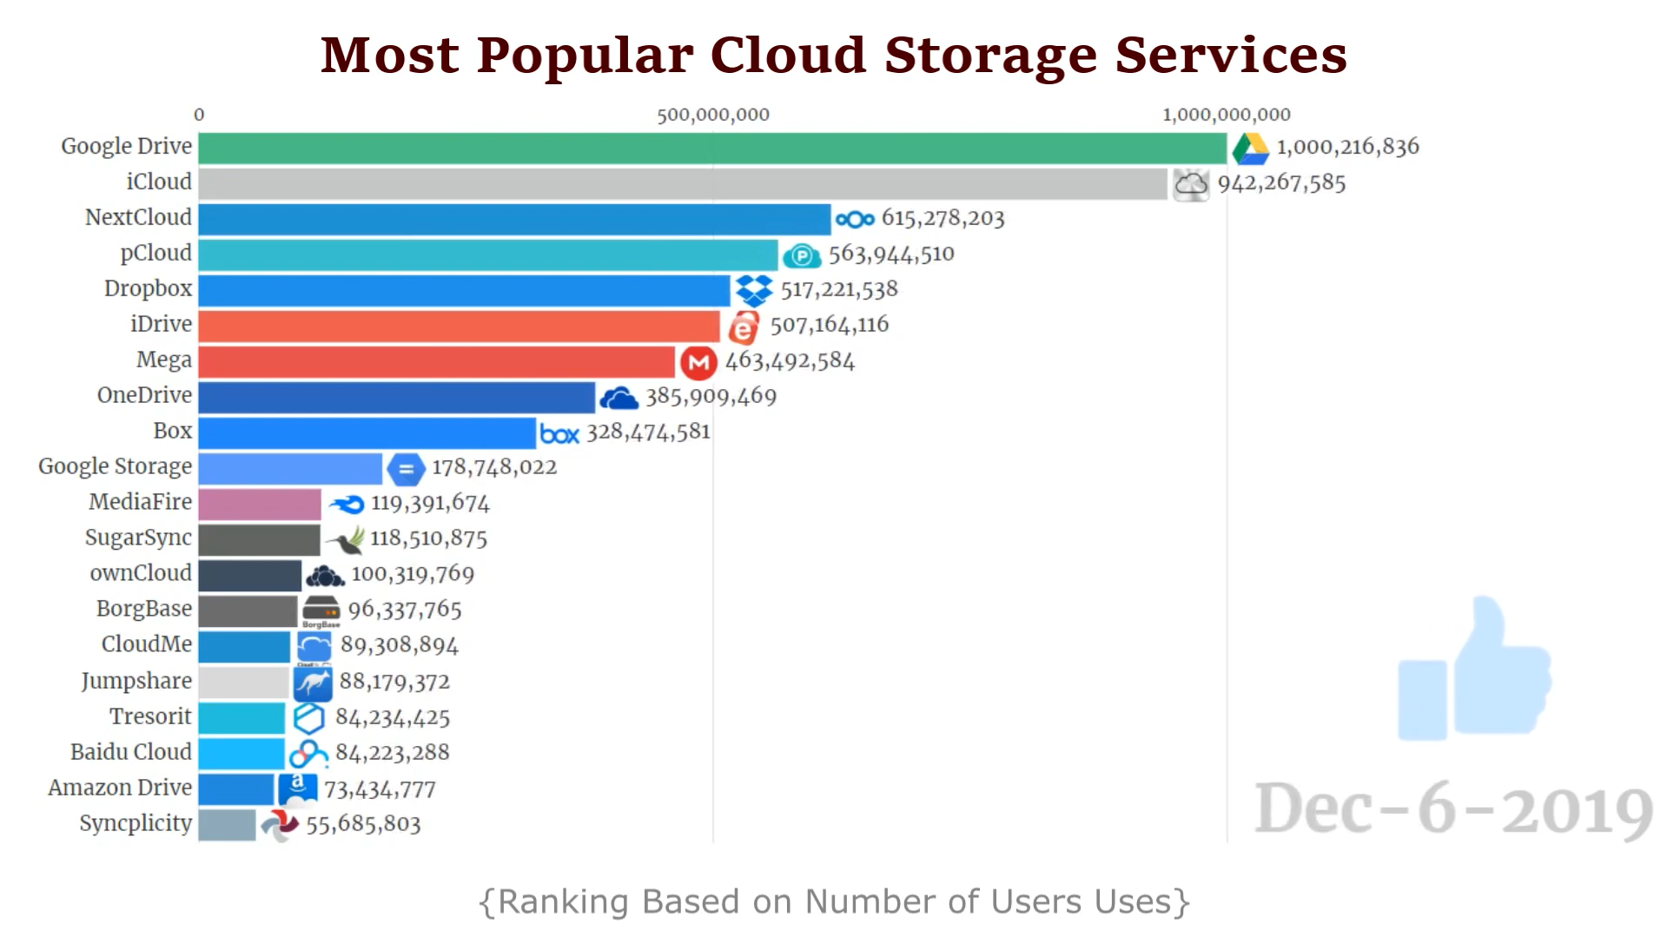
Subscriber Count of Google Drive Vs Other Applications
Google Drive has the largest cloud storage application users base in the world. That subscriber counts over than 1 billion
The reason for the increase in the number of users in past few years is that the number of free services provided by Google Drive plays a greater role than other services.
IT20068578

Slide 14
The amount of storage provided free of charge:
Google Drive | box | Dropbox | iCloud | OneDrive
15GB free Storage | 10GB free Storage | 2GB free Storage | 5GB free Storage | 5GB free Storage
IT20068578

Slide 15
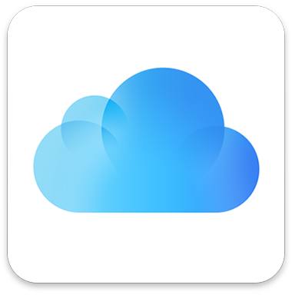
Streaming Competitors for Google Drive and Architecture Style
Google Drive has nearly 2 billion userbase. But Google Drive has only 5 – 7 million paid customers. Therefore, Google Drive has huge competition with other similar applications which provide cloud storages services.
iCloud :
iCloud is a cloud storage and cloud computing service from Apple Inc.iCloud and services compatible with web or download , Mac or Windows app. For mobile, iCloud only allow iOS
Active users : 1.8 billion
Paid Users : 600 million
IT20068578

Slide 16
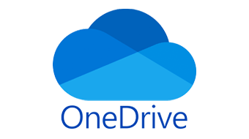
OneDrive:
OneDrive is Microsoft's storage option. Anyone can use it on the web, or download the iOS, Android, Mac or Windows app.
Active users : 1.3 billion
Paid Users : over 200 million
IT20068578

Slide 17
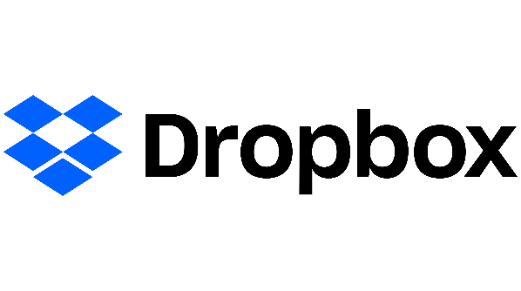
Dropbox:
Dropbox is a file hosting service operated by the American company Dropbox, Inc. Dropbox compatible with web, or download the iOS, Android, Mac or Windows app.
Active users : 700 million
Paid Users : 15.48 million
IT20068578

Slide 18

box:
Box is cloud-based content management application owen by private company name Box.inc.Box also compatible with web, or download the iOS, Android, Mac or Windows app.
Active users : 41 million
Paid Users : 13.2 million
IT20068578

Slide 19
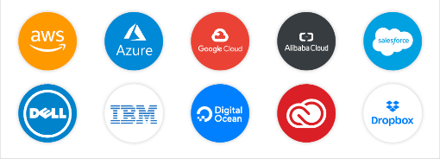
Pros and cons of Google drive comparing to other cloud Platforms
Pros
Easy Sharing
Free storage space of up to 15GB
Solid data backup
Compatible with various devices
File organization and Management
Instance access to edit files
Quick file search
Ability to View different file types
Solid data Backup
Character Recognition feature
SSL encryption
Compatibility with Microsoft
Excellent user Interface
Auto update feature
IT20046552

Slide 20
Cons
Security Risks
File size limits
Downloading and uploading speed
Requires Internet Connection
Has a limit of file size you can upload in a day
Just use AES 128 bit encryption
IT20046552

Slide 21
How the chosen quality attributes architecture styles help to stay competition
Google drive - 1 minutes of downtime, 100% uptime.
Drop box- 13 minutes of downtime, 99.97 % uptime
SkyDrive – 15 minutes of downtime, 99.97 % uptime
Google drive -Free storage space of up to 15GB.
Drop box- free storage space of up to 2GB.
OneDrive - free storage space of up to 5GB.
Google drive, it is stored securely in our world- class data center. Data is encrypted in-transit and at-rest. If you choose to access these files offline, we store this info on your device.
The RSA encryption key length is doubled to 2048 bits and is changed every few weeks to ensure the security of private data.
Two-step verification reduces the risk of unauthorized access to your accounts.
IT20046552

Slide 22
Judgement /Recommendation/ Suggestion
Google drive is one of the slickest, fullest –featured, and most generous cloud storage and syncing services, with excellent productivity suite collaboration capabilities.
Suggesting color code, Emoji and special Characters, hash tags, numerical Characters for improve google drive facilities.
IT20046552

Slide 23
Conclusion
Google Drive is one of the most reliable cloud storages with 1min downtime and 100% uptime which used client server architecture.
Therefore, many users preferred to use google drive because they can access any time they want with multiple devices using mechanism.
Besides, Performance wise Google Drive has easy maintenance, standard sharing mechanism, many quality attributes and standard security features with 256-bit SSL/TSL encryption for users to upload/download without any disturbances.
Google drive give user to sloid back paramount of free cloud storage than other companies and most generous features for customers.
Past few years google Drive competed with many competitors like OneDrive, Dropbox, box, iCloud and massive achievements among others with 2 billion userbase.

Slide 24
Thank You

