Slide 1
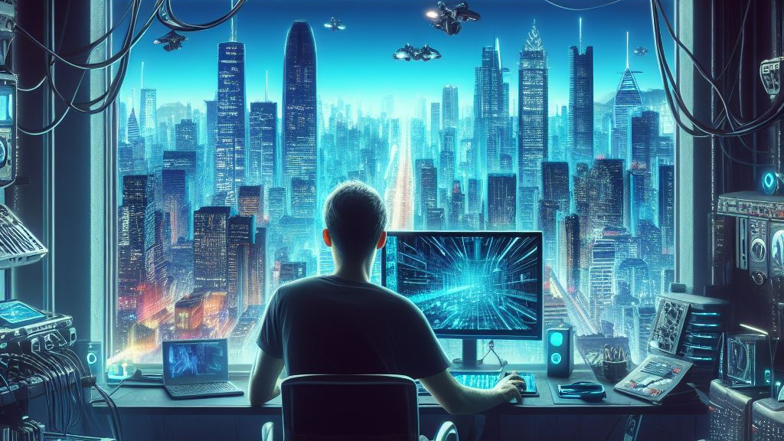
Hackers of Blysis

