Slide 1
INVERSE KINEMATIC PROBLEM WITH PSO

Slide 2
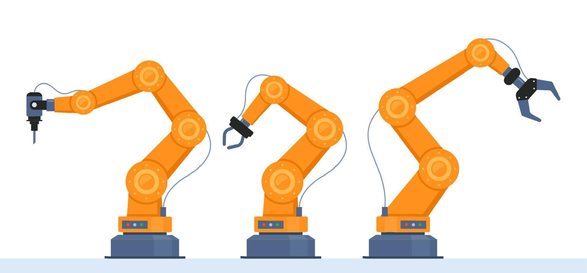
ROBOTIC ARM
The aim is to reach a target point in the space, given the lengths of links and possible constraints.

Slide 3
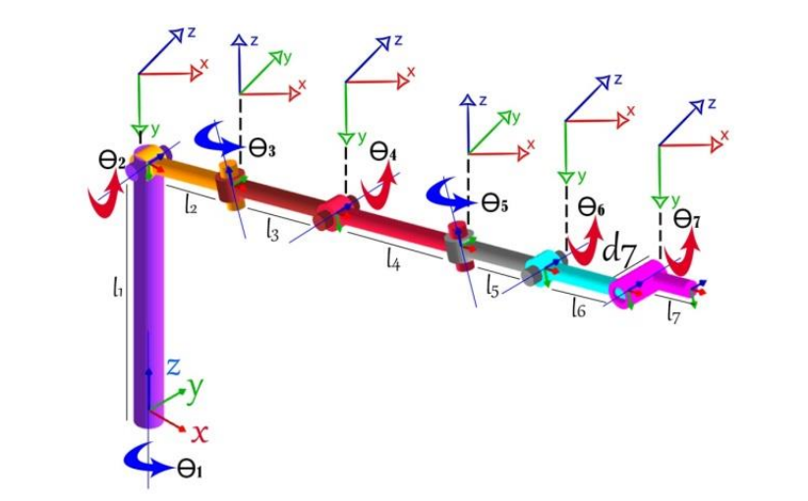
PROBLEM STATEMENT
UNCONSTRAINED:
Rotation around z of ϑ
Rotation around x of α
CONSTRAINED:
Rotation around z of ϑ within constraints
Fixed α given by robot articolations

Slide 4
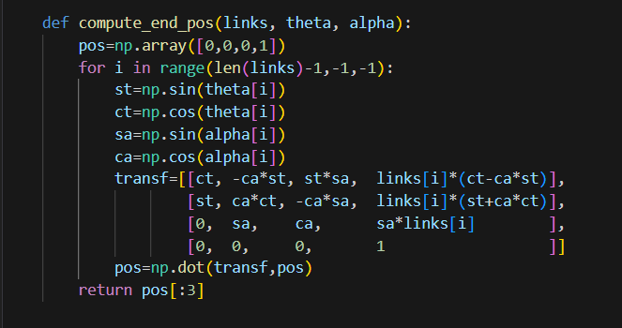
End position is computed with rototranslation matrix multiplication

Slide 5
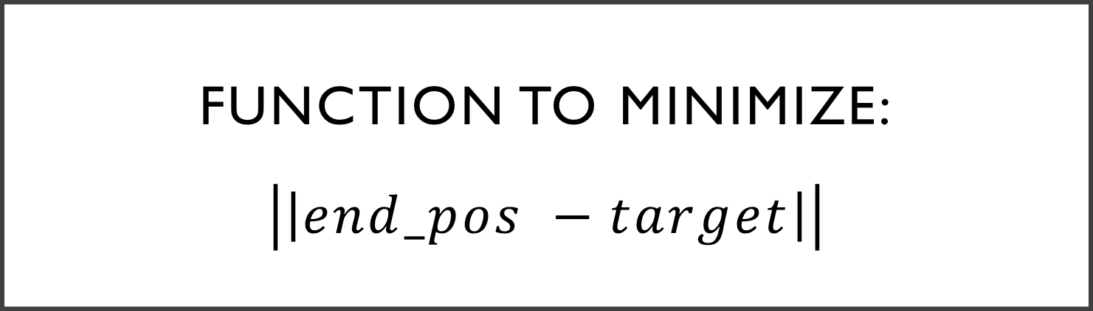
Function to minimize: $$\left|\left|end_pos −target\right|\right|$$

Slide 6
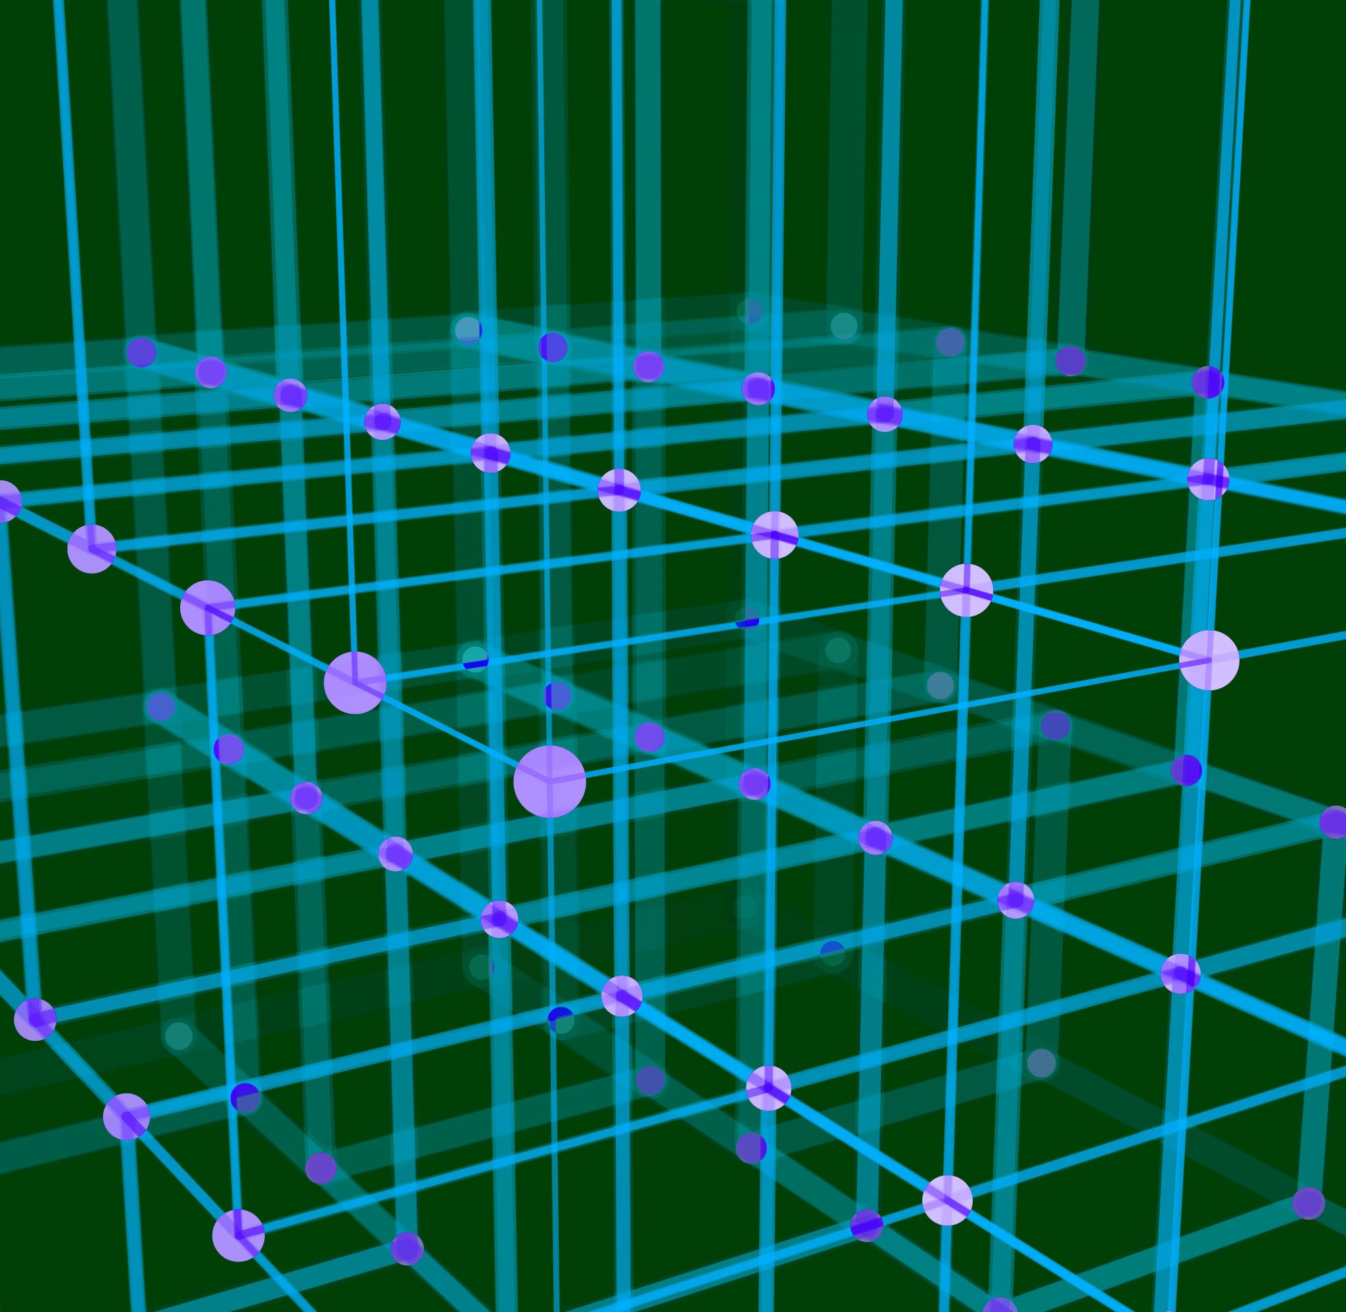


Function to minimize
Distance between end position and target
$\left|\left|end_pos −target\right|\right|$

Slide 7
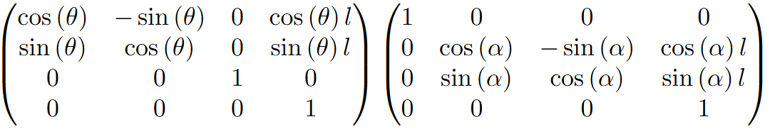
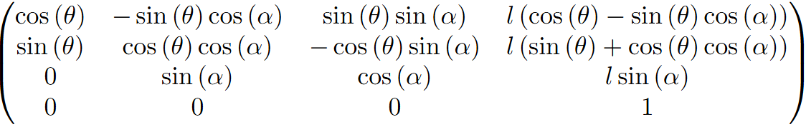
ROTATION MATRIX

Slide 8
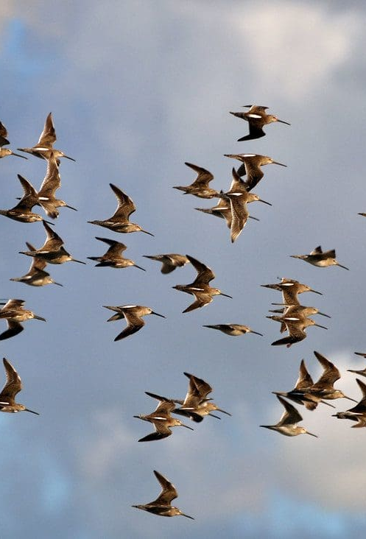
PARTICLE SWARM OPTIMIZATION
Initialization of population
Initialization of personal and global best
Initialize history of global best
While iteration<max_iter:
For each individual:
Compute fitness
If needed update personal best
If needed update global best
Check for convergence Update velocity and position
Update history of global best
Check for stationary point
Return for maximum iteration reached

Slide 9

POSITION AND VELOCITY UPDATE
HOW TO DEAL WITH INDIVIDUAL THAT DOESN’T RESPECT CONSTRAINTS?
If individual exceeds boundary in dimension i:
Absorb: individual[i]=boundary[i], velocity[i]=0
Reflect: individual[i]=boundary[i], velocity[i]=-velocity[i]
Damping: individual[i]=boundary[i], velocity[i]=-rand*velocity[i]

Slide 10
EXAMPLE 1
UNCONSTRAINED :
link=[2,1,3,2]
target=[2,3,4]
c_soc=1.49445
c_cog=1.49445
pop_size=100
max_iter=5000
w=0.5

Slide 11
EXAMPLE 2
UNCONSTRAINED :
link=[0.5,0.2,0.25,0.3,0.2,0.2,0.1]
target=[0.7,0.5,0.7]
c_soc=1.49445
c_cog=1.49445
pop_size=100
max_iter=5000
w=0.5

Slide 12
EXAMPLE 2 CONSTRAINED:
alpha_values=[-π/2, π /2, π /2, π /2, π /2,0,0]
theta=[[- π, π],[- π /2, π /6],[- π /2,2* π /3],[- π, π],[- π, π],[- π, π],[- π /6, π /2]]
ABSORBING REFLECTING DAMPING

Slide 13
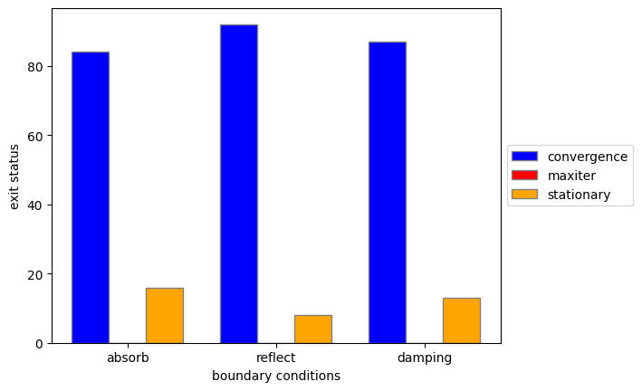
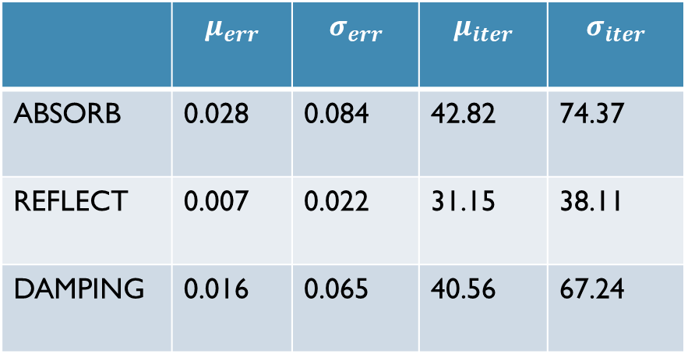
BOUNDARY CONDITIONS
 | $$μ_{err}$$ | $$σ_{err}$$ | $$μ_{iter}$$ | $$σ_{iter}$$
ABSORB | 0.028 | 0.084 | 42.82 | 74.37
REFLECT | 0.007 | 0.022 | 31.15 | 38.11
DAMPING | 0.016 | 0.065 | 40.56 | 67.24

Slide 14
HYPERPARAMETERS
Possible hyperparameters to optimize:
Inertia weight
Cognitive factor
Social factor
Population size
Maximum iterations

Slide 15
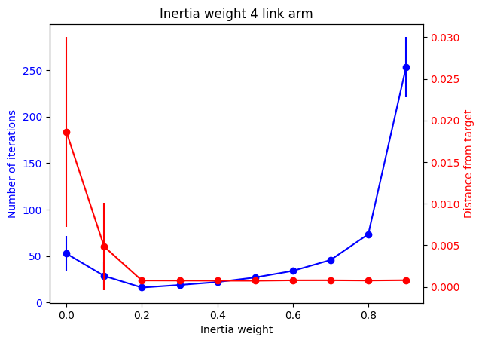
INERTIA WEIGHTS: example 1 (unconstrained)
weights | converged | Max_iter | Stationary
0.0 | 57 | 0 | 43
0.1 | 92 | 0 | 8
0.2 | 100 | 0 | 0
0.3 | 100 | 0 | 0
0.4 | 100 | 0 | 0
0.5 | 100 | 0 | 0
0.6 | 100 | 0 | 0
0.7 | 100 | 0 | 0
0.8 | 100 | 0 | 0
0.9 | 100 | 0 | 0

Slide 16
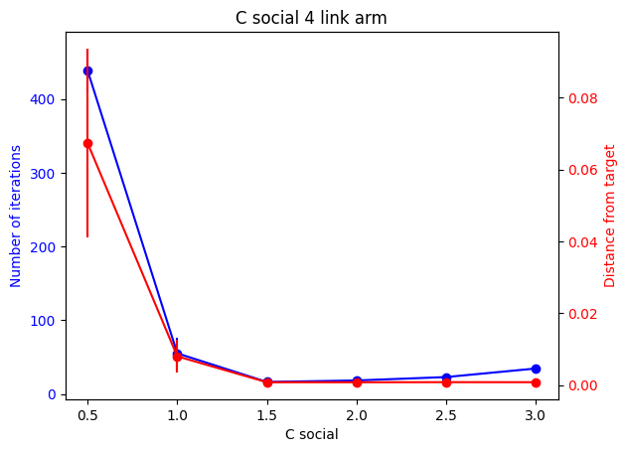
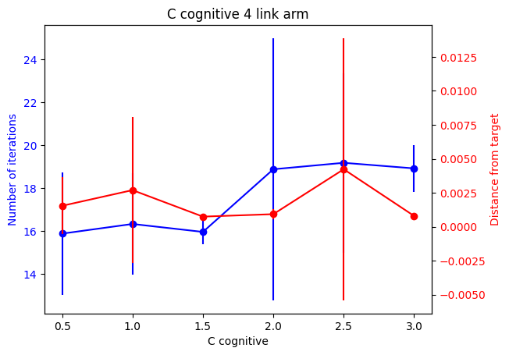
Social/cognitive factors: example1
SOCIAL FACTOR
COGNITIVE FACTOR

Slide 17
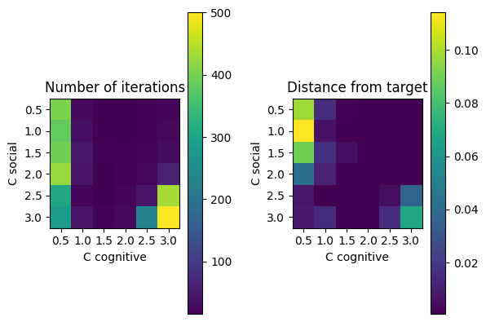
Social and cognitive factors example 1

Slide 18
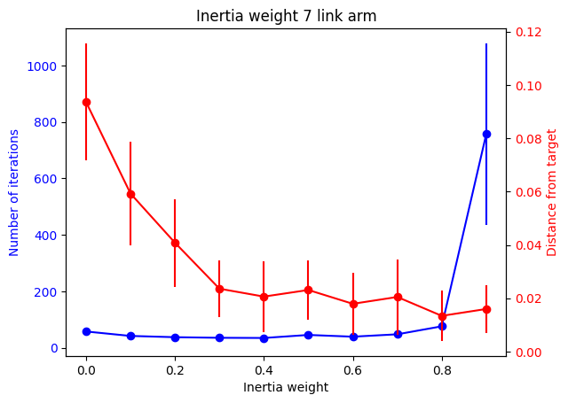
INERTIA WEIGHTS: example 2 (constrained)
weights | converged | Max_iter | Stationary
0.0 | 20 | 0 | 80
0.1 | 44 | 0 | 56
0.2 | 70 | 0 | 30
0.3 | 82 | 0 | 18
0.4 | 86 | 0 | 14
0.5 | 82 | 0 | 18
0.6 | 86 | 0 | 14
0.7 | 87 | 0 | 13
0.8 | 90 | 0 | 10
0.9 | 87 | 13 | 0

Slide 19
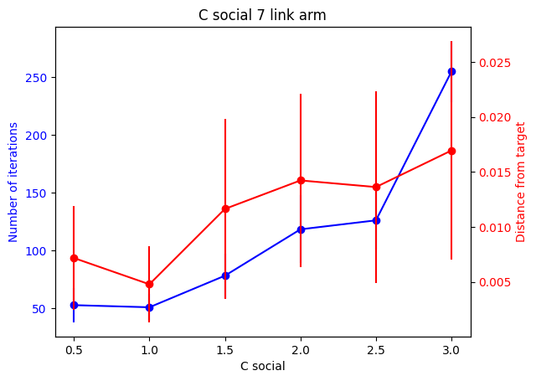
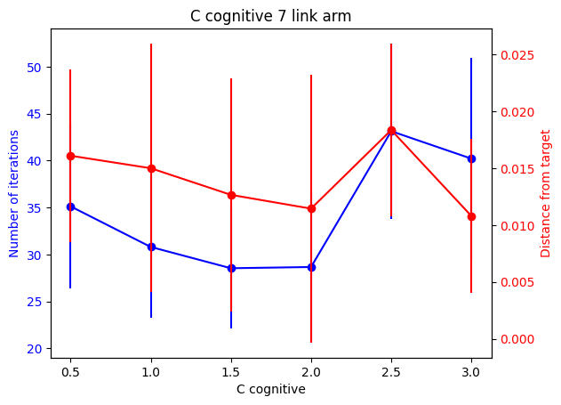
Social/cognitive factors: example 2
SOCIAL FACTOR
COGNITIVE FACTOR

Slide 20
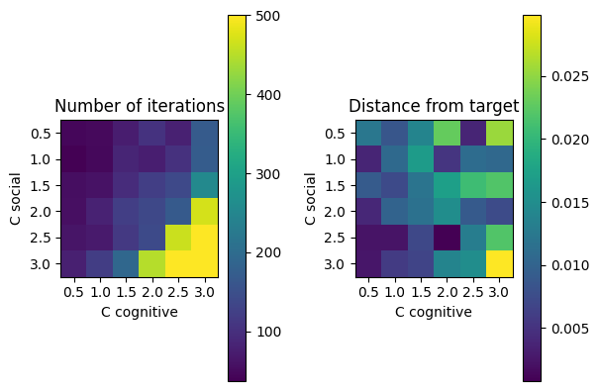
Social and cognitive factors example 2

Slide 21
THANKS FOR YOUR ATTENTION

