Slide 1
“ INTERACTIVE DIGITAL PORTFOLIO ” [ “My Digital Space“ ]
CAPSTONE PROJECT
Presented By:
B.TRISHA PRANATHI- Pallavi engineering College – CSE DEPT
Student ID: STU6798c78ff2e361738065807
Internship ID: INTERNSHIP_17522267216870dba1e54a43426

Slide 2
OUTLINE
Problem Statement (Should not include solution)
System Development Approach (Technology Used)
Algorithm & Deployment (Step by Step Procedure)
Result
Conclusion
Future Scope(Optional)
References

Slide 3
Problem Statement
Traditional resumes lack the ability to fully demonstrate a developer's skills, creativity, and achievements. Employers and recruiters are often faced with static documents that fail to showcase candidates’ real-world experience or their technical prowess. There is an urgent need for a more dynamic, engaging, and intuitive platform where developers can present their projects and expertise interactively.
Key Points:
Static resumes do not reflect technical growth or creativity
Lack of a centralized place to display achievements, skills, and projects
Difficulty attracting recruiters through conventional application methods.
Objectives:
Create a personalized and dynamic portfolio website for developers
Enable interactivity, smooth navigation, and visually rich presentations
Make it easy to update, customize, and share portfolios for academic, internship, or job opportunities

Slide 4
System Approach
PROJECT PHASES:
Requirement Gathering: Identify must-have profile sections (About, Skills, Projects, Contact, etc.)
Design: Plan website layout, user flow, and UI/UX for responsiveness
Implementation: Develop using HTML, CSS, and JavaScript for structure, styling, and interactivity
Enhancement: Use animation libraries (GSAP, ScrollMagic) for transitions and engaging effects
Testing and Deployment: Ensure cross-browser compatibility, mobile responsiveness, and host online (GitHub Pages/Netlify)

Slide 5
System Approach
TECHNOLOGIES USED
HTML5: Semantic markup, responsive structure
CSS3: Styling, Flexbox/Grid layout, custom animations, media queries for mobile-friendliness
JavaScript: Dynamic features (modal pop-ups, filtering, smooth scroll), connecting sections, enabling navigation logic
GSAP/ScrollMagic (Optional): Advanced animations for element transitions and scroll-based effects
FontAwesome: Icon library for visual enhancement
Hosting Platforms: GitHub Pages, Netlify for free and easy web deployment

Slide 6
Algorithm & Deployment
The project mainly uses JavaScript-driven algorithms for dynamic interactivity and user experience enhancements:
MODAL PROJECT DETAIL INTERACTION: When a project card is clicked, a modal popup opens to display detailed information about the project. This involves event listeners on each project card, fetching associated modal content by ID, and showing or hiding the modal with smooth transitions. It also stops page scroll when modal is open to focus user attention.
PROJECT FILTERING: Project cards have data attributes indicating categories or tags. Clicking on filter tabs triggers filtering logic that compares the selected filter value against each project's tags, showing or hiding cards accordingly with a small delay for smooth visual transition.
SCROLL ANIMATIONS (INTERSECTION OBSERVER): The Intersection Observer API monitors when sections and skill bar elements come into view. This triggers class additions that animate fade-ins and skill bar fill progress, improving visual engagement without heavy scroll event processing.

Slide 7
Algorithm & Deployment
SMOOTH NAVIGATION: Navigation links scroll smoothly to the targeted section accounting for header height offset. This uses JavaScript scrollTo with behavior set to 'smooth', ensuring a seamless user experience.
SKILL BAR ANIMATION: Proficiency levels are read from data attributes on skill containers; the fill bars get animated widths and color-coded classes for visual representation of skill levels.
INTERACTIVE AVATAR SWAP: Clicking the profile avatar swaps between two images with a brief pulse animation effect.
These core logics combine to make the portfolio site interactive, engaging, and easy to navigate.

Slide 8
Algorithm & Deployment
Product Catalog Creation
Organize portfolio into sections: About Me, Skills, Projects, Achievements, Contact.
Display projects with images, key details, and tags for easy browsing and filtering.
Frontend Design
Use HTML5, CSS3, Flexbox, and Grid for a modern, responsive layout.
Apply custom styles, color themes, and icons for visual appeal across devices.
Add animated elements like progress bars for engagement.
Interactive Features
Enable smooth navigation and section highlighting.
Filter projects by category and show details in pop-up modals.
Animate skills and avatar images for a lively, personal experience.

Slide 9
Algorithm & Deployment
Deployment
The portfolio website is deployed as a static site using free hosting platforms like GitHub Pages or Netlify.
The deployment involves:
Pushing the HTML, CSS, JavaScript, and asset files to a GitHub repository.
Connecting the repository to GitHub Pages or Netlify for automated deployment on push.
The site becomes accessible via a public URL shared in the resume or linked on professional profiles.
Deployment benefits:
Cost-effective, easy to update, and accessible from anywhere
No backend server needed, simplifying hosting and maintenance
Supports continuous integration workflows for version control and updates

Slide 10
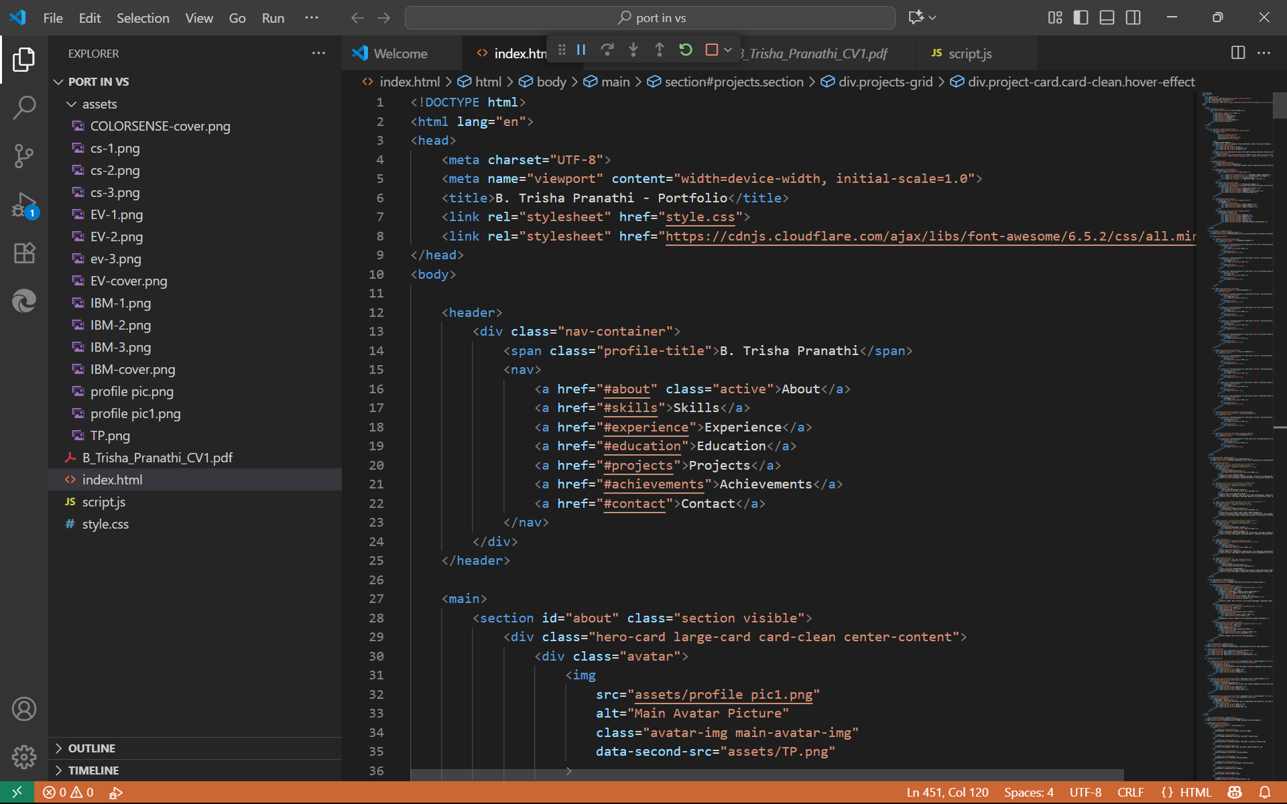
Result
“Screenshot of the code”

Slide 11
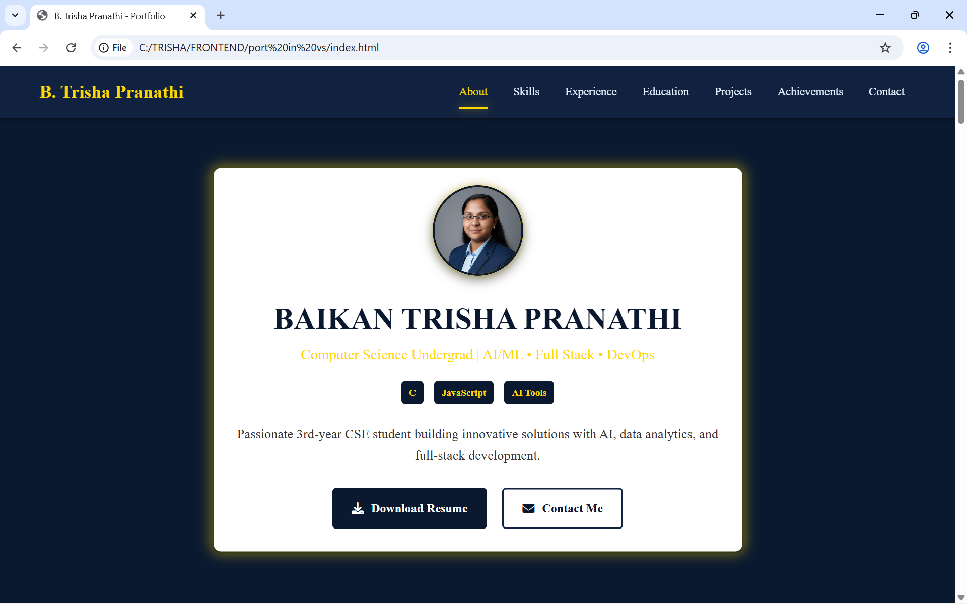
Result
“Opening page of the website, with a in-short description of user and a clean and intuitive header to help visitors navigate through portfolio ”

Slide 12
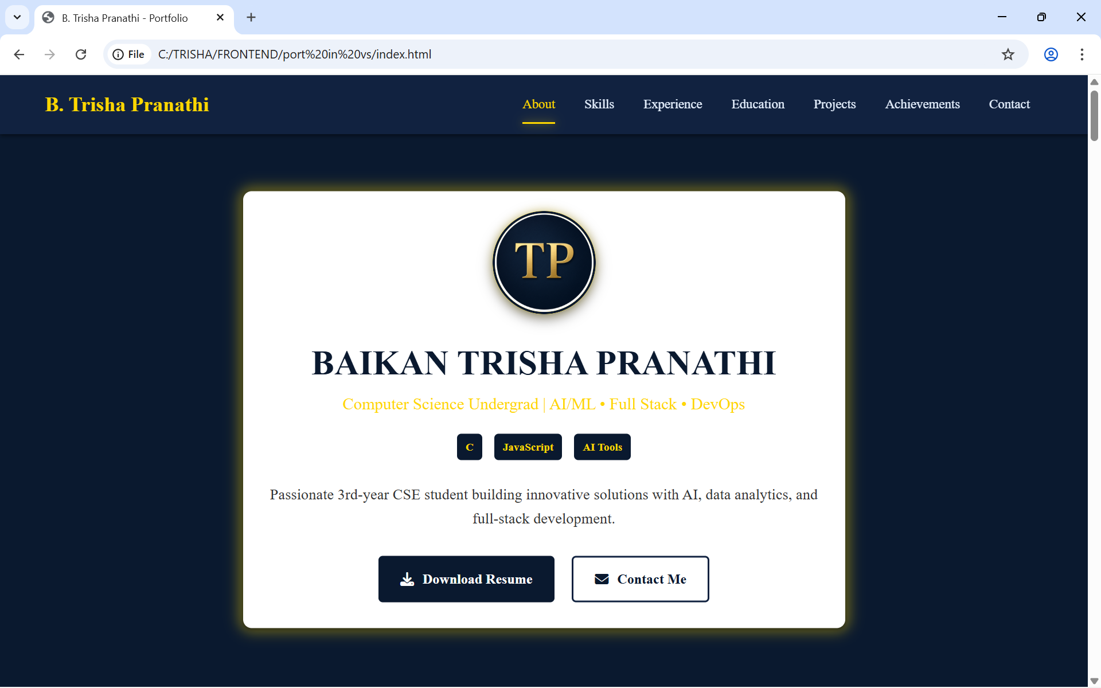
Result
“When the profile avatar is clicked , it changes to another avatar(Instagrams story ring effect)”

Slide 13
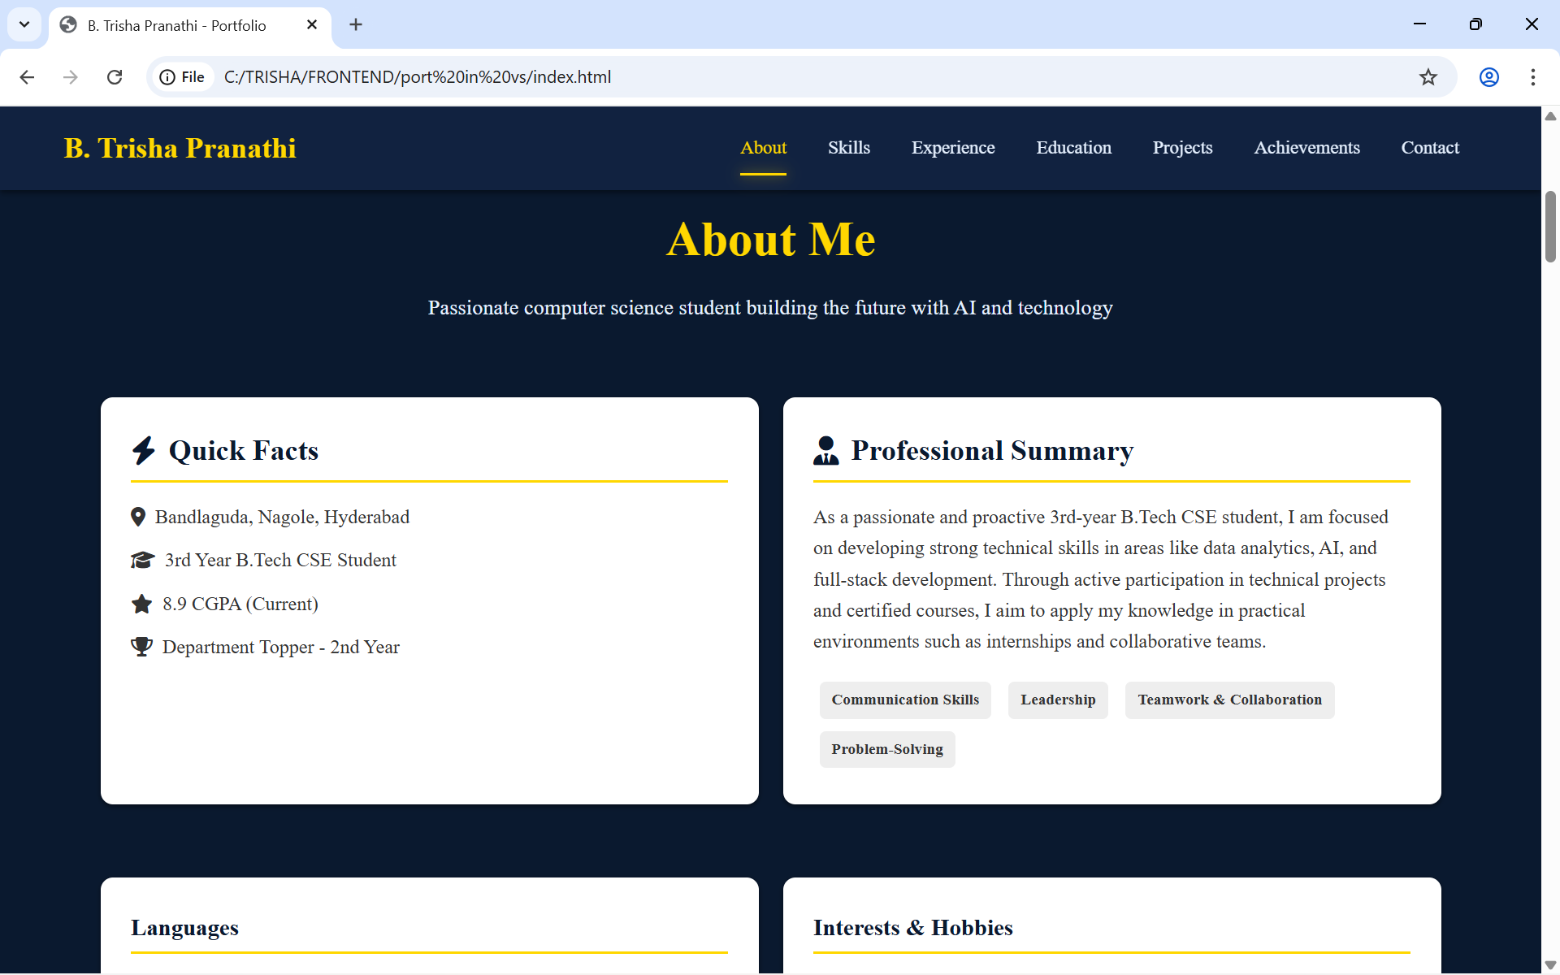
Result
“ About me page, displays brief facts and a basic introduction of the user”

Slide 14
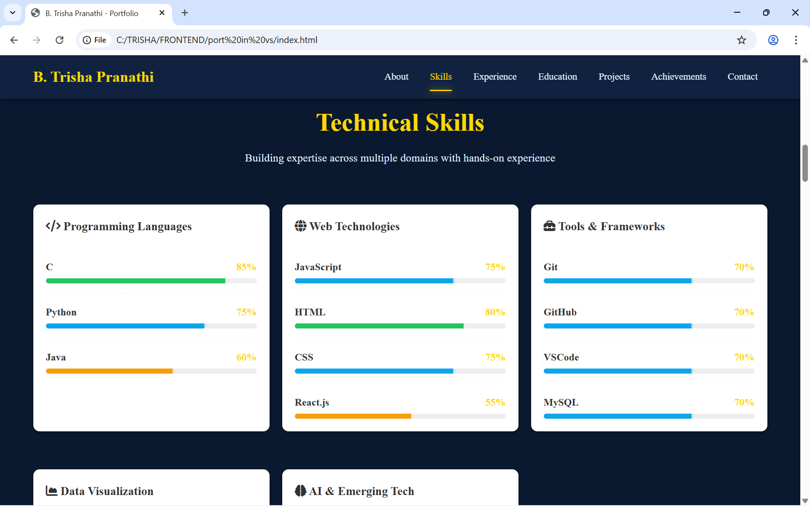
Result
“ Technical skills : An overview of the tools, programming languages, frameworks, and technologies mastered to tackle real-world projects effectively (with progress bar effect ) ”

Slide 15
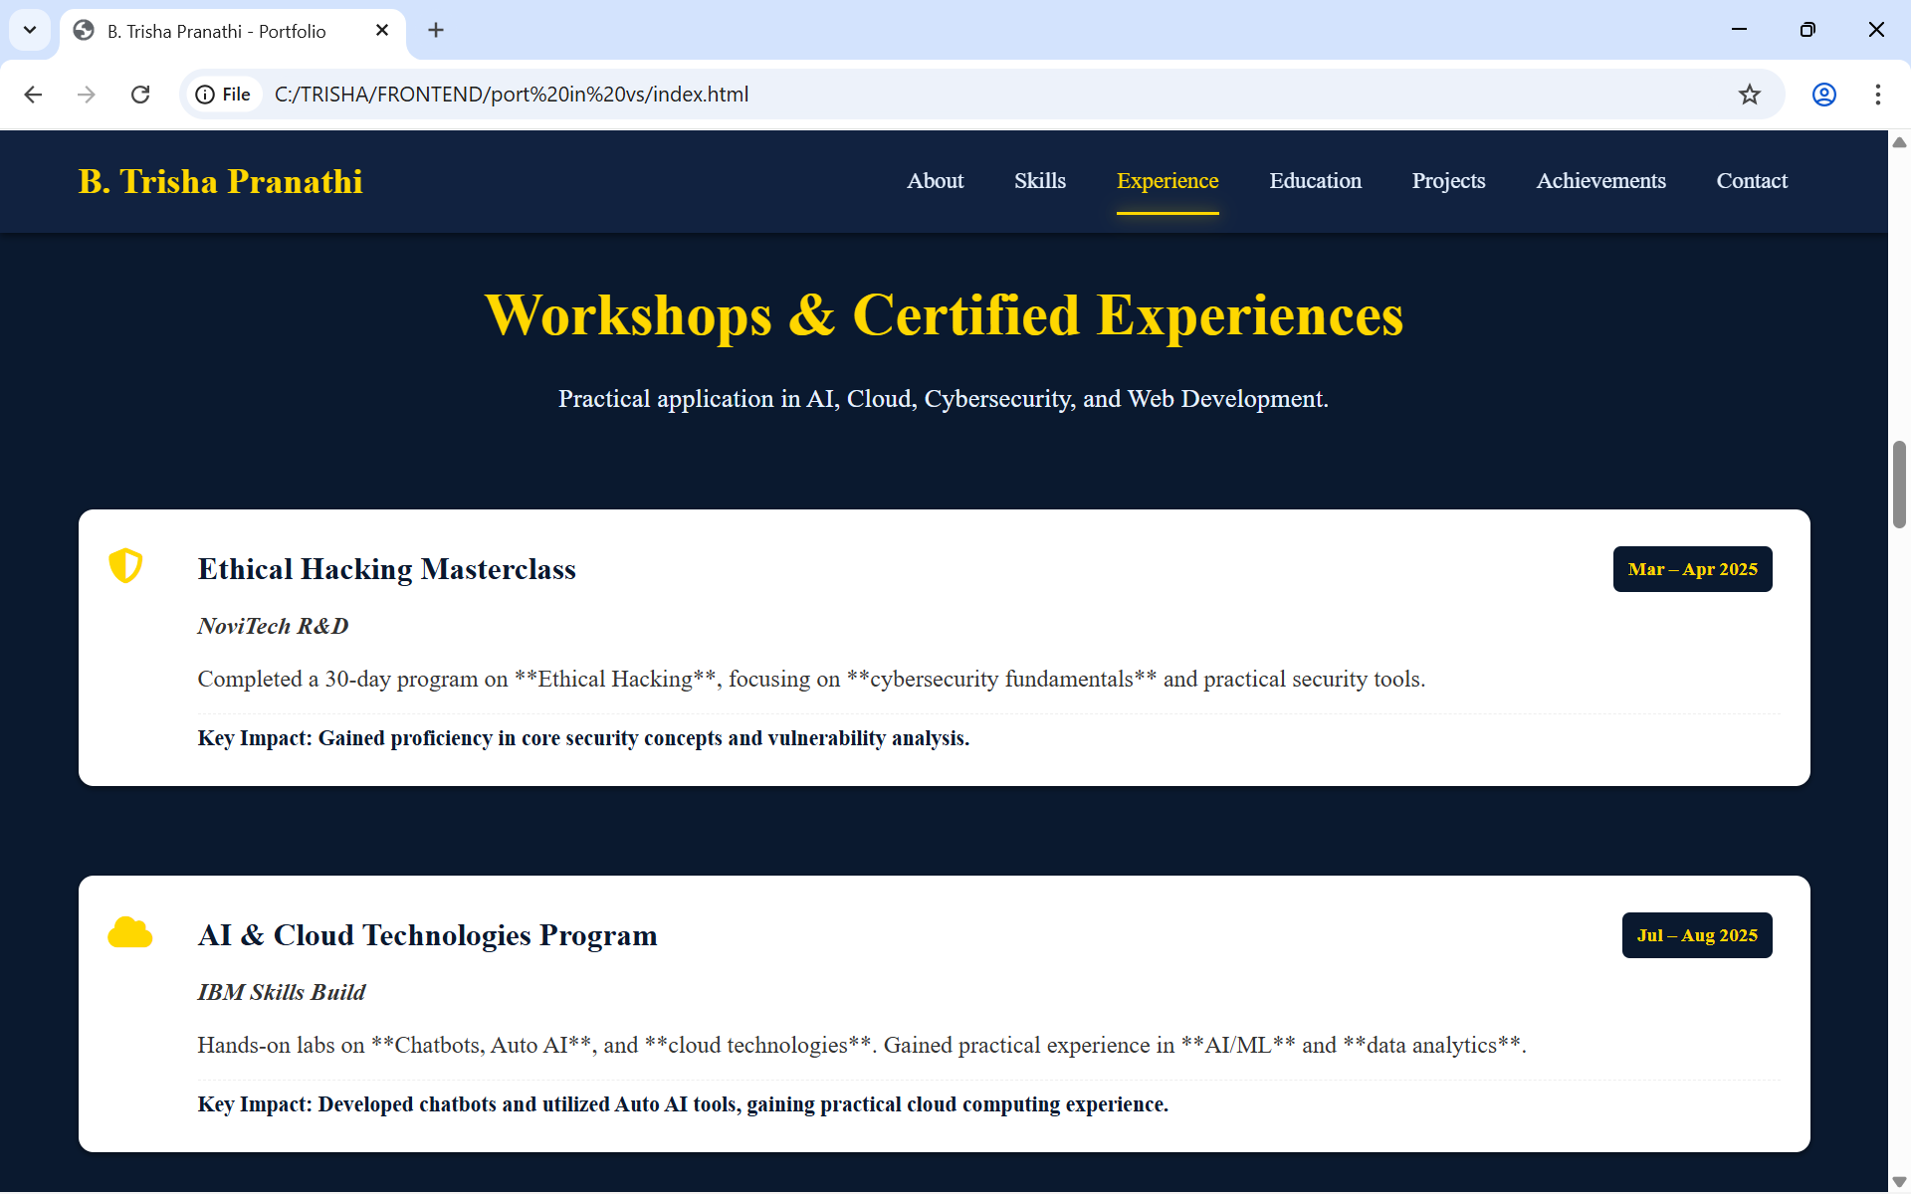
Result
“Experience section : A showcase of professional journey, internships, and real-world experiences that reflect skills, contributions, and growth in the industry."

Slide 16
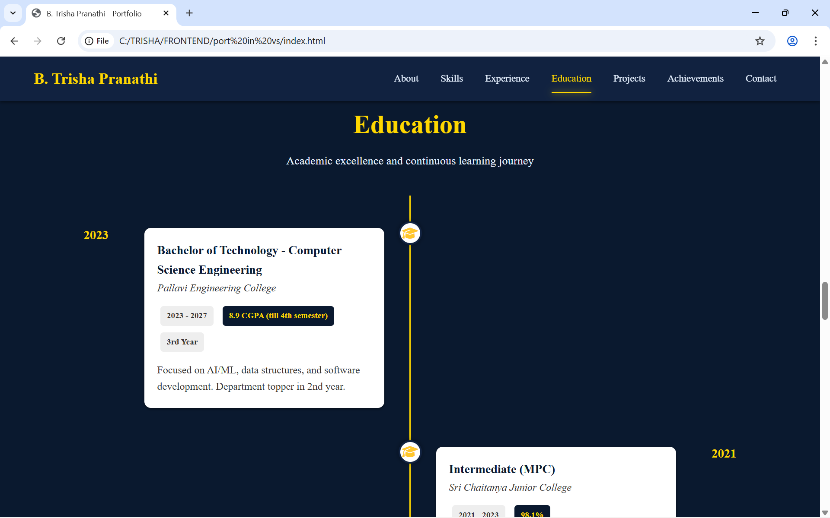
Result
“Education section, highlights the academic journey, foundational knowledge, and the institutions that shaped skills and passion. (using the timeline effects)”

Slide 17
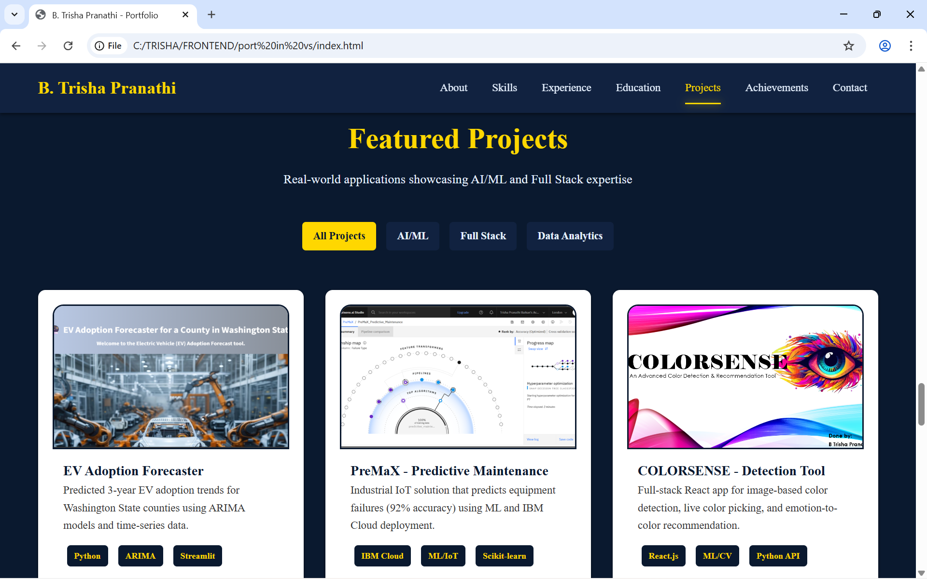
Result
“Projects section : A collection of hands-on work, showcases practical applications of skills featuring with live demos and repositories.(Click to Explore: A Deep Dive into Our Project Implementations)”

Slide 18
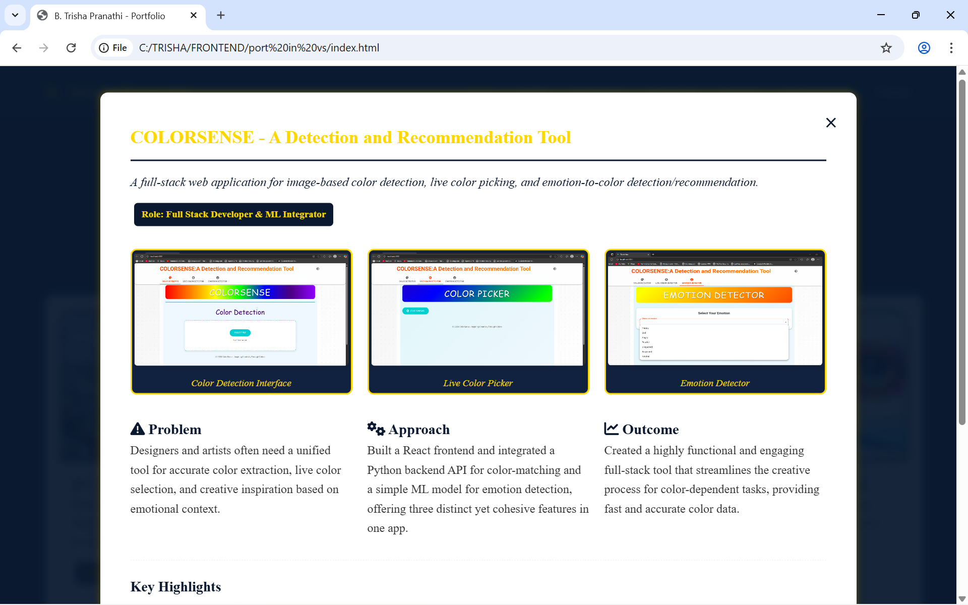
Result
“A Closer Look of projects: Click on any project to view more details. Each modal provides an in-depth look at the project, including its objectives, technologies used, features, and live preview or demo links, giving you a clear understanding of my work."”

Slide 19
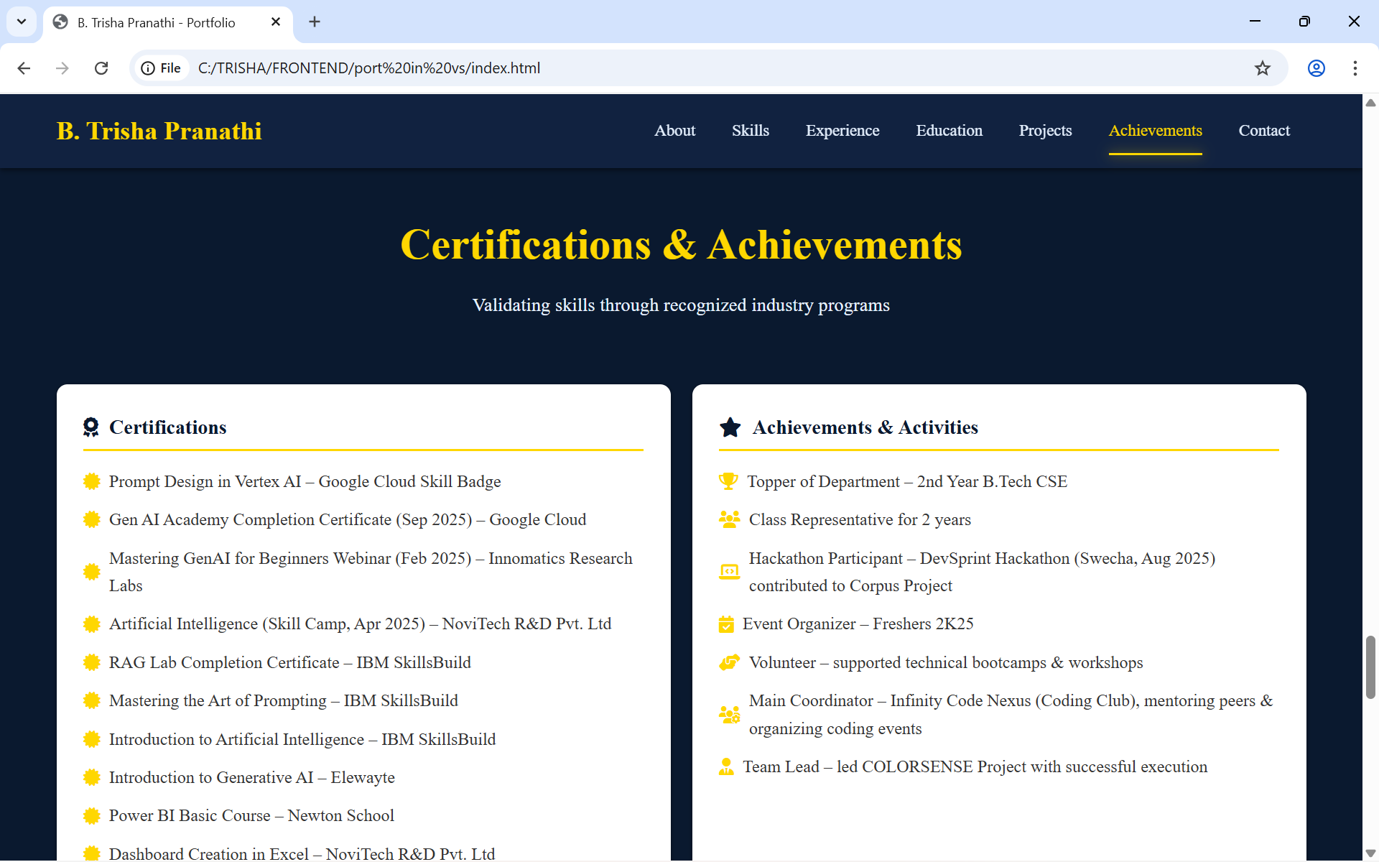
Result
“ Certificates and achievements section, displays the milestones and recognitions that highlight skills, dedication, and continuous learning journey in respective field and beyond."

Slide 20
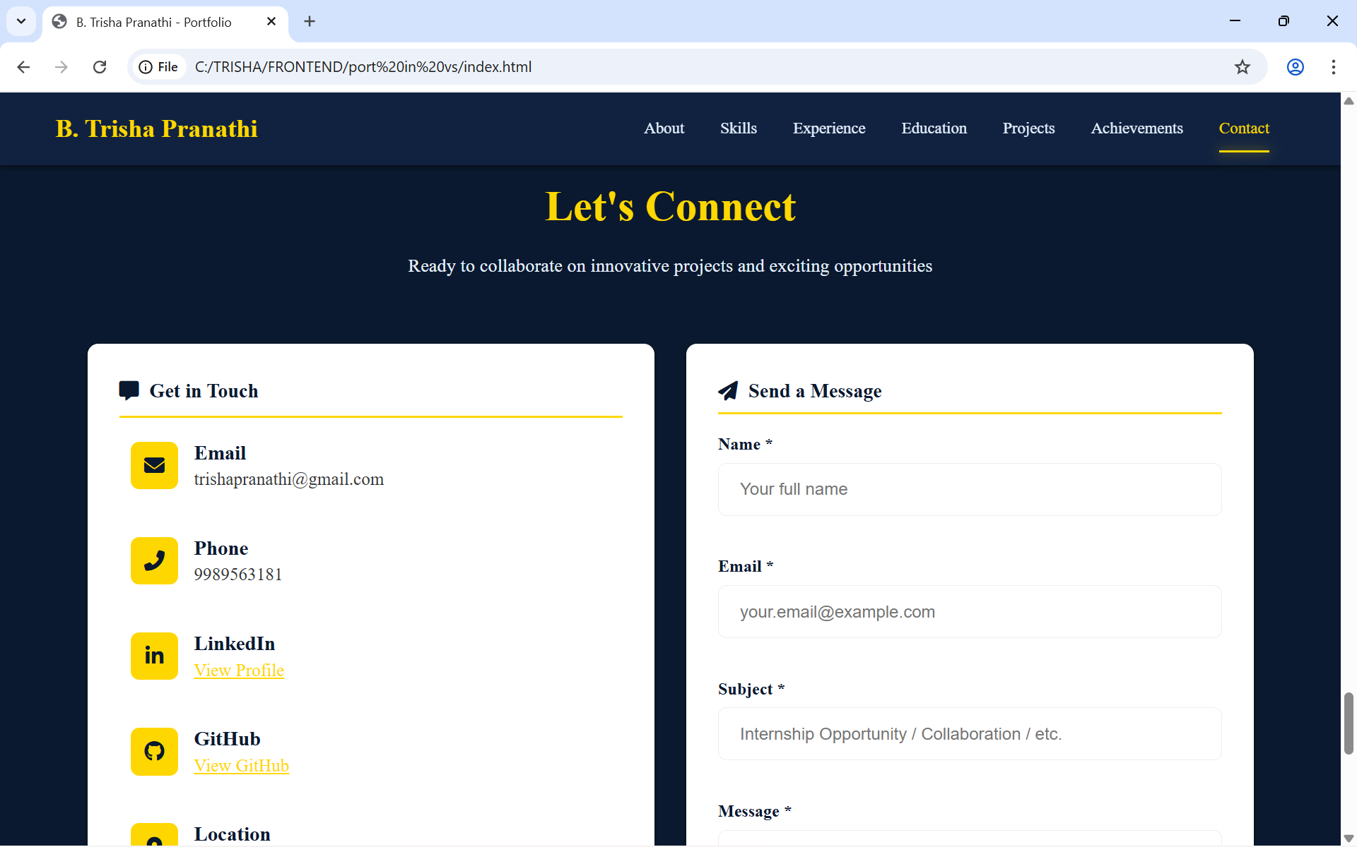
Result
“Contact page , a dedicated section for professional connections and for interaction.”

Slide 21
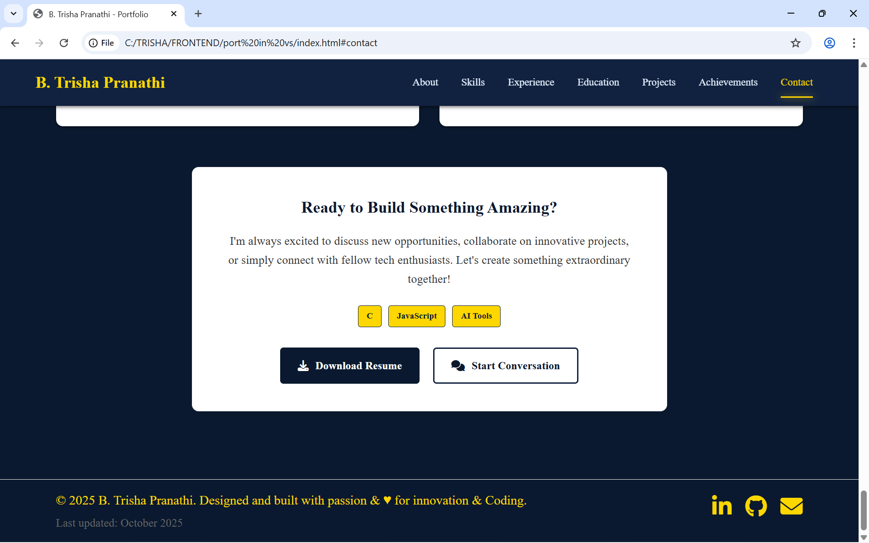
Result
“ Ready to build tab ,represents the readiness to take on new projects and collaborations. And a thoughtfully designed footer that adds completeness to the website, offering direct access to my contact links and reinforcing my digital presence.”

Slide 22
GITHUB AND DEPLOYMNET LINK
Attach your Github Link :
https://github.com/3sha507/AICTE-FWD-PROJECT.git
Deployment link:
https://3sha507.github.io/AICTE-FWD-PROJECT/

Slide 23
Conclusion
The Interactive Digital Portfolio successfully transforms a traditional resume into a dynamic, engaging, and personalized web experience. It allows developers to showcase their skills, achievements, and projects in a visually appealing and interactive format that reflects their creativity and professionalism.
By integrating modern web technologies like HTML, CSS, and JavaScript, the portfolio ensures responsiveness, interactivity, and aesthetic appeal across all devices. It not only highlights technical abilities but also enhances the user’s personal brand and digital presence in the competitive tech world.
This project demonstrates the importance of combining design, functionality, and storytelling to create impactful digital identities - empowering developers to stand out, connect, and communicate their journey with confidence.
💡 "A portfolio is more than a website — it's a reflection of who you are as a creator."

Slide 24
🚀 Future scope
🌙 Dark & Light Theme Toggle: Implement a smart theme switcher for better accessibility and user preference.
🧠 AI-Powered Personalization: Integrate AI to dynamically recommend portfolio layouts, themes, or projects based on visitor interest.
💬 Interactive Chatbot / Voice Assistant: Add an AI-driven assistant to guide visitors through your portfolio and answer questions.
📈 Analytics Dashboard: Track visitor interactions, clicks, and engagement to improve content presentation.
🎧 Multimedia Enhancements: Include background music, animations, and voice introductions to make the experience immersive.
🧩 Backend Integration: Enable message saving, feedback collection, and contact form automation using Firebase or Node.js.
🌐 Custom Domain & Hosting: Deploy on a personalized domain with SSL certification for a professional digital identity.

Slide 25
References
- W3Schools – https://www.w3schools.com/
*For HTML, CSS, and JavaScript syntax and design structure guidance.*
- MDN Web Docs – https://developer.mozilla.org/
*For detailed documentation on modern web development practices.*
- Font Awesome – https://fontawesome.com/
*For using high-quality icons and visual elements in the interface.*
- CSS-Tricks – https://css-tricks.com/
*Practical guides and articles on CSS techniques, animations, and effects.*

Slide 26
References
- Codrops (Tutorials & Demos) – https://tympanus.net/codrops/
*Creative UI/UX experiments and advanced CSS effect tutorials.*
- CSSFX – https://cssfx.dev/
*A curated collection of small, reusable CSS effects for buttons, cards, loaders, etc.*
- Animate.css – https://animate.style/
*Ready-made CSS animations for quick, polished transitions.*
- GitHub Docs – https://docs.github.com/
*For version control, repository setup, and collaboration.*

Slide 27
THANK YOU!!

