Slide 1
Predictive Maintenance of Industrial Machinery [ PreMaX – Predictive Maintenance eXpert ]
CAPSTONE PROJECT
Presented By:
1. B.TRISHA PRANATHI- Pallavi engineering College – CSE DEPT

Slide 2
OUTLINE
Problem Statement (Should not include solution)
Proposed System/Solution
System Development Approach (Technology Used)
Algorithm & Deployment
Result (Output Image)
Conclusion
Future Scope
References

Slide 3
Problem Statement
In industrial settings, machinery operates under continuous stress, making it vulnerable to failures like tool wear, overheating, and power issues. Such unexpected breakdowns cause unplanned downtime, increased repair costs, and reduced productivity. Current maintenance strategies are mostly reactive or time-based, lacking real-time condition monitoring. Reactive systems only act after failures occur, while preventive methods may lead to unnecessary maintenance or missed faults. This inefficiency highlights the need for a smarter solution. A predictive maintenance system using real-time sensor data can anticipate failures early, enabling timely intervention. This reduces downtime, optimizes resource use, and improves operational reliability.

Slide 4
Proposed Solution
Develop a machine learning-based system to classify industrial machine failures using sensor data.The proposed system addresses the challenge of unplanned machinery failures by predicting potential failure types using sensor data and machine learning. The system will detect patterns leading to faults like tool wear, overheating, or power failure and enable timely intervention, improving efficiency and reducing downtime. The solution comprises the following components:
Data Collection:
Collect historical and real-time sensor data from machines, including variables like temperature, torque, and tool wear.
Data Preprocessing:
Clean the dataset, handle missing values, and engineer features to highlight patterns related to equipment failures.
Machine Learning Algorithm:
Use IBM Auto AI to build and optimize a classification model that predicts specific types of machine failures.
Deployment:
Deploy the trained model as a REST API on IBM Cloud to enable real-time failure predictions..
Evaluation:
Evaluate the model using accuracy, precision, recall, and F1-score to ensure reliable performance.
Result: The system accurately predicts failure types in advance, allowing proactive maintenance and reduced downtime.

Slide 5
System Approach
The development and implementation of the PreMaX system follow a structured methodology, integrating data-driven modeling with modern cloud deployment to ensure real-time fault prediction and maintenance planning.
System Requirements
Category | Specification Used
Development Platform | IBM Cloud (Lite plan)
Runtime Environment | Watson Studio / AutoAI
Python Version | Default version provided by IBM Cloud
Internet Access | Required (for all development stages)

Slide 6
System Approach
2. Libraries and Tools Used
Name | Purpose
pandas | Data manipulation and preprocessing
numpy | Numerical operations and data handling
scikit-learn | Building machine learning classification models
matplotlib | Data visualization (graphs, charts)
joblib | Model saving and loading
IBM Watson Studio | Cloud-based development and model training platform
IBM AutoAI | Automated model selection, training, and optimization
Deployment Space | Managing assets and models in IBM Cloud
Online Deployment API | Real-time model inference via cloud endpoint
Kaggle Dataset Upload | Data ingestion for model training

Slide 7
Algorithm & Deployment
Algorithm Selection:
AutoAI selected Random Forest Classifier for its high accuracy and robustness in failure classification.
Data Input:
Input Features: Air Temp, Process Temp, Torque, Rotational Speed, Tool Wear, Product ID, Type
Target Variable: Failure Type (e.g., Tool Wear, Heat Dissipation, Power Failure).
Training Process:
The model was trained using historical machinery sensor data within IBM Cloud AutoAI. The platform automatically handled data preprocessing, feature selection, and model optimization.
AutoAI evaluated multiple algorithms and selected the best-performing pipeline (Random Forest) based on accuracy and F1-score.
Prediction Process:
Trained model predicts failure types in real-time using live sensor inputs via IBM Cloud online deployment..

Slide 8
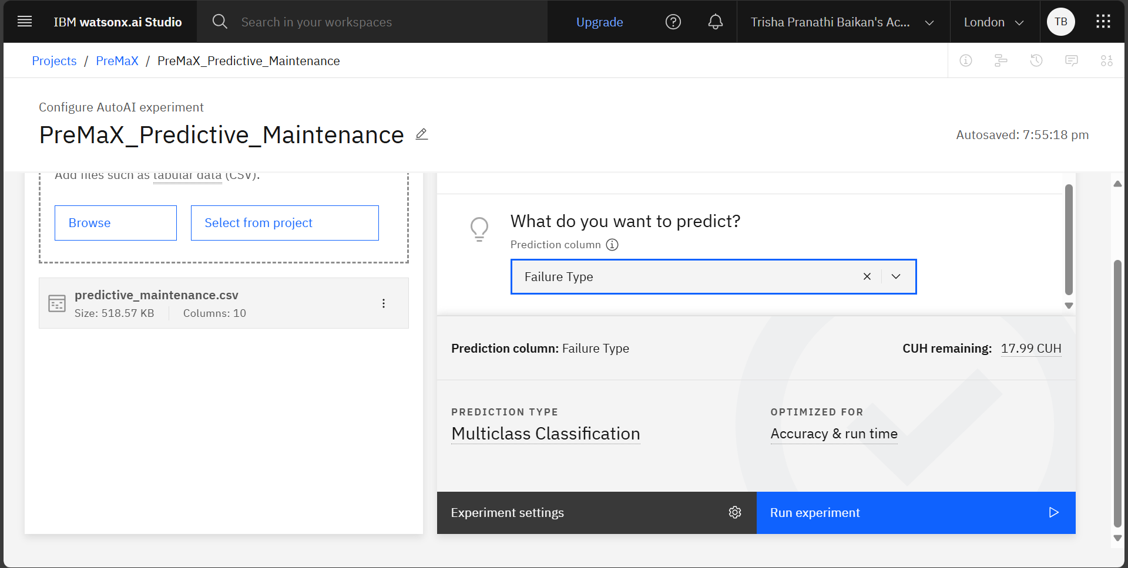
Result
The Random Forest model built using IBM AutoAI achieved high accuracy in predicting equipment failures. Key features like tool wear and process temperature significantly influenced predictions. The model showed excellent performance with 98.5% accuracy, as seen in confusion matrix and prediction charts.
DATASET LOADED

Slide 9
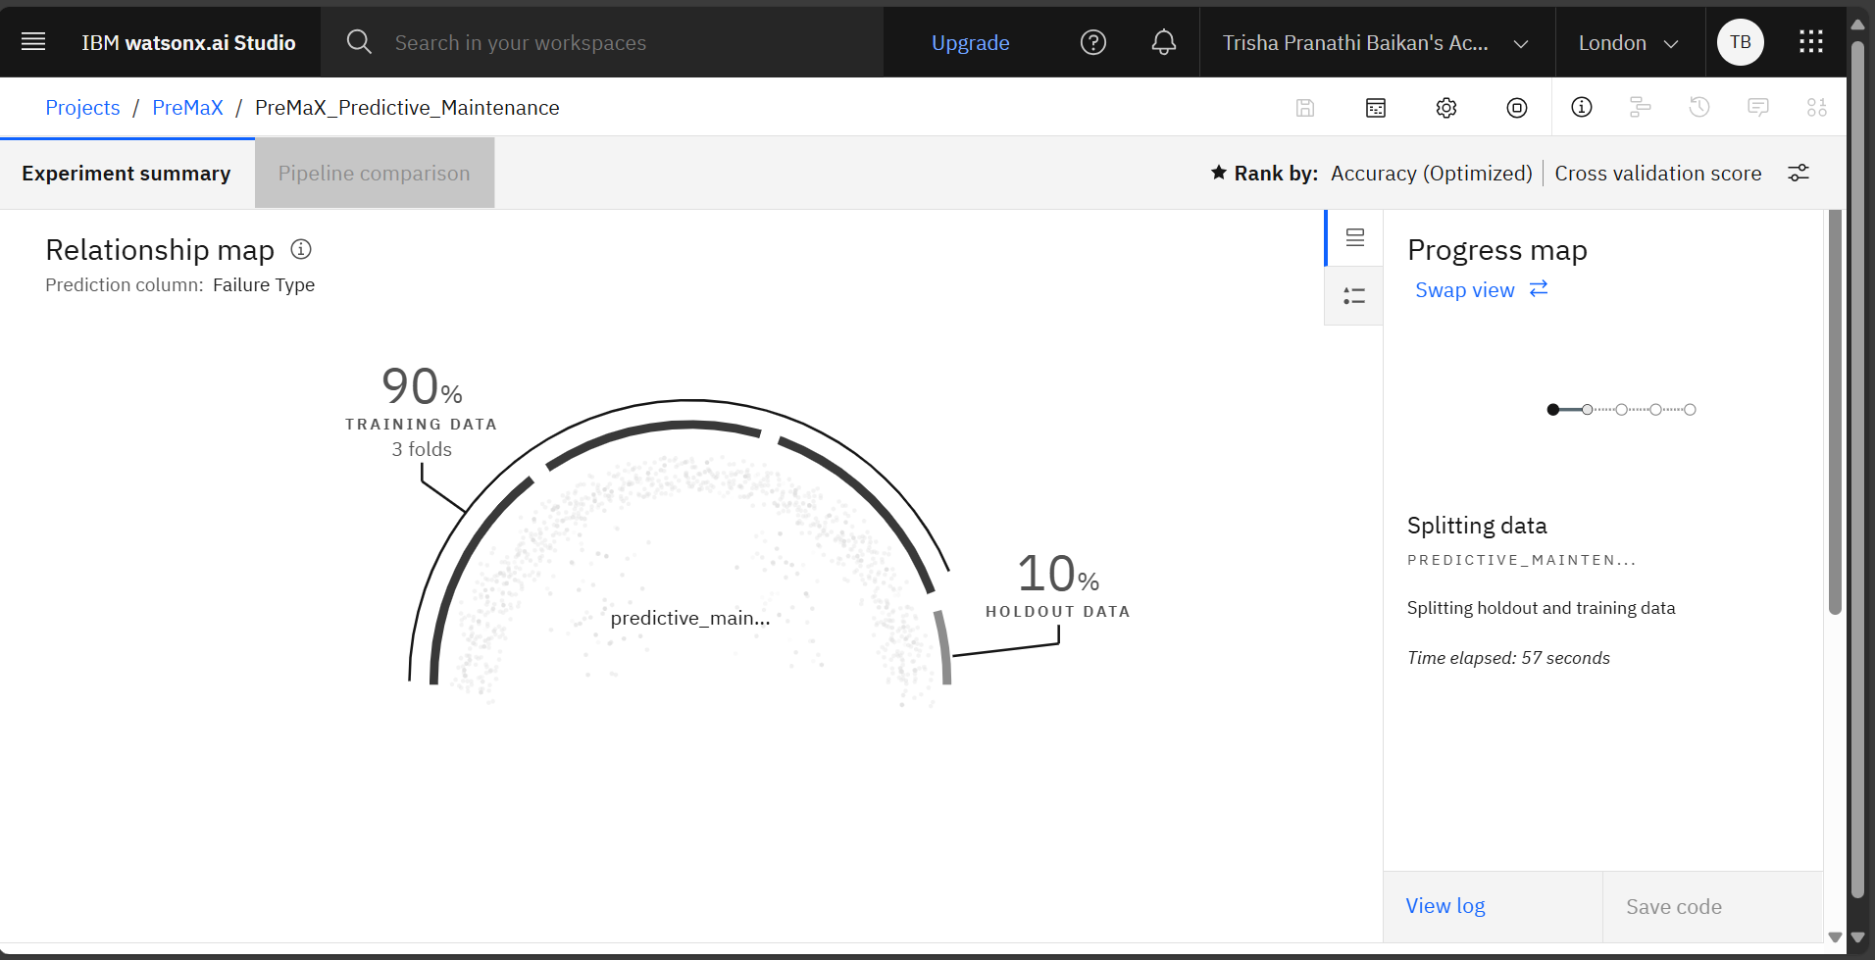
Result
DATA ANALYSING

Slide 10
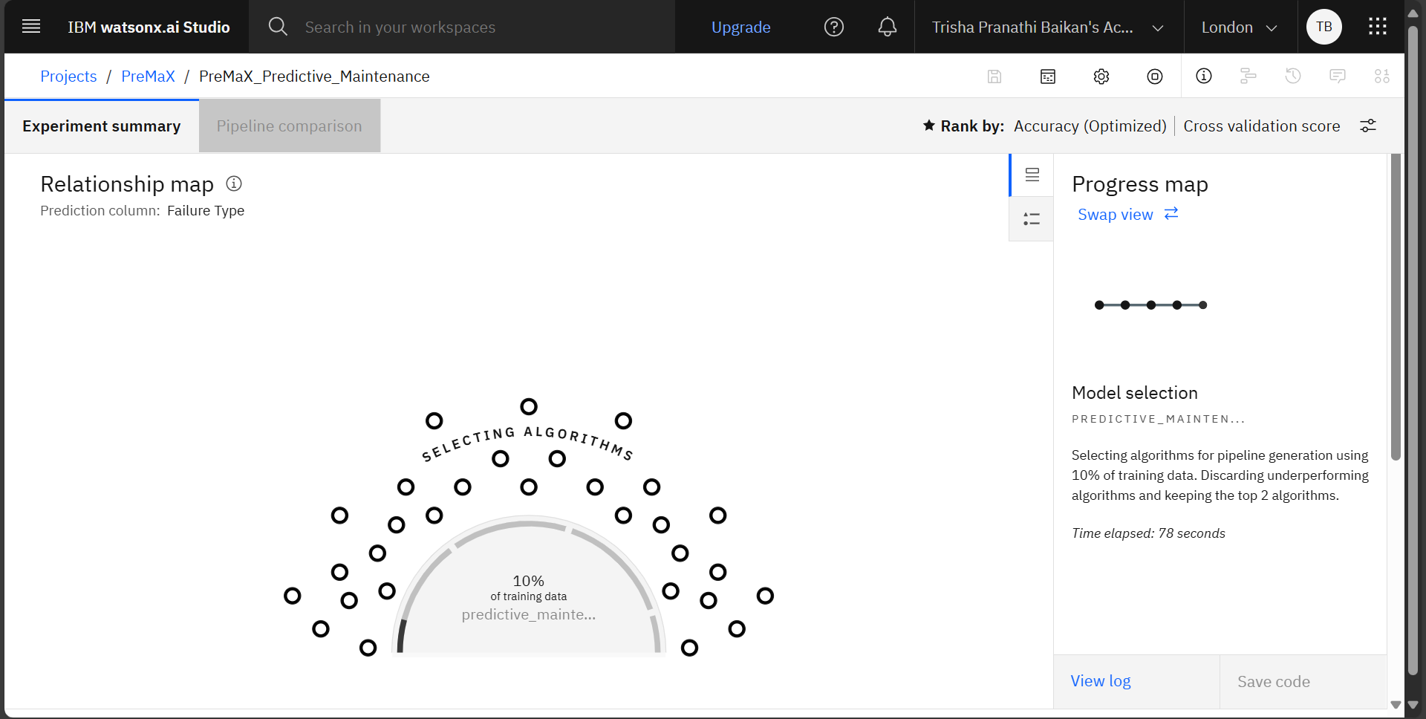
Result
SELECTING ALGORITHM

Slide 11
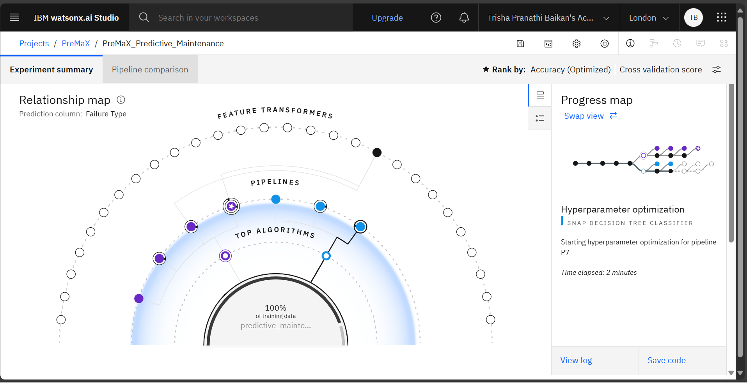
Result
Hyperparameter Optimization and Top Performing Pipelines are being generated with their accuracy

Slide 12
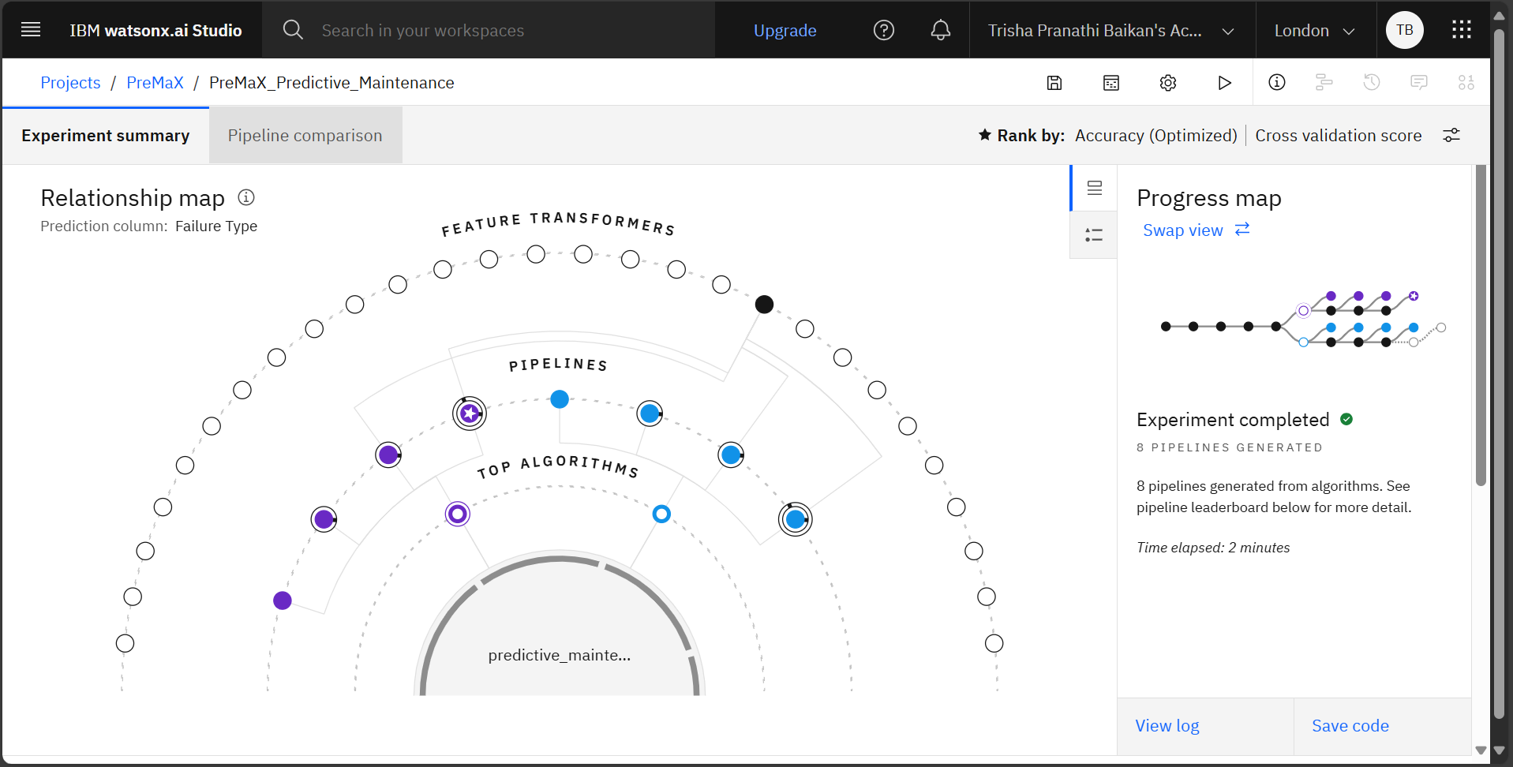
Result
Generation and evaluation process of Pipelines is completed

Slide 13
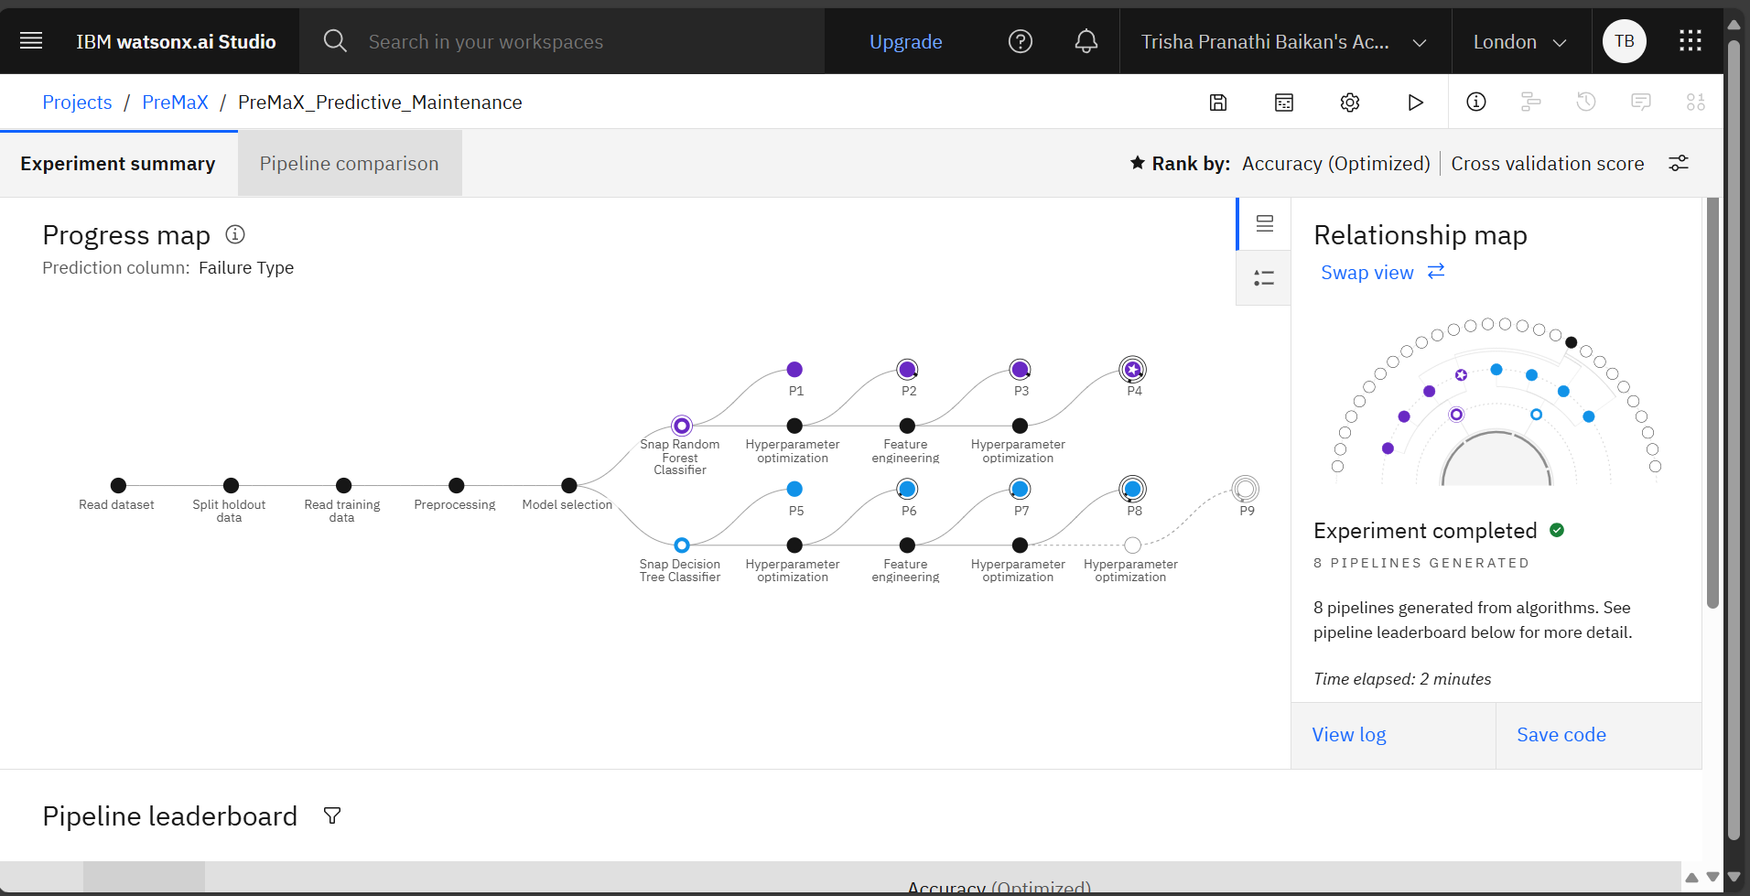
Result
OPTIMIZED ML PIPELINES

Slide 14
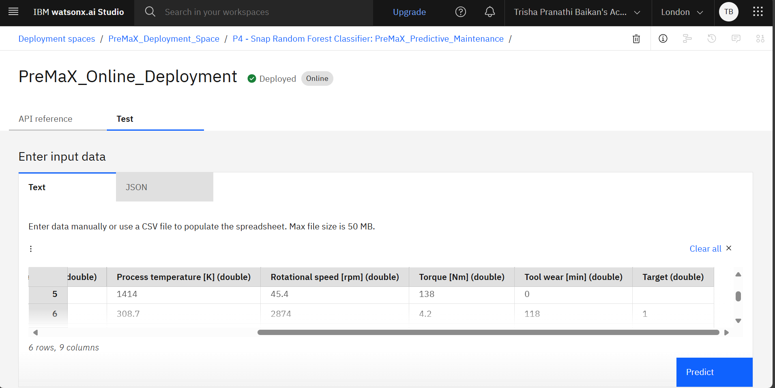
Result
Online Deployment – TESTING MODEL WITH REAL DATA

Slide 15
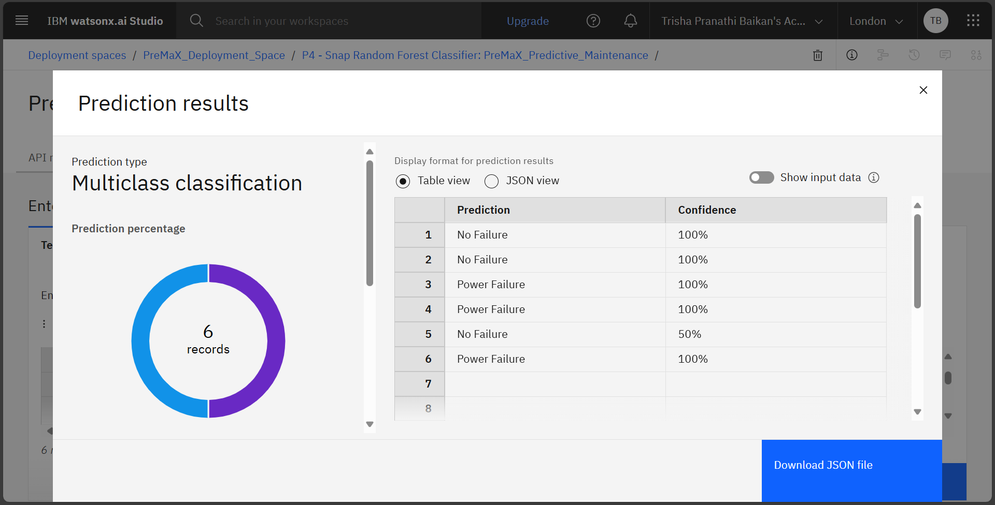
Result
Model Output: PREDICTED FAILURE TYPES WITH CONFIDENCE SCORES

Slide 16
Conclusion
The proposed solution successfully predicts machinery failures using a multiclass classification model, achieving high accuracy and confidence in classifying failure types like Power Failure and No Failure.
Deployment on IBM Watson Studio enabled real-time predictions, proving the feasibility and scalability of cloud-based predictive maintenance.
Despite the success, challenges such as data imbalance, sensor noise, and feature selection were encountered during model training.
Potential improvements include integrating real-time sensor streams, expanding the dataset, and applying advanced algorithms like XGBoost or Deep Learning for even better precision.
This project emphasizes the critical role of predictive maintenance in minimizing downtime, reducing operational costs, and enhancing the efficiency and safety of industrial systems.

Slide 17
Future scope
Add More Data Sources: Integrate real-time sensors, logs, and external conditions for improved accuracy.
Optimize Algorithms: Use advanced models (XGBoost, Deep Learning) and tuning techniques.
Scale to Multiple Regions: Deploy system across factories and cities for broader impact.
Use Edge Computing: Enable real-time predictions directly on machines.
Automate Maintenance: Trigger alerts and schedules for proactive repairs.
Enhance Explainability: Apply XAI tools to increase model transparency.

Slide 18
References
IBM Cloud Documentation – https://cloud.ibm.com/docs
Predictive Maintenance Dataset – Kaggle https://www.kaggle.com/datasets/shivamb/machine-predictive-maintenance-classification
Scikit-learn: Machine Learning in Python – Pedregosa et al. (2011)
"A Survey of Predictive Maintenance: Modeling, Algorithms and Applications" – IEEE Xplore
Towards Data Science Articles on Model Deployment & Evaluation
Research papers on Time Series Forecasting and Classification Algorithms (ARIMA, Decision Trees, etc.)

Slide 19
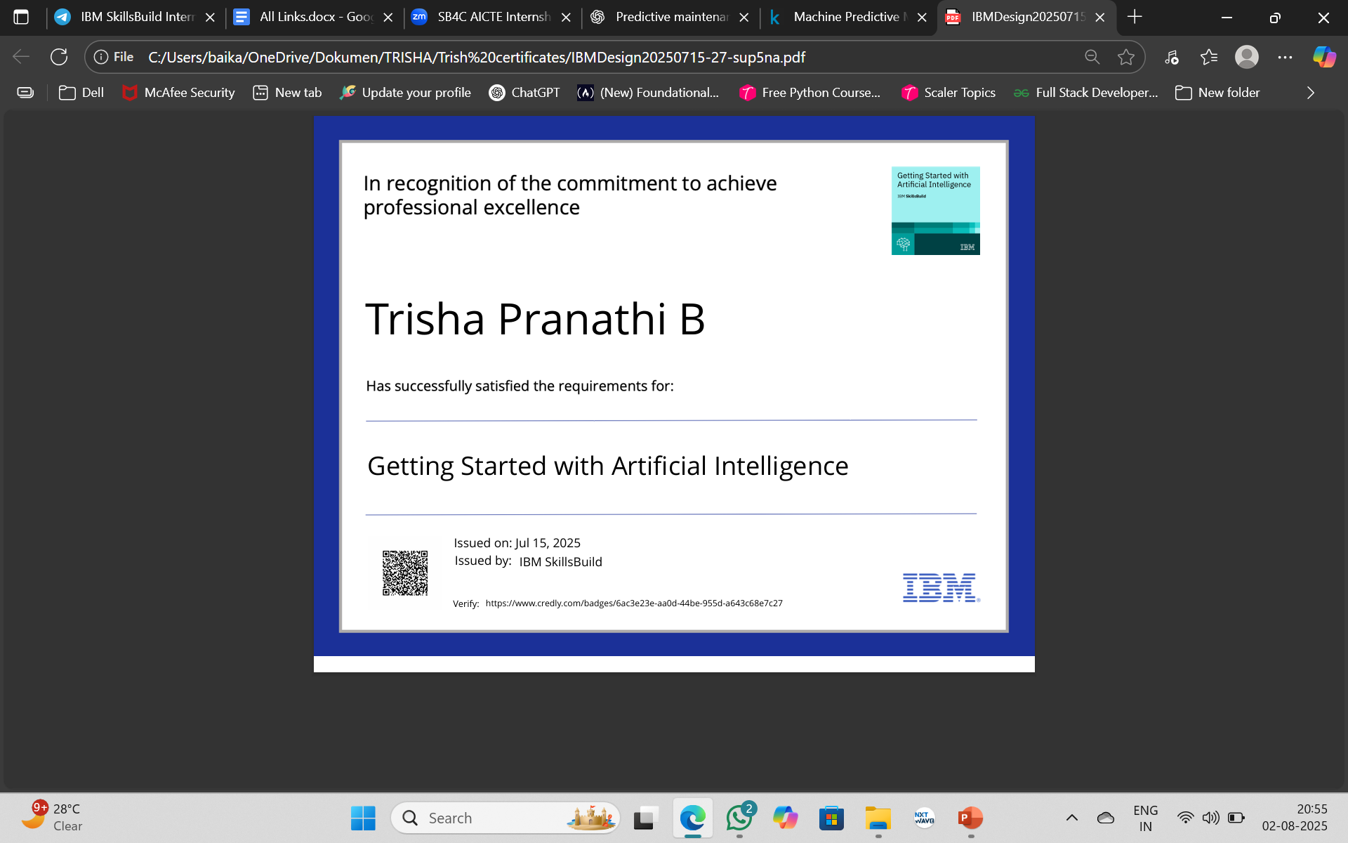
IBM Certifications

Slide 20
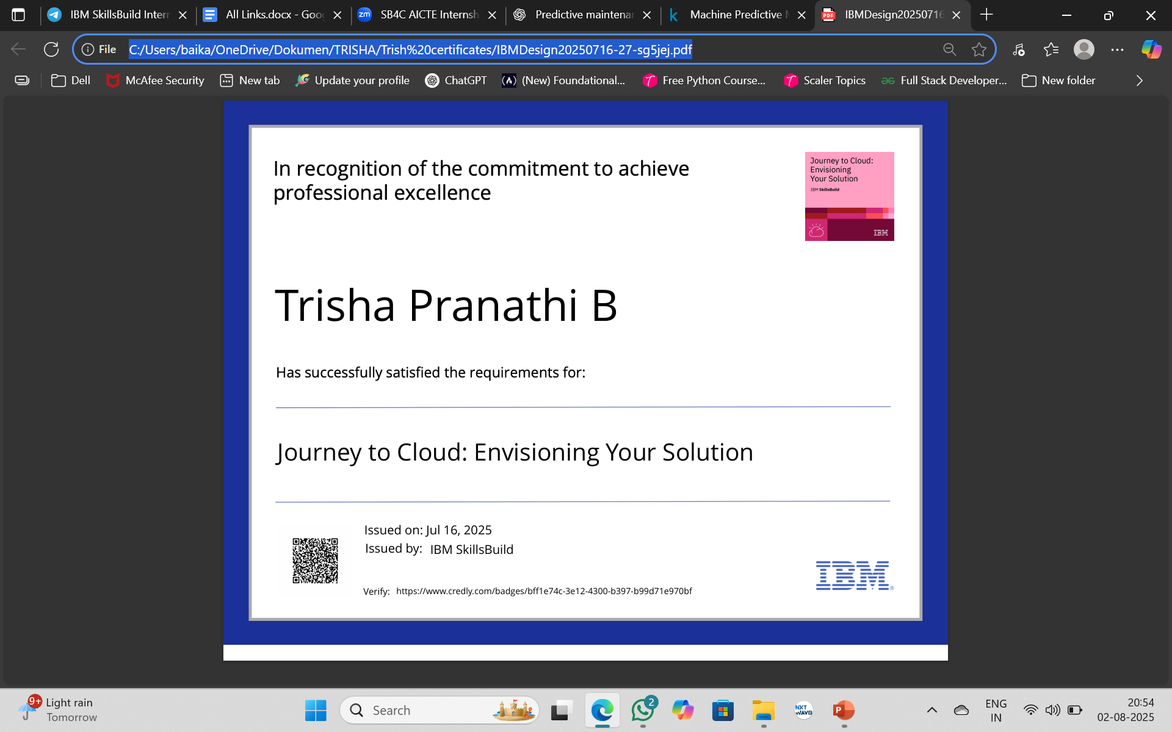
IBM Certifications

Slide 21
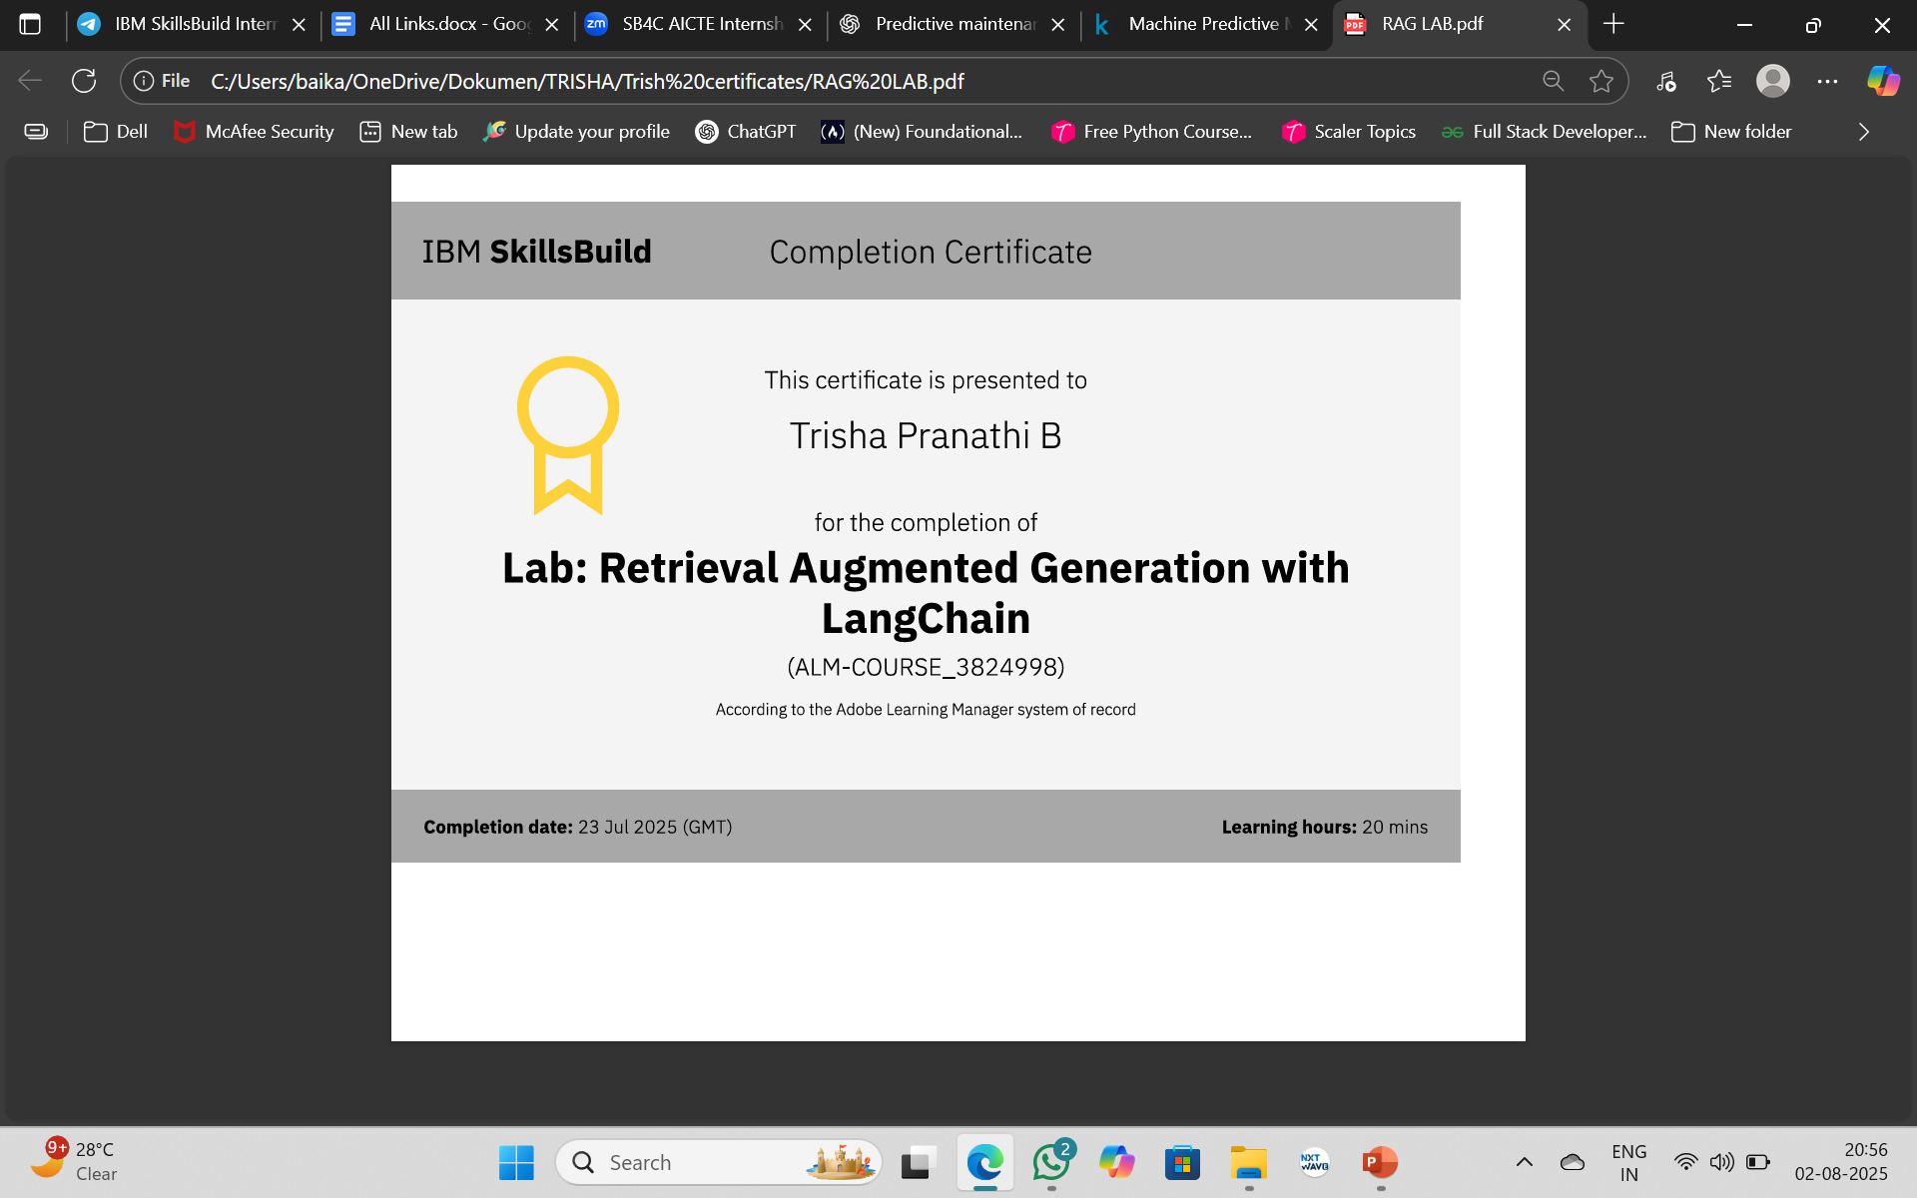
IBM Certifications

Slide 22
THANK YOU

